Slide 1

DICOMWebTM標準介紹 &
MI-TW2020-WG4影像聯測簡介
連中岳 博士 召集人
助理教授
台北護理健康大學資訊管理系
秘書長
台灣醫療影像資訊標準協會
MISAT 2020- WG4 - 影像聯測工作小組
2020.07.17

Slide 2
主題
DICOMWeb簡介
  DICOM RESTful概念
  DICOMWeb服務
DICOMWeb Query/Retrieve
  QIDO/WADO/STOW/Worklist/Capabilities
DICOMWeb與IHE之應用
WG4聯測項目介紹

Slide 3
DICOMWeb 簡介
Digital Imaging and Communications in Medicine
醫學數位影像及通信

Slide 4
DICOMWeb歷史
DICOM從2003年採用Web技術框架，提出WADO標準 (Web Access to DICOM Persistent Objects)
2011年提出DICOMWeb草案： STOW-RS, QIDO-RS, WADO Web Service 以及 WADO – RS
2013將DICOMWeb草案變成DICOM正式標準，此時尚未有DICOMWeb名詞出現
目前，美國電子製造協會(National Electrical Manufacturers Association, NEMA)擁有DICOM與DIOCOMWeb標準的版權

Slide 5

DICOMWeb標準與相關草案
發佈WADO標準
2010年
提出DICOMWeb草案
發布 DICOMWeb標準
2014年~
2003年
發佈DICOM XML標準
2011年
2013年
正式命名為DICOMWeb
FHIR + DICOMWeb 連測
Supp 211 - DICOMWeb Support for Retrieve via Application Zip
Supp 203 - Thumbnail Service over DICOMWeb
Supp 194 - RESTful Services for Non-Patient Instances (2016e 標準)
Supp 193 - REST Notifications
Supp 183 - Redocumentation Webservices
Supp 174 - RESTful Rendering (2015c 標準)
Supp 170 - Server Options RESTful Services
DICOMWeb相關草案與標準
Notes:
DICOM 為醫學影像的傳輸協定，
在 2013年 發布了「DICOM Web」，DICOM Web 的標準 允許使用「互聯網技術」，可以使用網頁瀏覽的方式來「查詢、獲取、存儲」DICOM檔。

Slide 6
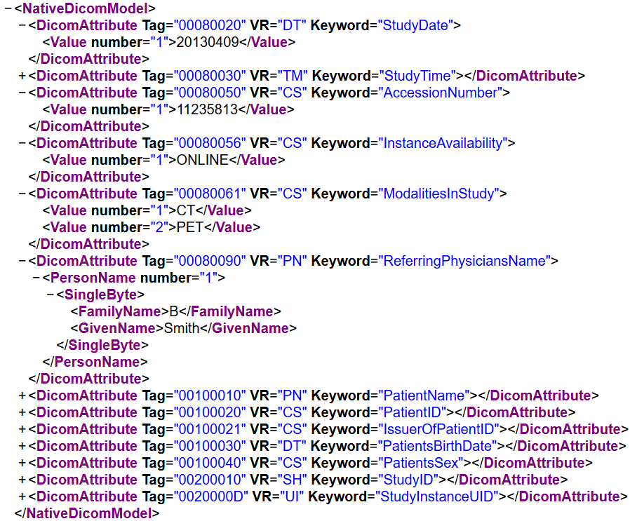
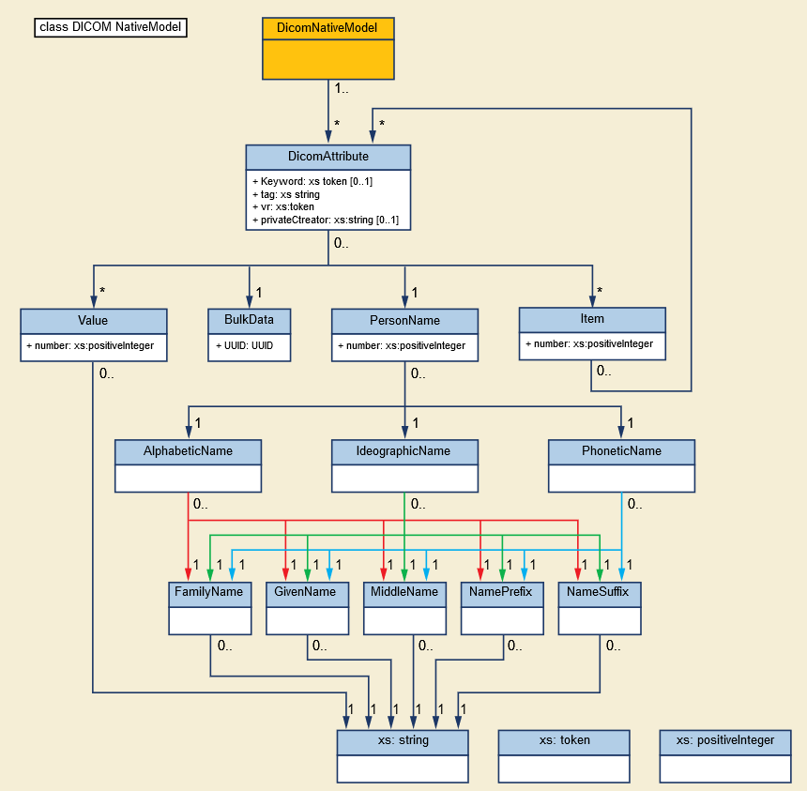
Native DICOM XML
範例
PS3.19 A.1 Native DICOM Model
Native DICOM XML定義DICOM編碼方式轉換成XML格式

Slide 7
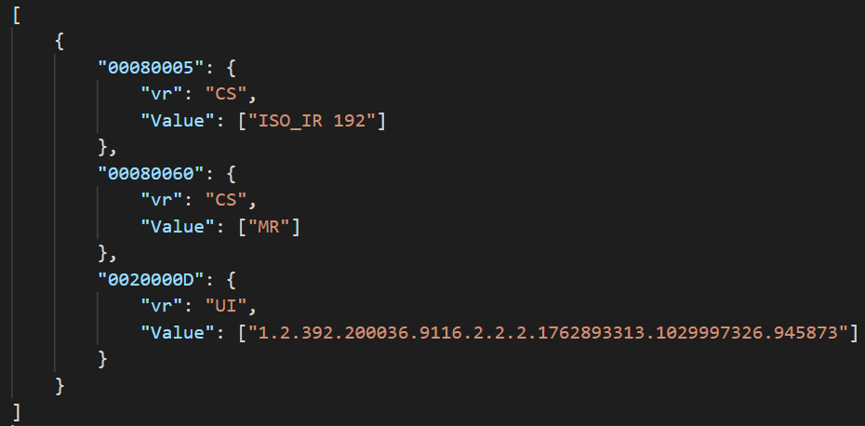
DICOM JSON Model
簡化資料量，例如: keyword
可與Native DICOM Model轉換格式
預設編碼方式為: UTF-8 / ISO_IR 192.

Slide 8
DICOM XML/JSON處理Bulk Data
定義在DICOM PS3.19 - Application Hosting
Bulk Data (大量資料)
  二進位資料無法寫入XML因為太大了
  DICOM VR (Value Representations)為 OB, OW, OD, Of以及 UN
  透過產生新的UUID (Universally Unique Identifier) 或是URI，將資料參考寫入到<BulkData>欄位，不需要將所有的二進位資料寫入到xml中
  可透過間接連結存取的方式取得Bulk Data

Slide 9
DICOMWeb RESTful API
DICOMWeb設計風格採用RESTful (Representational State Transfer)架構，能使WEB開發者更容易開發醫學影像以及PACS系統系統
通常被使用在與傳統DICOM系統介接溝通的轉換系統(Proxy)
  將Web協定轉換為DIMSE協定，透中介的方式存取DICOM系統
  或是直接在原本的DICOM系統加上DICOMWeb標準
“純” REST設計風格非常適合DICOM應用。簡單、廣泛採用Web技術(HTTP)、且很多的DICOM傳輸 服務可歸類為 CURD (Create, read, update and delete)

Slide 10
DICOMWeb RESTful API
資源為導向的架構(Resource Oriented Architecture)
  Addressability → 可透過定址的方式存取「資源」
  Statelessness → 無session, 每個交易都是獨立的
  Representations → 支援廣泛的 MIME Types
    Application/XML, Application/JSON, Application/DICOM, Image/JPEG, Image/PNG
  Links and Connectedness → 可透過URL存取各種資源
    Ex: <link href=“hastudies.html “ type =“Application/DICOM“ >
  Uniform Interface – 僅用HTTP Request即可達到Web存取DICOM服務，每個服務都可以對應到SQL action
{ DICOM RESTful }

Slide 11
DICOMWeb 服務
分成三種服務
  Studies Web Service
    提供影像檢查(studies)管理與儲存服務，例如PACS Server
  Worklist Web Service
    提供工作清單的管理或是連接DICOM Modality Worklist主機
  Non-Patient Instance Web Service
    提供與病患無關的服務，例如：Lookup table, Color Palettes等
服務 | 描述 | 對應DICOM服務
Query 查詢 | Search for DICOM objects (QIDO-RS) | C-FIND
Retrieve 調閱 | Retrieve DICOM objects (WADO-RS) | C-MOVE C-GET
 | Retrieve single DICOM instances (WADO-URI)
Store 儲存(上傳) | Store DICOM objects (STOW-RS) | C-STORE
Worklist 工作清單 | Manage worklist items (UPS-RS) | C-FIND (MWL)
Capabilities 服務檢索 | Discover services | Application host

Slide 12
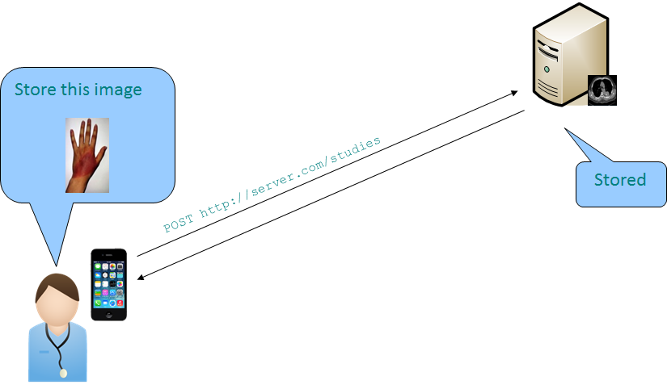
STOW
Verb | Path | Description
POST | {s}/studies | Store instances
POST | {s}/studies/{study} | Store instances

Slide 13
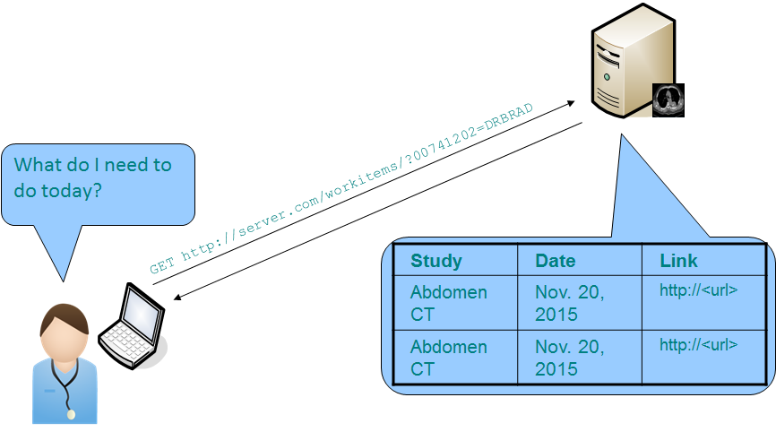
Worklist
Verb | Path | Description
POST | {s}/workitems{?AffectedSOPInstanceUID} | Create a work item
POST | {s}/workitems/{instance}{?transaction} | Update a work item
GET | {s}/workitems{?query*} | Search for work items
GET | {s}/workitems/{instance} | Retrieve a work item
PUT | {s}/workitems/{instance}/state | Change work item state
POST | {s}/workitems/{instance}/cancelrequest | Cancel work item
POST | {s}/workitems/{instance}/subscribers/{AETitle}{?deletionlock} | Create subscription
POST | {s}/workitems/1.2.840.10008.5.1.4.34.5/ | Suspend subscription
DELETE | {s}/workitems/{instance}/subscribers/{AETitle} | Delete subscription
GET | {s}/subscribers/{AETitle} | Open subscription channel
N/A | N/A | Send event report

Slide 14
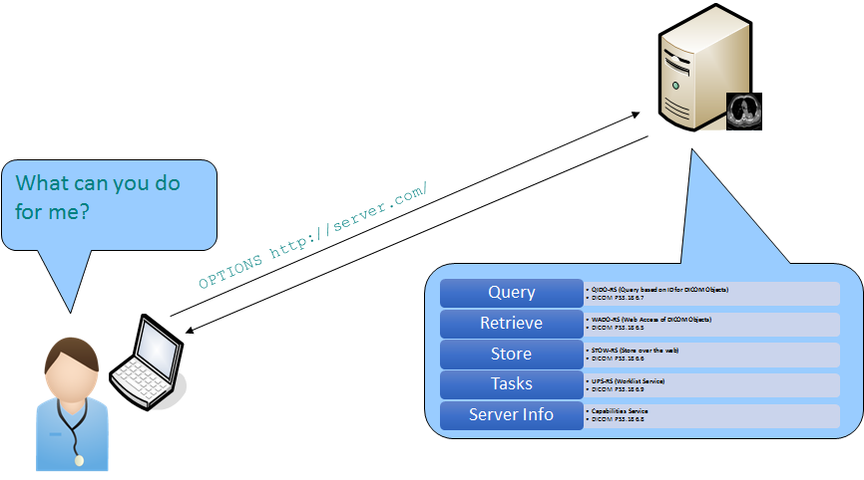
Capabilities

Slide 15
DICOMweb Query/Retrieve
DICOM Data Object Access

Slide 16
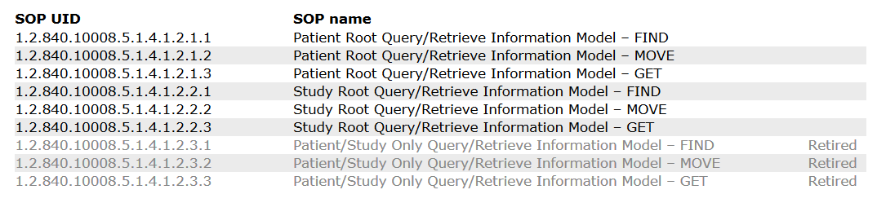
DICOM Q/R–資訊模型
定義三種Q/R的資訊模型(information models)，亦提供不同的查詢的用途
  病患層(Patient Root) : 4階層式查詢架構: Patient – Study – Series – Image
  檢查層(Study Root): 隱藏病患層，即所有病患資訊都視為該檢查的資訊
  病患/檢查層(Patient / Study Only) *:
    隱藏系列層與影像層，一次回傳病人全部的檢查影像
DICOM並無規定SCU與SCP一定要支援哪些模型
  大部分系統都支援檢查層(Study Root) Q/R模型
  病患層Q/R模型不常支援
  病患/檢查層極少被應用（ DICOM已經廢除了) *
http://www.dicomlibrary.com/dicom/sop/

Slide 17
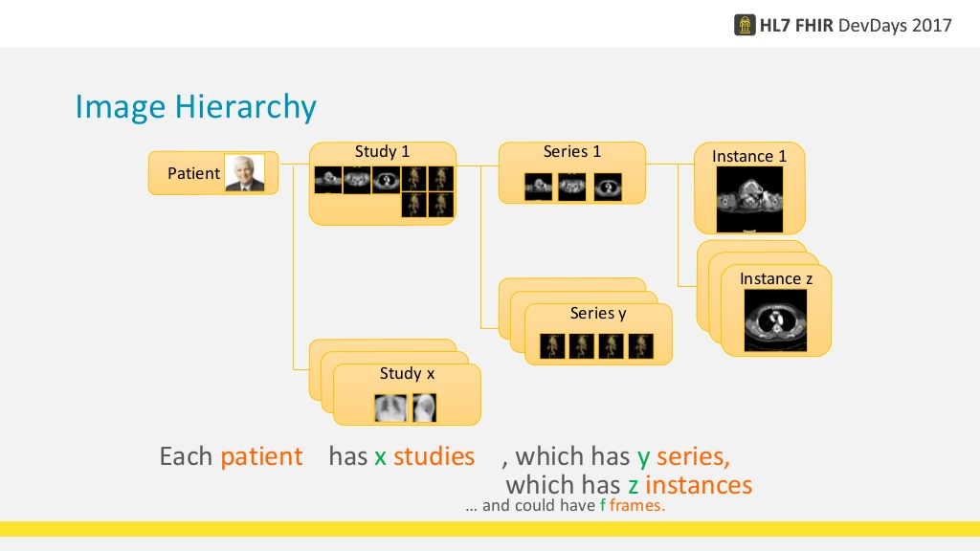
DICOM 階層式架構檢索模型
Study 層
Series 層
Instance 層
Series UID
檢查部位
儀器類別
……DICOM Tag
Instance UID
影像尺寸
造影方式
……DICOM Tag
Patient ID
病歷號
病患姓名
……DICOM Tag
Study UID
檢查日期
申請序號
……DICOM Tag
Notes:
Dicom 的階層式架構，整合病歷資料、將病歷結構化，
同一病歷的 醫學影像 分門別類，
每一個階層有 唯一的UID識別標籤，
區分 科別、系列、影像，
使得資料存取時不會錯亂。

Slide 18
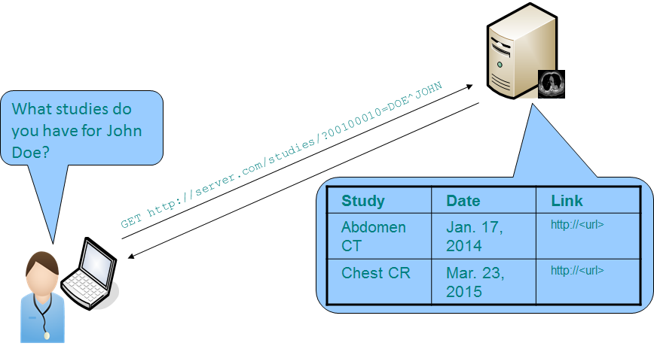
QIDO-RS
https://www.dicomstandard.org/dicomweb/query-qido-rs/

Slide 19
QIDO-RS – Request/Response
QIDO-RS支援三種查詢
  SearchForStudies – 對應DICOM Study Level Query
  SearchForSeries – 對應DICOM Series Level Query
  SearchForInstances – 對應DICOM Instance Level Query
Method: GET
Headers
  查詢結果
    DICOM JSON (預設): application/dicom+json
    DICOM XML: multipart/related; type="application/dicom+xml"
查詢參數
  以DICOM Tag數值或是欄位名稱作為查詢參數
  可支援多種查詢方式
    Fuzzymatching (模糊比對)
    Limit (查詢筆數上限, 類似SQL: Select TOP 500)
    offset( 可略過查詢前n筆資料，可用於多分頁查詢設計)
Notes:
範例：
https://cylab.cnakiyuki.com:8042/dicom-web/studies/1.2.840.113854.40510681.3051635771.2690307619.199734385/series/

Slide 20
QIDO-RS– RESFful設計樣式
SearchForStudies (URL指派資源ID)
  URL指派資源ID: {+SERVICE}/studies{?query*,fuzzymatching,limit,offset}
SearchForSeries
  URL指派資源ID:
    {+SERVICE}/studies/{StudyInstanceUID}/series{?query*,fuzzymatching,limit,offset}
  資源ID放在參數:
    {+SERVICE}/series{?query*,fuzzymatching,limit,offset, StudyInstanceUID=xxx}
SearchForInstances
  URL指派資源ID:
    {+SERVICE}/studies/{StudyInstanceUID}/series/{SeriesInstanceUID}/instances{?query*,fuzzymatching,limit,offset}
  資源ID放在參數:
    {+SERVICE}/studies/{StudyInstanceUID}/instances{?query*,fuzzymatching,limit,offset, SeriesInstanceUID=zzz}
    {+SERVICE}/series{?query*,fuzzymatching,limit,offset, StudyInstanceUID=xxx&SeriesInstanceUID=zzz}
{+SERVICE}為URL base
  例如: https://cylab.dicom.org.tw/dicom-web/

Slide 21
QIDO-RS Methods
動作 | 路徑規則 | 描述
GET | {s}/studies?… | 查詢影像檢查(Study)中的所有影像資訊
GET | {s}/studies/{study}/series?… | 查詢在一個檢查中的系列(series)中的所有影像資訊
GET | {s}/studies/{study}/series/{series}/instances?… | 查詢在一個系列中的所有影像資訊
QIDO-RS Query Parameters
Key | Value | Description
{attributeID} | {value} | 查詢符合輸入條件的結果
includefield | {attribute} | all | 結果回傳包含指定的欄位
fuzzymatching | true | false | 是否啟用模糊比對
limit | {n} | 回傳最多 n 筆結果(筆數上限, e.g., SQL: Select TOP 500)
offset | {n} | Skip {n} results (可略過查詢前n筆資料，可用於多分頁查詢設計)

Slide 22
不同階層的查詢條件
SERIES
STUDY
Key Word | Tag
Modality | 00080060
SeriesInstanceUID | 0020000E
SeriesNumber | 00200011
PerformedProcedureStepStartDate | 00400244
PerformedProcedureStepStartTime | 00400245
RequestAttributeSequence | 00400275
>ScheduledProcedureStepID | 00400009
>RequestedProcedureID | 00401001
StudyID | 00200010
Key Word | Tag
StudyDate | 00080020
StudyTime | 00080030
AccessionNumber | 00080050
ModalitiesInStudy | 00080061
Referring Physician Name | 00080090
PatientName | 00100010
PatientID | 00100020
StudyInstanceUID | 0020000D
StudyID | 00200010
INSTANCE
Key Word | Tag
SOPClassUID | 00080016
SOPInstanceUID | 00080018
InstanceNumber | 00200013

Slide 23
QIDO-RS– 範例
http://dicomrs/studies​?PatientID=11235813
http://dicomrs/studies​?PatientID=11235813​&StudyDate=20130509
http://dicomrs/studies​?00100010=SMITH*​&00101002.00100020=11235813​&limit=25
  萬用字元查詢：00100010=SMITH*
  查詢病患姓名為Smith開頭的, 00100010 = Patient's Name
http://dicomrs/studies​?PatientID=11235813​&includefield=00081048​&includefield=00081049​&includefield=00081060
  查詢病歷號＝ 11235813，且搜尋結果包含以下兩個欄位
  (0008,1048) Physicia(s) of Record以及： (0008,1030) Name of Physician(s) Reading Study
http://dicomrs/studies​?PatientID=11235813​&StudyDate=20130509-20130510
  查詢5/9-5/10這區間的檢查，且病歷號＝ 11235813
http://dicomrs/studies​?StudyInstanceUID=1.2.392.200036.9116.2.2.2.2162893313.1029997326.94587​%2c1.2.392.200036.9116.2.2.2.2162893313.1029997326.94583
  查詢這兩組Study: 1.2.392.200036.9116.2.2.2.2162893313.1029997326.94587​以及
  2c1.2.392.200036.9116.2.2.2.2162893313.1029997326.94583

Slide 24
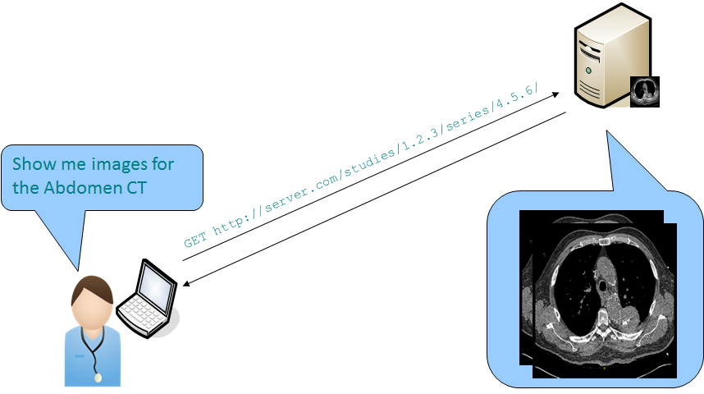
DICOMWeb Retrieve
https://www.dicomstandard.org/dicomweb/retrieve-wado-rs-and-wado-uri/

Slide 25
DICOMWeb Retrieve
分成兩種調閱機制
  Retrieve DICOM objects (WADO-RS)
  Retrieve single DICOM instances (WADO-URI)
差異:
  RS採用RESTful設計樣式，將資源ID併入URL
    所有的Response會以 multipart messages回應
    Content-Type: multipart/related; type=application/dicom; boundary={MessageBoundary}
    例如: 可調閱取得同一個study中的所有影像
    需特定撰寫程式取得multipart messages
  WADO沿用DICOM WADO設計架構，僅允許1個request, 1個response
    瀏覽器預設支援，可直接輸入URL即可取得影像

Slide 26
QIDO範例
Study Level Query
  https://startup.dicom.org.tw/dicom-web/studies/?Patient=*1*
  https://startup.dicom.org.tw/dicom-web/studies?00100010=*1*
Series Level Query
  https://startup.dicom.org.tw/dicom-web/studies/1.3.6.1.4.1.5962.99.1.939772310.1977867020.1426868947350.494.0/series
Instances Level Query
  https://startup.dicom.org.tw/dicom-web/studies/1.2.840.113854.40510681.3051635771.2690307619.199734385/series/1.2.840.113854.157366663.3807002887.2751268717.1830599468/instances

Slide 27
Study Level Query Example
查詢所有CT影像
  https://startup.dicom.org.tw/dicom-web/studies?ModalitiesInStudy=CT
查詢所有MR影像
  https://startup.dicom.org.tw/dicom-web/studies?AccessionNumber=123456
查詢日期區間2001/1/1-2009/1/10的檢查
  https://startup.dicom.org.tw/dicom-web/studies?StudyDate=20010101-20090110
  https://startup.dicom.org.tw/dicom-web/studies?00080020=20010101-20090110

Slide 28
Series Level Query Example
查詢某筆檢查中有多少的Series
  https://startup.dicom.org.tw/dicom-web/studies/1.2.840.113854.40510681.3051635771.2690307619.199734385/series
  https://startup.dicom.org.tw/dicom-web/series/?StudyInstanceUID=1.2.840.113854.40510681.3051635771.2690307619.199734385
  https://startup.dicom.org.tw/dicom-web/series/?0020000D=1.2.840.113854.40510681.3051635771.2690307619.199734385
https://startup.dicom.org.tw/dicom-web /studies/1.2.840.113854.40510681.3051635771.2690307619.199734385/series/1.2.840.113854.157366663.3807002887.2751268717.1830599468
https://startup.dicom.org.tw/dicom-web /studies/1.2.840.113854.40510681.3051635771.2690307619.199734385/series/1.2.840.113854.157366663.3807002887.2751268717.1830599468/instances/1.2.840.113854.157366663.3807002887.2751268717.1830599468

Slide 29
WADO Example-1
回傳JPEG
https://server.dcmjs.org/dcm4chee-arc/aets/DCM4CHEE/wado/?requestType=WADO&studyUID=1.2.840.113619.2.30.1.1762295590.1623.978668949.886&seriesUID=1.2.840.113619.2.30.1.1762295590.1623.978668949.890&objectUID=1.2.840.113619.2.30.1.1762295590.1623.978668950.112&contentType=image/jpeg
回傳DICOM
https://server.dcmjs.org/dcm4chee-arc/aets/DCM4CHEE/wado/?requestType=WADO&studyUID=1.2.840.113619.2.30.1.1762295590.1623.978668949.886&seriesUID=1.2.840.113619.2.30.1.1762295590.1623.978668949.890&objectUID=1.2.840.113619.2.30.1.1762295590.1623.978668950.112&contentType=application/dicom

Slide 30
WADO Example-2
回傳JPEG, 且指定Window Level
https://server.dcmjs.org/dcm4chee-arc/aets/DCM4CHEE/wado/?requestType=WADO&studyUID=1.2.840.113619.2.30.1.1762295590.1623.978668949.886&seriesUID=1.2.840.113619.2.30.1.1762295590.1623.978668949.890&objectUID=1.2.840.113619.2.30.1.1762295590.1623.978668950.112&contentType=image/jpeg&windowCenter=500&windowWidth=300
回傳JPEG, 且指定rows (縮圖)
https://server.dcmjs.org/dcm4chee-arc/aets/DCM4CHEE/wado/?requestType=WADO&studyUID=1.2.840.113619.2.30.1.1762295590.1623.978668949.886&seriesUID=1.2.840.113619.2.30.1.1762295590.1623.978668949.890&objectUID=1.2.840.113619.2.30.1.1762295590.1623.978668950.112&contentType=image/jpeg&rows=100

Slide 31
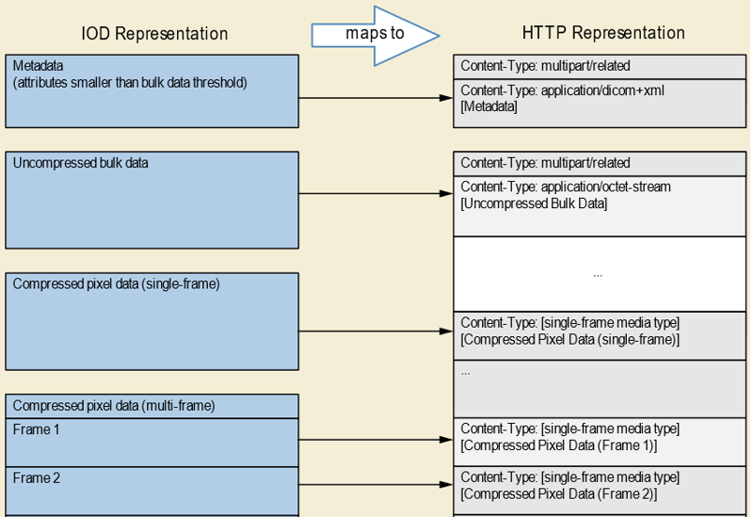
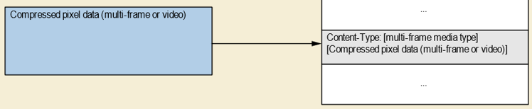
未壓縮資料: DICOM TAG
壓縮資料: JPEG2000, JPEG失真壓縮, JPEG無失真壓縮
壓縮資料: 多張影像取出其一
壓縮像素資料:例如影片
http://dicom.nema.org/medical/dicom/current/output/chtml/part18/sect_8.6.html

Slide 32
QIDO-RS Methods
Verb | Path | Description
GET | {s}/studies/{study} | Retrieve entire study
GET | {s}/studies/{study}/rendered | Retrieve rendered study
GET | {s}/studies/{study}/series/{series} | Retrieve entire series
GET | {s}/studies/{study}/series/{series}/rendered | Retrieve rendered series
GET | {s}/studies/{study}/series/{series}/metadata | Retrieve series metadata
GET | {s}/studies/{study}/series/{series}/instances/{instance} | Retrieve instance
GET | {s}/studies/{study}/series/{series}/instances/{instance}/rendered | Retrieve rendered instance
GET | {s}/studies/{study}/series/{series}/instances/{instance}/metadata | Retrieve instance metadata
GET | {s}/studies/{study}/series/{series}/instances/{instance}/frames/{frames} | Retrieve frames in an instance
GET | {s}/{bulkdataURIReference} | Retrieve bulk data

Slide 33
Rendered WADO-RS Query Parameters
Key | Value | Description
annotation | “patient” / “technique” | Add burned-in demographics / procedure details
quality | {n} | Quality of image (lossy factor)
viewport | vw,vh / sx,sy,sw,sh | Width and height, or crop to specific region
window | centre,width,shape | Center of the range of gray scale in the image

Slide 34
QIDO-RS Accept Headers
Category | Media Type | Support
Single Frame Image | image/jpeg | default
 | image/gif | required
 | image/png | required
 | image/jp2 | optional
Multi-frame Image | image/gif | optional
Video | video/mpeg | optional
 | video/mp4 | optional
 | video/H265 | optional
Text | text/html | default
 | text/plain | required
 | text/xml | required
 | text/rtf | optional
 | application/pdf | optional

Slide 35
QIDO-RS WADO Error Codes
Code | Client Error Name | Error Situation
206 | Partial Content | Accept type, Transfer Syntax or decompression method supported for some but not all requested content.
400 | Bad Request | Malformed resource
404 | Not Found | Specified resource does not exist
406 | Not Acceptable | Accept type, Transfer Syntax or decompression method not supported
410 | Gone | Specified resource was deleted
503 | Busy | Service is unavailable

Slide 36
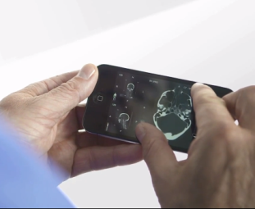
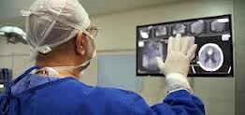
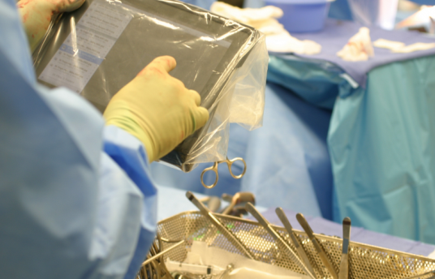
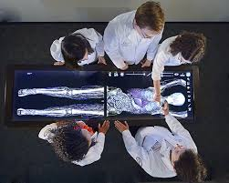
DICOMWeb市場性: Use cases
從電子病歷系統跨科室/院/區查詢
  可從HIS或EMR系統查詢PACS的資料，家庭醫師希望能看到檢查影像
轉診以及跨院交換時能瀏覽影像
視訊會議(Video Conference)
作為FHIR (Fast Healthcare Interoperability Resources) resources內容而準備
放射科作業流程使用(Worklist in Viewer)
可查詢多個系統(Multiple System Query)
  可針對不同的 Image Archive 進行同時Query
影像重建技術(Clinical Reconstruction)
  用於Patient-centered EHR系統建置
病患自行使用(Secondary Use for Personal Health Record)
外科醫師在手術室的瀏覽(Operating Room Viewing)
行動影像擷取系統上傳
https://www.youtube.com/watch?feature=player_embedded&v=6POBb3xHMM4
https://encrypted-tbn1.gstatic.com/images?q=tbn:ANd9GcScLmr1bTypIEPpK9n2VjdCcuLpzsbBxQC2u0WOXFyyfVbqlhIp
http://tabtimes.com/feature/healthcare/2011/12/19/dc-surgeon-i-use-ipad-every-day-operating-room
https://encrypted-tbn3.gstatic.com/images?q=tbn:ANd9GcSFOmQaMWi9RQxrmQkQ75LbNL8_HEccvZ-YRY-nGTgdLam54_tD

Slide 37
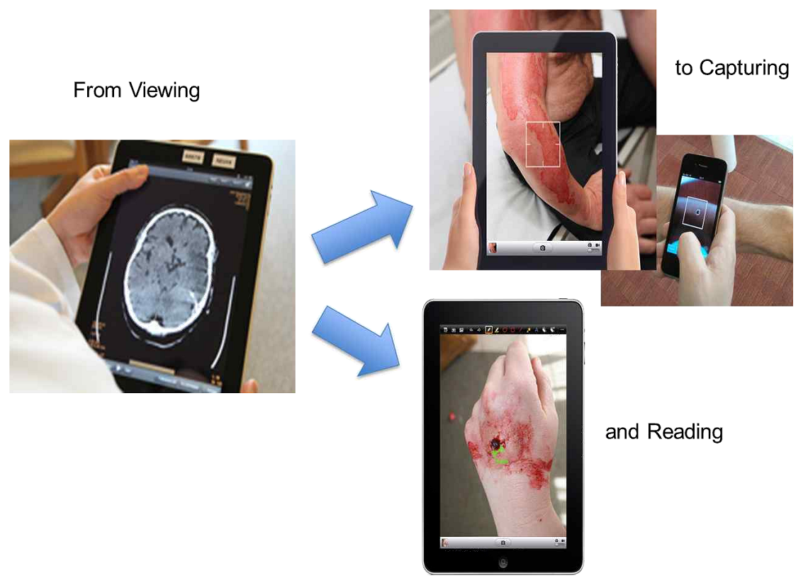
Web影像擷取
Web-based Image Capture (WIC)
Web-based Image Capture (WIC) 提供了一種 簡單、輕量、行動友善（Mobile-Friendly） 的機制，可以將擷取到的圖片、影片、Evidence Document（ED）從行動裝置進行編碼並發送到 Image Manager，以便這些對象可以容易集成到影像工作流程。

Slide 38
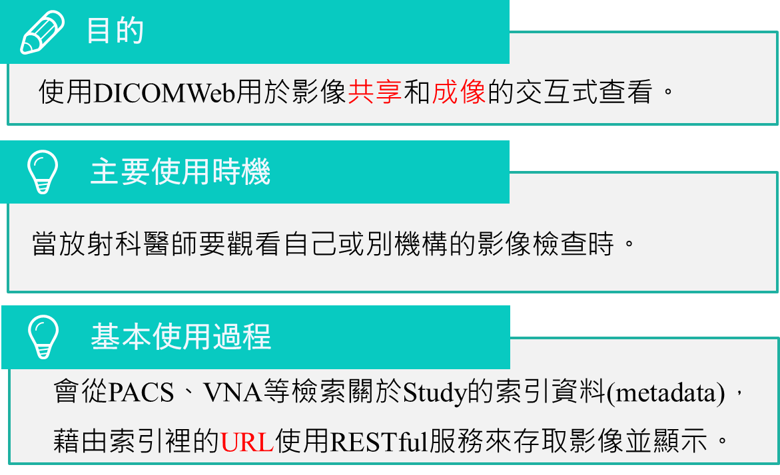
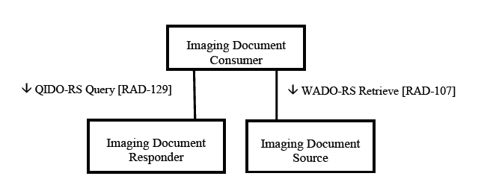
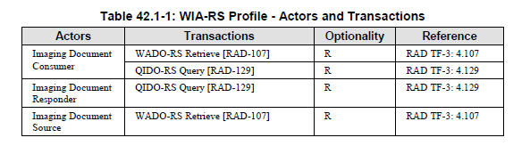
Web-based Image Access (WIA)

Slide 39
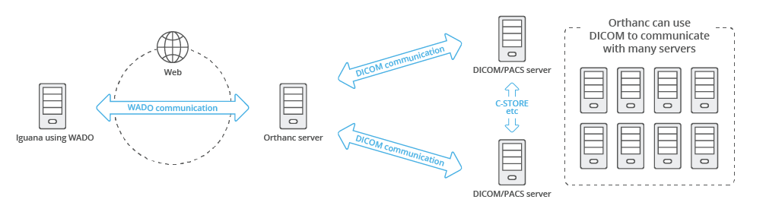
使用情境1:
DICOMWeb存取DICOM Server
1. 使用DICOMWeb協定存取Orthanc server (安裝DICOMWeb Plugin)
2. Orthanc server控制其他DICOM/PACS servers
https://help.interfaceware.com/v6/dicom-orthanc-pacs-server

Slide 40
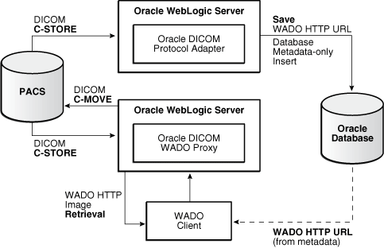
使用情境2:
PACS Server支援DICOMWeb協定
PACS Server與DICOMWeb使用相同資料庫
PACS Server保有DICOM通訊傳輸
DICOMWEB服務(WADO Client)支援HTTP 協定取得影像資料
https://docs.oracle.com/en/database/oracle/oracle-database/12.2/imdcm/dicom-protocol-support.html#GUID-6280DA49-4DF2-414C-8069-FCA1C74AC4DE

Slide 41

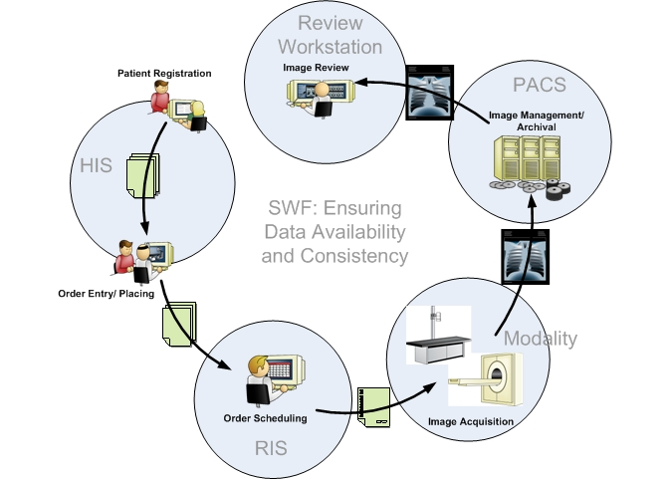
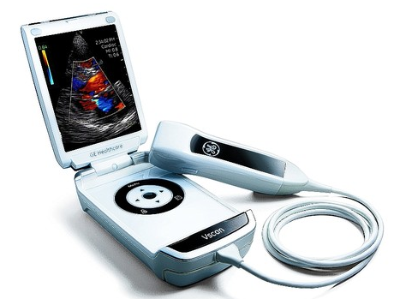
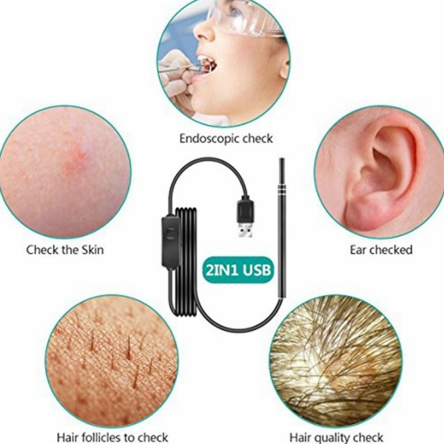
Scheduled Workflow + IoT Medical Imaging Devices
https://www.imedicalapps.com/wp-content/uploads/2011/05/mobile-ultrasound.png

