Slide 1

Winning an NBA game
Team: Significantly Different
Team Members: Jacob Padden, Michael Sparkman, Jenny Tseng, Kelly Zhang, Grant Zhong

Slide 2
What Makes a Winning Basketball Team?
We set out to help NBA team managers and coaches to improve their team performance
Hypothesis | Approach
The following attributes are more likely to lead to a winning team: With home-court advantage Making more three-pointers Getting more offensive rebounds | Exploratory analysis in SQL
A winning team has multiple players who contribute to the success of a game, rather than one star player | Use logistic regression to predict win/lose with a team’s top seven scorers’ contributions
Superstar guard is more important than a superstar front court player | Leverage Monte Carlos simulations to obtain winning percentages by team
1
2
3
Notes:
A quick recap

Slide 3
Home Court Advantage: Season 16-17
We looked at how many more games teams win when they’re at home vs. away; the results from the 16-17 season coincide with our hypothesis
Note(s): See appendix for Season 17-18
Notes:
This is home wins – away wins; if teams win the same number of games either way, it would be zero (this doesn’t consider how many games they win in general though)
17-18 have similar findings as 16-17

Slide 4
Home Court Advantage: Season 18-19
The 18-19 season has largely the same pattern, with two outliers
Note(s): See appendix for Season 17-18
Notes:
What happened to Chicago Bulls and Miami Heat? Chicago was a bad team (22-60) but Miami was an ok team (39-43) – guess they just didn’t great fans

Slide 5
Three Pointers Do Help
… with winning games, but two pointers are more important
80% of the winning teams had better 2-pt FG%
71% of the winning teams had better 3-pt FG%
Notes:
Can talk about approach

Slide 6
Offensive Rebounds Are Not Indicative
... of a winning team, disproving our hypothesis
The difference between the winning team’s offensive rebound and that of the losing team has a mostly normal distribution centered around zero
Note(s): See appendix for Season 17-18 and 18-19, which yielded the same conclusion
Notes:
The average is actually about -1, meaning the losing teams on average have one more offensive rebounds than the winning team

Slide 7
Defensive Rebounds are More Important
…with a distribution averaging slightly above zero
On average, the winning team has two additional defensive rebounds compared to the losing team
Note(s): See appendix for Season 17-18 and 18-19, which yielded the same conclusion

Slide 8
Data Preparation to Test Star Player Importance
We used each team’s top seven contributions in each game to predict whether a team would win
 |  |  | Contribution to Total Team Points (in %)
GameID | Win-Lose | Team Points | First Player | Second Player | Third Player | Fourth Player | Fifth Player | Sixth Player | Seventh Player
1 | W | 109 | 19.27 | 19.27 | 14.68 | 13.76 | 11.93 | 10.09 | 7.34
2 | W | 131 | 27.48 | 15.27 | 14.5 | 12.21 | 10.69 | 9.16 | 6.87
3 | W | 127 | 18.9 | 17.32 | 13.39 | 11.81 | 11.02 | 10.24 | 8.66
4 | L | 113 | 20.35 | 12.39 | 11.5 | 9.73 | 9.73 | 9.73 | 9.73
5 | W | 124 | 15.32 | 14.52 | 13.71 | 13.71 | 11.29 | 9.68 | 8.06
6 | L | 99 | 27.27 | 20.2 | 18.18 | 17.17 | 9.09 | 4.04 | 2.02
7 | W | 121 | 25.62 | 21.49 | 15.7 | 10.74 | 9.92 | 6.61 | 4.96
8 | L | 118 | 20.34 | 17.8 | 13.56 | 12.71 | 11.86 | 5.93 | 4.24
9 | L | 110 | 21.82 | 16.36 | 12.73 | 11.82 | 10 | 9.09 | 8.18
10 | W | 133 | 18.8 | 18.05 | 12.03 | 10.53 | 8.27 | 7.52 | 7.52
Notes:
Sample data; we had 2460 rows
Data prepared using SQL through a series of ranking, aggregating, and pivoting

Slide 9
To Our Surprise…
The logistic regression results indicate scoring percentages do not matter at all
 | Coefficient | P-Value
Intercept | -1.6252 | 0.126
First | 0.0219 | 0.096
Second | 0.0091 | 0.647
Third | -0.0179 | 0.501
Fourth | 0.052 | 0.091
Fifth | -0.0215 | 0.542
Sixth | 0.0524 | 0.189
Seventh | 0.0629 | 0.17
Model Accuracy | 51%
Essentially random
No significant coefficient; if anything, the first scoring player does need to score more
Notes:
Draw some conclusion: need other info; more team dependent than generalizable

Slide 10
Overall Simulation Approach
Total team contribution: Simulated based on team rosters
+ Trade scenario: Two rosters, separated by a trade date
+ Player distributions: In PTS, AST, REB, TOV, STL, BLK
Player contribution: Simulated based on distributions, considering injuries
Main Tool: Monte Carlo Simulation
Notes:
Assuming normal distribution
Fill na’s: 0 if didn’t player
Contribution = a composite score
Total team contribution = sum of player contributions

Slide 11
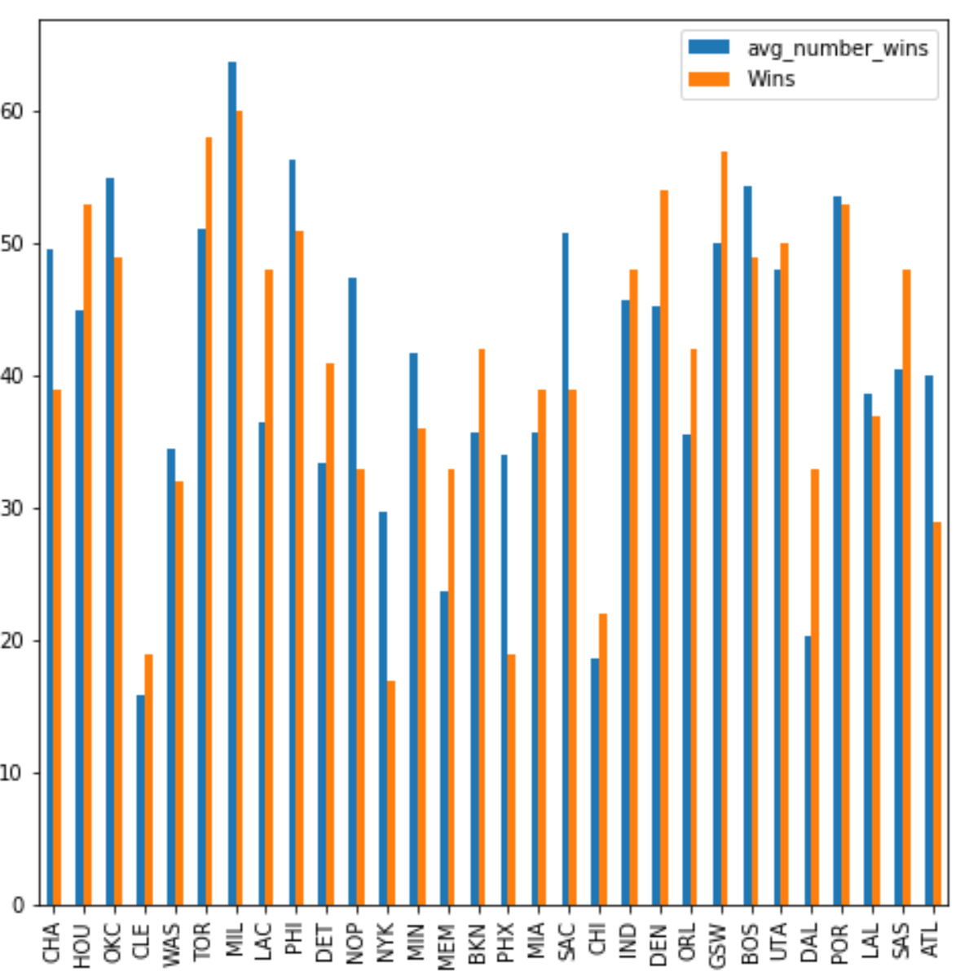
A Look at Some Simulation Results
In general, our simulations match reality
Notes:
On average, we’re about 7 games off (out of 82)

Slide 12
Simulation Result to Test Hypothesis
“Bigs” are actually more consistent than guards
Methodology
Three even teams generated from all-NBA and all-star teams with the following profiles:
100% all-star guards
100% all-star wings
100% all-star “bigs” (front courts)
Simulated competitions
Results
Original | Without injuries
Bigs | Bigs
Guards | Guards/Wings
Wings

Slide 13
Conclusion
We don’t know basketball that well
Hypothesis | Outcome
The following attributes are more likely to lead to a winning team: With home-court advantage Making more three-pointers Getting more offensive rebounds
A winning team has multiple players who contribute to the success of a game, rather than one star player
Superstar guard is more important than a superstar front court player
1
2
3
…but we’ve dispelled many misconceptions…

Slide 14
Bonus!
Who should’ve won the MVP?
Approach
We took out each of the top 10 players in the running for MVP for 18-19 one at a time
At each turn, run simulation to determine how many more games the team would have lost without the player
Results
Who actually won: Giannis (19 additional games lost without him)
Who should’ve won:
James Harden: 22
Paul George: 23
The possibilities are endless with our simulation toolkit

Slide 15
Appendix

Slide 16


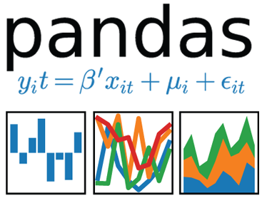




Tools
3 seasons of game data by team (3x2460x29)
Game data by player (26101x27)
API
Basic player info (536x30)
Data collection
EDA; training data setup
Modeling

Slide 17
Home Court Advantage: Season 17-18
The results are largely in line with expectations, with minor outliers
Notes:
This is home wins – away wins; if teams win the same number of games either way, it would be zero (this doesn’t consider how many games they win in general though)
17-18 have similar findings as 16-17

Slide 18
For Season 17-18, Offensive Rebounds Also Not Indicative
…of a winning team, which actually averaged fewer offensive rebounds

Slide 19
Defensive Rebounds Clearly Important
…in Season 17-18, with the winning team averaging almost three additional ones

Slide 20
For Season 18-19, Offensive Rebounds Show Same Importance
… with winning team again averaged fewer offensive rebounds
Notes:
Averaged -0.84

Slide 21
Defensive Rebounds Also Important in 18-19
…with the winning team averaging 2.9 additional ones
Notes:
Averaged 2.92

