Slide 1

Analyzing Current and Future Water Consumption: Meeting Our Needs

Slide 2



Mosaab odeh From Nablus Studying CAP At NNU
Anas Salahat
From Nablus
Studying Water and environment Engineer
At NNU
Ayat abuomar
From Nablus
Studying CE
At NNU

Slide 3
Feedback from the course:
We benefited from the course by nourishing and developing data analysis skills in our areas of specialization. and that we opened a new field in which we can develop quickly and with great quality. and this project is a summary of the knowledge that we gained from the course.

Slide 4

Our Vision
Our vision is to assess the current water availability from various sources and analyze the required quantity to be supplied by the year 2042 in the northern governorate of the West Bank.

Slide 5
Life cycle of project
feature engineering
Hypothesis
Data Cleaning
About Data
Idea of project
Data Visualization

Slide 6

01
Idea of project

Slide 7
Where did the idea start?
We noticed that there is a water problem in many areas in the northern West Bank, as the water does not reach enough to the citizens, and we felt a real danger, as by the year 2042 these areas will face the risk of drought, and from here our idea began.

Slide 8
Our goals
Short term
Long term
Analyzing the data in order to know the amount of consumption and the current amount of water shortage per person
Attempting to address the water shortage by the year 2042 by analyzing data and estimating new sources of water

Slide 9
About Data
02
Data Source
Data Size
Type Of Data
The Palestinian Water Authority
Supply point /Source .
Current amount Supply Source
3. Population numbers in 2021 .
4. Served Communities/
859 the Totoal record of Data in our research
For all the westbank

Slide 10
Data Cleaning
03
To ensure high-quality data analysis, we must purify it in order to give us a valid result Using Python.
we did a cleanup of the data,
which was before 859 records , and it became...
Code for Python:

Slide 11
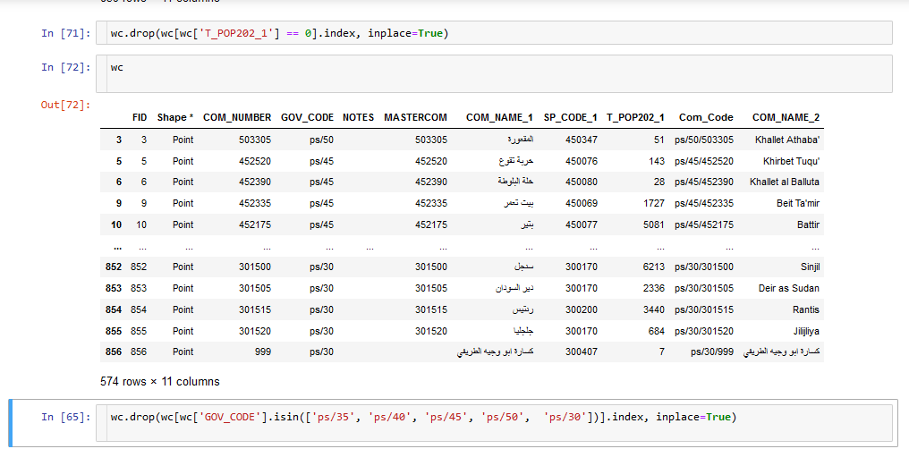
Our Code :

Slide 12
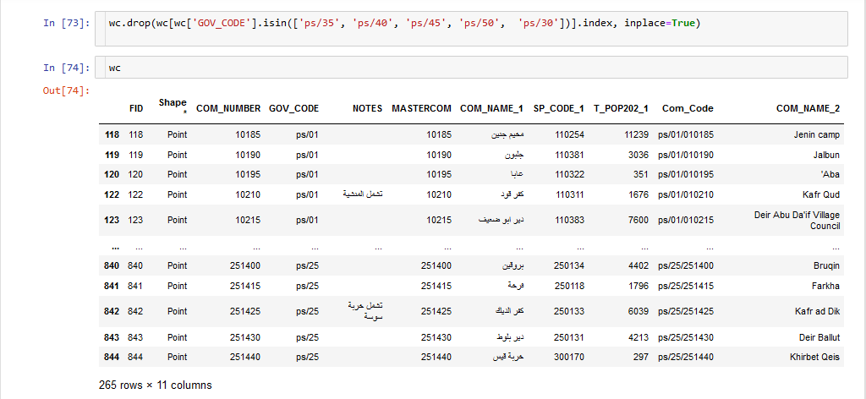
Our Code :

Slide 13
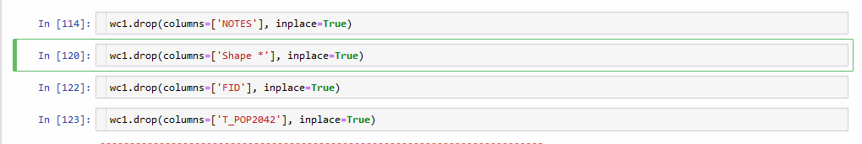
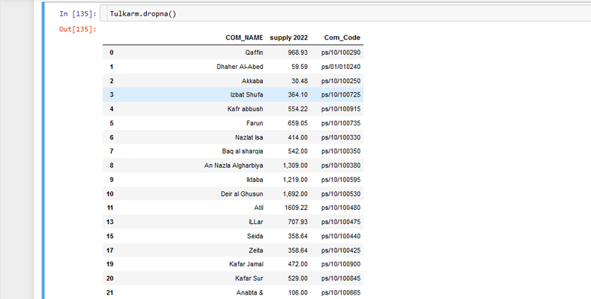
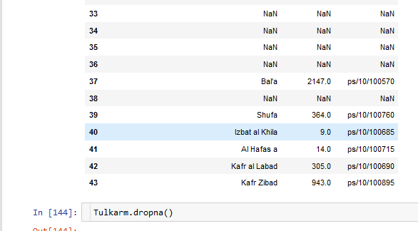
Our Code :

Slide 14
Hypothesis
04
A decrease in the amount of water received from sources in 2021 will lead to drought or a significant decrease in the person’s share in 2042

Slide 15
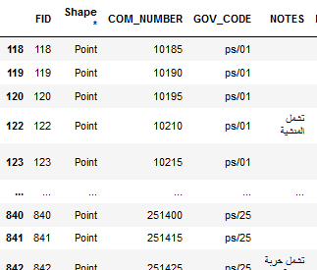
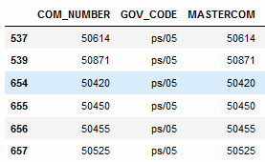
feature engineering
We deleted a group of columns that contain much data that are of no importance in our research, such as the column chip, which represented the shape of each water source on the map.
05

Slide 16
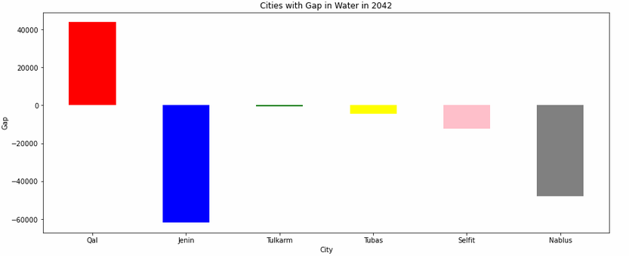
Statistics for the northern West Bank
05

Slide 17
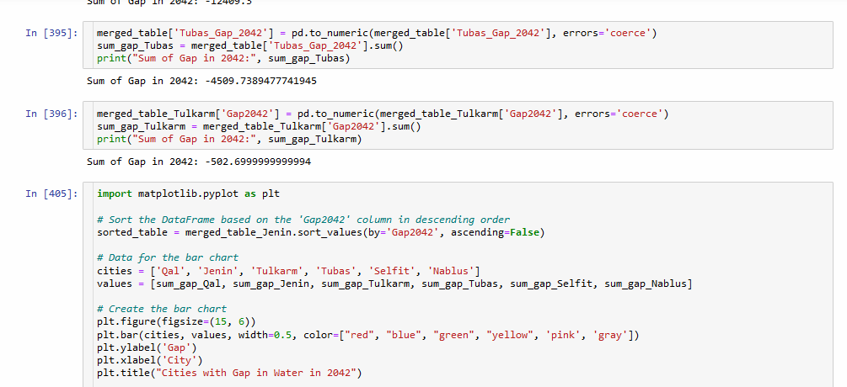
Code :

Slide 18
The Equations :
Gap Equation
Nablus: population rate 1.84
Tubas: publication rate 2.08
Qalqilla: publication rate 2.21
Selfite: publication rate 2.24
Jennie: publication rate 2.48
Tulkarm: publication rate 1.71
['Gap2042'] = ['supply 2022'] - ['Demand_m3pd_2042']
The Demand of person is :
['Demand_m3pd_2042'] = (['T_POP204_2'] * 156)/1000

Slide 19
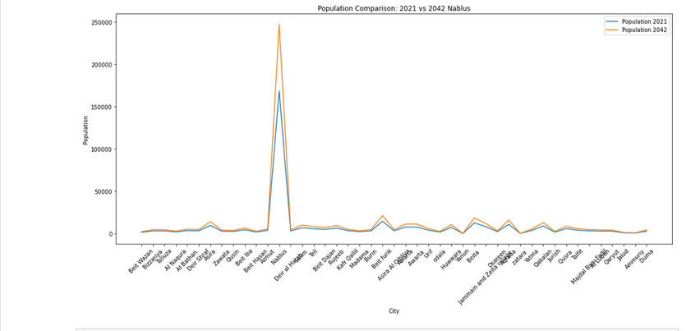
Nablus Consumption

Slide 20
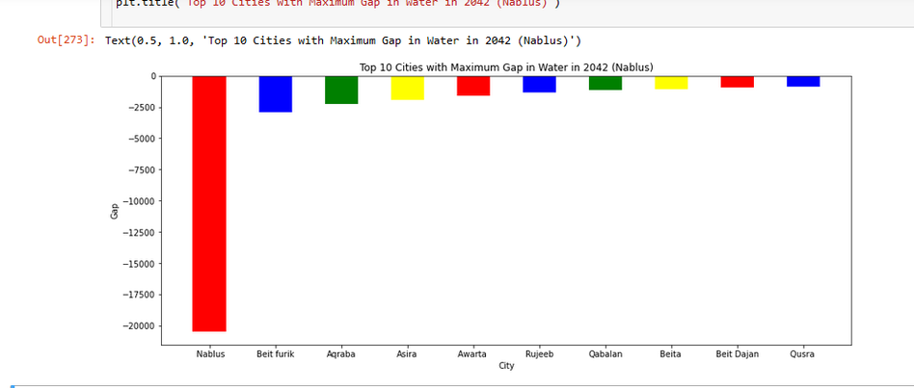
Nablus Gap

Slide 21
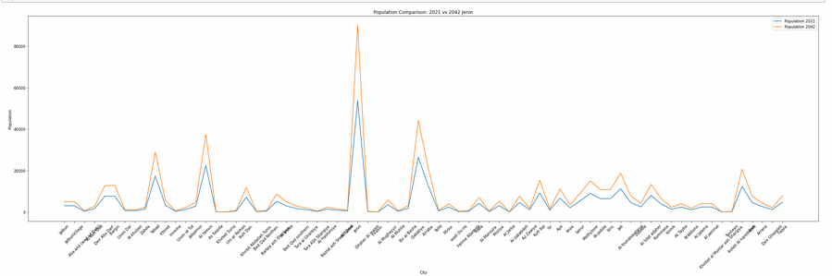
Jenin 21-42 consumption

Slide 22
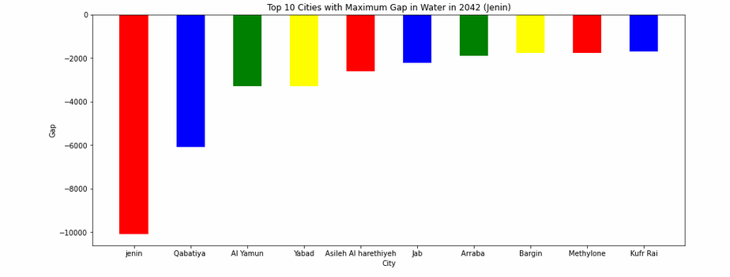
Jenin Gap Top 10

Slide 23
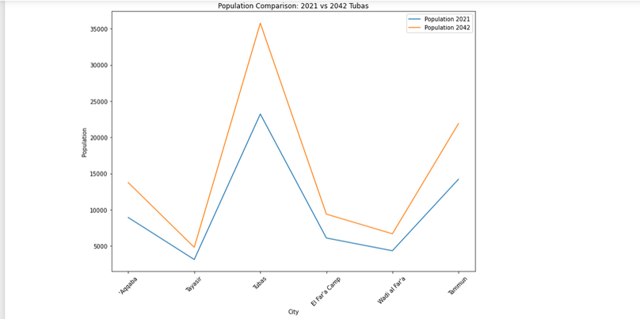
Tubas cosumption

Slide 24
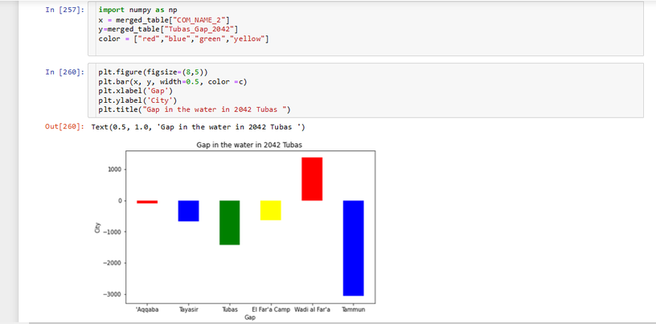
Tubas Gap

Slide 25
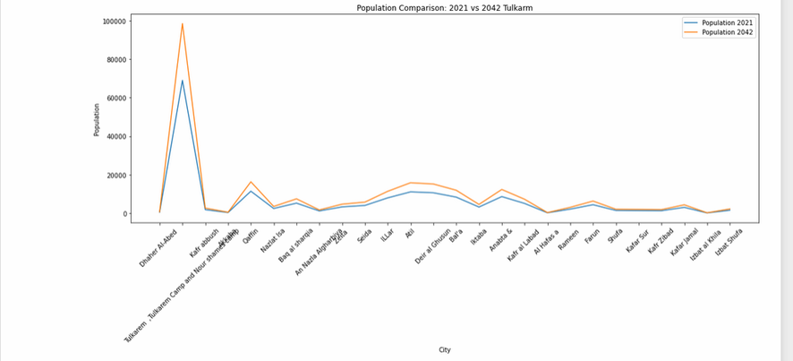
Tulkarm cosumption

Slide 26
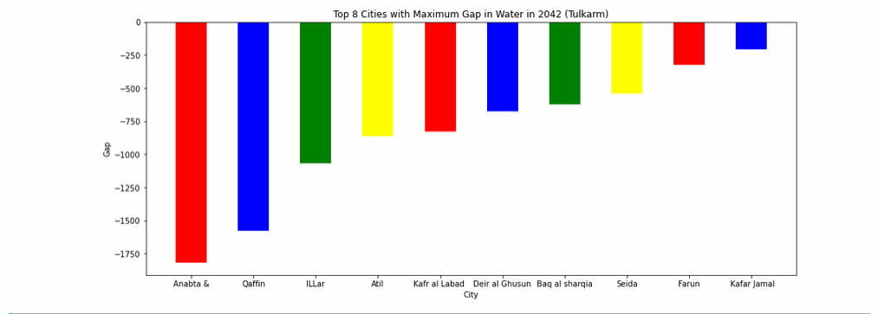
Tulkarm Gap

Slide 27
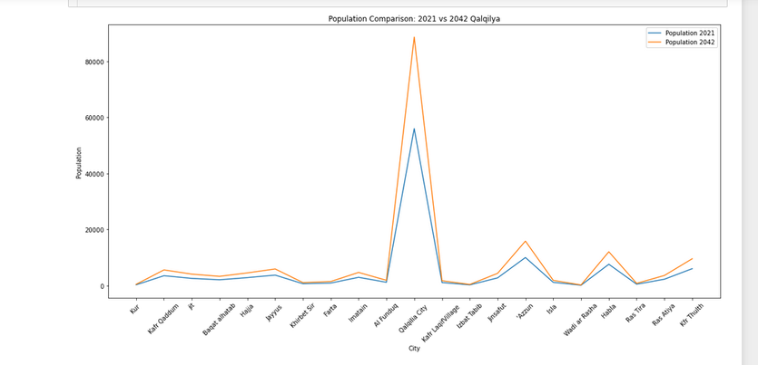
Qalqilya population

Slide 28
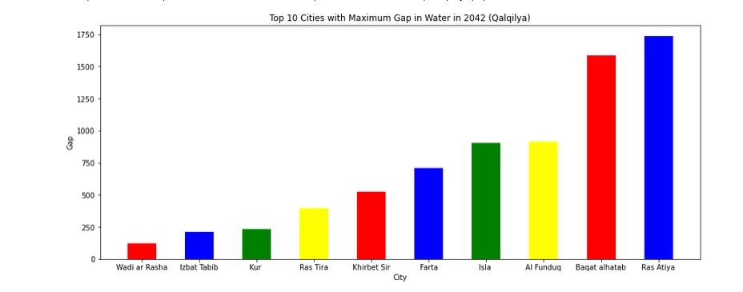
Qalqilya Gap

Slide 29
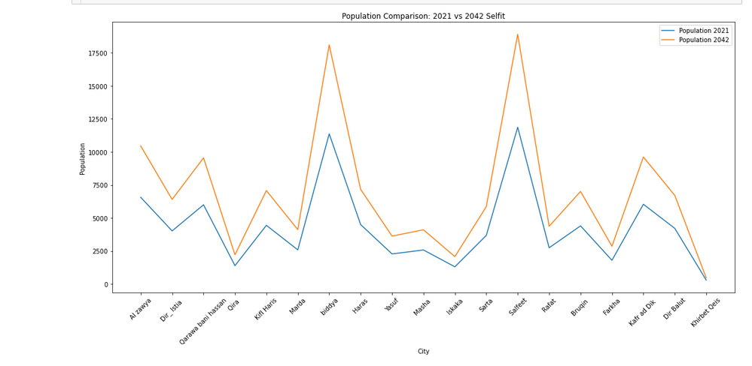
Salfit

Slide 30
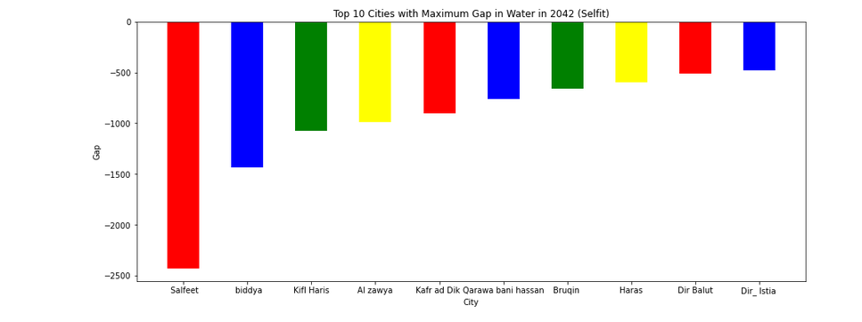
Salfit Gap

Slide 31

Thanks
Thank dr.Emad Natsheh
Done by :
Ayat abuomer
Mosaab odeh
Anas salahat

