Slide 1
Probe Data Analysis for Road Slope
Group Members
Boyan Zhang, Yunfei Gao, Ting Liu

Slide 2
Overview
Problem Statement
Approach
Map Matching
Slope Calculation
Result and Analysis
References

Slide 3
Problem Statement
Probe data are data collected from moving objects like vehicles. Probe data contain many information about time, location and so on.
Link data contain the information of road segments that can be matched by probe data.
Our tasks are as follow:
Match probe points to road links.
Derive road slope for each link.
Evaluate the derived road slop with the surveyed road slope in the link data file.

Slide 4
Map Matching
Goal: find the road link that a probe data point most likely belongs to
Load data and preprocessing
Load probe points and road links.
Delete incomplete data(such as data that don’t have longitude and altitude).
Choose candidate links for each probe points.
Compute geohash value of endpoint for each road link.
Compute geohash values of each probe point.
Select candidate links for each probe point based on the geohash value of probe point and refnode of road link.

Slide 5
Map Matching(cont.)
Useful probe data information such as shapeinfo, geohash, and candidates will be stored to a list.
Similarly, useful road link data information such as linkPVID, refNodeId, and shapeInfo will be stored to a dictionary.
Compute distance from each probe points to its candidates and select the link that are closest to the probe point.

Slide 6
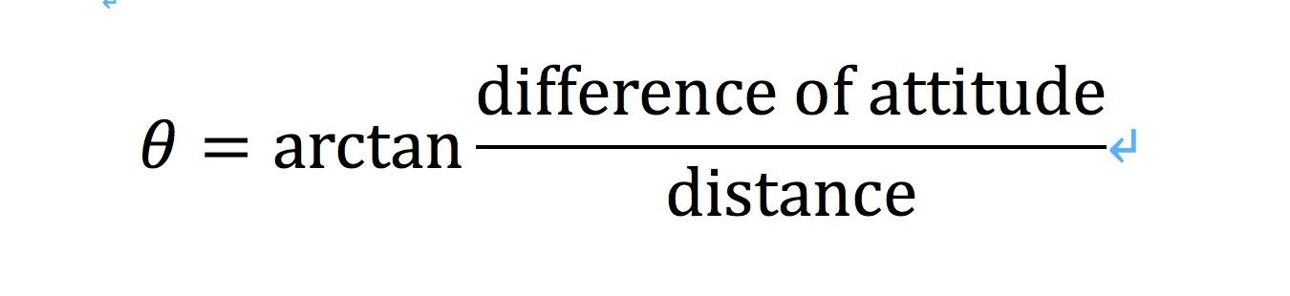
Slope calculation
We employed the following equation to calculate the slopes for the road links.

Slide 7
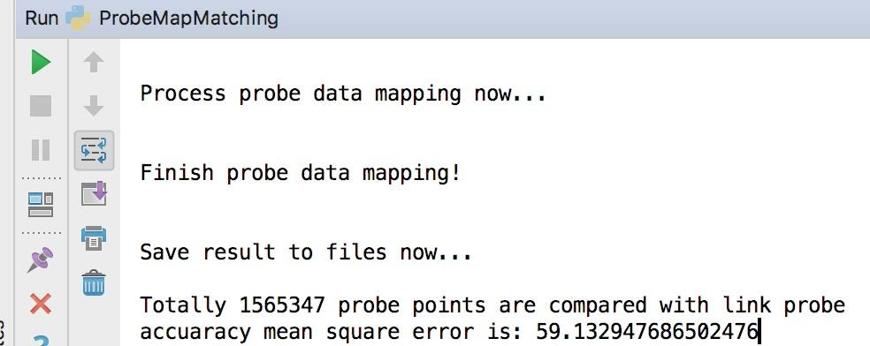
Result and Analysis
About Result:

Slide 8
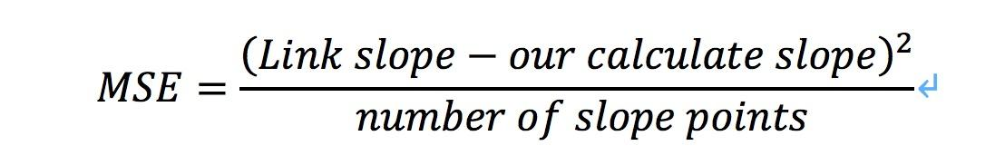
Result and Analysis(cont.)
About Result:
We use the accuracy mean square error to evaluate the derived road slope with the surveyed road slope in the link data file.
MSE means mean square error

Slide 9
Result and Analysis(Cont.)
About Analysis:
In the result, we can see that we use the 1565347 probe points, used for evaluating the road slope, which is an enormous number. But we get the good result, the mean square error is around 59.
However, we can try other methods to improve this result. We read some paper introducing that point to link with heading algorithm and employing machine learning techniques to predict the slopes for the road links.

Slide 10
References
Greenfeld, Josh. (2002). Matching GPS Observations to Locations on a Digital Map.
S. Maity, S. Dalal, S. Ranu and L. Vanajakshi, "A weight-based map matching algorithm using minimum input variables for urban road networks," 2017 9th International Conference on Communication Systems and Networks (COMSNETS), Bangalore, 2017, pp. 437-442.

