Slide 1
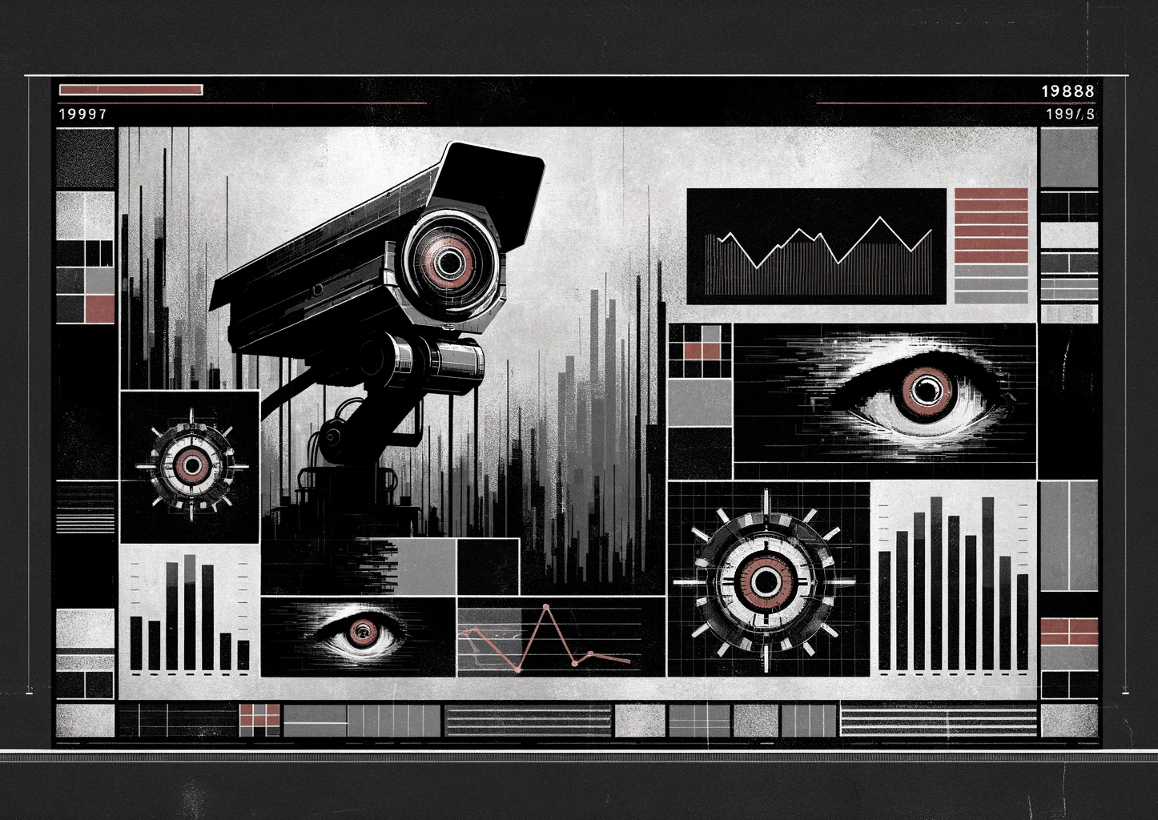
Party like it’s 1984
Case studies for Social Networks, Freedom of Expression and Censorship in China

Slide 2
