Slide 1
Trip duration predication
the 2016 NYC Yellow Cab trip record data

Slide 2
Presentation outline
01 | Business objective | Problem define
02 | Data resource | All information about dataset
03 | EDA | Visualization to discover and catch new information
04 | Model | Build model to predict trip duration
05 | summary | Summarized information that collected from EDA

Slide 3
Business objective
build a model that predicts the total ride duration of taxi trips in New York City. Your primary dataset is one released by the NYC Taxi and Limousine Commission, which includes pickup time, geo-coordinates, number of passengers, and several other variables

Slide 4
Data resource
The competition dataset is based on the 2016 NYC Yellow Cab trip record data made available in Big Query on Google Cloud Platform. The data was originally published by the NYC Taxi and Limousine Commission (TLC). The data was sampled and cleaned for the purposes of this playground competition. Based on individual trip attributes, participants should predict the duration of each trip in the test set.

Slide 5
Data resource
File descriptions
train.csv - the training set (contains 1458644 trip records)
test.csv - the testing set (contains 625134 trip records)
sample_submission.csv - a sample submission file in the correct format
Data fields
id - a unique identifier for each trip
vendor_id - a code indicating the provider associated with the trip record
pickup_datetime - date and time when the meter was engaged
dropoff_datetime - date and time when the meter was disengaged
passenger_count - the number of passengers in the vehicle (driver entered value)
pickup_longitude - the longitude where the meter was engaged
pickup_latitude - the latitude where the meter was engaged

Slide 6
Data resource
dropoff_longitude - the longitude where the meter was disengaged
dropoff_latitude - the latitude where the meter was disengaged
store_and_fwd_flag - This flag indicates whether the trip record was held in vehicle memory before sending to the vendor because the vehicle did not have a connection to the server - Y=store and forward; N=not a store and forward trip
trip_duration - duration of the trip in seconds (target value )

Slide 7
exploratory data analysis (EDA) and feature engineering
Visulization
Visualization individual features and relationship with target feature
4
2
Data loading
And
Data information
load the dataset
Understand the structure of the dataset
3
Data Cleaning
Featue engineering
Handle missing values
Data Transformation
Encode
Scale or normalize numerical features
1

Slide 8
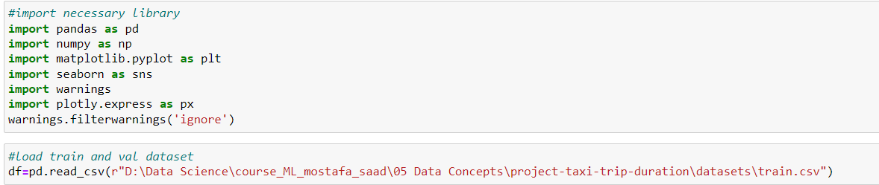
Data loading And Data information
Import the necessary libraries and load the dataset.
Understand the structure of the dataset by examining its shape, data types, and basic statistics (mean, standard deviation, etc.).

Slide 9
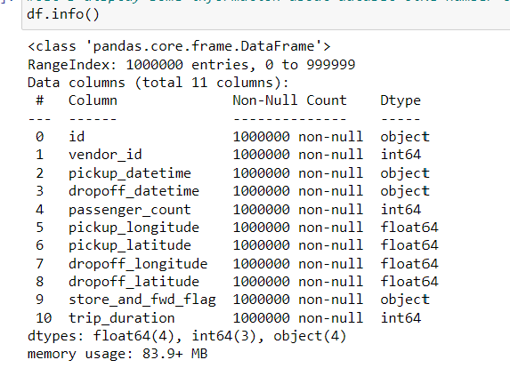
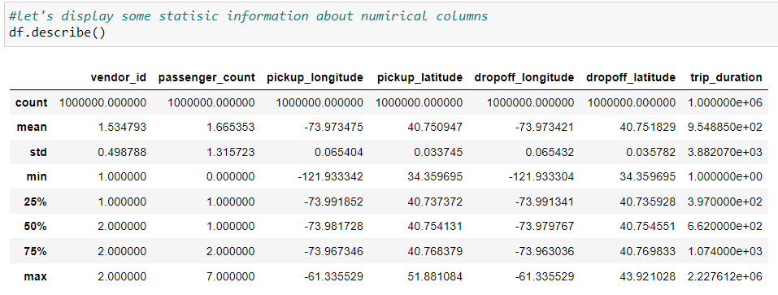
Data loading And Data information
Understand the structure of the dataset by examining its shape, data types, and basic statistics (mean, standard deviation, etc.).
can convert pickup_datetime from data tyoe object to data time To extract some information from those columns
Drop dropoff dateimte from your table. It is used to compute the duration
vendor id have two value 1,2
passenger count has 8 value from zero to 7
trip duration has outlear values

Slide 10
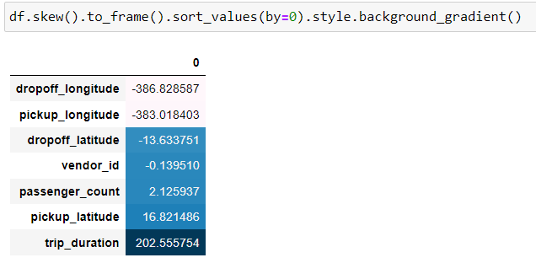
Data loading And Data information
Skew of columns.
trip_duration column is positive skew
pickup_longitude and dropoff_longitude are negative skew

Slide 11
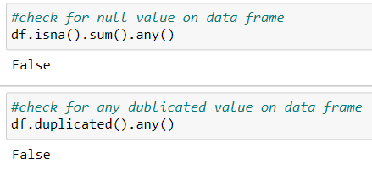
Data Cleaning
Handle missing data
Check for duplicated data
Data don’t have any missing values
Data don’t have any duplicated values

Slide 12
Data loading And Data information
Import the necessary libraries and load the dataset.

Slide 13
Data resource
Budget
1
2
3
Destination
Insurance
Transport
Jupiter is a gas giant and it’s the biggest one
Mercury is the closest planet to the Sun
Venus has a nice name but is a very hot place

Slide 14
Data resource
File descriptions
train.csv - the training set (contains 1458644 trip records)
test.csv - the testing set (contains 625134 trip records)
sample_submission.csv - a sample submission file in the correct format
Data fields
id - a unique identifier for each trip
vendor_id - a code indicating the provider associated with the trip record
pickup_datetime - date and time when the meter was engaged
dropoff_datetime - date and time when the meter was disengaged
passenger_count - the number of passengers in the vehicle (driver entered value)
pickup_longitude - the longitude where the meter was engaged
pickup_latitude - the latitude where the meter was engaged

Slide 15
Data resource
File descriptions
train.csv - the training set (contains 1458644 trip records)
test.csv - the testing set (contains 625134 trip records)
sample_submission.csv - a sample submission file in the correct format
Data fields
id - a unique identifier for each trip
vendor_id - a code indicating the provider associated with the trip record
pickup_datetime - date and time when the meter was engaged
dropoff_datetime - date and time when the meter was disengaged
passenger_count - the number of passengers in the vehicle (driver entered value)
pickup_longitude - the longitude where the meter was engaged
pickup_latitude - the latitude where the meter was engaged

Slide 16
Data cleaning
1
Missing values
2
doublicates
3
Eliminate outliers

Slide 17
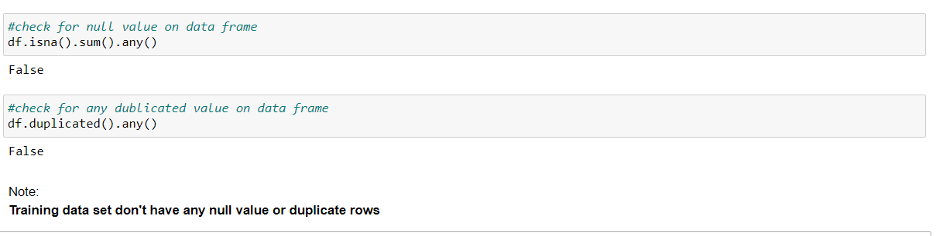
Missing values & doublicates
check for any missing values or any duplicates in dataset

Slide 18
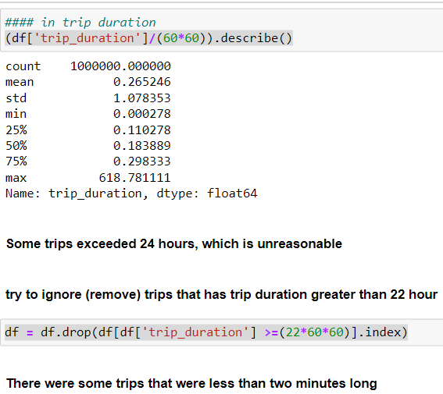
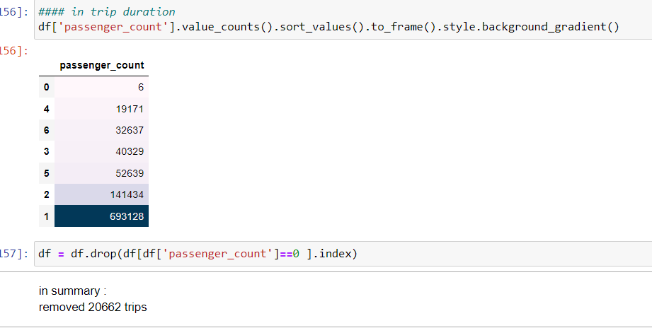
Eliminate outliers
Remove Trips That Have Improbable Features
Removed some trips that have Improbable values
trip duration :trips duration greater than 22 passenger counts :trips have not passenger

Slide 19
Visualization
The vendor id is 2 made more trips
The largest number of trips was the number of rams in it 1, then the next 2
can you have some trips that have zero passenger (38 trips)
can you have some trips that have large number passenger (7 passengers) (2 trips)

Slide 20
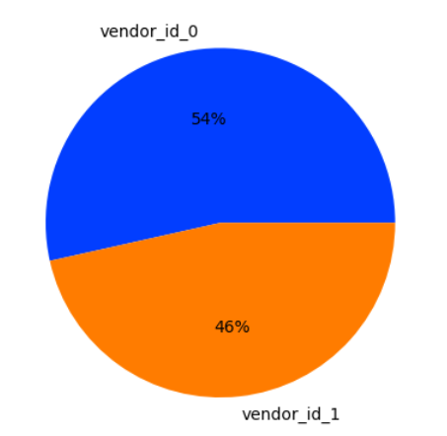
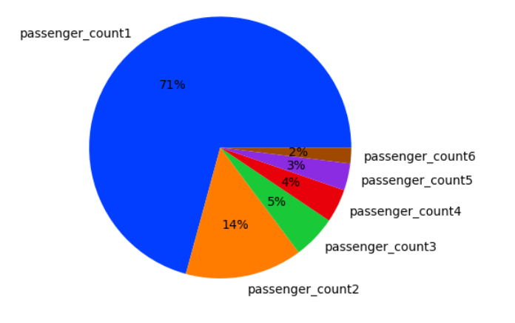
analysis numeric features
analysis discrete features
The values are close
The number of passengers, one, is the most frequent, then two passengers, and the rest have small values

Slide 21
The vendor id is 2 made more trips
The largest number of trips was the number of rams in it 1, then the next 2
can you have some tris that have zero passenger (38 trips)
can you have some trips that have large number passenger (7 passengers) (2 trips)

Slide 22
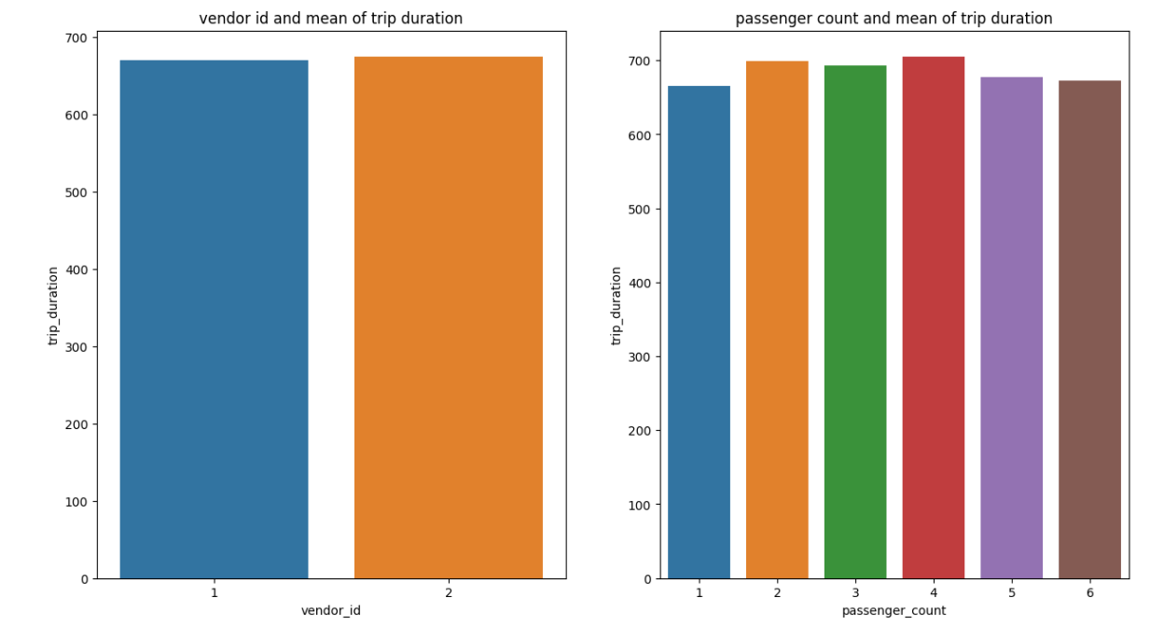
analysis numeric features
analysis discrete features
relationship with target feature:

Slide 23
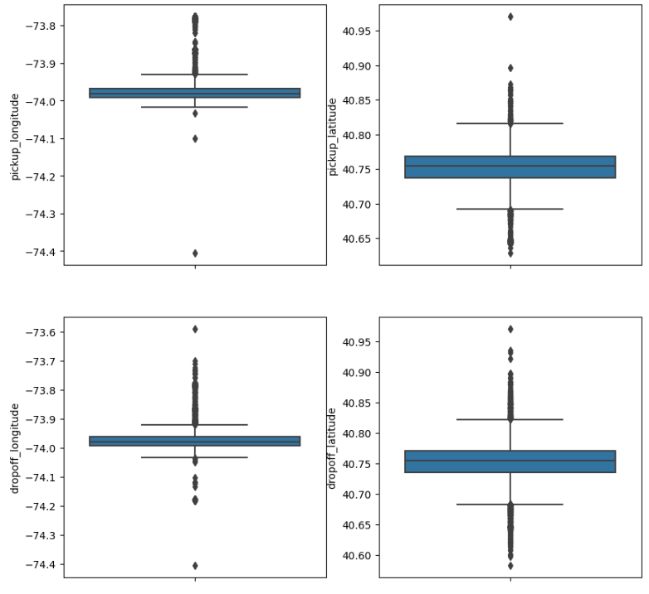
analysis numeric features
analysis continues features:
Continues features 'pickup_longitude','pickup_latitude','dropoff_longitude','dropoff_latitude'

Slide 24
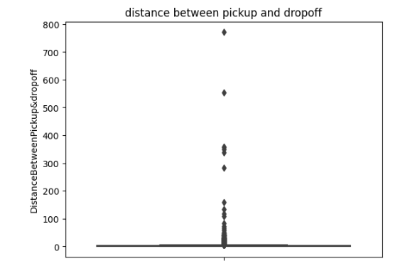
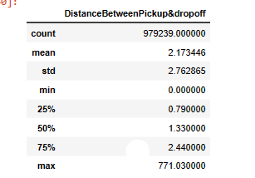
analysis numeric features
Continues features 'pickup_longitude','pickup_latitude','dropoff_longitude','dropoff_latitude’
can you extract new feature like distance between pickup and dropoff
Distance has clearly outliers some trips have distance 771 kilo meters that is impossible

Slide 25
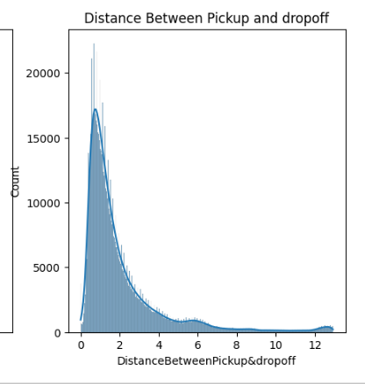
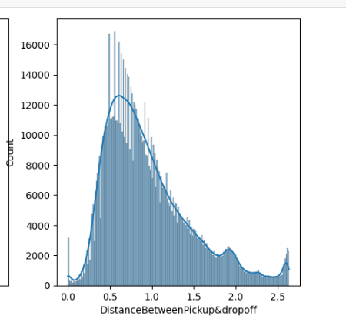
analysis numeric features
After remove some outliers and apply log
after log transformation the distribution transform from positive skew to normal distribution

Slide 26
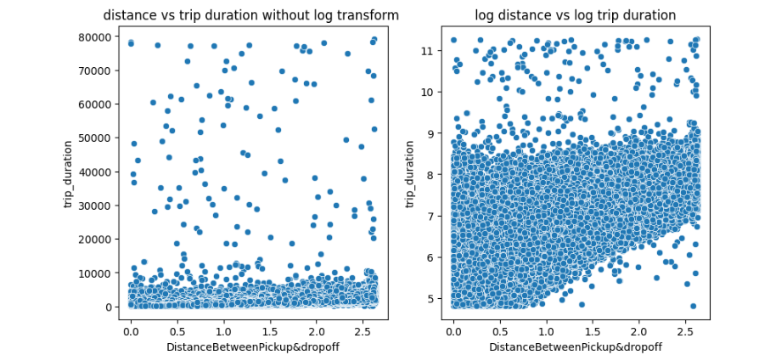
analysis numeric features
Relationship between target column and distance
Nothing can be deduced from the resulting figure due to the large scale of trip duration can apply log transform to reduce scale

Slide 27
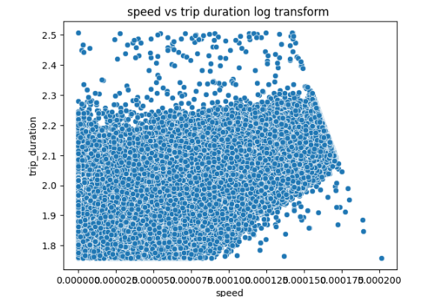
analysis numeric features
Can extract extra new feature (speed )from distance and duration

Slide 28
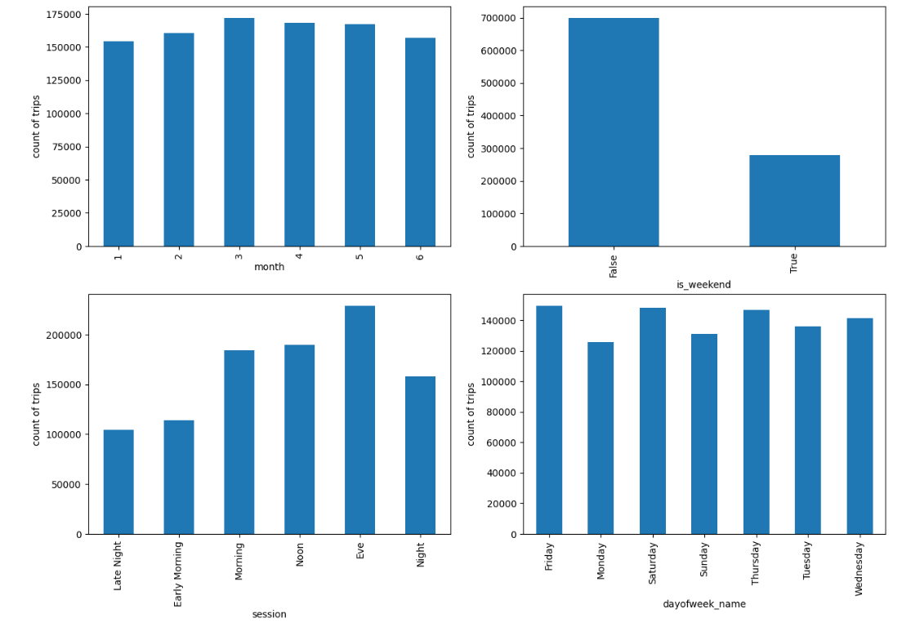
Analysis DateTime features

Slide 29
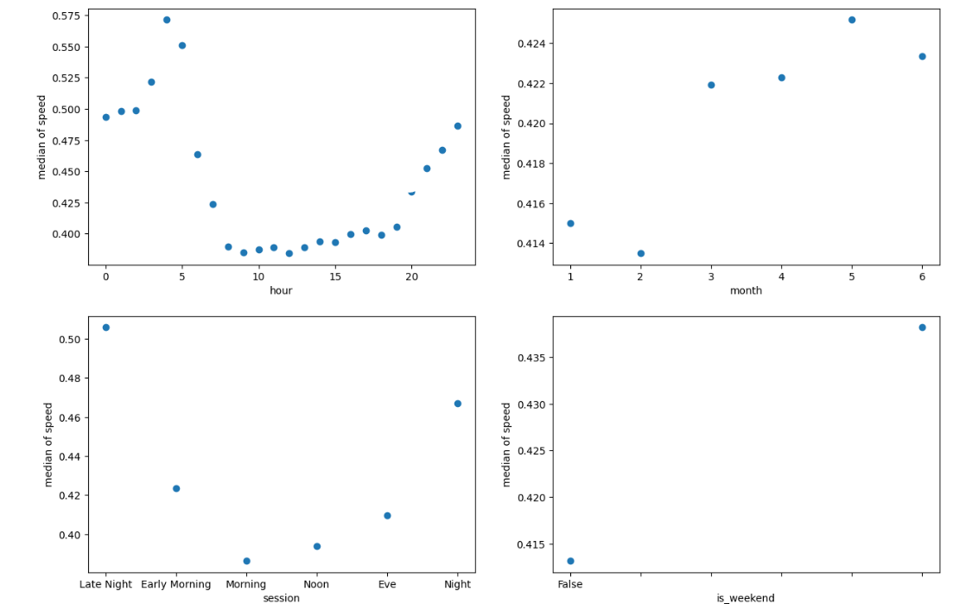
Analysis DateTime features and relationship with speed

Slide 30
Analysis DateTime features
The number of trips increases at noon and in the evening than at any other time
The number of flights increases on Friday, Saturday, and Thursday of each week
The speed of vehicles increased between night and late at night
The speed of vehicles increased on Sunday and Saturday
The speed of vehicles increased in the months of 5 and 6
The speed of vehicles increased on holiday days than on other days

Slide 31
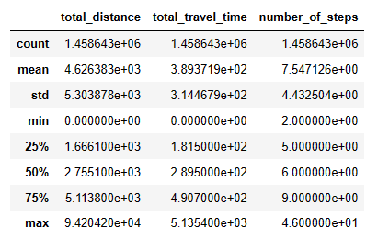
Used external dataset
add new feature from The Open Source Routing Machine (OSRM) dataset
There are many columns that can help him predict like total_distance,total_travel_time,number_of_steps
You can also verify this by merging with the main dataset by column ID
Merge with own dataset
Some statistics on it features

Slide 32
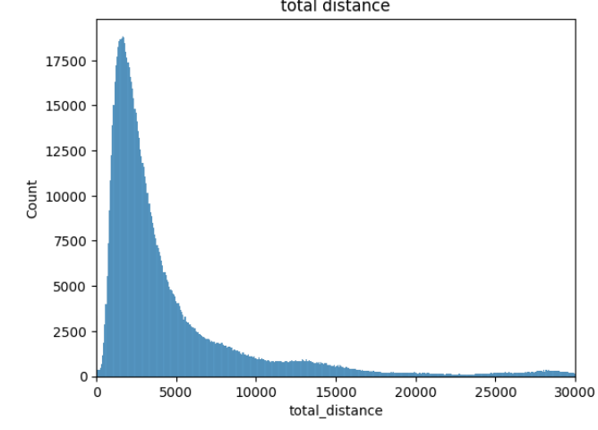
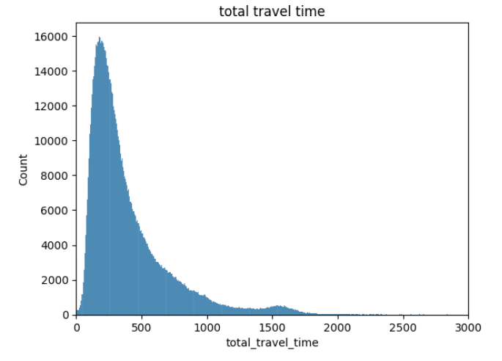
total_distance has negative skew most distance is between 0 and 5000 metre
total_travel _time has negative skew most distance is between 0 and 500 second

Slide 33
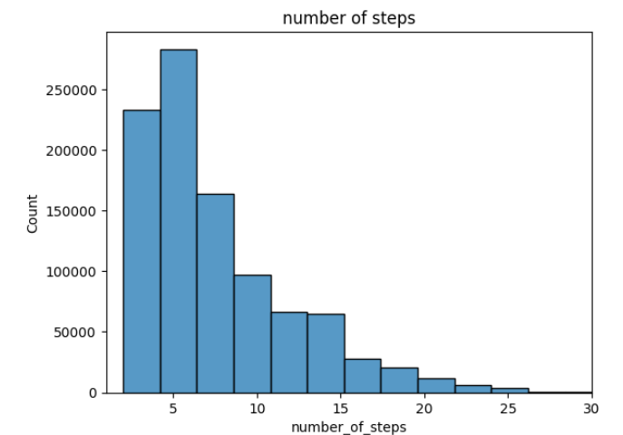
number of steps time has negative skew
most values is between 1 and 10 steps

Slide 34
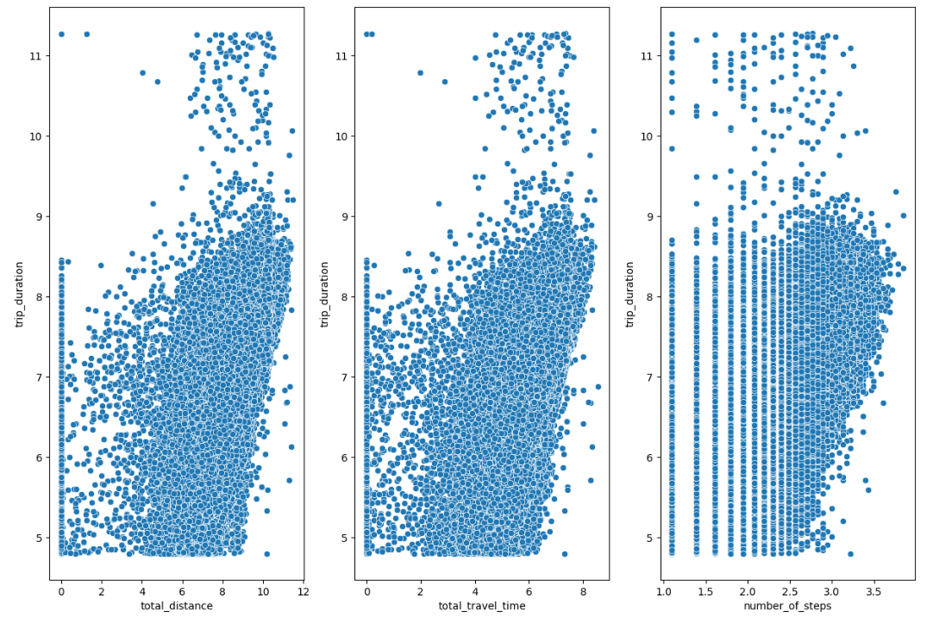
The relationship of the three columns ('total_distance','total_travel_time','number_of_steps') with target column (trip_duration)

