Slide 1
Askiris Log Collection

Slide 2
Open postman app
Import curl command and put authorization key-----
curl --location 'https://askiris-app.inxeption.com/api/v1/chat-logs' \--header 'Authorization: Bearer DA-001698389999908@QA!'

Slide 3
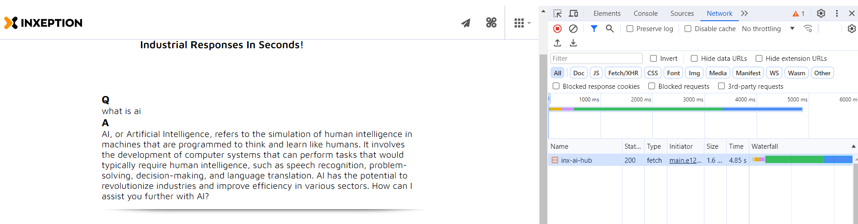
Getting authorization key----Go to https://askiris.inxeption.com/
Right click and go to inspect option
Click on network
Refresh page
Clear network
Ask any question in Askiris question box
You are getting this screen

Slide 4
Click on inx-ai-hub
And copy Authorization:
i.e
Bearer AI-221698389999908@PROD!
Paste it in postman header authorization.

Slide 5
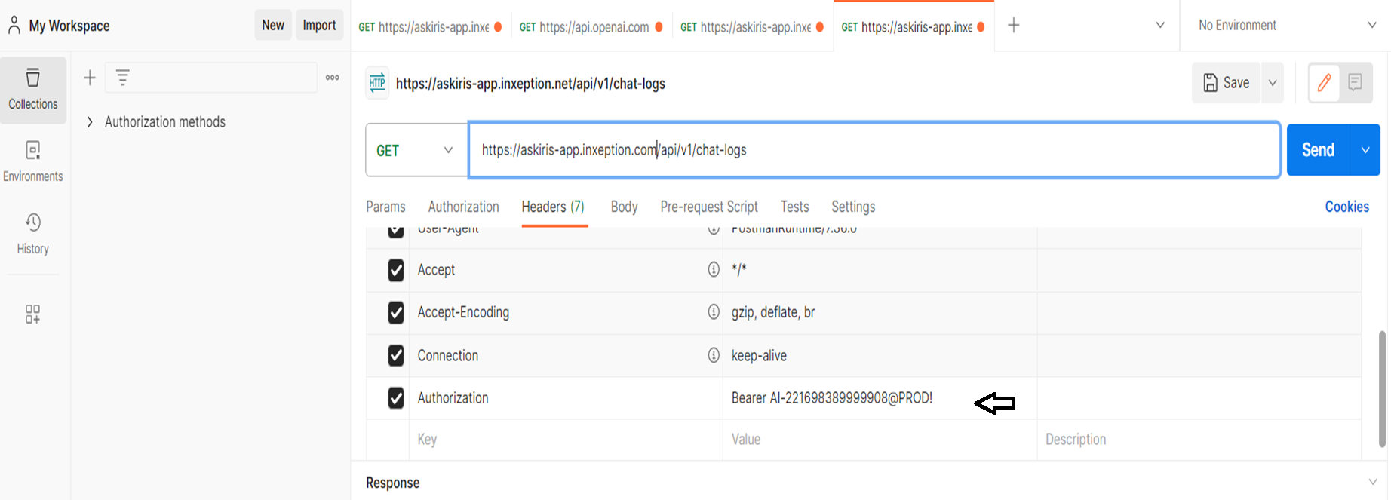

Slide 6
Hit send tab
You are getting last 5 days logs.

