Slide 1
MAHARISHI INTERNATIONAL UNIVERSITY
1971-1995
MAHARISHI UNIVERSITY
of
MANAGEMENT
Engaging the Managing
Intelligence of Nature

Slide 2
Lab 4:
Command Pattern

Slide 3
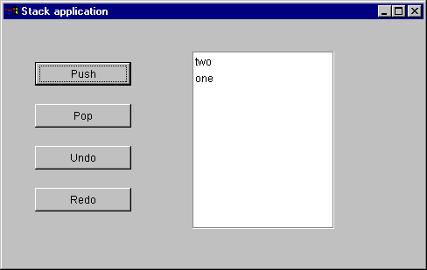
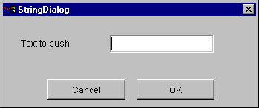
Command : Lab

Slide 4
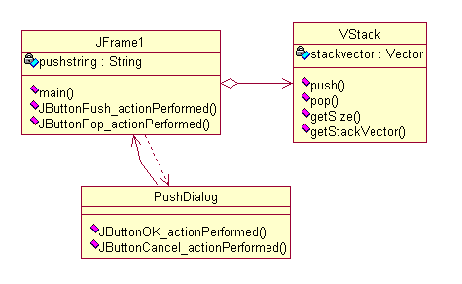
Command : Lab without command pattern
void JButtonPush_actionPerformed(java.awt.event.ActionEvent event)
{
pushstring= "";
PushDialog dialog = new PushDialog(this); //ask the user what to push
dialog.setVisible(true);
if (!pushstring.equals("")) // after the dialog is closed,
stack.push(pushstring); // pushstring contains the user input
JList1.setListData(stack.getStackVector()); // refresh the JList
this.repaint();
}
void JButtonPop_actionPerformed(java.awt.event.ActionEvent event)
{
stack.pop();
JList1.setListData(stack.getStackVector()); // refresh the JList
this.repaint();
}

Slide 5
Command : Lab without command pattern
Exercise:
1. Redraw the class diagram of this application with the command pattern applied.
2. Redraw the class diagram of step one when we add support for undo and redo.

Slide 6
© 2005 Maharishi University of Management, Fairfield, Iowa, USA
This tape may not be copied, duplicated, or distributed without written consent from Maharishi University of Management, Fairfield, Iowa, USA.

Slide 7
® Science of Creative Intelligence is a service mark registered in the United States Patent and Trademark Office, licensed to Maharishi Vedic Education Development Corporation, and is used under sublicense.

