Slide 1
MAHARISHI INTERNATIONAL UNIVERSITY
1971-1995
MAHARISHI UNIVERSITY
of
MANAGEMENT
Engaging the Managing
Intelligence of Nature

Slide 2
Lab 10:
Factory /Abstract Factory Pattern

Slide 3
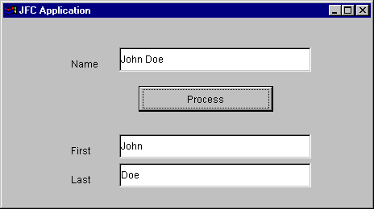

Factory Method: Lab
public void processName(String str){
int i = str.indexOf(",");
if (i>0){
last=str.substring(0,i).trim();
first=str.substring(i+1).trim();
}
else{
i = str.indexOf(" ");
if (i>0){
first=str.substring(0,i).trim();
last=str.substring(i+1).trim();
}
else{
first = "";
last= str;
}
}
}

