Slide 1

Multi-Branch Network Automation
ASSIGNMENT
Mohamed Yasser Khalifa
TELECOM ENGINEER

Slide 2

Table of Contents
3
4
5
Problem
Network Architecture
Addressing
6
7
8
Automation Archeticture
Monitoring and Failover Logic
Mock Simulation
MOHAMED YASSER KHALIFA

Slide 3
Problem
Design a resilient, multi-branch architecture (HQ, Giza, Alexandria) with automated provisioning and self-healing.
You must design the IP addressing plan, network topology, and create a Python script that:
1
Applies initial configurations to all routers and switches
2
Monitors the connectivity between branches
3
Automatically updates configurations if a link goes down
MOHAMED YASSER KHALIFA
3

Slide 4
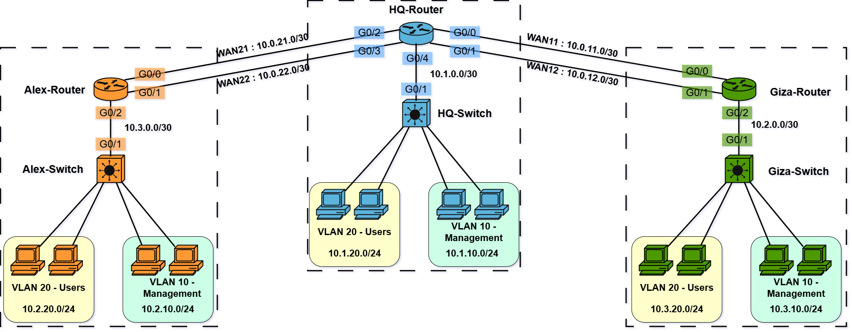
Network Topology
MOHAMED YASSER KHALIFA
4

Slide 5
Addressing & Routing
WAN | 10.0.xy.0/30 | x--> WAN, y--> Link | 10.0.11.1
LAN | 10.x.y.0/24 | x--> branch, y--> VLAN | 10.1.10.0
Router to Switch | 10.x.0.0/30 | x--> branch | 10.1.0.1
loopback (management) | 10.x.x.x 10.xx.xx.xx | x--> branch | 10.1.1.1 10.11.11.11
STATIC ROUTING WAS SELECTED FOR THIS DESIGN
MOHAMED YASSER KHALIFA
5

Slide 6
Automation Archeticture
Day 0 Configuration
Device Data (IP, Hostnames, DHCP Pools, ...)
config.json
NetworkConfigurator class — pushes initial configuration to all devices
configure.py
NetworkMonitor class — monitors WAN links and handles failover/failback
monitor.py
Orchestrator — loads config, calls configure, starts monitoring loop
main.py
MOHAMED YASSER KHALIFA
6

Slide 7
Monitoring and Failover Logic
The NetworkMonitor class runs a continuous loop, checking WAN link health every 10 seconds using system ping commands via Python's subprocess module.
Ping Results | Current Role | Action
Success | Primary active | Do nothing — link healthy
Success | Backup active | Failback — restore primary route
Fail | Primary active | Failover — push backup route
Fail | Backup active | Do nothing — backup already active
MOHAMED YASSER KHALIFA
7

Slide 8
Testing & Simulation (Mock Mode)
A simulation layer that replaces real network communication with predefined Cisco IOS responses, allowing the system to be tested and validated without requiring physical devices.
Link Failure Triggering:
Simulates a WAN outage by automatically forcing ping failures after a defined time, allowing the failover mechanism to be tested and validated.
MOHAMED YASSER KHALIFA
7

Slide 9
The End
THANK YOU FOR LISTENING
Mohamed Yasser Khalifa

