Slide 1

Moritz Sauter
Patrick Schmidt

Slide 2
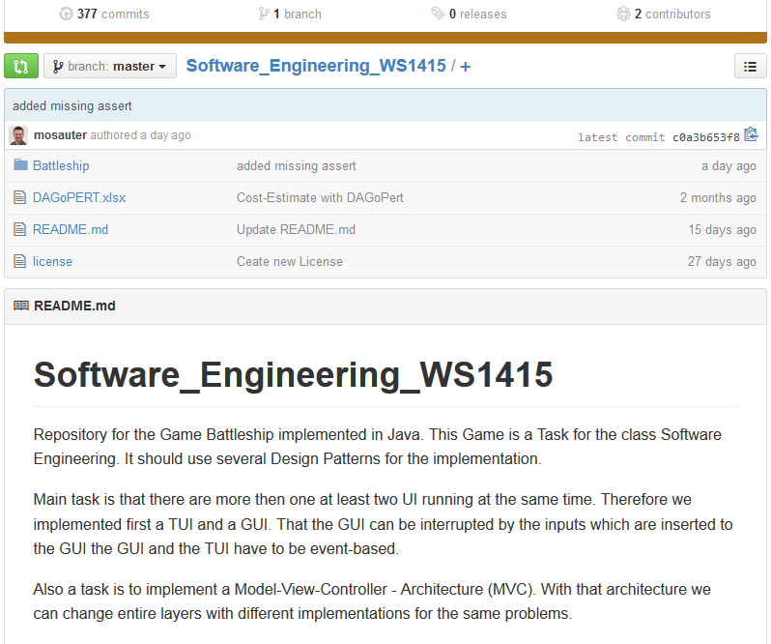
Version Control Systems

Slide 3
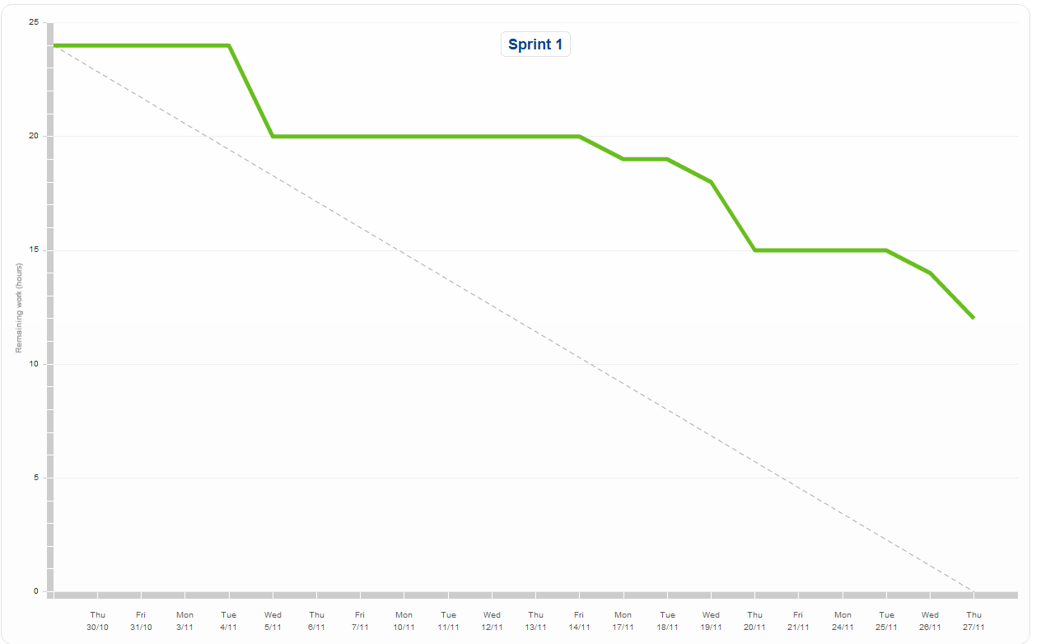
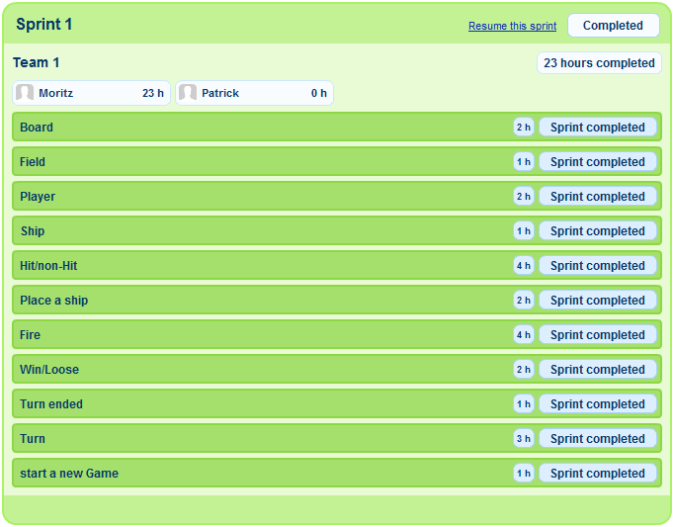
Scrum

Slide 4
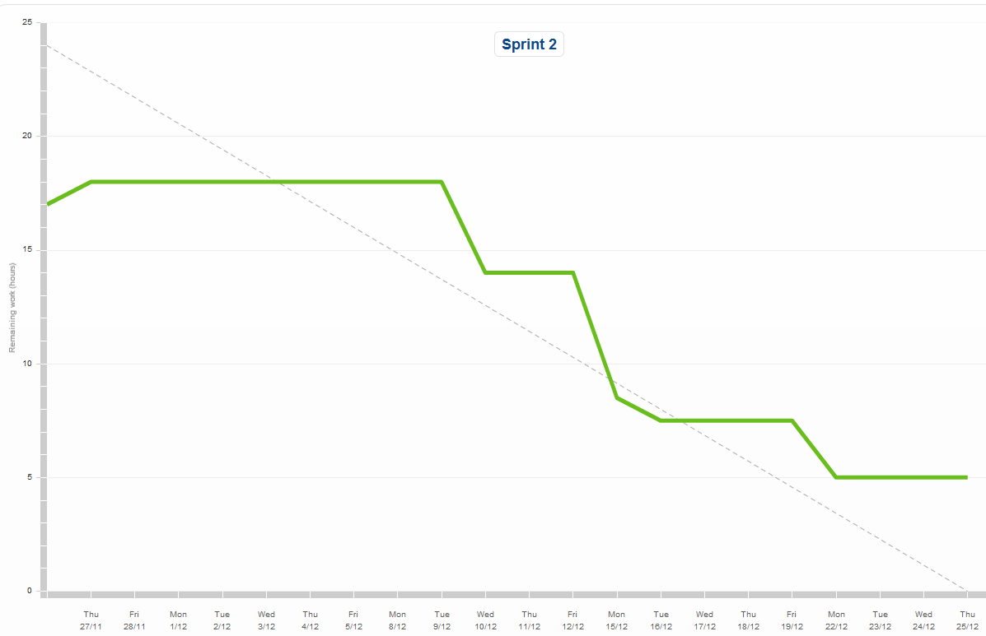

Scrum

Slide 5
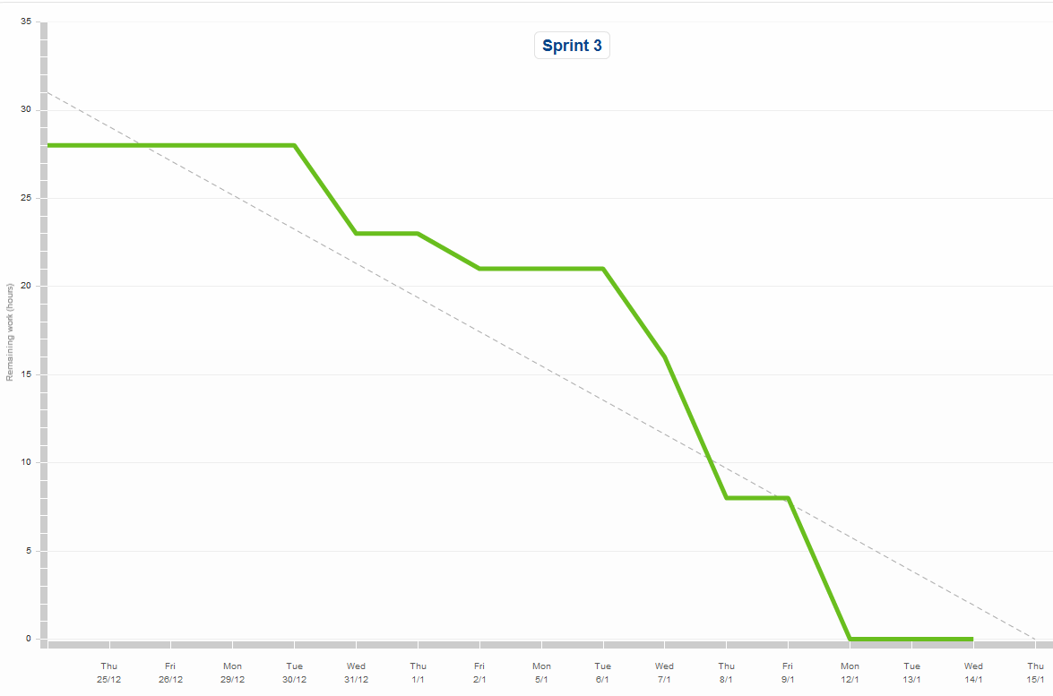

Scrum

Slide 6

Layers and MVC
Util Layer

Slide 7
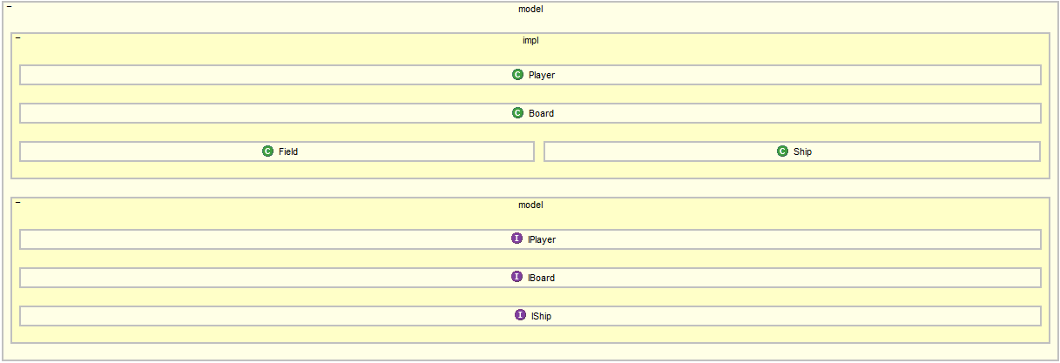
Layers and MVC
Model Layer

Slide 8
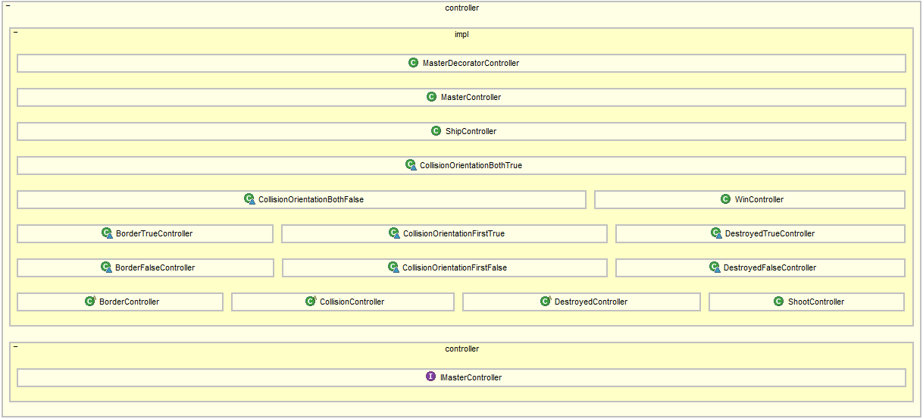
Layers and MVC
Controller Layer

Slide 9

Layers and MVC
View Layer

Slide 10
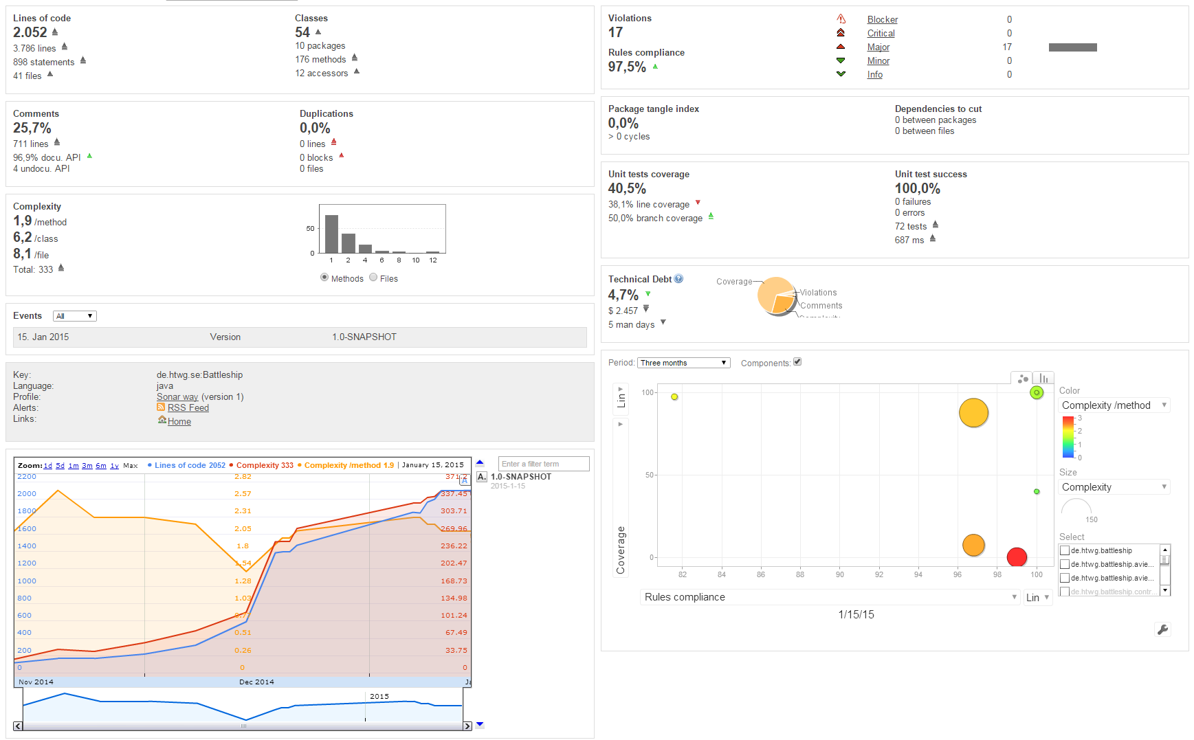
Metrics

Slide 11
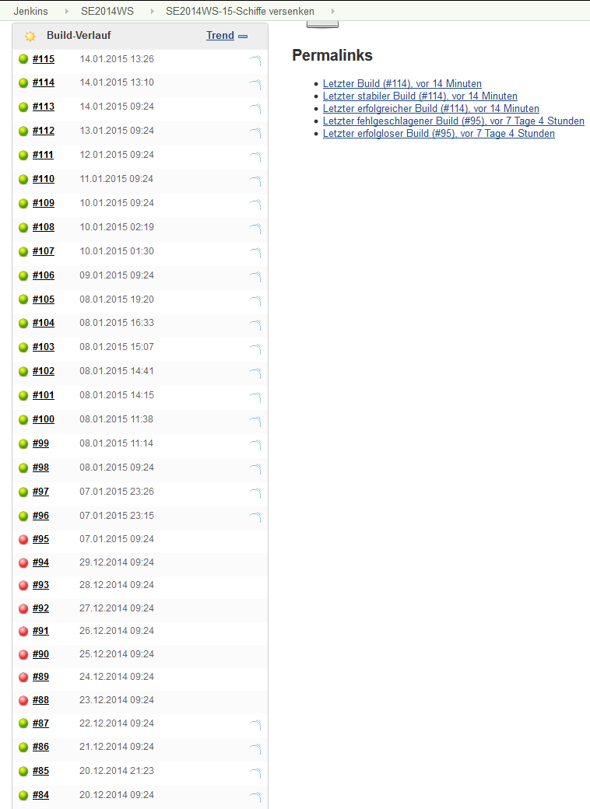
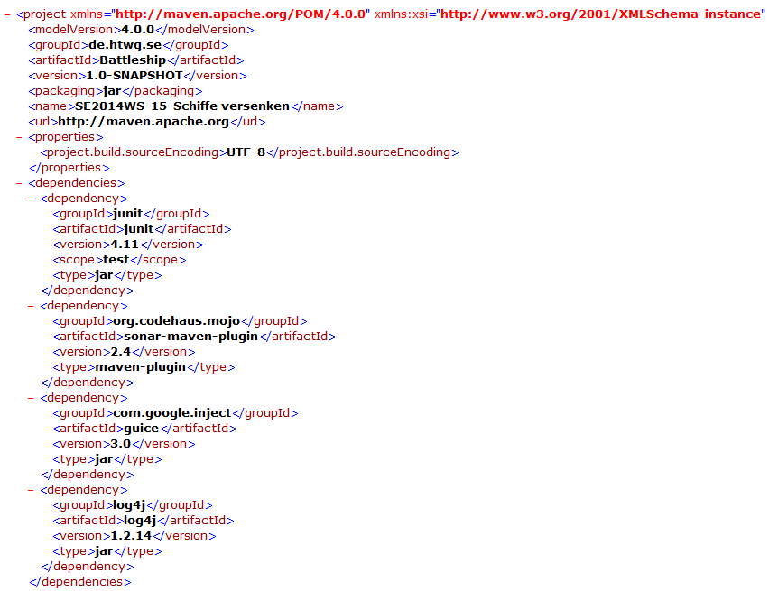
CI, Buildtools and Continuous Delivery

Slide 12


Cost Estimation
Estimation:
Real:

Slide 13
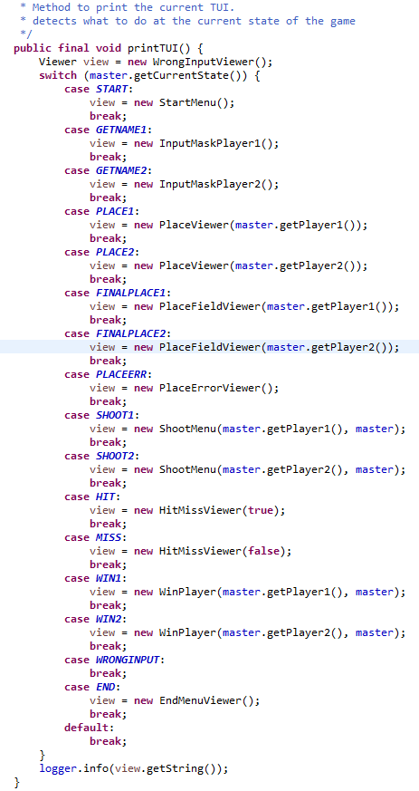
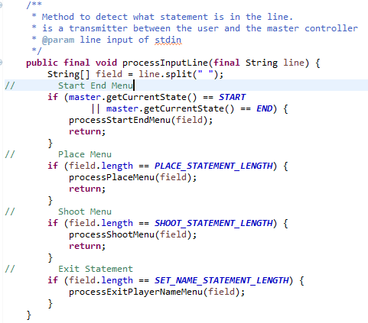
OO Principles and Clean Code

Slide 14
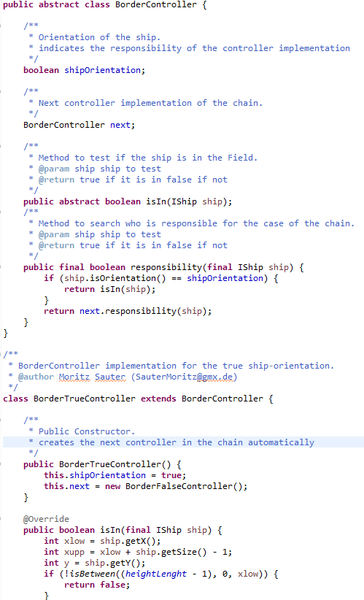
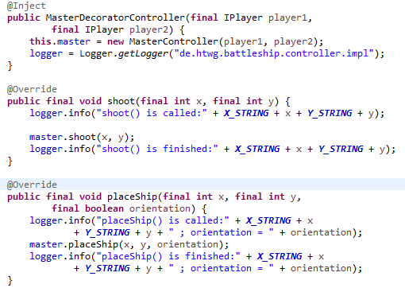
Design Patterns
Chain of Responsibility
Decorator

Slide 15
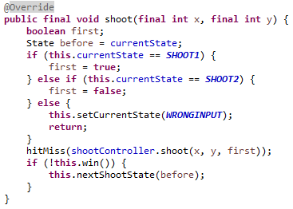
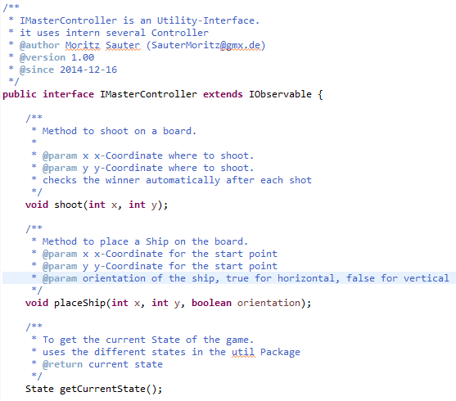
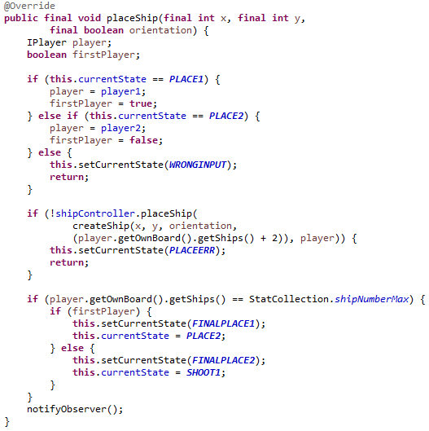
Components and Interfaces
Interface
Implemenation

Slide 16
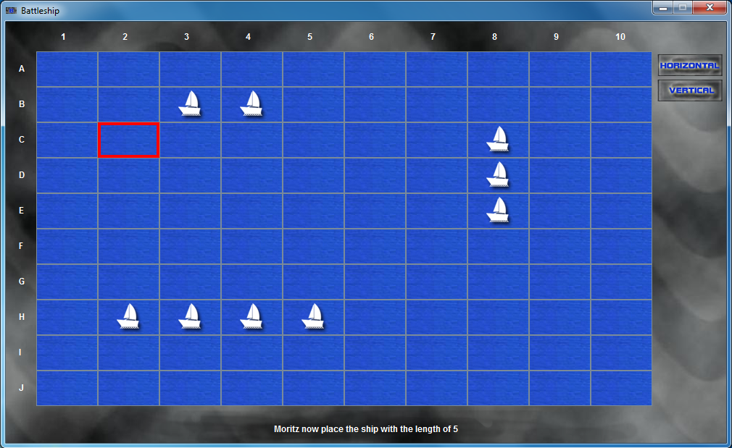
GUI Development

Slide 17
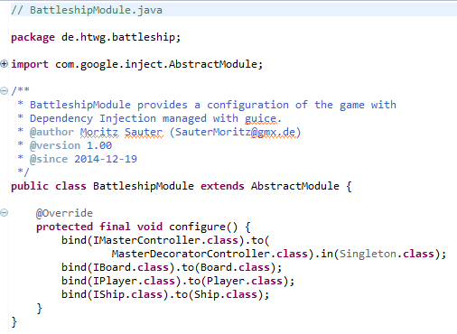
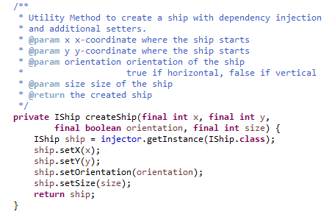
Dependency Injection
Configurationfile
Snippet of MasterController

Slide 18
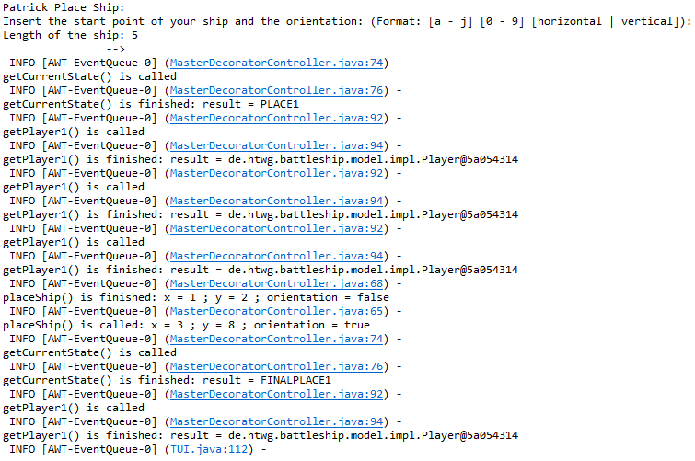
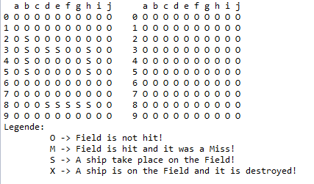
Logging

Slide 19
Demonstration

