Slide 1

Moritz Sauter
Patrick Schmidt

Slide 2
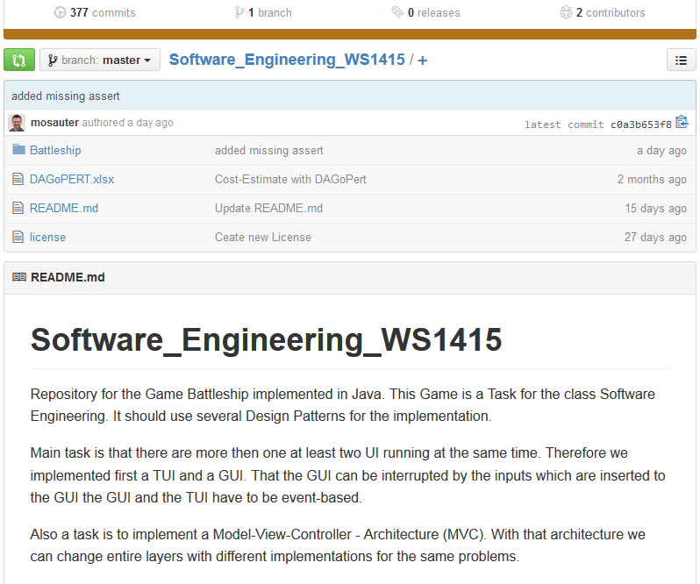
Version Control Systems

Slide 3
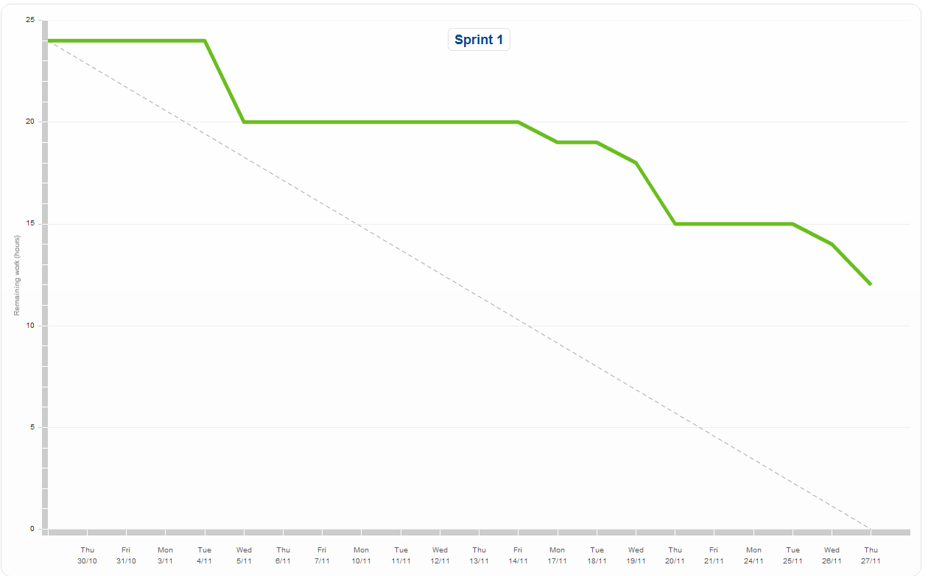
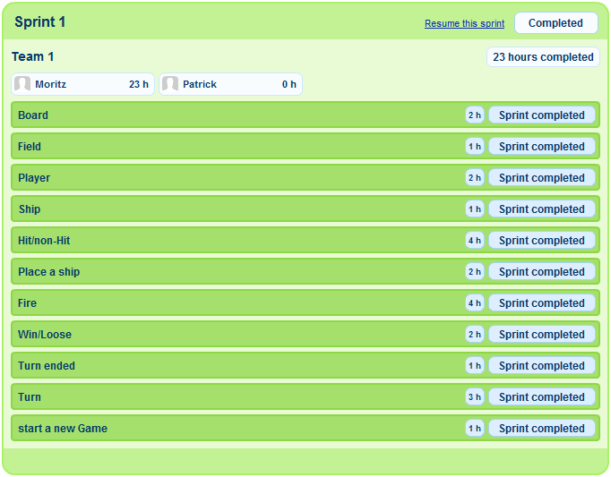
Scrum XP and TDD

Slide 4
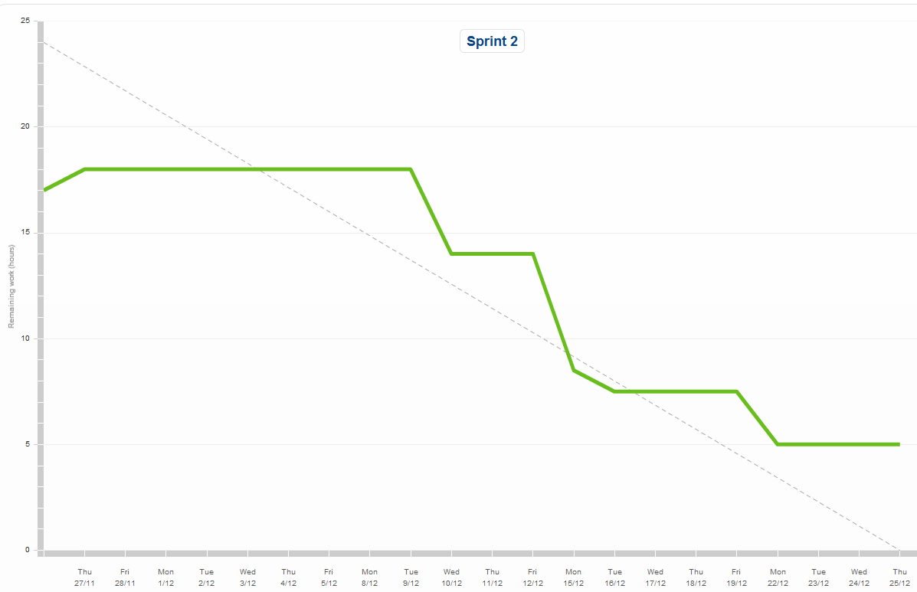

Scrum XP and TDD

Slide 5
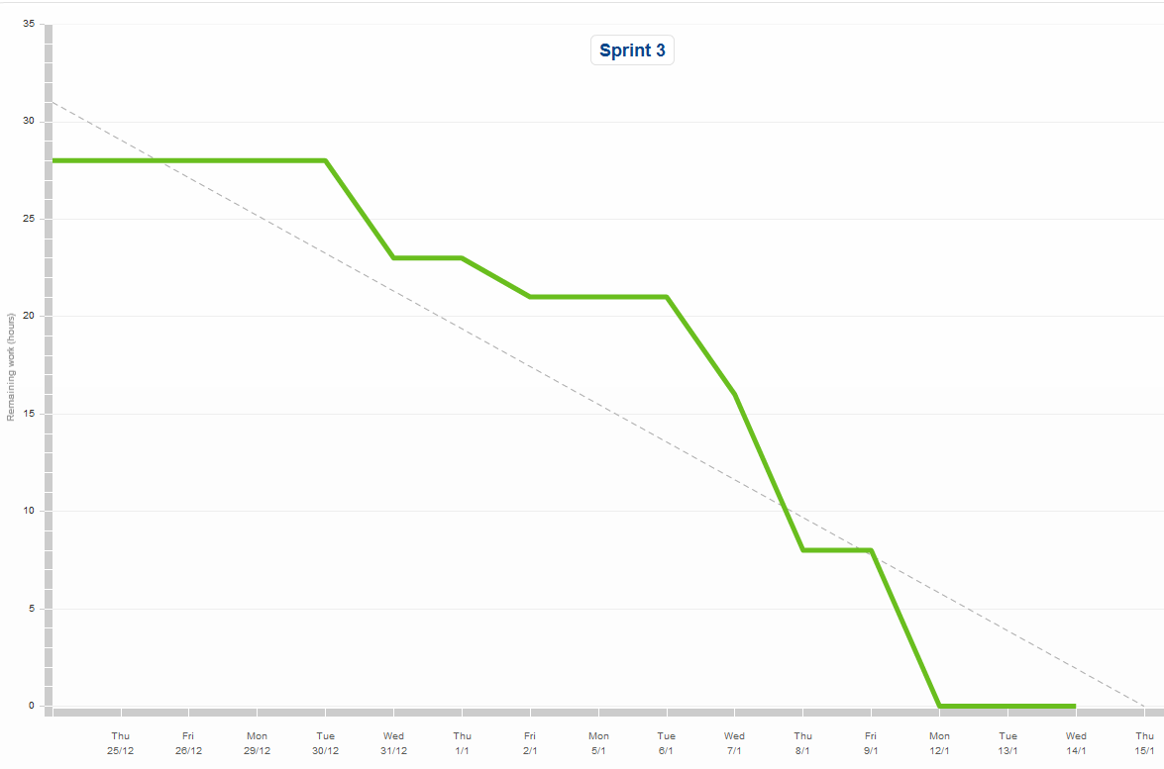

Scrum XP and TDD

Slide 6
Layers and MVC
Morgen structure101

Slide 7
Metrics
Morgen Sonar

Slide 8
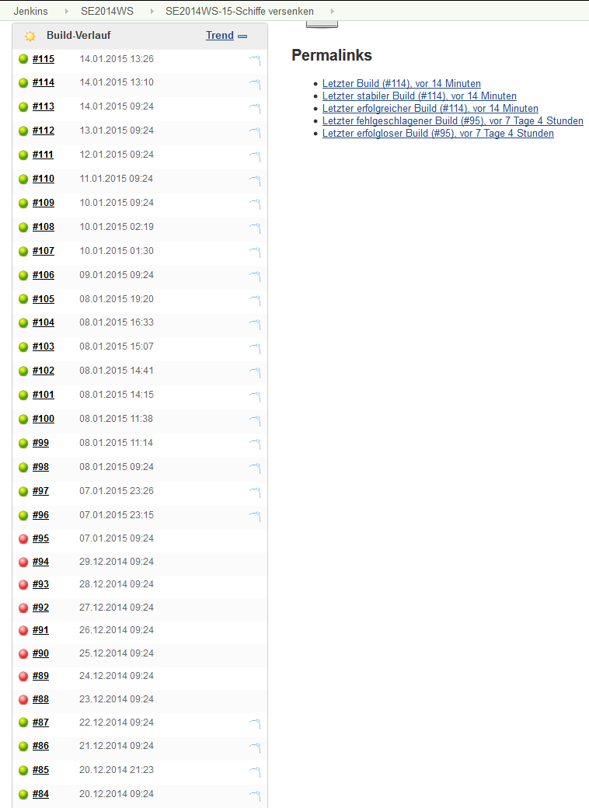
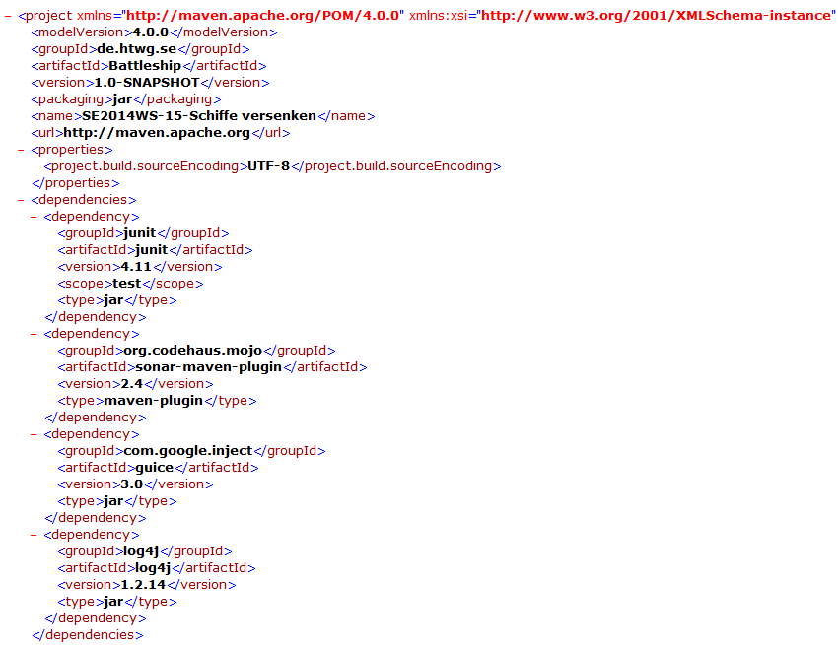
CI, Buildtools and Continuous Delivery

Slide 9


Cost Estimation
Estimation:
Real:

Slide 10
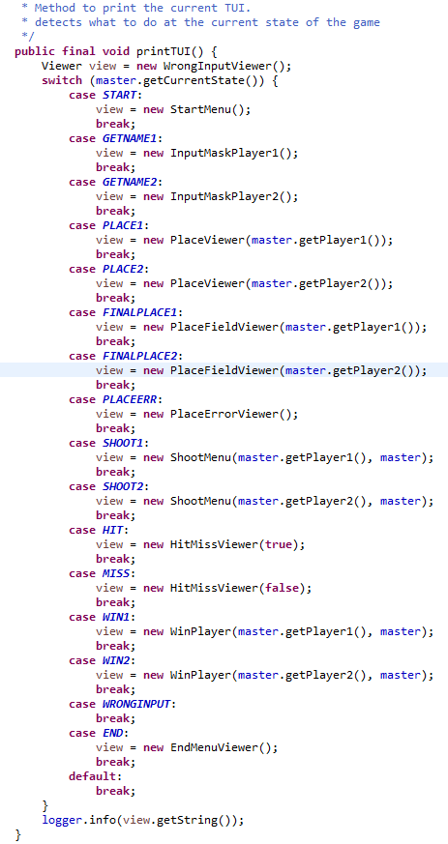
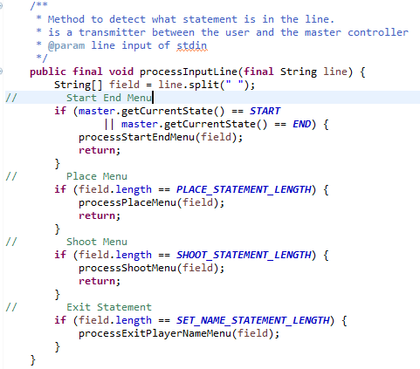
OO Principles and Clean Code

Slide 11
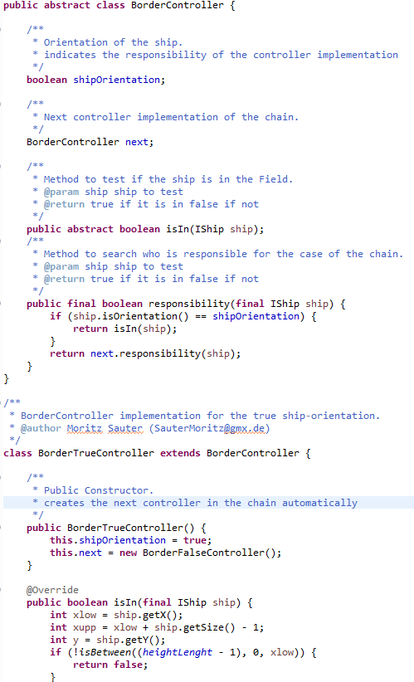
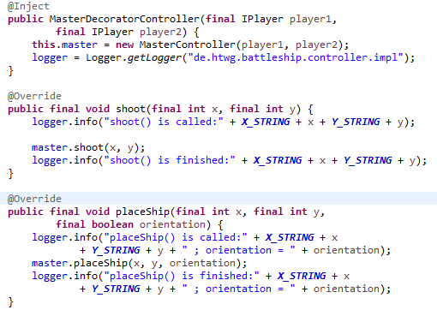
Design Patterns
Chain of Responsibility
Decorator

Slide 12
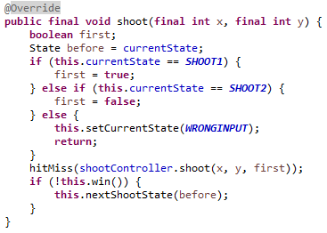
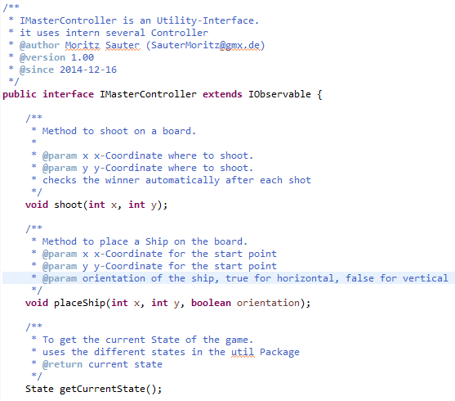
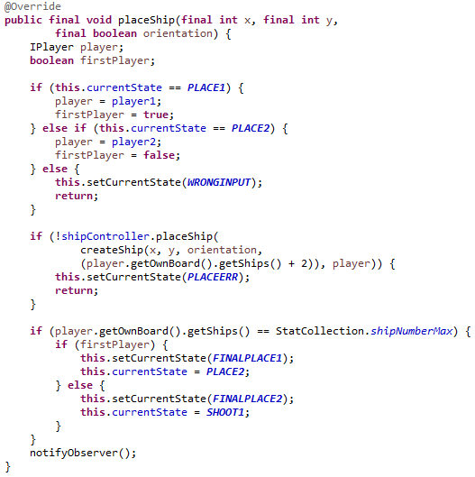
Components and Interfaces
Interface
Implemenation

Slide 13
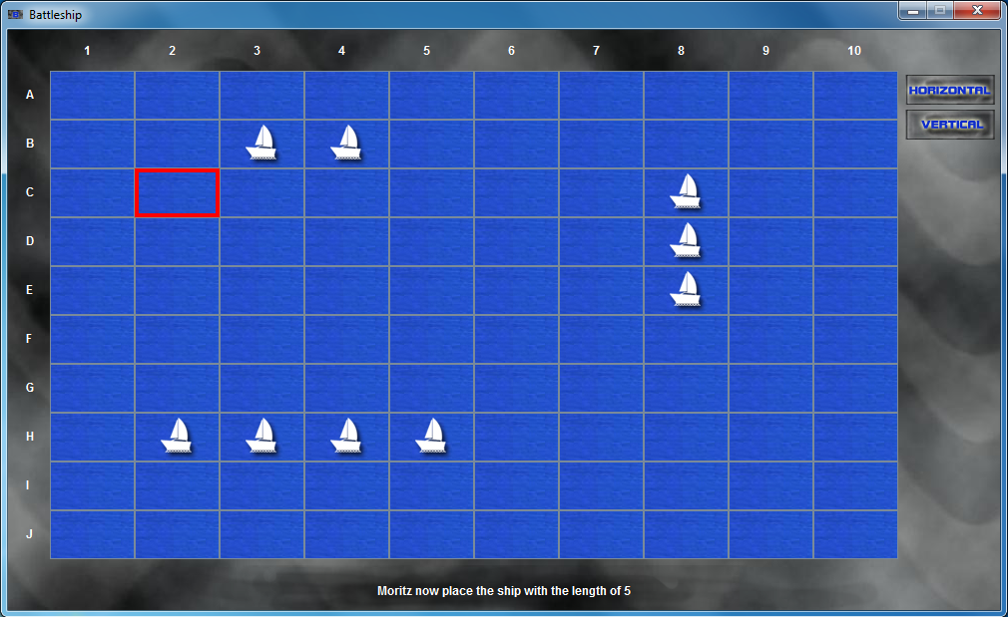
GUI Development and Licensing

Slide 14
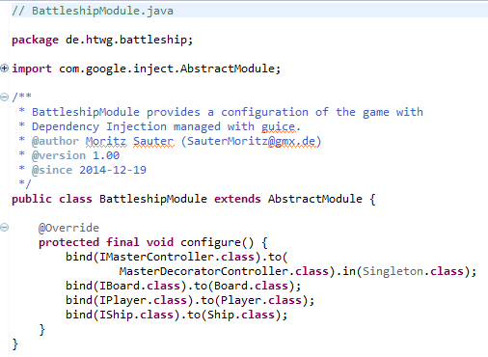
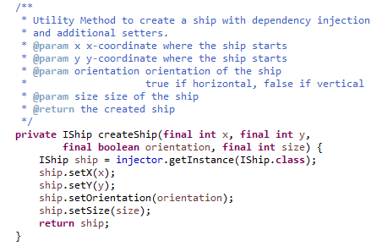
Dependency Injection
Configurationfile
Snippet of MasterController

Slide 15
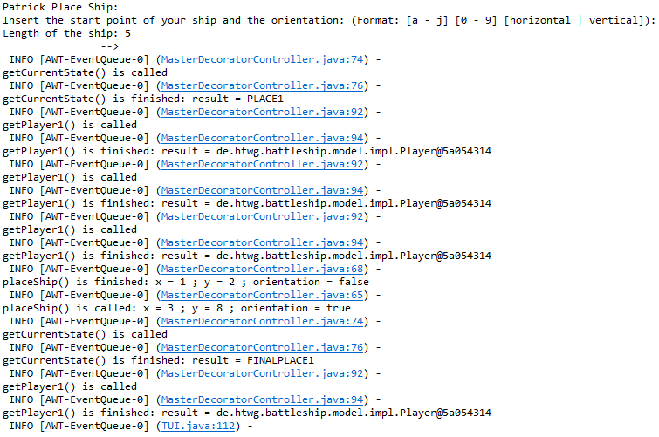
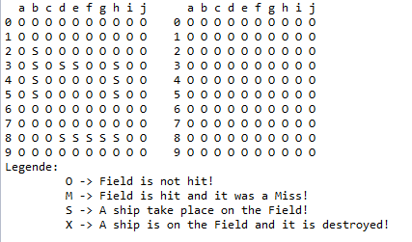
Logging

Slide 16
Demonstration

