Slide 1
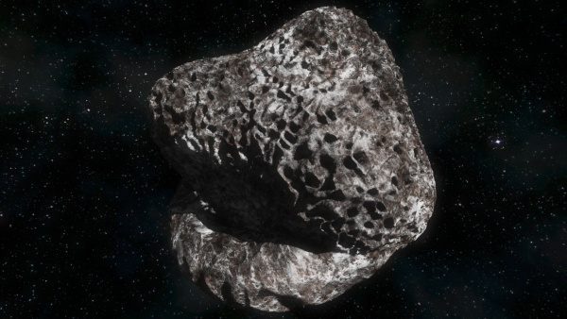
Asteroids Risk Analyzer

Slide 2
Summary
Intro to Near Earth Objects (NEO)
Challenges
Our team’s challenge
Our solution
Potential value
Q&A

Slide 3
Intro to Near Earth Objects (NEO)
Any object’s whose body can orbit in close proximity to earth and whose closest approach to the sun is less than 1.3 Astronomical Units.
If the object’s size exceeds 140 meters in diameter, they are considered as Potentially Hazardous Objects by global convention.
The majority of Potentially Hazardous Objects are asteroids and a small fraction of them are comets.

Slide 4
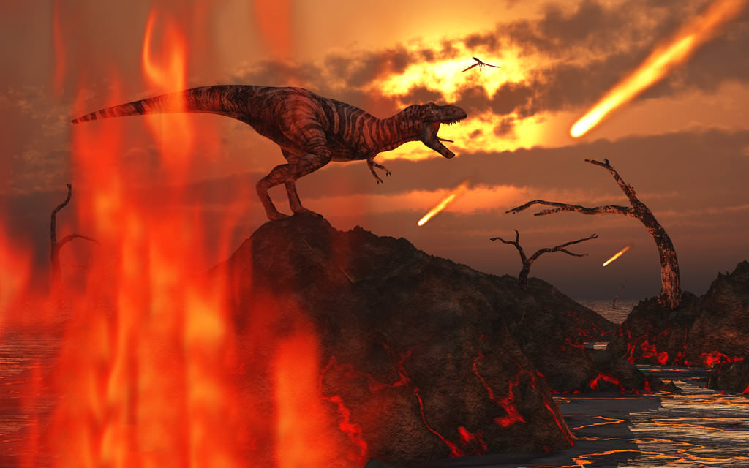

Slide 5

Challenges
Requirement of constant monitoring and tracking of all NEOs.
Lack of technology required to mitigate Hazardous objects especially if they are large.
Public opinion is viewed as skeptical about space related research and investments due to a common belief that such investments are “Burning money in the air” around the world; also, the lack of reliable and credible media coverage since media channels use everything related to space to get more subscriptions without offering any useful information and social media made it worse.

Slide 6
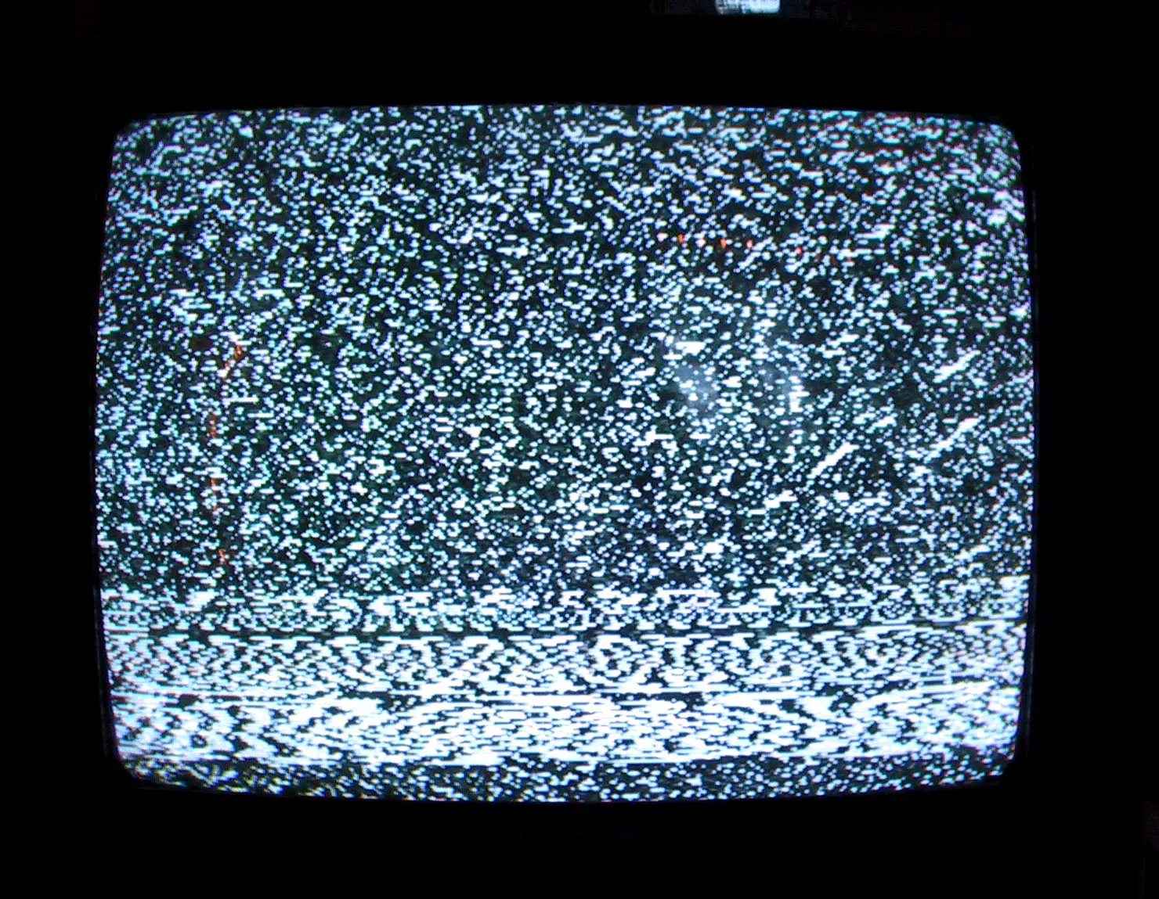
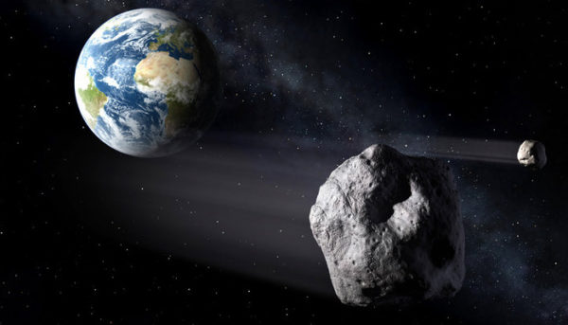
Our Team’s Challenge
Transforming data into information that is comprehensible to the public and educates on the importance of investing in Near Earth Objects detection and planetary defense mechanisms.

Slide 7
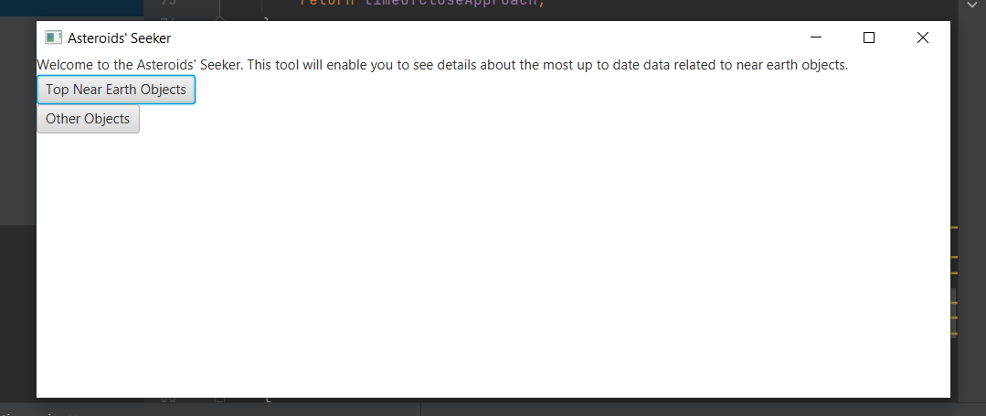
Our Solution
A tool that uses trusted sources to fetch the data, and transform it into a useful information about the object and the implications/impact of said object in case of a collision.
The tool uses the existing data from NASA but puts it in more understandable format.

Slide 8
Our Solution
Our solution will also calculate the potential damage caused by the asteroid if it reaches the earth.
Kinetic energy calculated based on the data.
Potential spread damage radius.
Severity based on past asteroid collision events.
Recommendations in case of collision based on the calculations.
Our solution will also calculate how much the PHO needs to deviate from it’s present course in order to no longer qualify as a PHO.

Slide 9
Potential Value
Makes information more accessible to the public and easier to understand.
Useful for both researchers and non-researchers to filter data quickly and get meaningful and credible information depending on the parameters.
Engaging the interest of the public opinion in the value of studying asteroids and also mining them on a larger scale.

Slide 10
Q&A
Questions?

