Slide 1
Strings and Sequences in Z3
Nikolaj Bjørner
Microsoft Research

Slide 2
Outline
Origins of String solving in Z3
Strings as Sequences
String Solving Architecture and Approach
Extensions

Slide 3
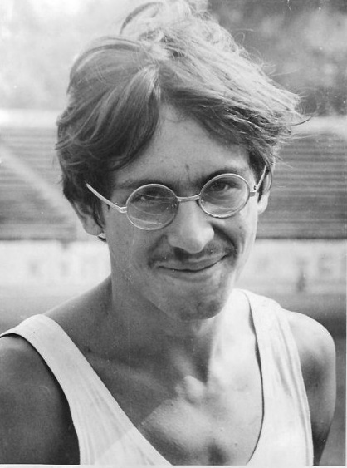


Strings and Symbolic Execution
Let’s encode string library functions as constraints over sequences with length bounds
Solve for the length bounds
Given a solution for lengths, instantiate strings by character variables
Reduces problem to reasoning about arrays
[TACAS 2009]
I can use this in Pex for .Net symbolic execution.
Let’s propose an SMT-LIB theory of generalized strings and send it to SMT workshop 2012.

Slide 4
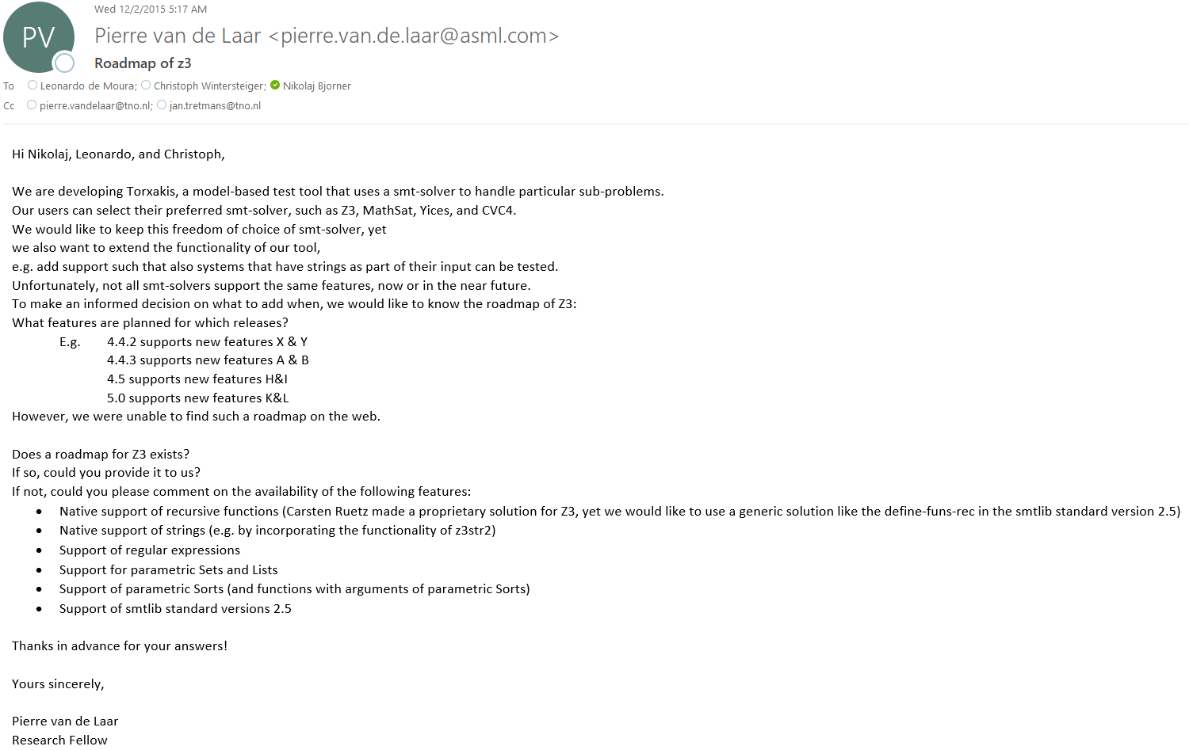


?????

Slide 5


Quality time with strings in Z3: Christmas 2015 Thanksgiving 2018

Slide 6
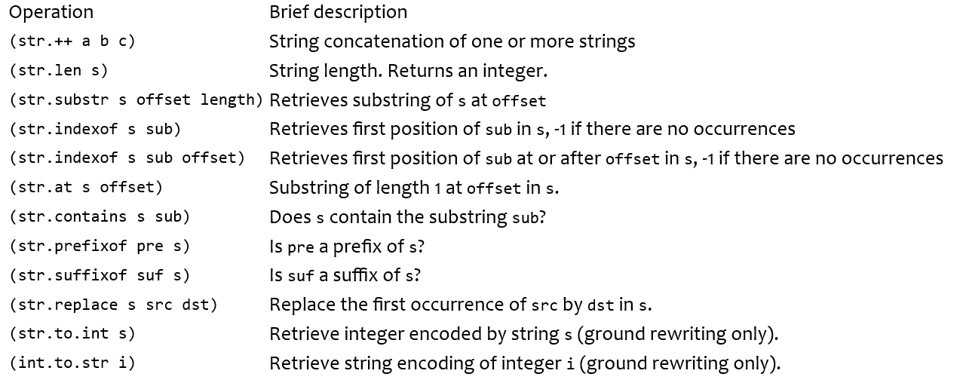
Strings

Slide 7
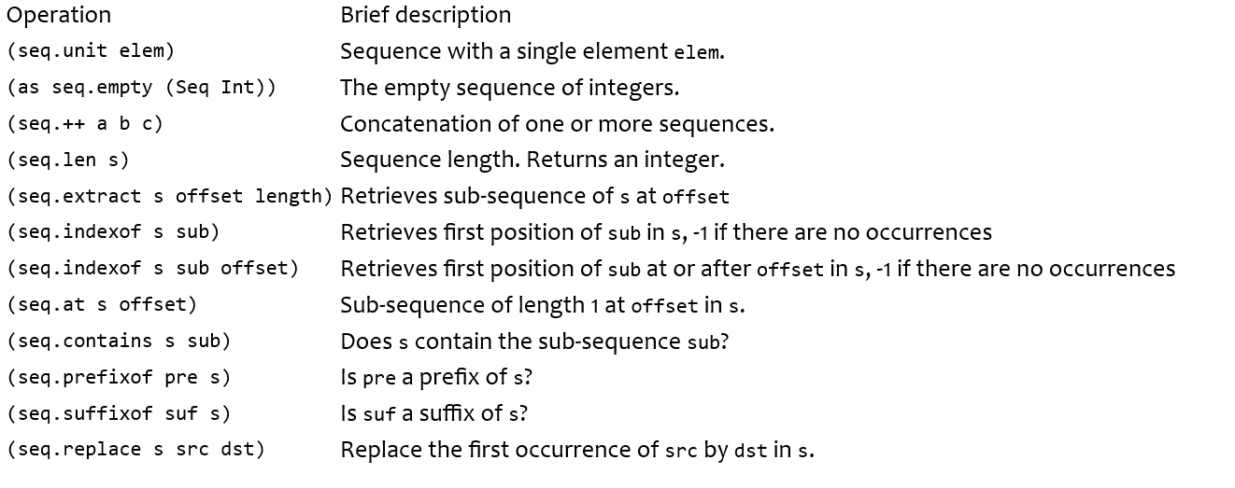
Strings as sequences

Slide 8
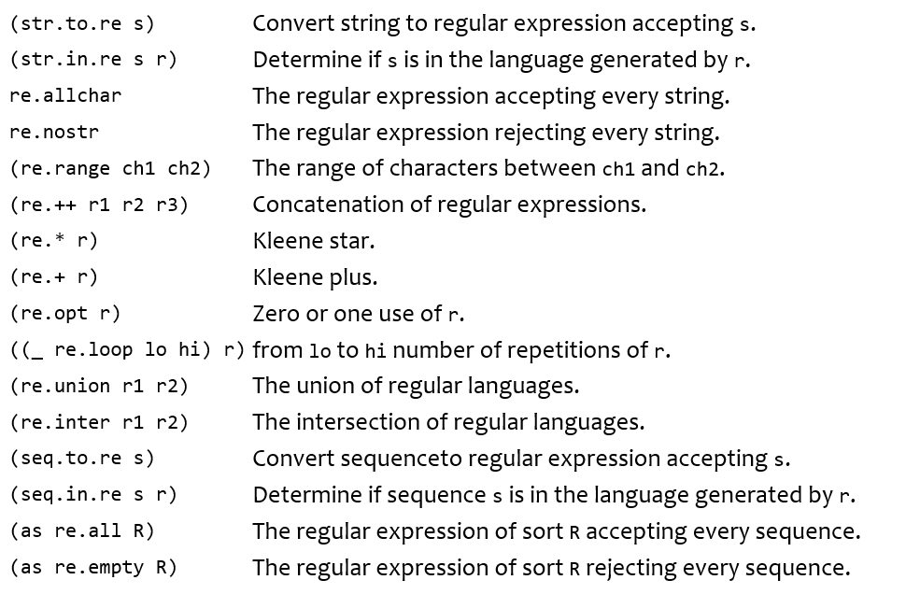
Regular Expressions

Slide 9
String Solving Architecture
SMT-LIB
API
Seq Terms
Rewriting
Equation Solving
Symbolic Automata
MySolver
TheorySeq
z3Str3
CDCL(T)

Slide 10

Reductions
prefix$\left(s,t\right)≔sx≃t$
suffix$\left(s,t\right)≔xs≃t$
$¬$ prefix$\left(s,t\right)≔\left|s\right|>\left|t\right|∨s≃xay∧t≃xbz∧a≠b$
Indexof$\left(s,t, offs\right) :$
…
Use Skolem functions to create fresh variable:
prefix$\left(s,t\right)≔s.{sk}_{prefix}(s,t)≃t$

Slide 11
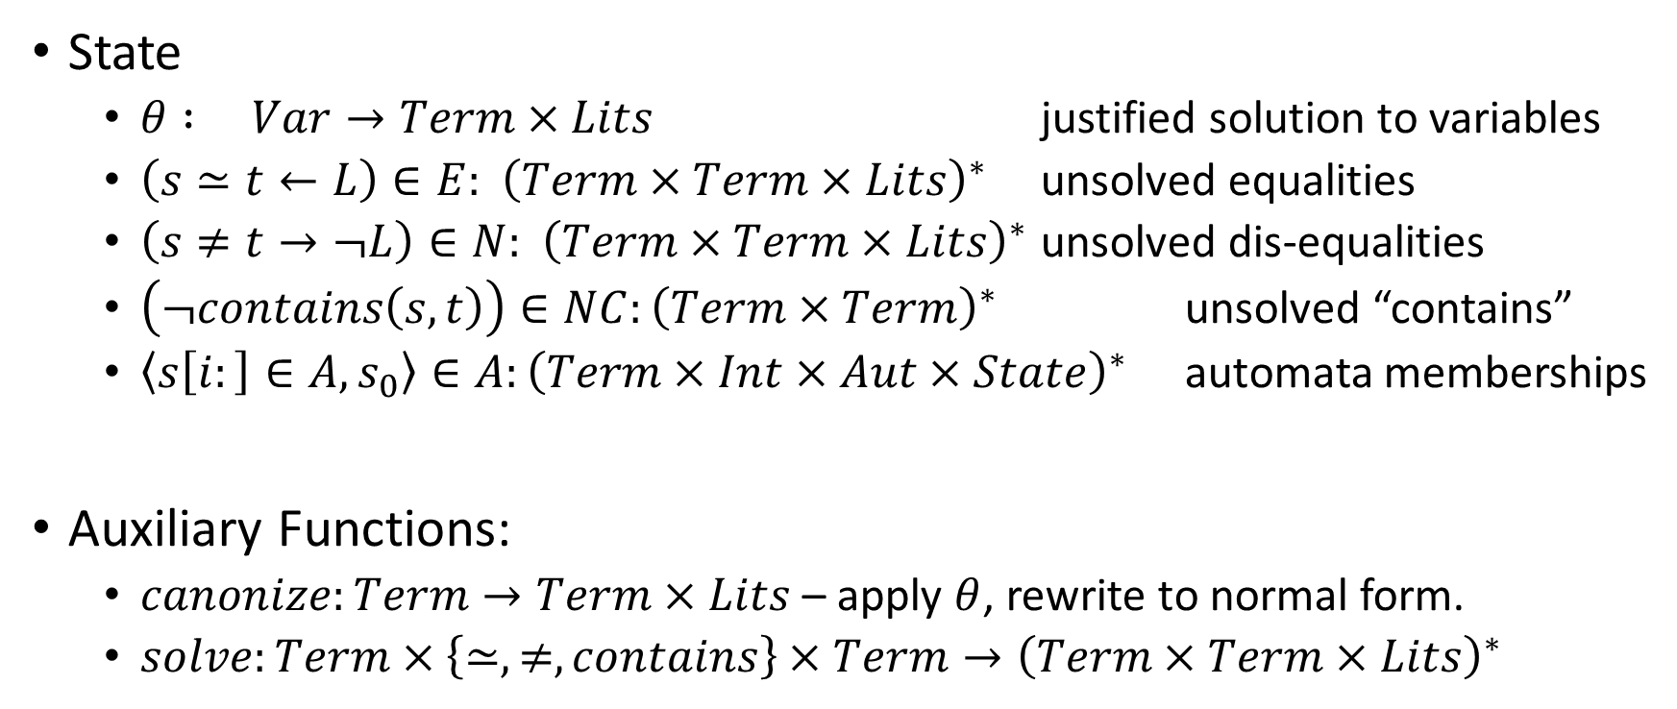
A Canonizing Solver
State
$θ : Var→Term×Lits$ justified solution to variables
$\left(s≃t←L\right)∈E:{ \left(Term×Term×Lits\right)}^{∗}$ unsolved equalities
$\left(s≠t→¬L\right)∈N:{ \left(Term×Term×Lits\right)}^{∗}$ unsolved dis-equalities
$\left(¬contains\left(s,t\right)\right)∈NC:{\left(Term×Term\right)}^{∗}$ unsolved “contains”
$\left\langle s\left[i:\right]∈A,s_{0}\right\rangle ∈A:{\left(Term×Int×Aut×State\right)}^{∗}$ automata memberships
Auxiliary Functions:
$canonize:Term→Term×Lits$– apply $θ$, rewrite to normal form.
$solve:Term×\left\{≃,≠, contains\right\}×Term→{\left(Term×Term×Lits\right)}^{∗}$

Slide 12
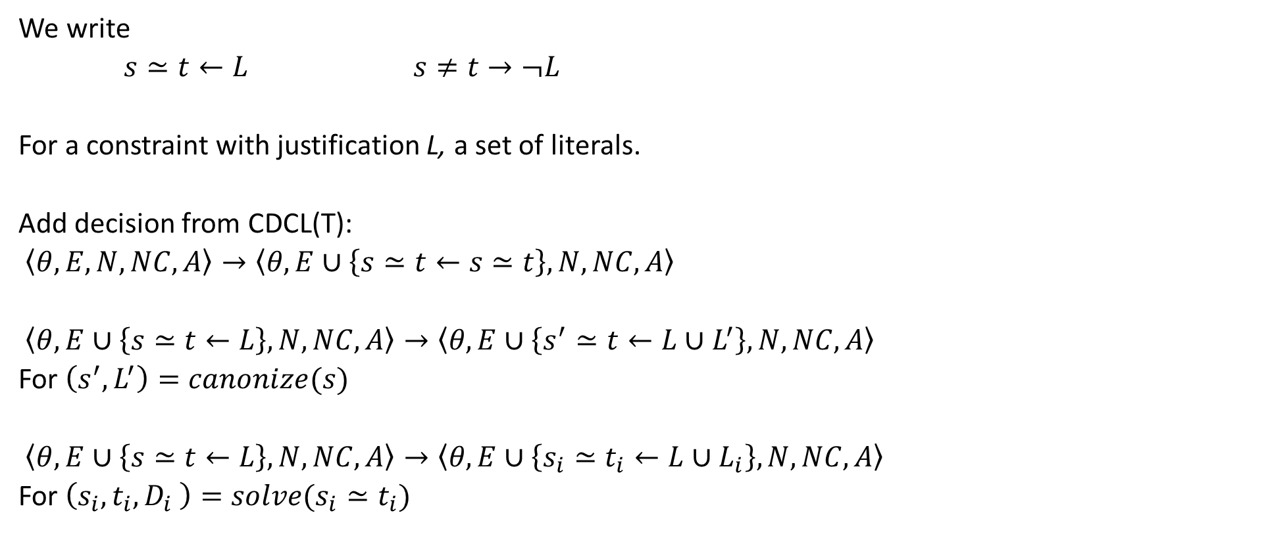
State Machine
We write
$s≃t←L$ $s≠t→¬L$
For a constraint with justification L, a set of literals.
Add decision from CDCL(T):
$\left\langle θ, E, N, NC,A\right\rangle →\left\langle θ, E∪\left\{s≃t←s≃t\right\}, N, NC,A\right\rangle$
$\left\langle θ, E∪\left\{s≃t←L\right\}, N, NC,A\right\rangle →\left\langle θ, E∪\left\{s^{′}≃t←L∪L^{′}\right\}, N, NC,A\right\rangle$
For $\left(s^{′},L^{′}\right)=canonize(s)$
$\left\langle θ, E∪\left\{s≃t←L\right\}, N, NC,A\right\rangle →\left\langle θ, E∪\left\{s_{i}≃t_{i}←L∪L_{i}\right\}, N, NC,A\right\rangle$
For $\left(s_{i},t_{i},D_{i} \right)=solve(s_{i}≃t_{i})$

Slide 13
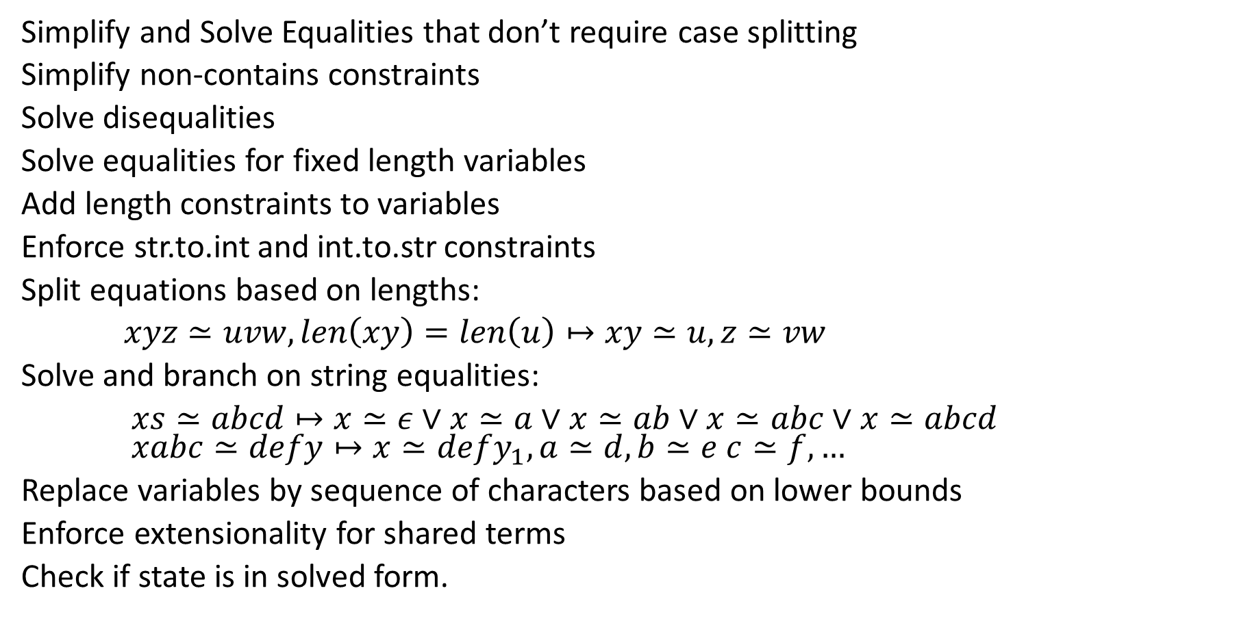
Cascading Solvers
Simplify and Solve Equalities that don’t require case splitting
Simplify non-contains constraints
Solve disequalities
Solve equalities for fixed length variables
Add length constraints to variables
Enforce str.to.int and int.to.str constraints
Split equations based on lengths:
$xyz≃uvw, len\left(xy\right)=len\left(u\right)↦xy≃u, z≃vw$
Solve and branch on string equalities:
$xs≃abcd↦x≃ε∨x≃a∨x≃ab∨x≃abc∨x≃abcd$ $xabc≃defy↦x≃defy_{1}, a≃d, b≃e c≃f,…$
Replace variables by sequence of characters based on lower bounds
Enforce extensionality for shared terms
Check if state is in solved form.

Slide 14
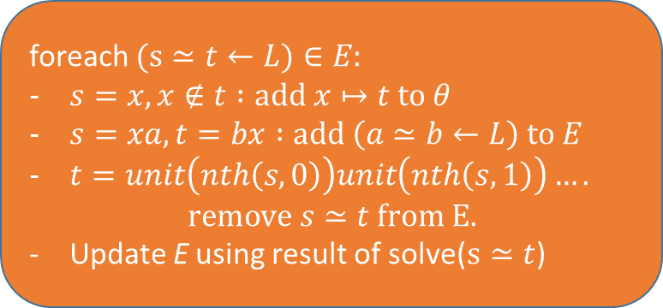
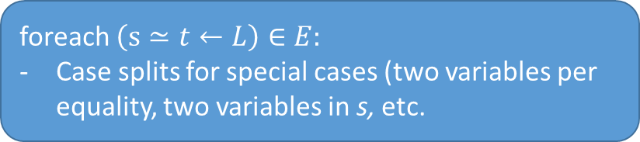
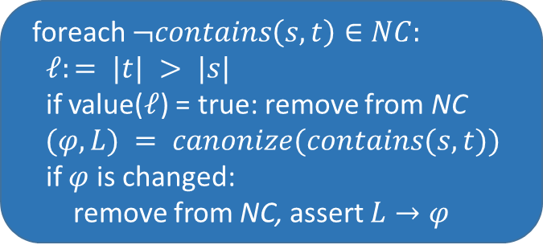
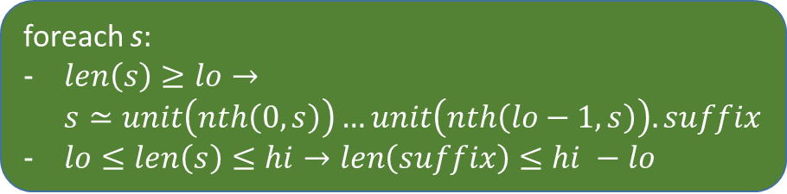
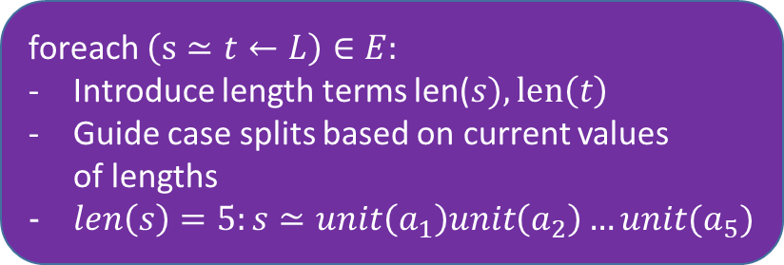
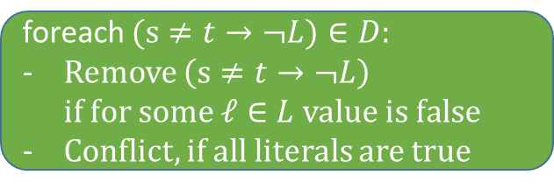
foreach $(s≃t←L)∈E:$
$s=x, x∉t :add x↦t to θ$
$s=xa, t=bx :add \left(a≃b←L\right) to E$
$t=unit\left(nth\left(s,0\right)\right)unit\left(nth\left(s,1\right)\right)….$ $remove s≃t from E.$
Update E using result of solve($s≃t$)
foreach s$:$
$len\left(s\right)≥lo→$ $s≃unit\left(nth\left(0,s\right)\right)…unit\left(nth\left(lo−1,s\right)\right).suffix$
$lo≤len\left(s\right)≤hi→len\left(suffix\right)≤hi −lo$
foreach $(s≠t→¬L)∈D:$
Remove $\left(s≠t→¬L\right)$ if for some $ℓ∈L value is false$
Conflict, if all literals are true
foreach $\left(s≃t←L\right)∈E:$
Case splits for special cases (two variables per equality, two variables in s, etc.
foreach $¬contains\left(s,t\right)∈NC:$
$ℓ:= |t| > |s|$
if value($ℓ$) = true: remove from NC
$(φ,L) = canonize(contains(s, t))$
if $φ$ is changed:
remove from NC, assert $L→φ$
foreach $\left(s≃t←L\right)∈E:$
Introduce length terms len($s), len\left(t\right)$
Guide case splits based on current values of lengths
$len\left(s\right)=5:s≃unit\left(a_{1}\right)unit\left(a_{2}\right)…unit(a_{5})$

Slide 15
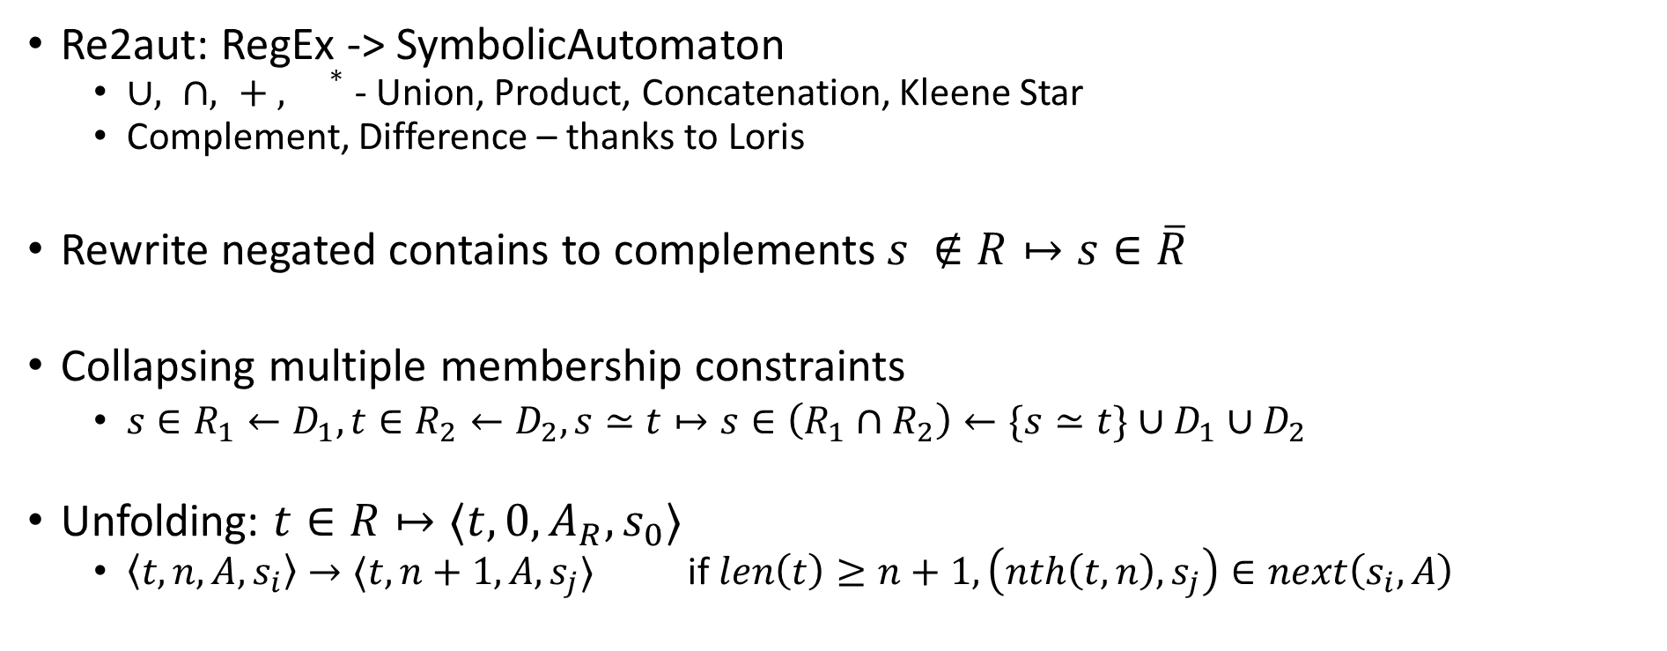
Regular expressions as symbolic automata
Re2aut: RegEx -> SymbolicAutomaton
$∪, ∩, + , {}^{∗}$- Union, Product, Concatenation, Kleene Star
Complement, Difference – thanks to Loris
Rewrite negated contains to complements$s ∉R↦s∈\overline{R}$
Collapsing multiple membership constraints
$s∈R_{1}←D_{1},t∈R_{2}←D_{2},s≃t↦s∈\left(R_{1}∩R_{2}\right)←\{s≃t\}∪D_{1}∪D_{2}$
Unfolding: $t∈R↦⟨t,0,A_{R}, s_{0}⟩$
$\left\langle t,n,A, s_{i}\right\rangle →⟨t,n+1,A,s_{j}⟩$ if $len\left(t\right)≥n+1, \left(nth\left(t,n\right), s_{j}\right)∈next\left(s_{i}, A\right)$

Slide 16
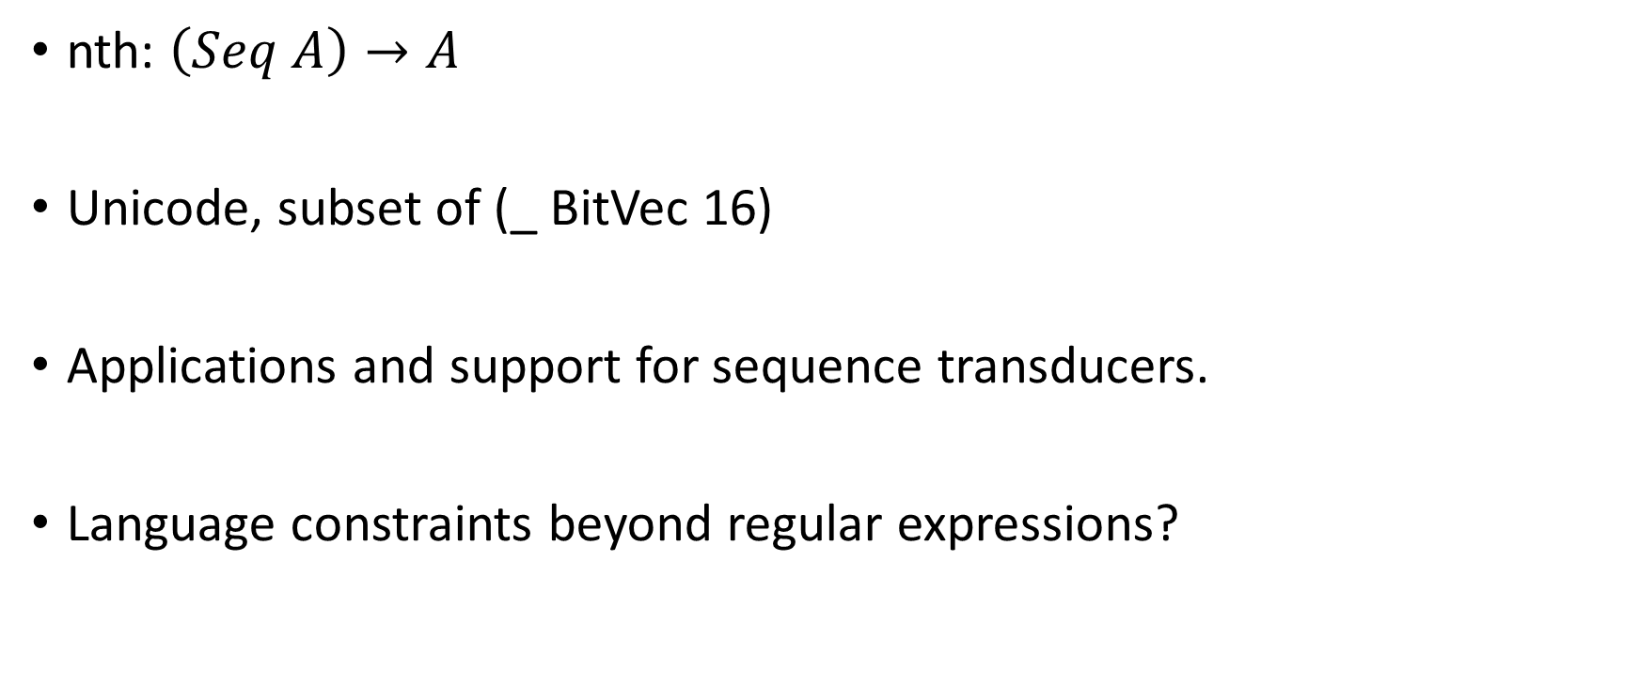
Extensions
nth: $\left(Seq A\right)→A$
Unicode, subset of (_ BitVec 16)
Applications and support for sequence transducers.
Language constraints beyond regular expressions?

