Slide 1
OTHER FOCUS
MC Notes story pack
A first presentation cut built from the dashboard data, centered on OTHER notes.
DOCUMENTS
OPINION ROWS
DOCS WITH OPINIONS
CLASSIFIED MC TYPE
BO DATE RANGE
2,594
3,540
1,160
2,576
2022-12-19
Template Type = OTHER
Across service columns
44.7% of OTHER
99.3% of OTHER
to 2026-05-19
Storyline
1. Service opinions are concentrated in a handful of services, but length patterns differ. 2. Monthly page load is mostly driven by annexes, so page composition matters more than total pages alone. 3. Decision notes dominate OTHER volume; opinion coverage is much lower for Info and Discussion notes. 4. The deck uses BO validation dates for all time series.
Source: Data Analysis/dashboard_data.json | Timeline: BO validation date

Slide 2
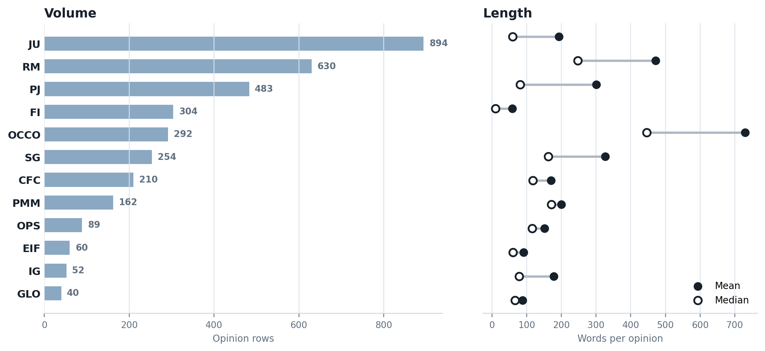
OTHER FOCUS
Service Volume and Length
JU is the highest-volume service with 894 opinion rows. The right-hand markers separate volume from length, so services with fewer opinions but longer text still stand out.
Source: Data Analysis/dashboard_data.json | Timeline: BO validation date

Slide 3
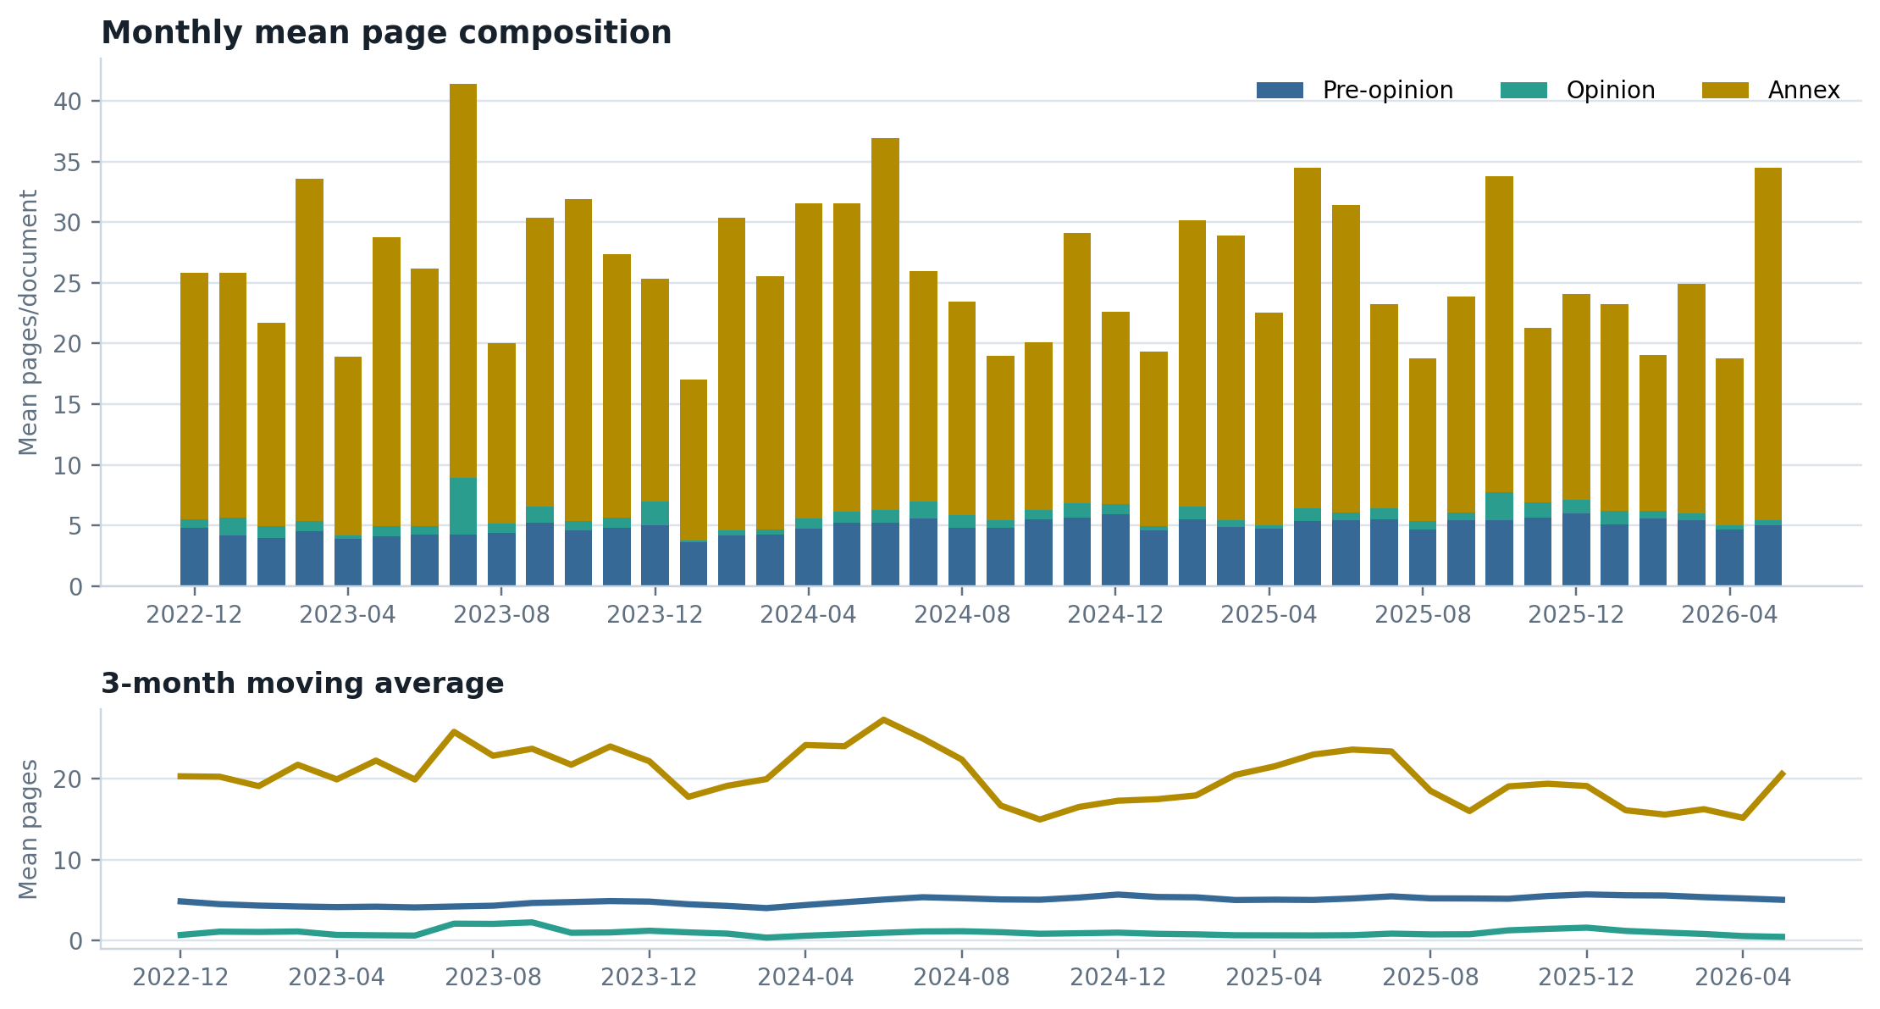
OTHER FOCUS
Monthly Page Composition
OTHER averages 27.0 total pages per document, with annexes averaging 21.0 pages. The monthly view shows whether document growth is coming from pre-opinion text, opinions, or annex load.
Source: Data Analysis/dashboard_data.json | Timeline: BO validation date

Slide 4
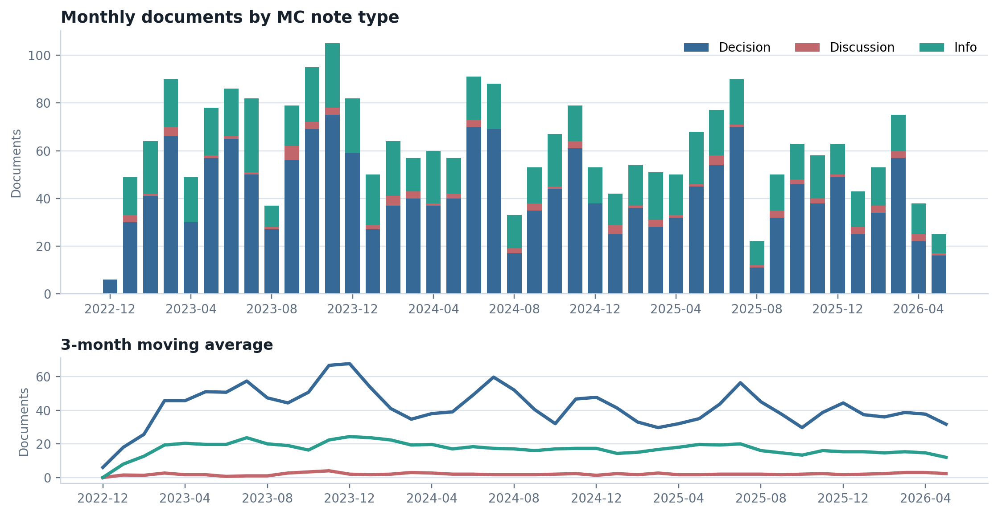
OTHER FOCUS
Monthly Documents By MC Note Type
Decision notes are the dominant classified OTHER note type (1,766 documents). The moving-average lines make changes in the smaller types easier to see.
Source: Data Analysis/dashboard_data.json | Timeline: BO validation date

Slide 5
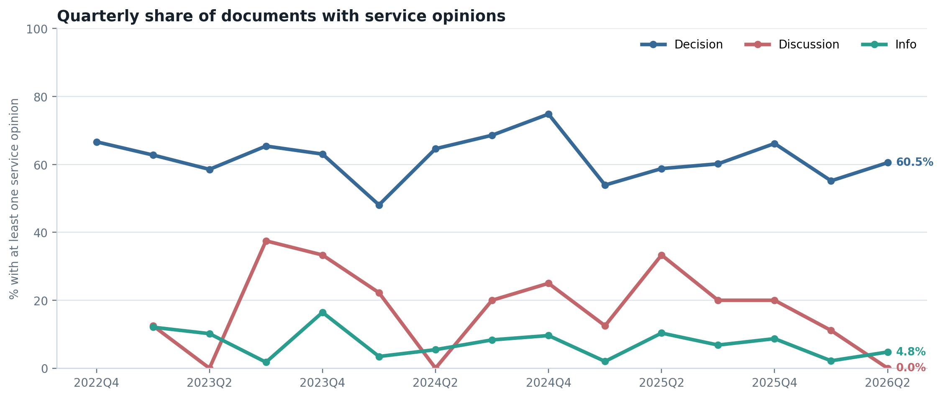
OTHER FOCUS
Quarterly Opinion Coverage
Opinion coverage differs sharply by type: Decision is 62.1%, while Info is 7.7%. This slide frames coverage as a rate, not a raw count.
Source: Data Analysis/dashboard_data.json | Timeline: BO validation date

Slide 6
OTHER FOCUS
MC Note Type Detail
Type | Docs | Opinion docs | Opinion share | Median pages | Pre-op | Opinion | Annex | BO date range
Decision | 1,766 | 1,097 | 62.1% | 17.0 | 5.7 | 1.4 | 24.4 | 2022-12-19 to 2026-05-17
Discussion | 85 | 16 | 18.8% | 23.0 | 4.5 | 0.6 | 29.0 | 2023-01-11 to 2026-05-07
Info | 725 | 56 | 7.7% | 12.0 | 3.1 | 0.0 | 12.4 | 2023-01-03 to 2026-05-19
Decision has the highest opinion coverage at 62.1%, while Info has the lowest at 7.7%. That makes note type a useful first lens for explaining where service opinions appear in OTHER.
Source: Data Analysis/dashboard_data.json | Timeline: BO validation date

