Slide 1
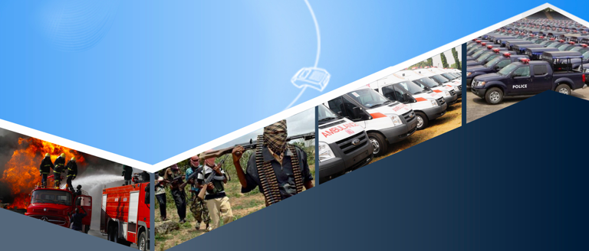
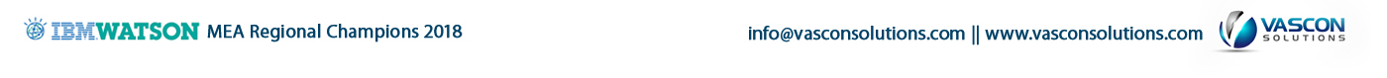
MEL - AI Powered Emergency Response System
MEL - AI Powered Emergency Response System

Slide 2
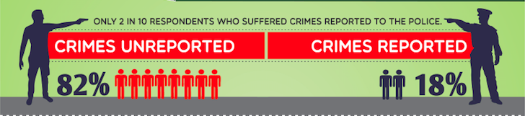
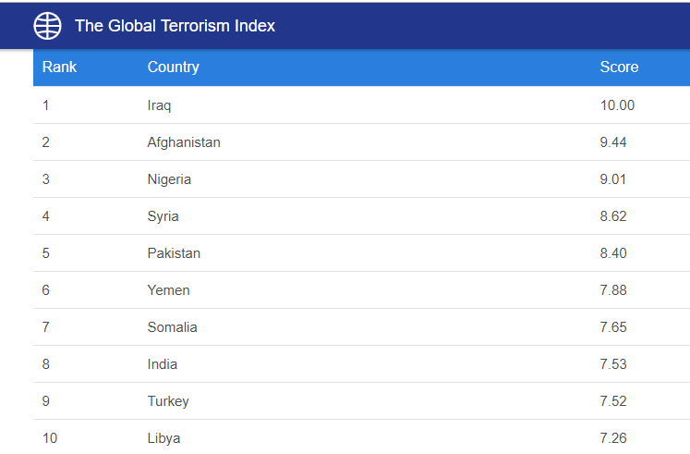
Sub-Saharan Africa particularly Nigeria is faced with emergency response & security challenges
Over 33,303 general hospitals, 20,278 PHCs, and 59 federal medical centers¹ there is no way of reporting and responding to medical emergencies in an integrated way” ¹https://www.ncbi.nlm.nih.gov/pmc/articles/PMC3249694/

Slide 3
Challenges

Slide 4
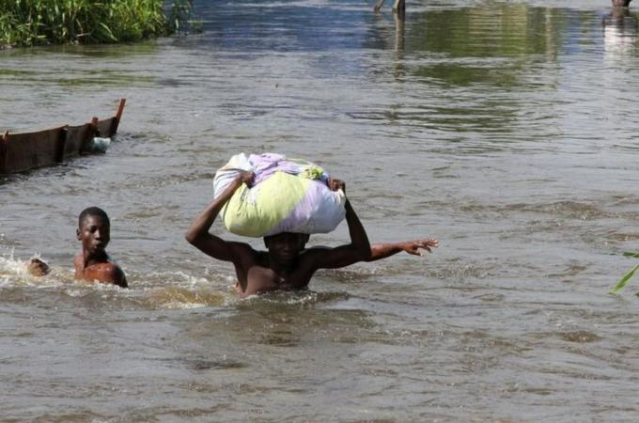
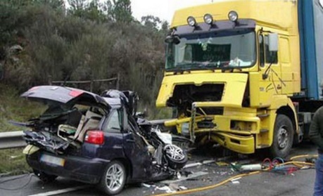
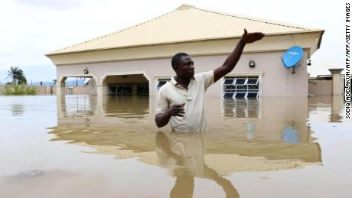
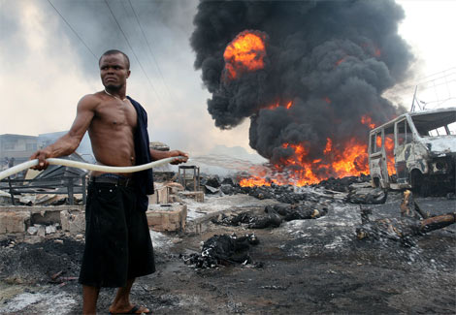
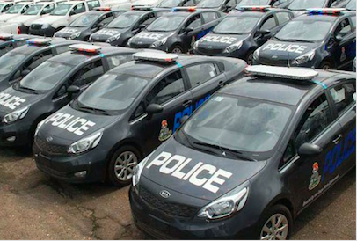
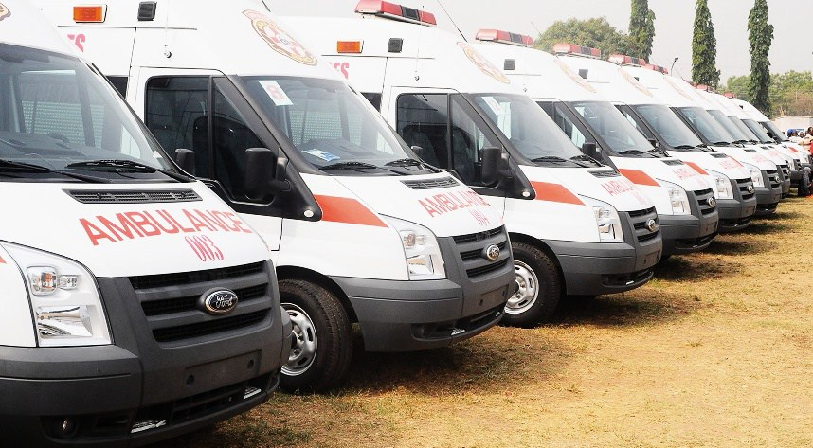

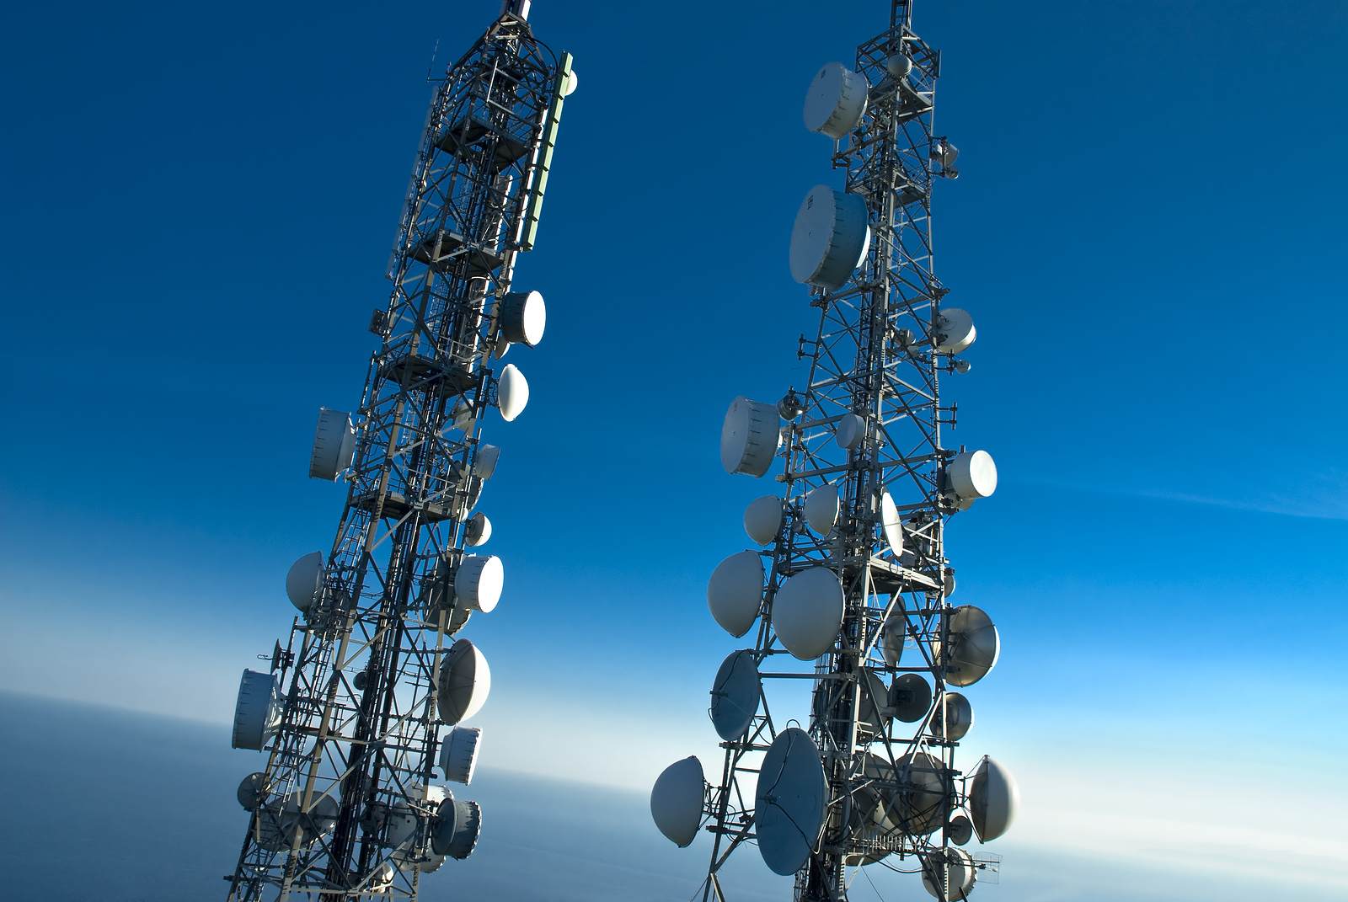
Inability to quickly report/respond to incidences
Poor disaster management planning and information dissemination.
Inadequate corporation between relevant stakeholders
like Police,
Ambulance Services,
Insurance
and Telecoms Companies

Slide 5
Implications

Slide 6
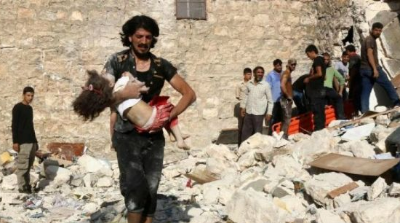
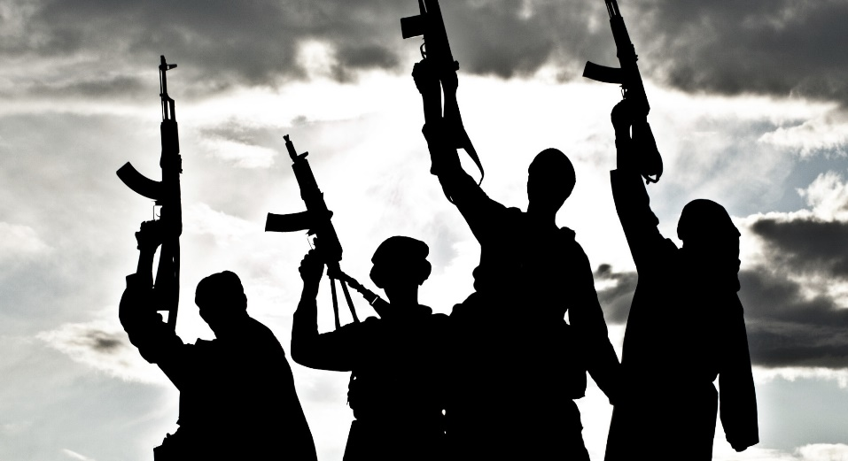
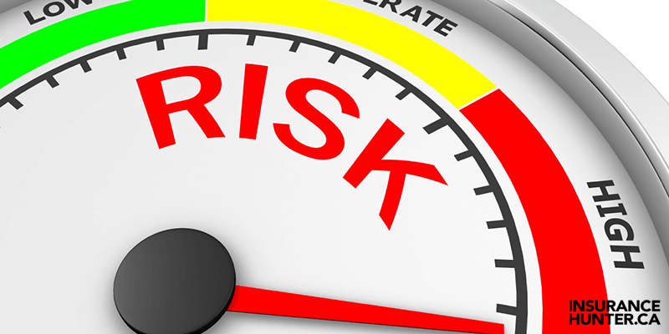
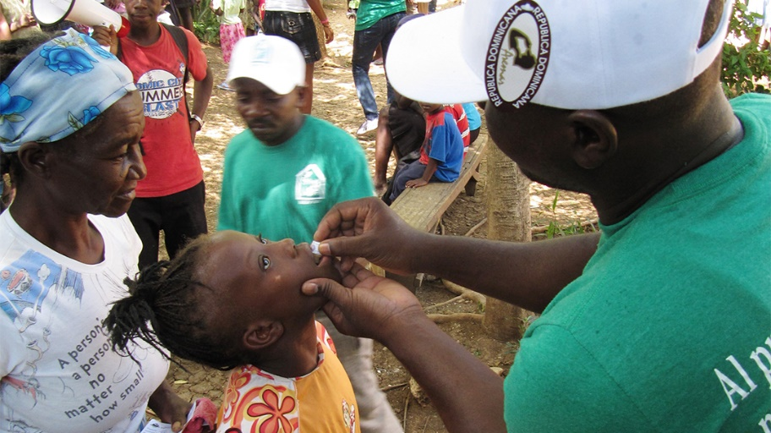
INCREASE IN LOSS OF LIVES
INCREASING LEVELS OF TERRORISM, KIDNAPPING, ROBBERIES
INAPPROPRIATE PLANNING DATA AND SPREAD OF EPIDEMIC
LOW INVESTOR CONFIDENCE

Slide 7





MEL
<aMELiore>
French word for
<IMPROVE>
A next gen cognitive emergency reporting,
response and notification system with
support for Video/Messaging/Voice
IBM Assistant
speech-to-text
Technology based on Geo Location and
IBM services like Assistant, Speech-to-Text, Text to Speech, Cloud Object Storage, Visual Recognition, Kubernetes Services on IBM Cloud, etc.
text-to-speech
Kubernetes Services on IBM Cloud
Visual Recognition

Slide 8
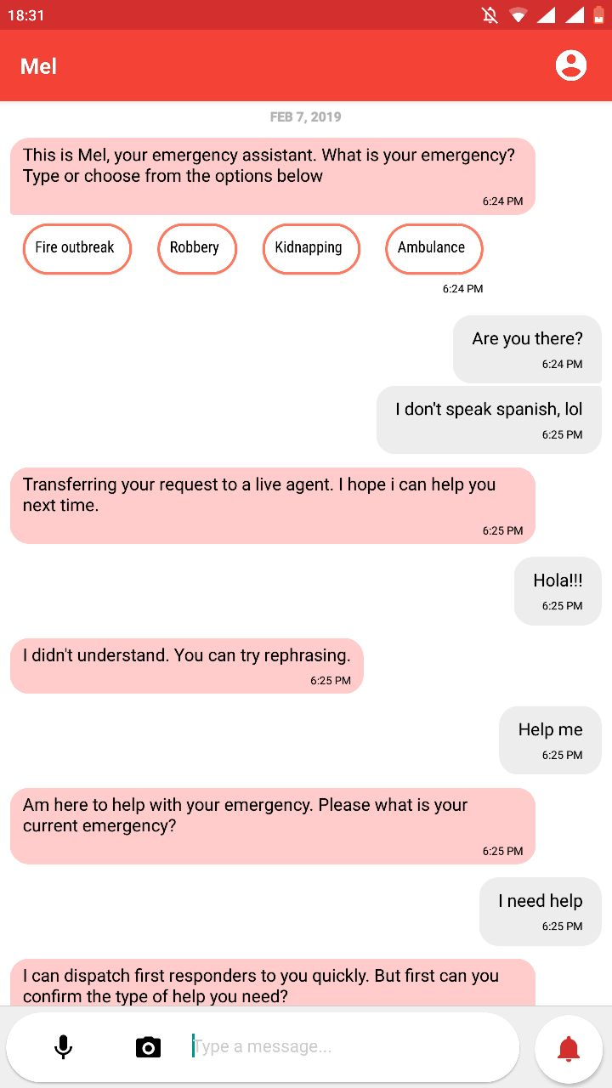
1.) Think about the effect of having a working multi channel emergency system with support for audio clips, videos, images and messaging
3.) Highlight if multiple emergencies are related or quickly identify the location of the accident, no. of accident victims to tag and classify them
2.) System that is able to "Process" emergency reports intelligently before and after it gets to the dispatcher or responder
4.) Respond to thousands of citizens simultaneously and intelligently

Slide 9
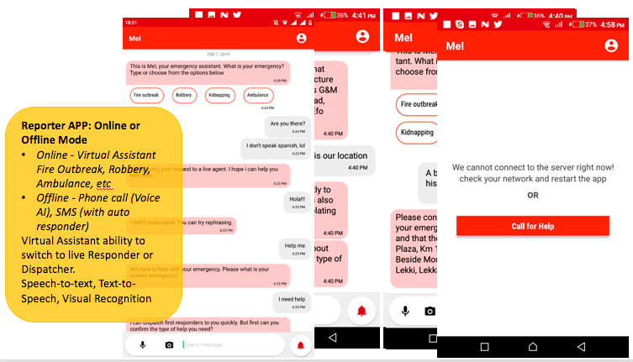

Slide 10
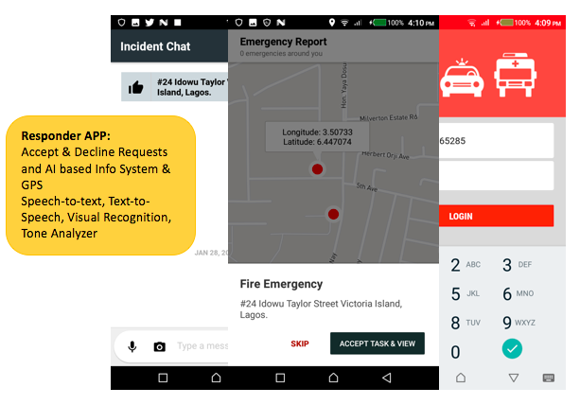

Slide 11
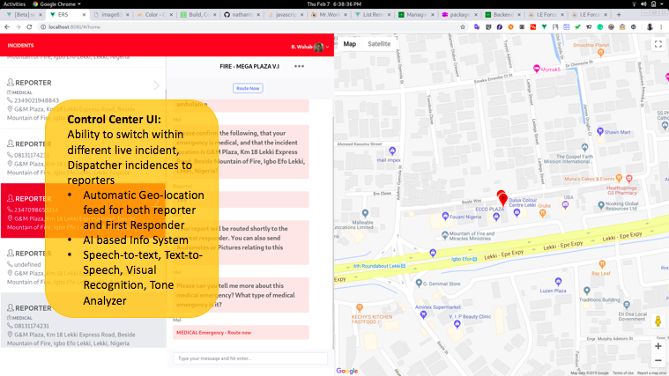

Slide 12
B
T
L
P
Better Global Rating/Standing – Increase in Investor Confidence
Predictive, Proactive disaster management
Less "preventable" deaths, preventable incidences
This will result in improved emergency response for over 180 million people in Nigeria

Slide 13
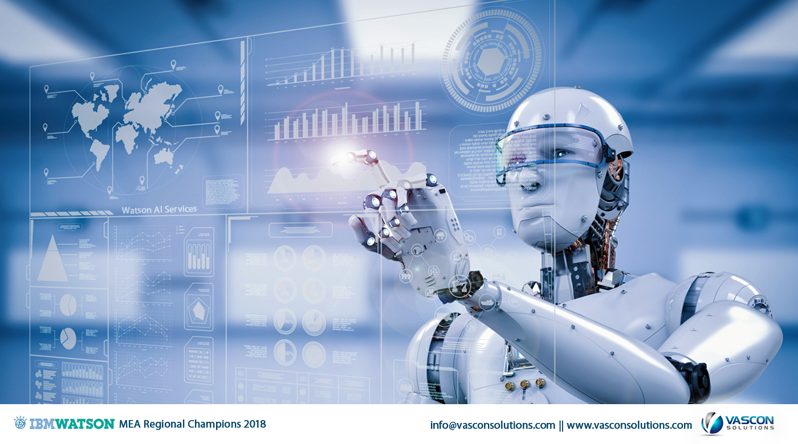
MEL
Next Generation cognitive based emergency reporting, response and notification system

Slide 14
Demo Agenda

Slide 15
Provides more contextual information to the Dispatcher and Responders when an emergency occurs, which may be crucial to the safety of the first responders.
Expands the capacity of the system to handle complaints by having the Assistant converse with callers before escalating it to a human Dispatcher.
Simpler pricing model that reduces initial setup cost and provides clearer operational cost analysis.
Distress Mode
Benefits of Mel over tradition emergency systems:

Slide 16
Assistant – AI Assistant helps gather all the information required to route the incident.
Speech-to-text / Text-to-speech
Visual Recognition - Process incident images automatically & derive context to the dispatcher UI
Cloud object storage - Store all the digital assets that is uploaded on the app, like pictures and audio.
Tone Analyzer - This will be used to analyze the tone of an incident reporter audionotes to prioritize incident.
IBM Cloud using kubernetes
What Watson services where used?

Slide 17
Do the reporters need Internet access?
Can we integrate to third party applications and wearables (APIs)?
Reporting when there is Internet connection
Reporting when there is no Internet connection
Using Distressed Mode
Questions & Demos:

Slide 18
Thank You

