Slide 1
NovaMed Solutions
Sales Performance Analysis and Reporting

Slide 2
Executive summary
NovaMed Solutions, a leading pharmaceutical distributor, has been facing challenges in optimising sales performance, managing inventory effectively, and identifying key market opportunities. Despite these challenges, the company has amassed a rich dataset of sales, profit margins, drug performance, and customer demographics that can be leveraged for strategic growth.
To address inefficiencies, an interactive Power BI Sales Performance Dashboard has been developed. This dashboard provides real-time insights into sales metrics, customer behaviours, and market trends, enabling stakeholders to make informed, data-driven decisions.
Some analyses focused on 2022 and 2026 only, while some looked at the overall year the business has been operating (2022 - 2026).

Slide 3
Business context
The company serves a wide and diverse healthcare sector, ensuring the availability of essential medications. However, operational bottlenecks have arisen due to inaccurate demand forecasting, stock management inefficiencies, and limited customer engagement insights. By integrating sales and customer data into analytical dashboards, NovaMed Solutions now has a powerful tool to optimise performance and streamline operations.

Slide 4
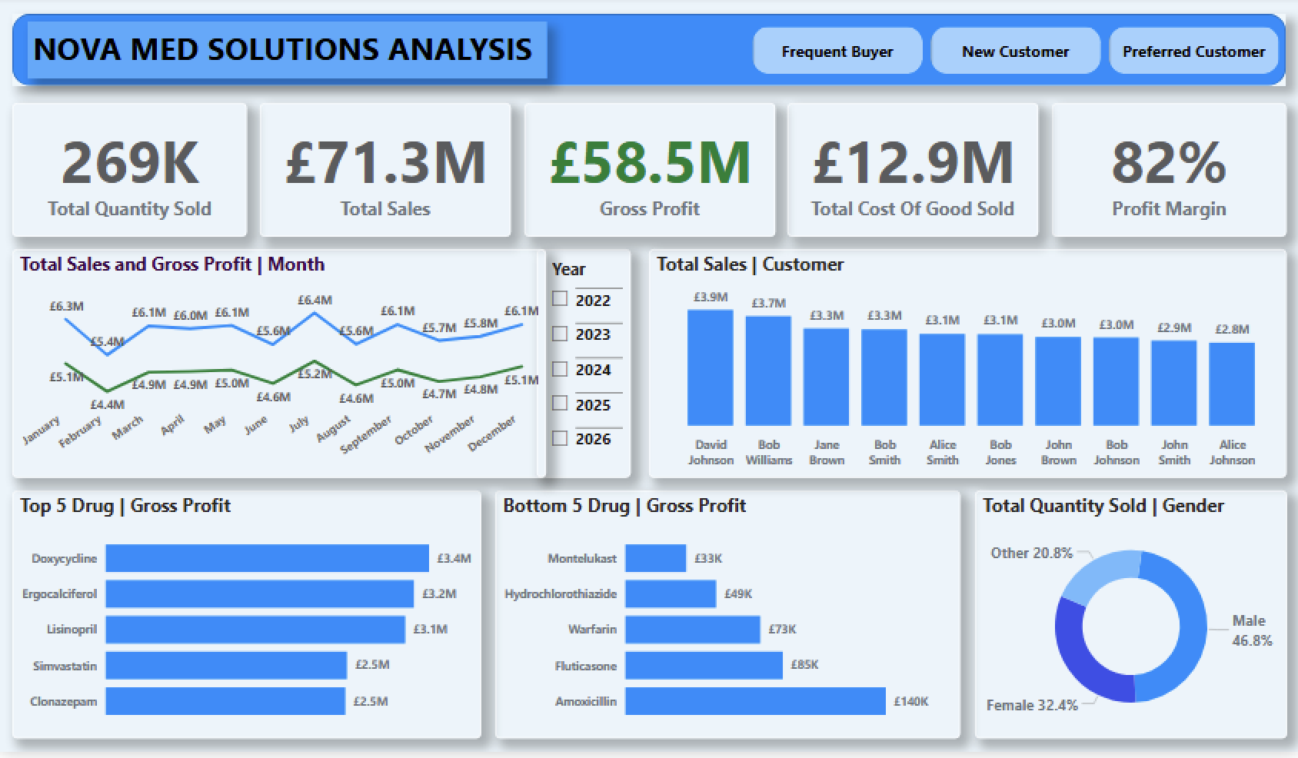
Key dashboard insights (2022 - 2026): TOP/BOTTOM

Slide 5
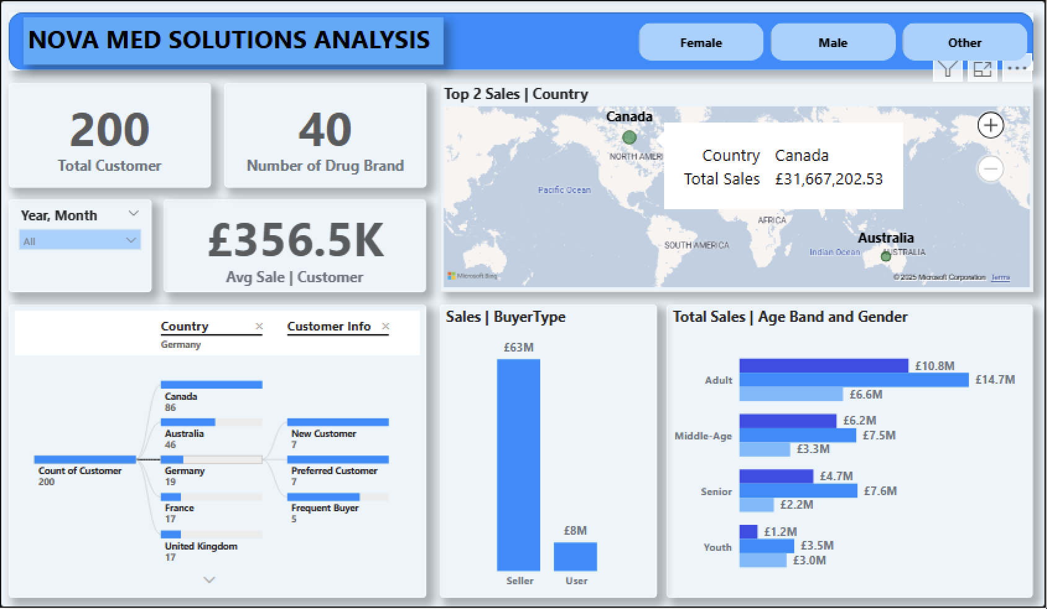
Key dashboard insights (2022 - 2026): CUSTOMER

Slide 6
Overall sales performance
2022
Total Sales: £3M
Gross Profit: £2.5M
Total COGS: £0.5M
Profit Margin: 82%
Total Quantity Sold: 11K units
2026
Total Sales: £0.4M
Gross Profit: £ 0.4M
Total Cost Of Goods Sold: £0.1M
Profit Margin: 87 %
Total Quantity Sold: 1387K units
BASED ON THESE ANALYSIS RESULTS, WE CAN SEE THAT NOVAMED SOLUTIONS HAS A SIGNIFICANT MARGIN IN THEIR TOTAL SALES, GROSS PROFIT, TOTAL COST OF GOODS SOLD, AND A SUBSTANTIAL REDUCTION IN THE TOTAL QUANTITY SOLD, EVEN THOUGH THE PROFIT MARGIN REMAINS CONSISTENT OVER THE YEARS. THIS COULD BE DUE TO MANY FACTORS; FOR EXAMPLE, IN 2022, ERGOCALCIFEROL HAD A GROSS PROFIT OF £2.5M, BUT IN 2026, IT WAS £0.4M, WHICH IS A VERY LOW FIGURE. DESPITE THIS, THE PROFIT MARGIN REMAINED LARGELY UNAFFECTED.
SALES VOLUME & GROSS PROFIT DROPPED SHARPLY IN 2026, BUT MARGINS IMPROVED.

Slide 7
MONTHLY TRENDS
In 2022 the highest months were April(£0.32M),July(£0.29M) and September(£0.35M);
In 2026 the three highest months were January(£0.22M),July(£0.05M) and most of the other months less than £0.03;
With the above results, we can see a significant drop in the goods sold in a month, which could be a result of low sales, changes in the type of medications people buy, for example, it can be that people are buying medications with small price tags.

Slide 8
CUSTOMER ANALYSIS
Total Customers: 200, Average Sale per Customer: FLUCTUATES WITH 2022 HAVING £17.6K AND 2026, £12.1K.
2022 Top customers – Bob Johnson, David Johnson, Jane Brown (~£0.23–0.24M)
2026 Top customers – David Johnson (£50K), David Brown (£47K), Jane Brown (£45K)
SHOWS Strong loyalty, but sales per customer fell sharply in 2026.

Slide 9
Product Performance: top 5 drugs
In 2022: Ergocalciferol (£0.25M), Insulin Glargine (£0.19M), Lisinopril (£0.18M), Levothyroxine (£0.14M), Budesonide (£0.11M)
in 2026: Ergocalciferol (£71K), Aspirin (£48K), Simvastatin (£46K), Lisinopril (£44K), Fentanyl (£39K)
Ergocalciferol remains the top performer in both periods, showing consistent demand. Insulin Glargine dropped out of the top 5, replaced by Aspirin, Simvastatin, and Fentanyl in the latest period—indicating a shift in therapeutic demand. Lisinopril maintained strong performance across both dashboards.

Slide 10
Product Performance: bottom 5 drugs
In 2022: Montelukast (£1.4K), Hydrochlorothiazide (£2.0K), Fluticasone (£3.9K), Warfarin (£4.1K), Prednisone (£7.5K)
in 2026: Fluticasone (£13.82), Montelukast (£30.59), Amoxicillin (£112), Metformin (£144), Pregabalin (£586)
Fluticasone and Montelukast remain low-profit drugs across 2022 and 2026, consistently weak performers. Prednisone & Warfarin (bottom drugs earlier) are no longer in the bottom list, meaning their profitability improved or sales stabilised. New weak performers (Amoxicillin, Metformin, Pregabalin) suggest changing prescribing patterns or competitive pricing pressures.

Slide 11
Demographic insights
In 2022: Male 42.8%, Female 37.9%, Other 19.3%
In 2026: Male 63%, Female 16%, Other 21%
Shift towards male consumers (42.8% → 63%). Female share dropped sharply (37.9% → 16%). "Other" remained relatively stable. Suggests a change in prescription focus (possibly more male-prevalent conditions being treated).
Adults remain the highest spending age group, but total sales fell from £0.58M to £0.14M (Male) in 2026.
Middle-aged group sales declined from £0.38M to £0.07M.
Seniors and Youth also showed significant decreases.
Gender distribution: Males maintained dominance, though all gender categories saw reduced sales

Slide 12
OVERALL GEOGRAPHIC insights (2022 - 2026)
CANADA
Customer Count: 86 (highest), New Customers: 30, Preferred Customers: 34 AND FREQUENT BUYERS: 22
Australia
Customer Count: 46, New Customers: 12, Preferred Customers: 13 AND FREQUENT BUYERS: 21
GERMANY
Customer Count: 19, New Customers: 7, Preferred Customers: 7 AND FREQUENT BUYERS: 5
FRANCE
Customer Count: 17, New Customers: 6, Preferred Customers: 3 AND FREQUENT BUYERS: 8
UNITED KINGDOM
Customer Count: 17, New Customers: 6, Preferred Customers: 4 AND FREQUENT BUYERS: 7
UNITED STATES
Customer Count: 15, New Customers: 6, Preferred Customers: 6 AND FREQUENT BUYERS: 3

Slide 13
OVERALL GEOGRAPHIC insights (2022 - 2026)
TOTAL CUSTOMERS FROM 2022 – 2026 IS 200
Canada and Australia represent the highest-revenue markets, suggesting regional demand concentration.
AUSTRALIA AND GERMANY also have a balanced mix of new and preferred customers, showing both acquisition and retention success

Slide 14
BUYER TYPE (2022 - 2026)
Seller:
Total Sales: £63M
Represents the dominant buyer type, contributing approximately 88.7% of total sales (£71M combined).
Sellers are the core revenue drivers for the business. Their large share suggests they may be bulk buyers, distributors, or businesses purchasing for resale.
User:
Total Sales: £8M
Makes up only 11.3% of total sales.
These are likely end consumers or individual customers. The significantly lower volume suggests either lower product consumption or fewer users in the market

Slide 15
BUYER TYPE (2022 - 2026)
The company’s revenue relies heavily on sellers, suggesting a business model that is more B2B-focused than B2C.
This highlights NovaMed’s core strength in B2B transactions, while expanding B2C channels could open additional revenue opportunities.
Risk Factor:
A strong dependence on a single customer segment—sellers—poses a risk if that group’s activity declines. Broadening the user base would help enhance stability.

Slide 16
OPPORTUNITIES AND RECOMMENDATION
Implement predictive analytics to align drug availability with seasonal and demographic trends.
Strengthen loyalty programs for frequent buyers and convert new customers into preferred buyers.
Focus marketing on top-profit drugs and reassess underperforming drugs to decide whether to phase out or re-price them.
Increase focus on Canada and Australia while nurturing growth in Europe and the USA.
Leverage insights on gender and age to tailor campaigns, exploring youth and senior-specific healthcare products.

Slide 17
OPPORTUNITIES AND RECOMMENDATION
Explore direct-to-consumer digital sales models to diversify revenue.
Overall market contraction is evident from 2022 to 2026.
Focus on regaining customer base and reactivating lost markets such as Australia.
Targeted marketing for Adults and middle-aged groups remains crucial.
Efforts needed to attract New Customers and retain Frequent Buyers
Investigate female demographic decline → adjust marketing.

Slide 18
CONCLUSION
NovaMed Solutions has a strong profit margin and established market presence but faces challenges in customer engagement, inventory management, and product optimisation. With the Power BI dashboard providing granular visibility into sales performance, product profitability, and customer demographics, the company is well-positioned to make data-driven decisions that will drive sustainable growth.

