Slide 1
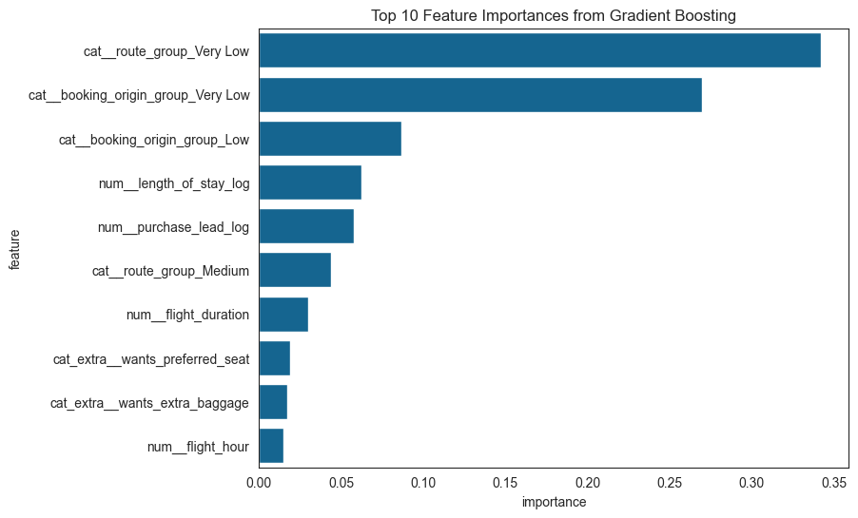
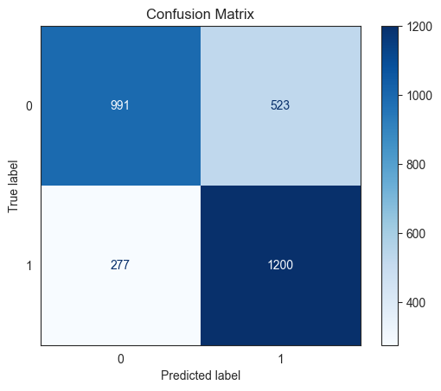
British Airways Predicting customer buying behaviour
Data Preprocessing
A balanced sample was drawn from the available dataset with 50000 instances.
Training set for exploratory data analysis: 11965
Validation set for model evaluation: 2991
Route and Booking Origin were transformed through aggregation into 5 groups each.
This retained the complicated but insightful information.
Model Evaluation
A gradient boosting classifier was built
Accuracy: 73%
Recall: 81%
F1-score: 75%
Using a sample with a balanced number of labels significantly enhanced the generalisation of the model for predicting both labels.
Without a balanced sample, a predictive model with >80% accuracy can be built, which simply predicts every instance as 0 (incomplete booking) due to its commonality.
Feature Importance
The most important features are as follows:
Route group – very low
Booking origin group – very low
Booking origin group - low
Length of stay (log)
Conclusion
Marketing may pay attention to how to increase the chance of booking completion for a larger length of stay and specific route/booking origin.
Further model improvement may include:
Data collection focusing on completed bookings.
Additional features such as the month of flight.

