Slide 1
Data Warehousing Project.
By Moses Mbabaali 4846019

Slide 2
My analysis is going to answer the following questions based on the hire heroes dataset.
What are the main statistics of the service men that register for employment placement at “Hire heroes”?
What are the client registration trends over the years?
How successful is the program in placing service men into jobs?
Which communication channels are successful? What are the outcomes of using those channels?

Slide 3
Statistics of the service men that register for employment placement at “Hire heroes”.
In terms of numbers by service branch the army has over 50K registrants, followed by those that did not mention which branch they belong to and then Navy with a little over 10K, Marines, Airforce, Coast guard and one solo Merchant Marine.
The average amount of time spent in the army mostly is determined by one’s rank, C3s have the highest average of 28.9 years on the contrary lower ranked service men spend the lowest amount of time in service.
E-4 to E-8 have highest composition of registrants.
In terms of time spent in the army, the Cost guard has the highest value in years which is 12.28 years, followed by the Airforce with 11.2 years, then Navy 10.15, Army 9.93, Marines 6.9, Merchant marine 4.04 years.

Slide 4
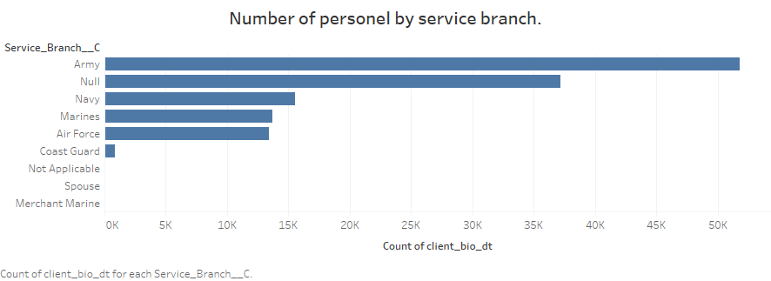

Slide 5
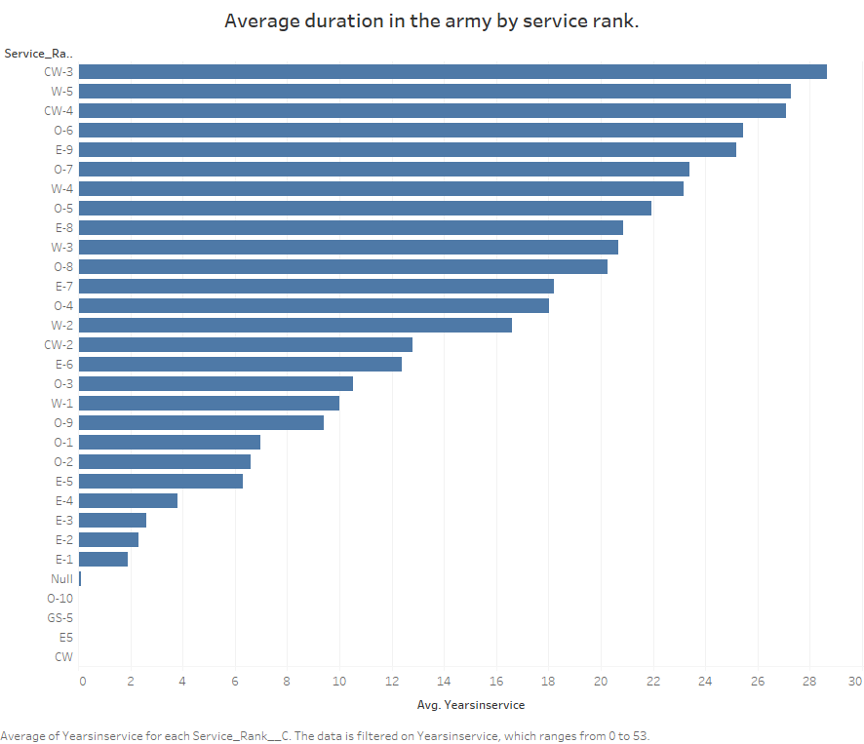

Slide 6
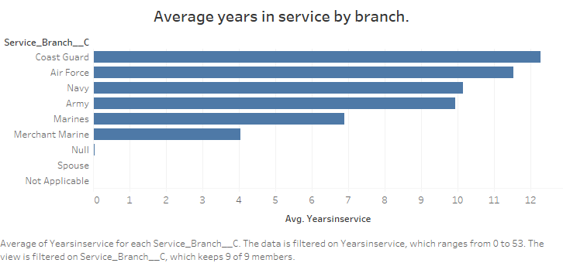

Slide 7
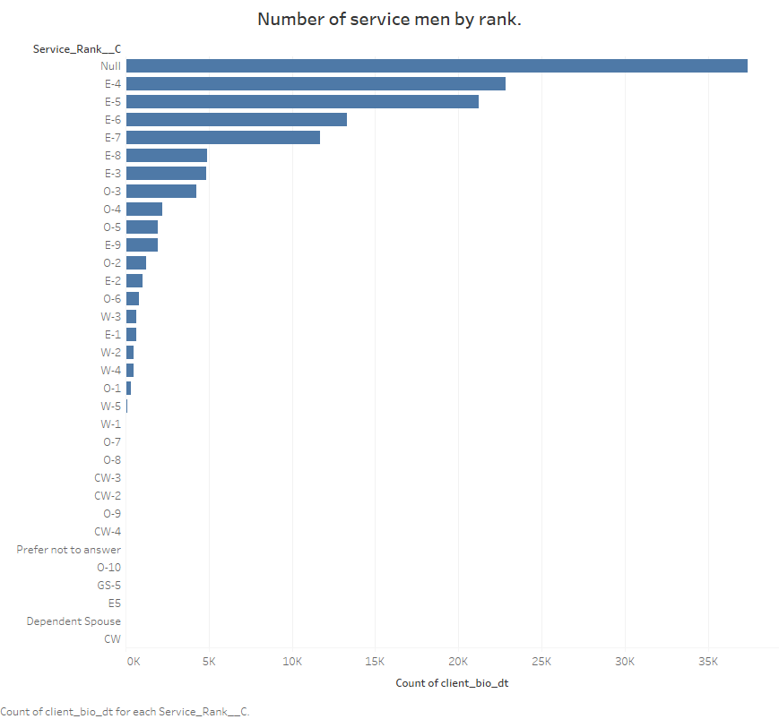

Slide 8
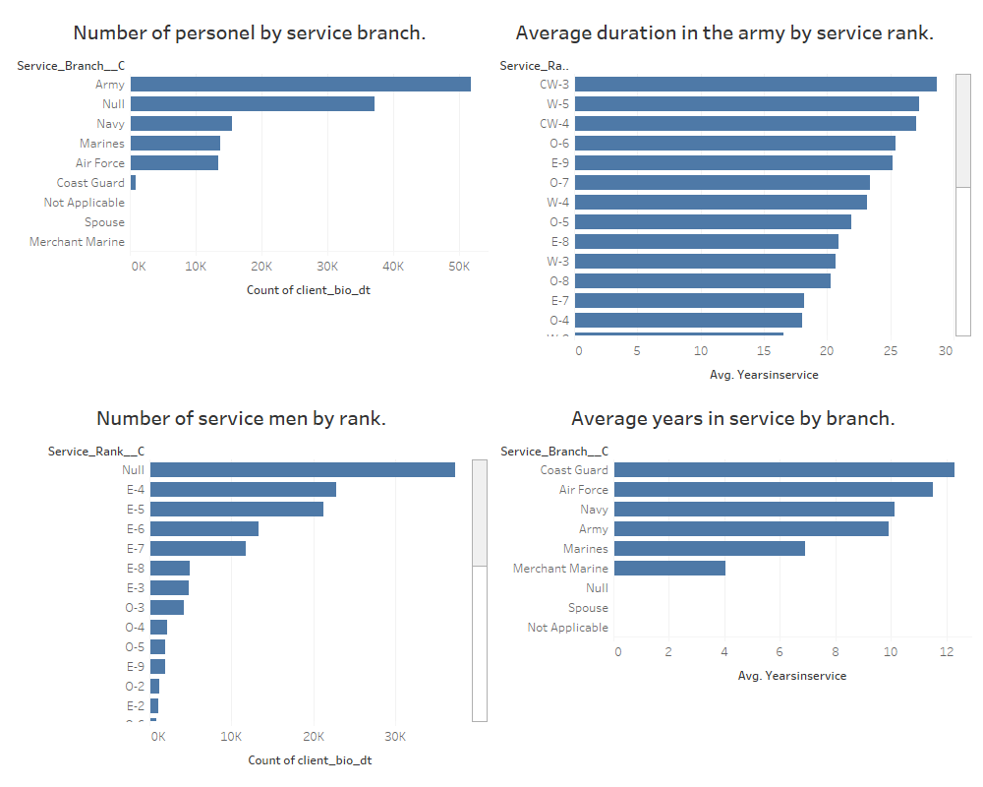
1.

Slide 9
What are the client registration trends over the years?
Since the inception of the program in 2007 seems that the trend has been going up and from the historical values its very much evident this trend is going to continue to go up.
In term of registration service men with lower ranks take longer to register for services compared with those that have higher ranks. It should also be noted that higher service men have spent more time in the army.
Lower rank service men will register on average 8 years after service and higher rank and service men spouses register when they are still in service hence the negative values.

Slide 10
What are the client registration trends over the years?
4. The trend for registration where gender is taken into consideration the average time between the 2 genders is the same or all service branches.
5. The average per service branch is less than 3 years but the higher end can go up to 8 years for lower rank service rank soldiers.

Slide 11
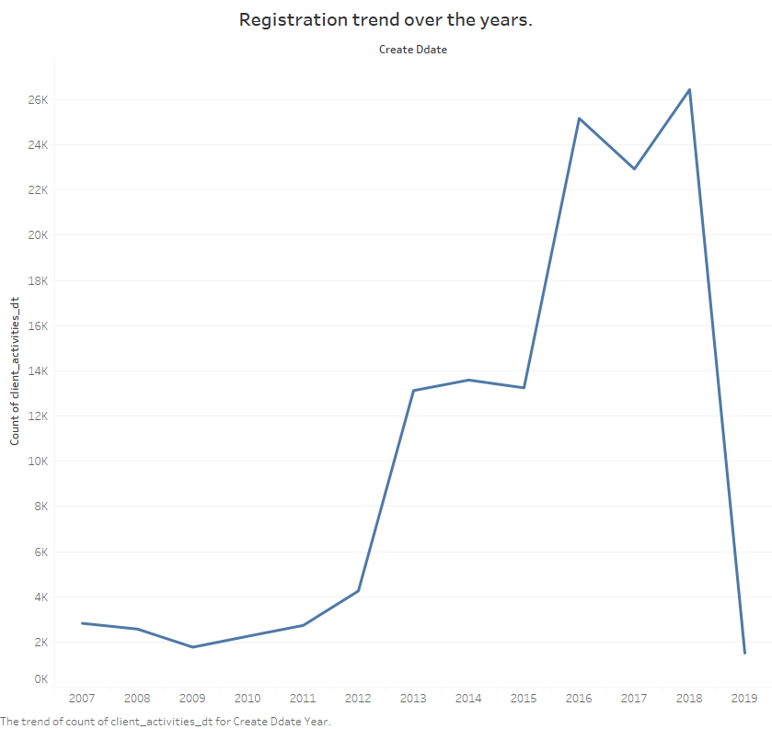

Slide 12
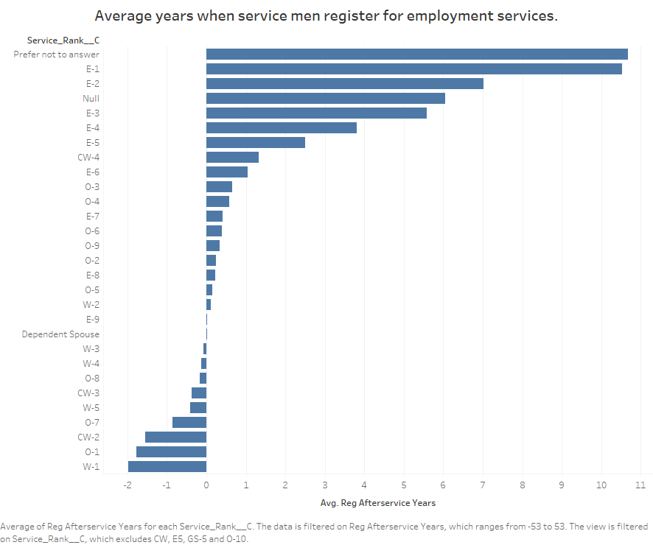

Slide 13
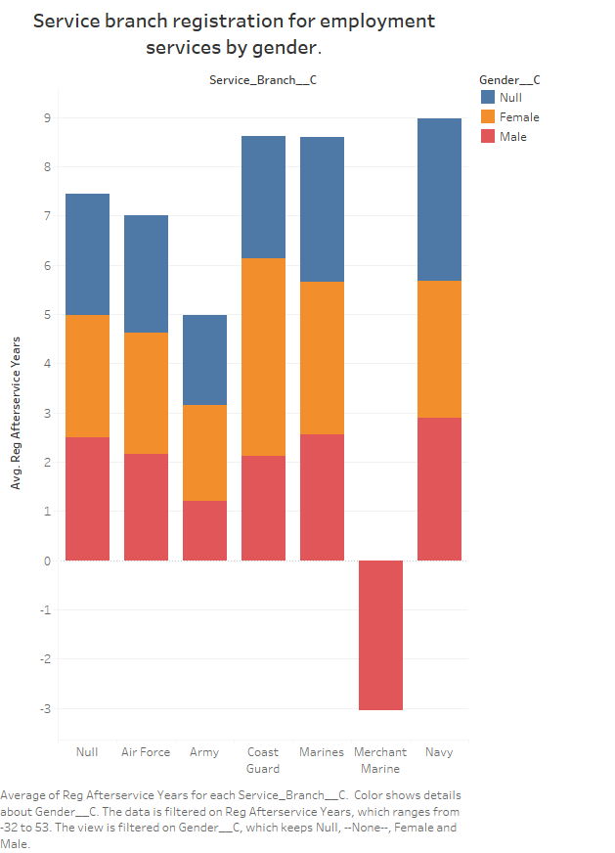

Slide 14
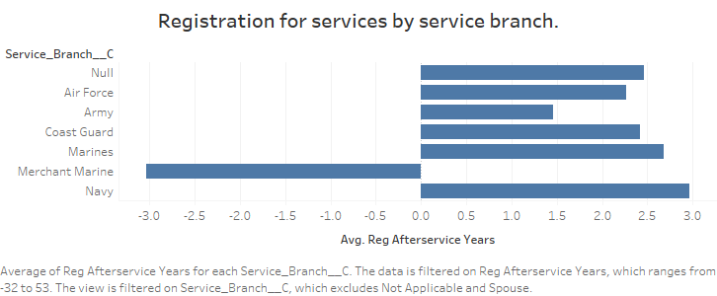

Slide 15
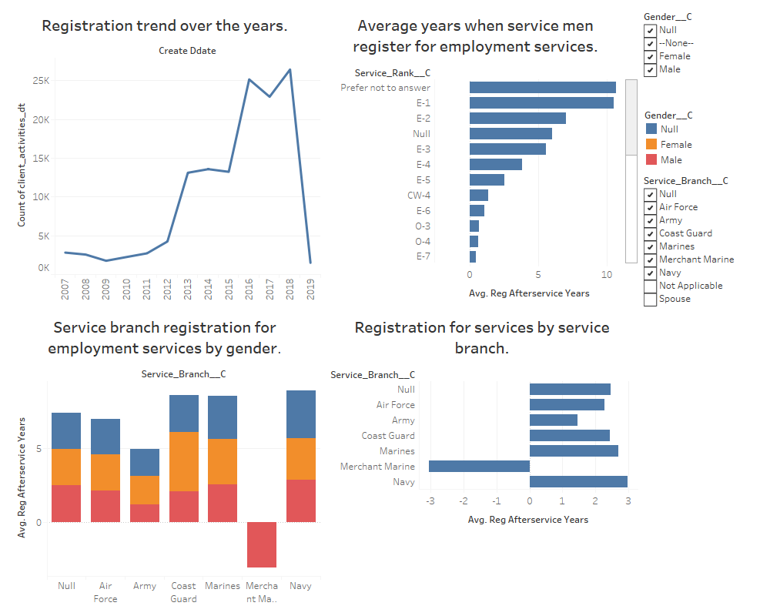

Slide 16
How successful is the program in placing service men into jobs?
To compute the group of service men that were hired through the project, I considered those that had left service and were not serving any more.
Those that got jobs over the years through the program are 20,091. These are not active service men, but instead those that retired.
The split between men and women is made up in such a way that more men got jobs than women. But this makes sense because overall there are more men than women in the program. 1950 clients never indicated their gender, 3731 were female and 14410 were male.
Since the program started it gained momentum by 2014 in fact in 2016 it was able to place over 8000 men into jobs, more than the unemployed to 2015.
From the data those that get hired through the program are mostly satisfied with the placements that they get.
In term of hires by service branch, the Army gets the lions share with 10,417 followed by the Navy with 3,055 and then Airforce with 2,880, then the Marines take up 2423 and Coast guard 170 and those that indicated null 1,145.

Slide 17
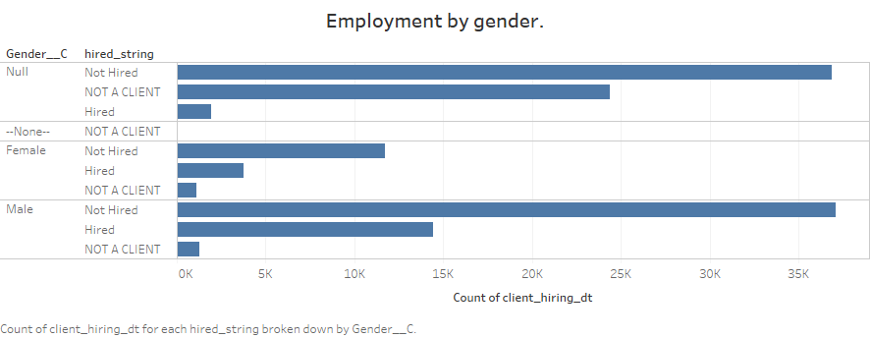

Slide 18
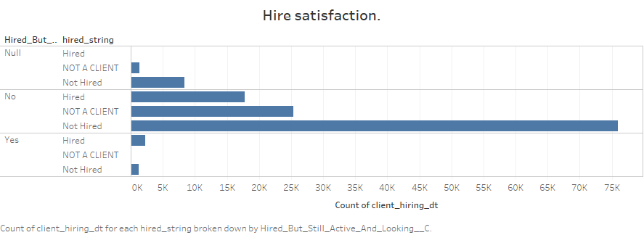

Slide 19
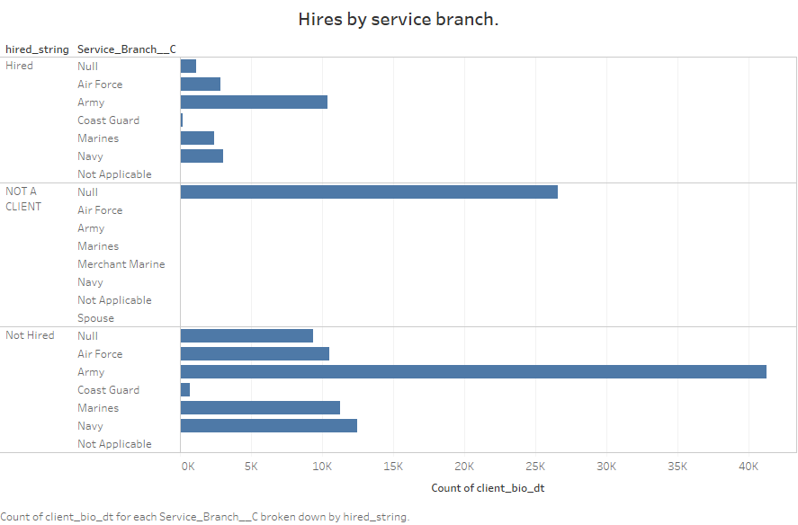

Slide 20
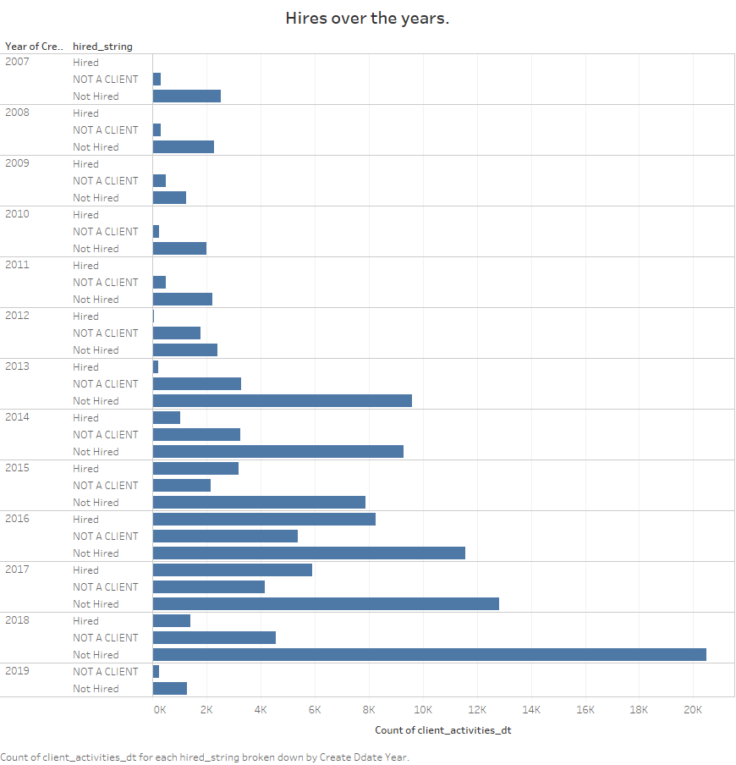

Slide 21
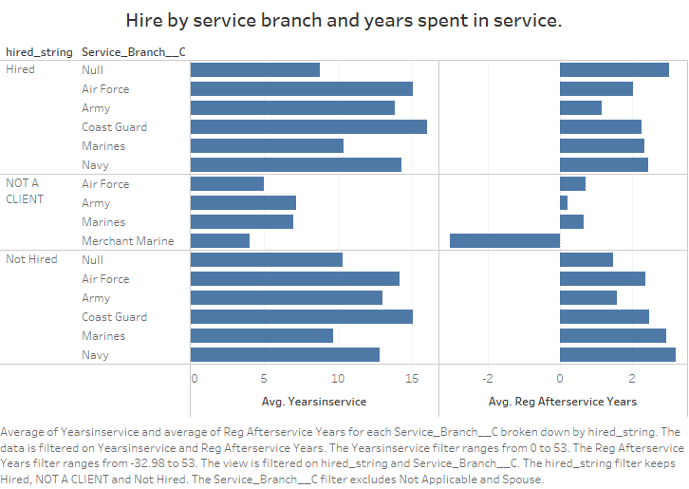

Slide 22
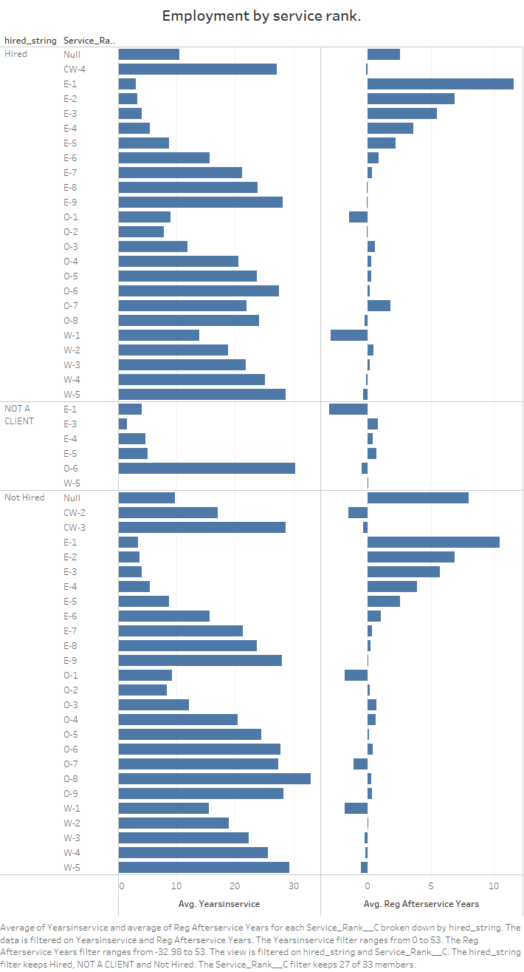

Slide 23
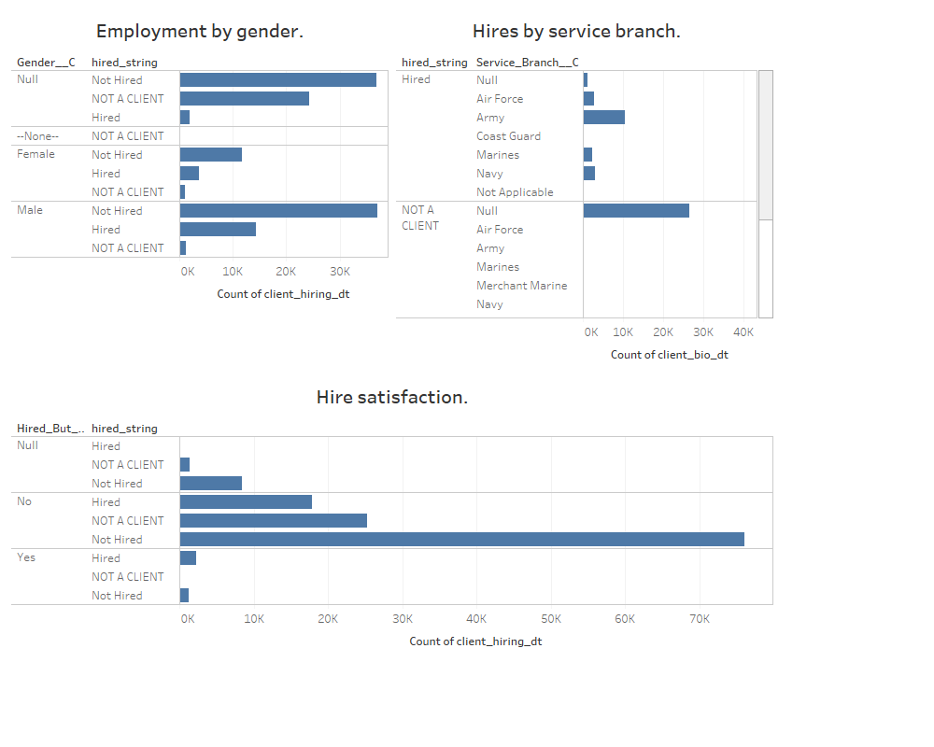

Slide 24
Which communication channels are successful? What are the outcomes of using those channels?
So far the most used communication channels are telephone, email and text.
Those that got job placements mostly used Phone and Email.
So this is one of key factors that determine successful job placement.

Slide 25
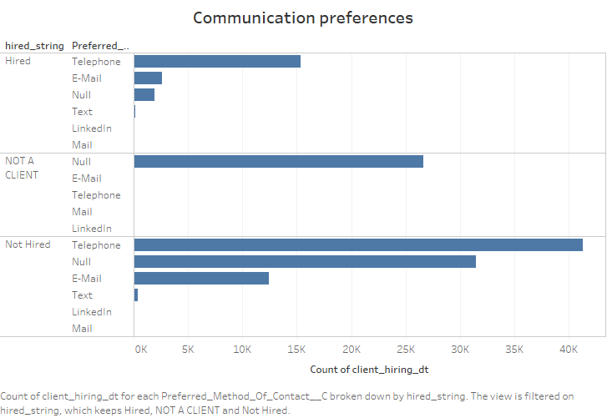

Slide 26
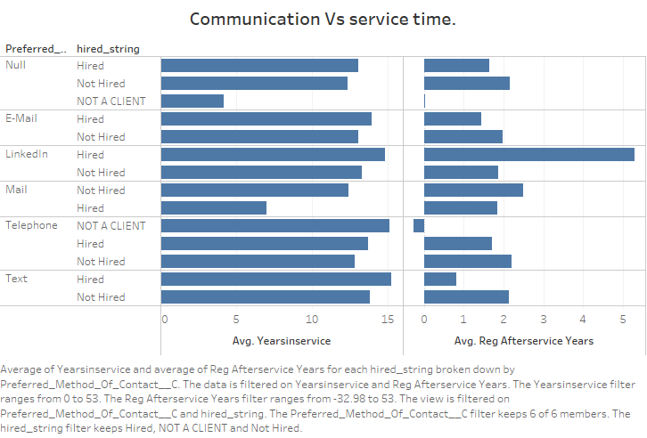

Slide 27
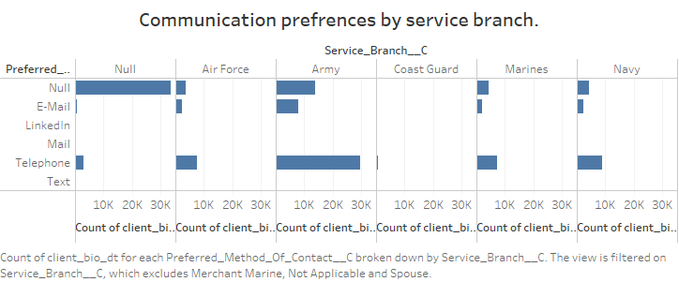

Slide 28
