Slide 1
Using Machine Learning Methods to Indentify Human Activities
By Mbabaali Moses

Slide 2
Background.
With the advent of machine learning and artificial intelligence we have the ability to indentify hidden information in data.
In this study an accerelometer and gyroscope were used to generate movement data in the x,y and z directions (Anguita et al, 2012) for everyday human activities such as walking, laying, going upstairs etc.
Human activity recognition is important today because of its application in sectors such as health, sports, care(Remote care for the elderly) etc (Neha et al, 2022).
Forecast of these activities is going to be done using machine learning algorithms.

Slide 3
The aims
Do an exploratory data analysis of the dataset and also identify the included activities.
Use different machine learning algorithms to predict human activity.
Aquire and compare predictive scores of different classifiers, with their respective cross validation scores.

Slide 4
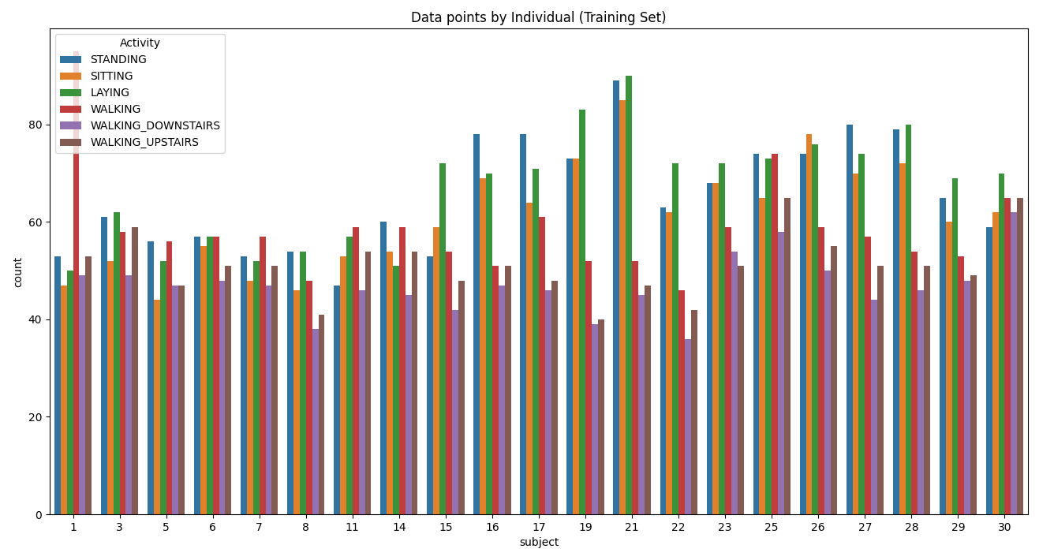
Exploratory Data Analysis. (EDA)
The data is split into 70% for the training set and 30% for the testing set.
The count plot below shows data for each of the individuals in the training set.
We can infer that the dataset is balanced with the respective activities.

Slide 5
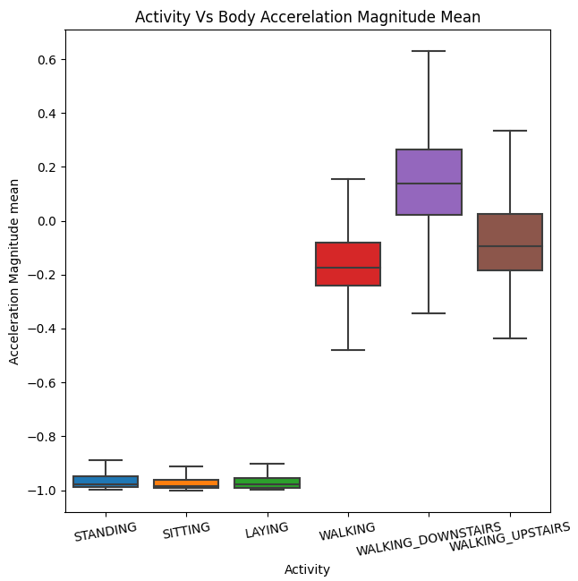
Exploratory Data Analysis. (EDA)
Body Acceleration plot for each of the activities.
Stationary activities have lower acceleration magnitude values compared to dynamic activities.

Slide 6
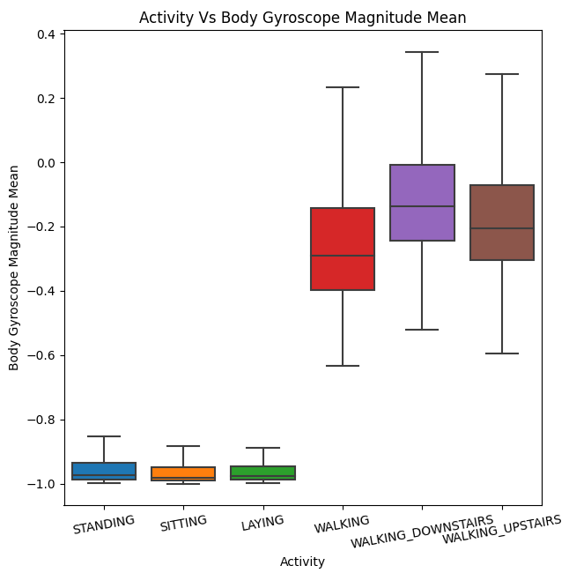
Exploratory Data Analysis. (EDA)
This box plot shows the gyroscope magnitude mean.
We have a similar set up whereby the stationary activities have lower gyroscope magnitude values and the dynamic activities have high values.

Slide 7
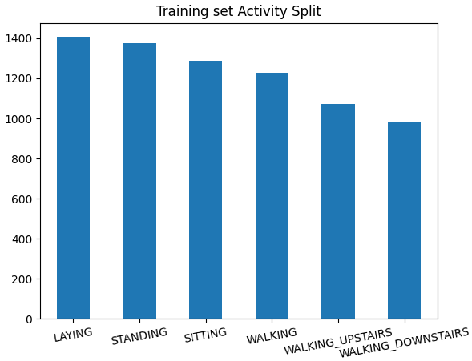
Exploratory Data Analysis. (EDA)
Count plot for all the activities.
The activities are arranged basing on highest occurrence to lowest.

Slide 8
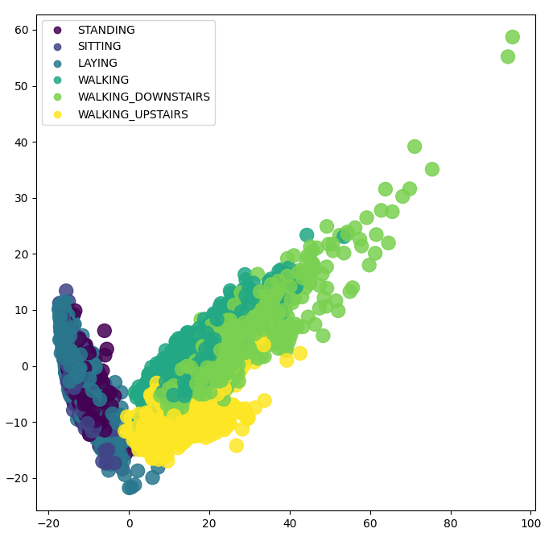
Exploratory Data Analysis. (EDA) Principle Component Analysis (PCA)
Dimensionality reduction for the features from 561 to 2 components using PCA.
From the 2 components we get an explained_variance_ratio_ of 57% which shows that this is the information we have retained from the original 561 features.

Slide 9
Modeling
To model the problem, 4 supervised machine learning algorithms were used.
These are,
XgboostClassifier.
Random Forest Classifier.
Support Vector Machines.
Decision Tree Classifier.

Slide 10
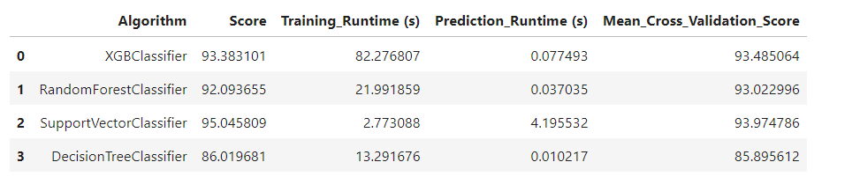
Prediction and Cross Validation Results
The Support Vector Machines perform better than the other algorithms followed by XGBClassifier, then RandomForests and last DecisionTree.
Cross validation scores are pretty much similar to prediction scores, so we can trust our predictive scores.

Slide 11
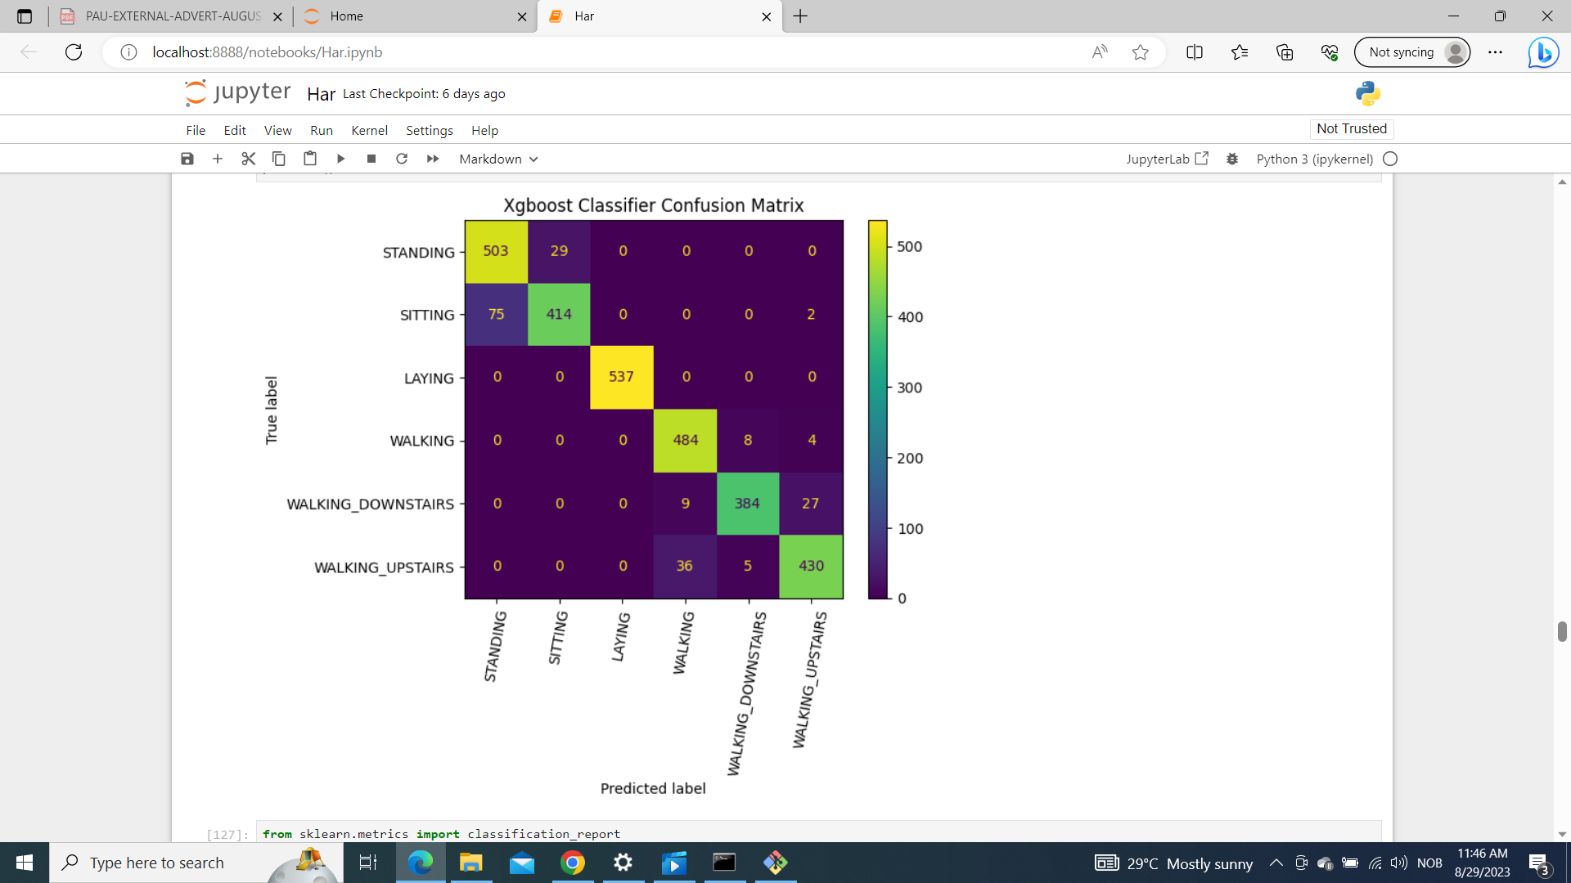
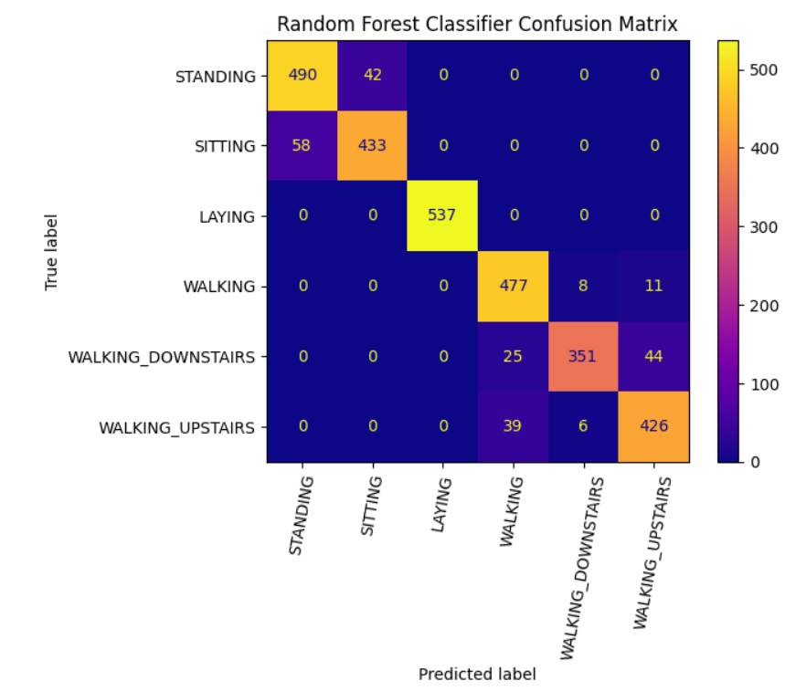
Confusion Matrices (XGBClassifier and RandomForestClassifier)
Stationary activities tend to misclassify within themselves.
The same is true within dynamic activities.

Slide 12
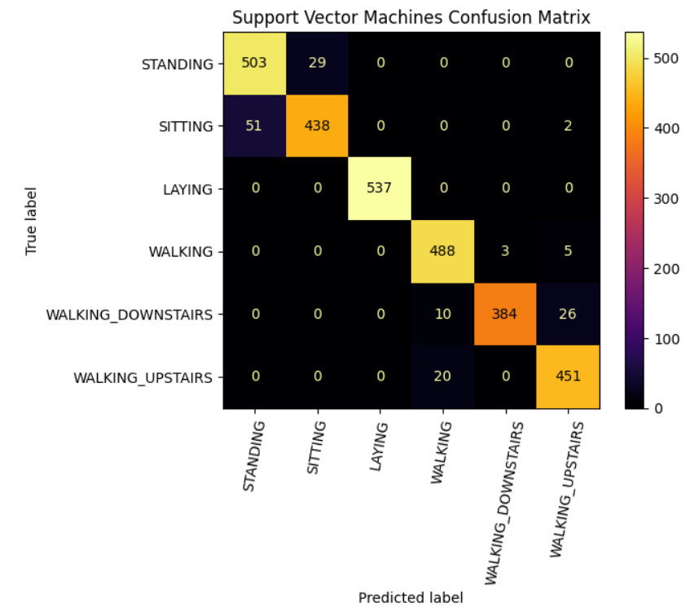
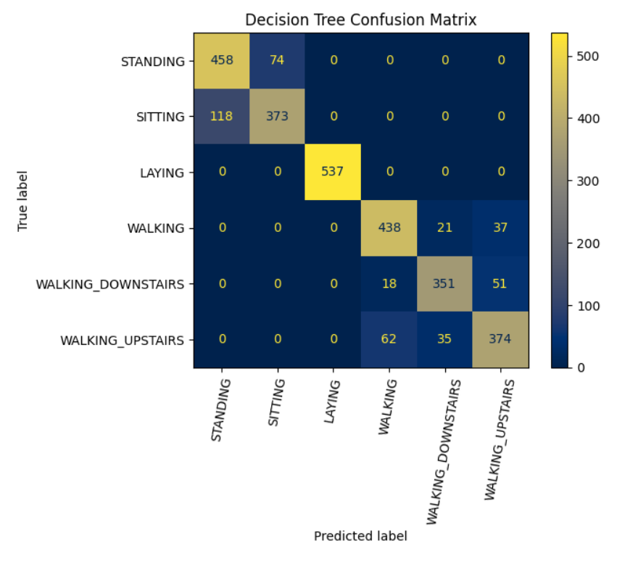
Confusion Matrices (SupportVectorClassifier and DecisionTreeClassifier)
Decision trees tend to have a much more higher misclassification rate than the other algorithms.

