Slide 1

Analytics Methodology
for Parsing and Processing Valorant Matches

Slide 2
outline
Introduction
Computer vision
Contextual metrics
Automated tactical analysis (quantitative)
Game developmental analysis (qualitative)
Simulations & machine learning
Conclusion

Slide 3
introduction
Computer vision extracts meaningful player data from their screen (recording or livestream)
Contextual metrics describe various game-specific measures of performance
Automatically store and process player position data (if available), recognize common patterns and tendencies of play
Incorporate game developer update descriptions and community opinions for figuring out general developmental trends
Simulate match events and use match and simulation data as input for machine learning algorithms

Slide 4
Computer vision
Detect presence of objects on screen with template matching
Assign meaning to those objects based on where they are on screen and what it is
Convert this to game information and store

Slide 5
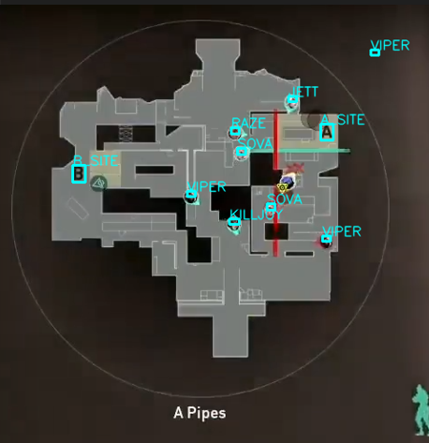

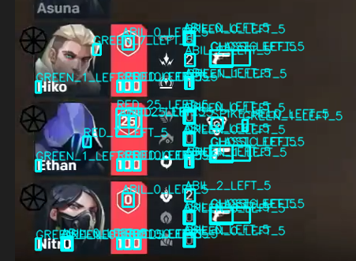
Computer vision

Slide 6
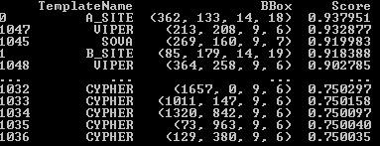
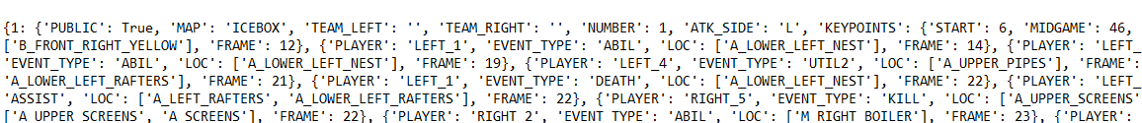
Computer vision

Slide 7
Contextual metrics
Determine measures of player and team performance with the game information captured from screen
Depending on the match situation, the meanings of these measures will be different
Combining game knowledge with captured game information conditionally allows for more meaningful and understandable metrics

Slide 8
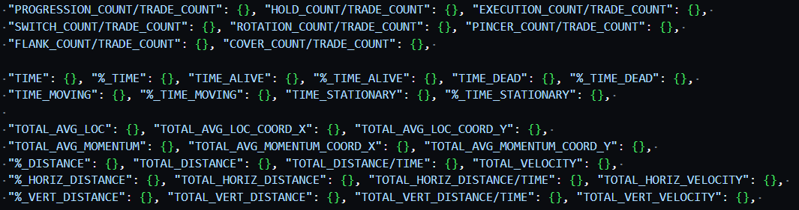
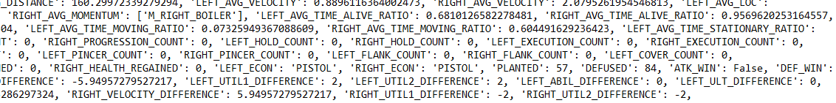
Contextual metrics

Slide 9
Automated tactical analysis
Using the game information and metrics stored and designed, patterns of play that cannot be easily recognized by humans can be automatically identified and highlighted
Analysts can reduce time spent watching opposition matches for preparation through automated tactical pattern recognition, reducing analyst bias and potential errors
Analysts can specify certain game situations or conditions and visualize how opposition plays in those circumstances
High-level reports and visualizations can be offered to further reduce burden on teams preparing for matches

Slide 10
developmentAl analysis
Game developmental changes can be catalogued as the developers update the game
By qualitatively analyzing the update history of the game and player-base opinions (professional and casual), analysts can get a general sense of what sort of changed are most likely to be next implemented
For games with longer lifetimes, more broad long-term predictions can be made on how the game will evolve in coming periods, allowing teams to be better prepared for the future

Slide 11
Simulation & Machine learning
Analysts can simulate possible future match situations with the provided framework, allowing them to test sensitivity to position, resources, opposition setup, etc.
Over many simulations, analysts can estimate conditional probabilities given events and aggregate simulation data to summarize to players
Simulations can be stored just like game information for ease of analysis and accessibility
Analysts can develop machine learning algorithms (regression, classification, clustering, generation) on their match and simulation data to increase match preparedness

Slide 12
conclusion
The goal of this informational framework is to increase level of play and preparedness of esports teams, and increase accessibility and interest of audience
Esports industry generated $800 million in sponsorships in 2022
By making esports more understandable and appealing with metrics and analytics, the industry can provide more value on both sides of market
There is low cost for informational framework, beyond analysts’ time and labor not much else is needed to create valuable insights from esports data
This facilitates a higher level of play in esports and contributes to more entertaining broadcasts via informative insights

