Slide 1
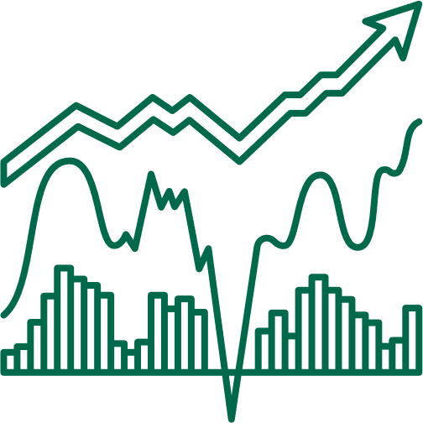

Presented by Moses Yebei
E-COMMERCE ANALYTICS: FROM DATA CLEANING TO CHURN MODELING
Comprehensive Data Science Project at Qatalyst

Slide 2



Project Overview
Objective: analyze ~250k e-commerce transaction records to understand and predict shifts in customer behavior.
Project “end-to-end” pipeline:
Data Cleaning & Exploration → Segmentation (RFM & CLTV) → Churn EDA & Modeling.

Slide 3

Glossary of Key Terms
key terminology used throughout the presentation.
EDA (Exploratory Data Analysis)
A process of examining datasets to summarize main characteristics, often using visual methods. Helps discover patterns, detect anomalies, and formulate hypotheses.
RFM (Recency, Frequency, Monetary):
A customer-value model analyzing (a) how recently a customer purchased (Recency), (b) how often (Frequency), and (c) how much money they spend (Monetary value).
CLTV (Customer Lifetime Value): An estimate of the total revenue a business can expect from a customer over the entire relationship, factoring in purchase frequency, average order value, margins, etc.
Churn: The rate at which customers stop doing business with an entity. In this context, a churned customer is one who has not returned for new purchases beyond a specified window.
Confusion Matrix: A 2×2 or multi-class representation of predicted vs. actual outcomes in classification models, highlighting true positives, false positives, true negatives, and false negatives.

Slide 4
Project Motivation & Business Context
High churn rates (~20%) can erode both short-term revenue and long-term brand loyalty.
RFM-based segmentation combined with CLTV values highlights which customers are “worth” re-engaging aggressively vs. those who need consistent, lower-cost tactics.
Seasonal fluctuations (e.g., spikes in August/December) amplify the importance of timely marketing and personalized promotions.
A 5% Reduction in Churn → +25% in Profit

Slide 5


Data Overview & Preprocessing Steps
Data Volume: ~250,000 rows, spanning multiple years (2020–2023), with 13–38 columns depending on merges and feature engineering.
Key Fields: Customer ID, Purchase Date, Quantity, Price, Returns, Gender, Age, Churn. Explain how each field is used (IDs for grouping, Price × Quantity for revenue, etc.).
Initial Cleaning:
Recalculated total spending for accuracy.
Dropped duplicates (e.g., columns with redundant age info) and unnecessary fields.
Addressed ~47k missing “Returns” entries by verifying if these data gaps skew results.

Slide 6
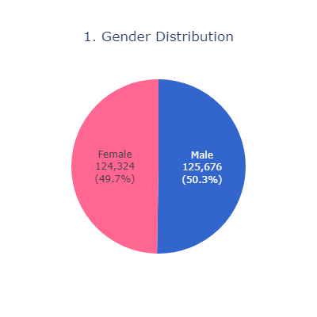
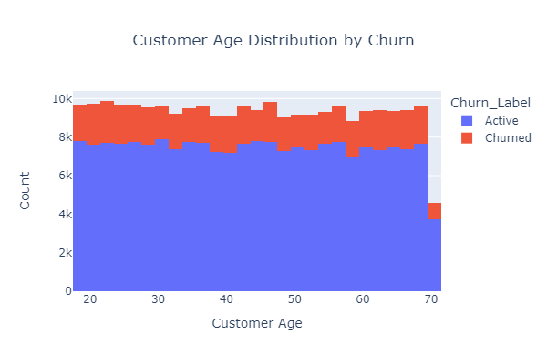
Data Overview & Preprocessing Steps
Early Observations: Nearly balanced gender distribution (~124k female vs. ~126k male).
~20% churn rate across various ages.

Slide 7
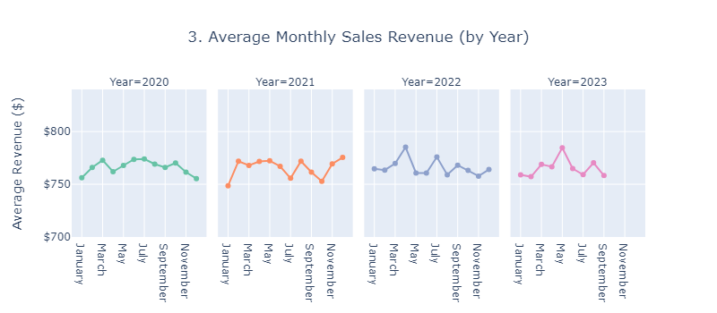
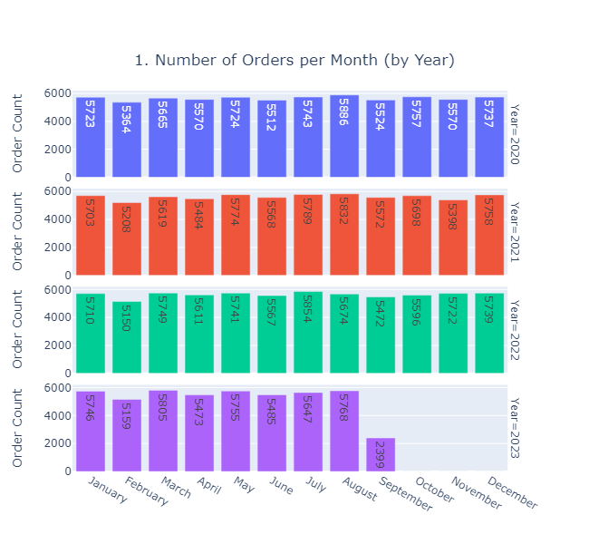
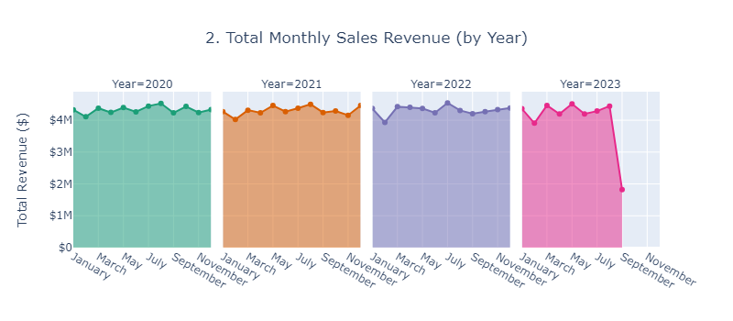
Key EDA Insights
01.
Seasonal Trends: Notable transaction peaks in August (back-to-school, summer sales) and December (holiday shopping).
Implications: EDA clarifies where we might focus deeper segmentation: e.g., exploring returns among Clothing sub-categories or reevaluating marketing in Q4 months.

Slide 8
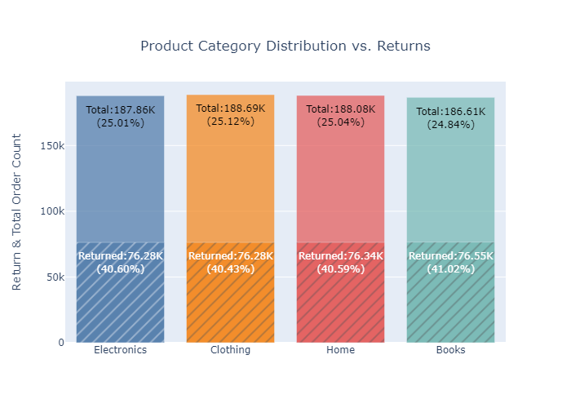
Key EDA Insights
02.
Category & Return Rates:
Electronics, Clothing, Home, Books → each ~25% returns, but Clothing slightly higher.
Investigate product sizing or quality issues leading to returns.
Implications:EDA clarifies where we might focus deeper segmentation: e.g., exploring returns among Clothing sub-categories or reevaluating marketing in Q4 months.

Slide 9
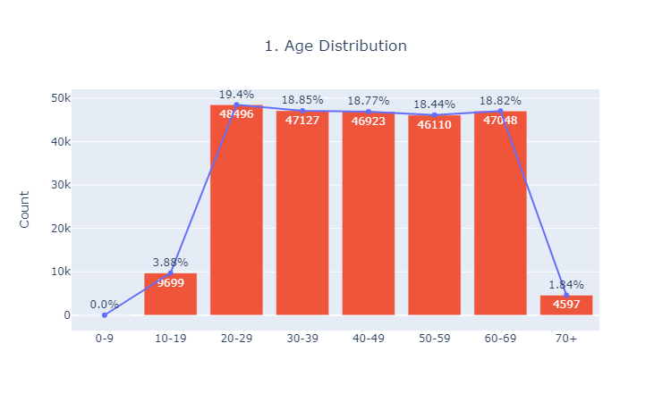
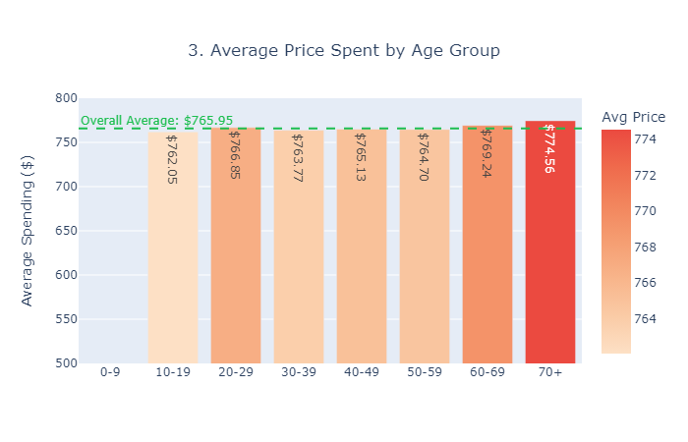
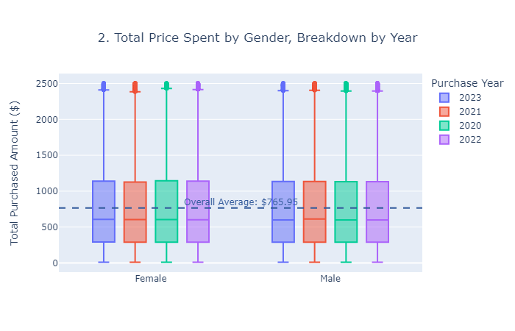
Key EDA Insights
03.
Age & Gender Patterns:
Main age bracket: 20–69.
Gender-based average spending: ~ $767 for females vs. $765 for males, negligible difference.
Implications:EDA clarifies where we might focus deeper segmentation: e.g., exploring returns among Clothing sub-categories or reevaluating marketing in Q4 months.

Slide 10

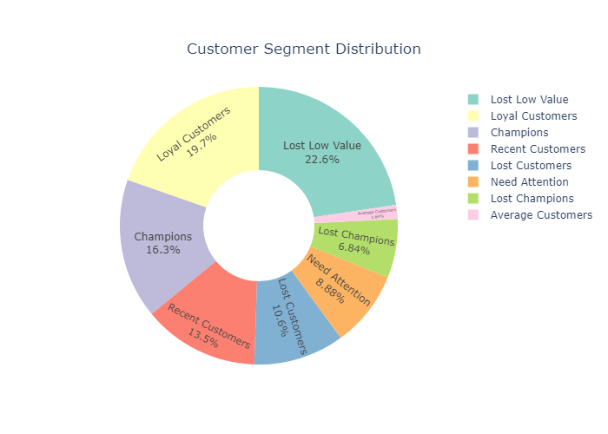
Segmentation Strategy: RFM + CLTV
Why Both Approaches: RFM captures short-term, transaction-based behavior. CLTV extends horizon for lifetime revenue potential. Overlap helps fine-tune marketing budgets and retention strategies.
RFM Methodology:
Recency: days since last purchase.
Frequency: total number of transactions per customer.
Monetary: total spend.
Segments: “Champions” (top across R, F, M), “Lost Champions,” “Loyal Customers,” “Lost Low Value,” etc.
Key Findings:
“Lost Low Value”: ~11.2k, rarely purchase, minimal spend, big churn risk.
“Champions”: ~8.1k, high spend, frequent, prime for loyalty programs.

Slide 11
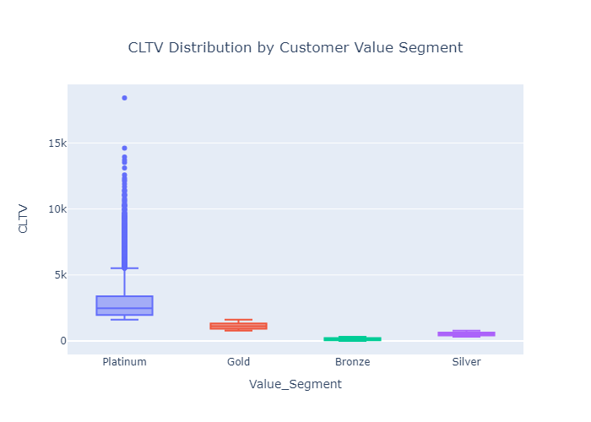
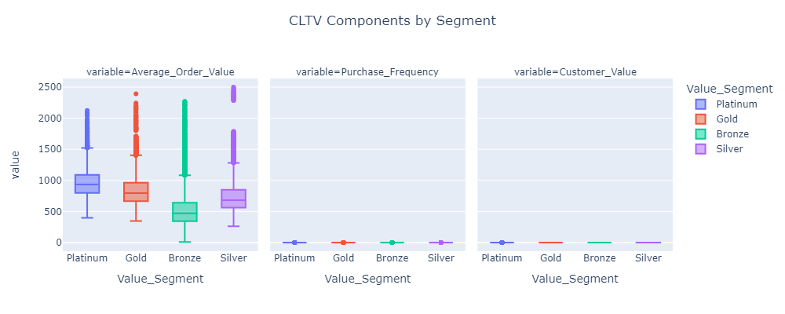
Segmentation Strategy: RFM + CLTV
CLTV Calculation:
Incorporates average order value, purchase frequency, churn risk, profit margin.
Segments: “Bronze” (lowest quartile CLTV), “Silver,” “Gold,” “Platinum” (top quartile).
Key Findings:
“Platinum”: ~top 25% CLTV, best for upselling or exclusive perks.

Slide 12
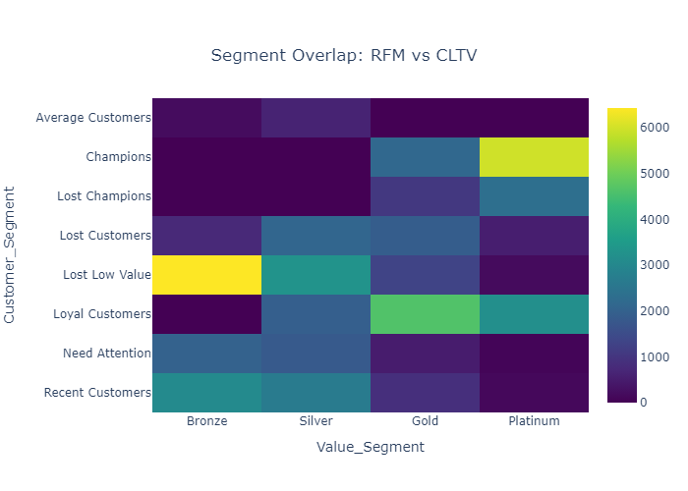
Segmentation Strategy: RFM + CLTV
Key Insights:
“Platinum” strongly overlaps with Champions.
“Gold” strongly overlaps with Loyal Customers.
“Bronze” and “Silver” strongly overlaps to recent customers and lost low value.
Recommendation:
Up-sell “Platinum” and “Gold” customers with premium services.
Incentivize recent customers with discounts

Slide 13

Value of Combining Both RMF and CLTV
RFM highlights short-term patterns; CLTV projects long-term revenue.
The intersection reveals marketing priorities.

Slide 14
Churn Analysis & Model Approach
Definition: A churned customer is one who hasn’t purchased in X months. Dataset has ~20% churn.
Product Category & Churn
• Churn Rates by Product Category:
– Clothing: 20.12%
– Books: 20.08%
– Electronics: 20.04%
– Home: 19.96%
• While differences are small, Clothing shows the highest churn. Understanding product return processes or competition in this category may help reduce churn.

Slide 15
Churn Analysis & Model Approach
Demographics (Gender)
• Churn Rates by Gender:
– Female: 20.16%
– Male: 19.94%
• The churn gap between genders is minimal (≈ 0.2%), suggesting both male and female segments similarly warrant retention efforts.
Customer Value & Segments
• Churn Rates by Value Segment:
– Gold: 20.42%
– Silver: 20.15%
– Platinum: 19.98%
– Bronze: 19.39%
• Bronze customers churn the least, while Gold customers are the most likely to churn (possibly due to higher expectations). Targeted loyalty programs for Gold members may help reduce attrition.

Slide 16
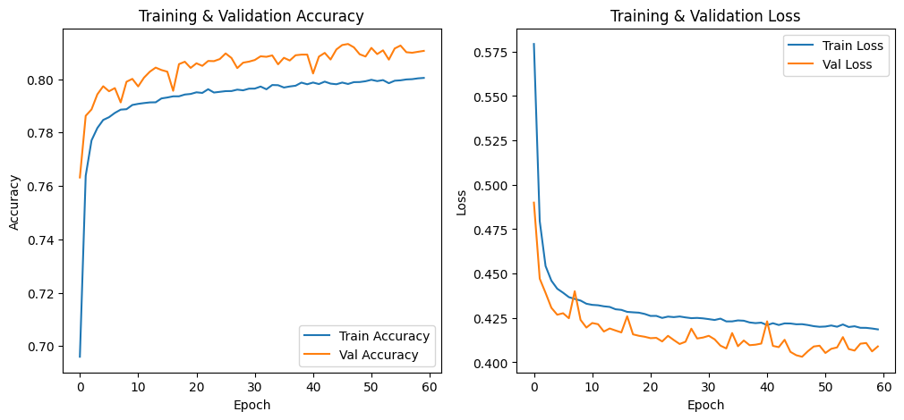
Churn Analysis & Model Approach
Class Imbalance:
SMOTE oversampling used to bolster minority (churn ~20%) class.
Original Target Distribution in y_train:
Churn: 0 159896, 1 40104
After SMOTE, new Target Distribution in y_train:
Churn: 0 159896, 1 159896
Models:
Logistic Regression: ~77% accuracy, ~5% recall (low sensitivity to churn).
Random Forest: ~81% accuracy, ~20% recall (higher sensitivity).
XGBoost: ~80% accuracy, ~8% recall.
Simple Neural Net: ~78% accuracy, ~3% recall, needs tuning.

Slide 17
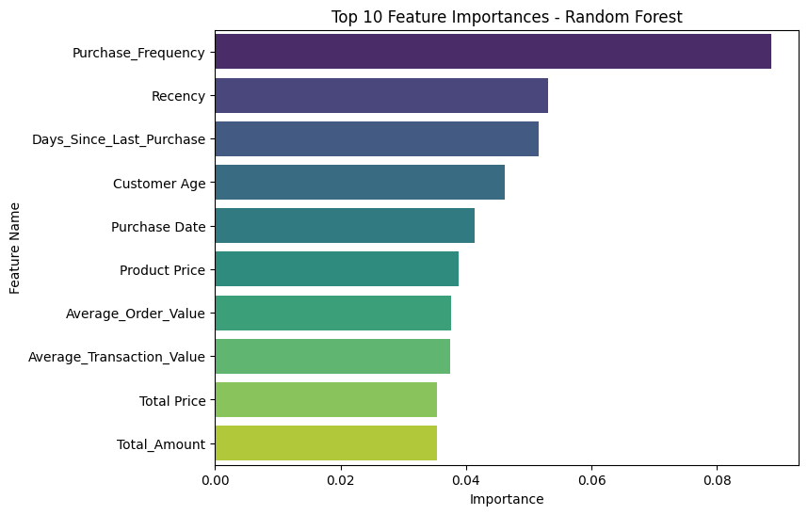
Feature Importance & Business Implications
Beyond Accuracy: Toward Actionable Insights.
Key Features: Among the top features influencing churn prediction are. Recency, Purchase Frequency, Product Price and Customer Age echoing the importance of purchase behavior in predicting churn

Slide 18

Business Relevance & Next Steps:
01.
02.
03.
ROI Consideration: Minimizing churn in the top 10% of your revenue base yields disproportionate returns.
Offer loyalty perks, special promotions, or automated payment incentives.
Product & Payment Methods:
Clothing category and one-off Cash/PayPal buyers are slightly more prone to churn; consider subscription billing or targeted re-engagement.
Retention Priorities:
“Gold” & “Platinum” with rising Recency need urgent re-engagement.
High-Frequency or High-Monetary customers deserve curated loyalty programs.

Slide 19
Conclusion & Future Roadmap
Model Tuning: Explore hyperparameter search (GridSearchCV, Bayesian optimization) for Random Forest, XGBoost, or refine your NN architecture.
Interpretability: Tools like SHAP, LIME to see how each feature or transaction detail influences individual churn predictions.
Production Integration: Automated daily scoring on the CRM.
Real-time alerts to the marketing team for at-risk “Gold”/“Champion” customers.
Beyond Churn: Potential for sentiment analysis of reviews, cross-category bundling, real-time product recommendations.

Slide 20
Q&A & Acknowledgments
I Invite any questions about data cleaning, methodology, the segmentation logic, or model results.

Slide 21
Presented by Moses Yebei
THANK YOU
SO MUCH!

