Slide 1
Superstore Sales Dashboard
Task 4 – Interactive Dashboard Summary

Slide 2
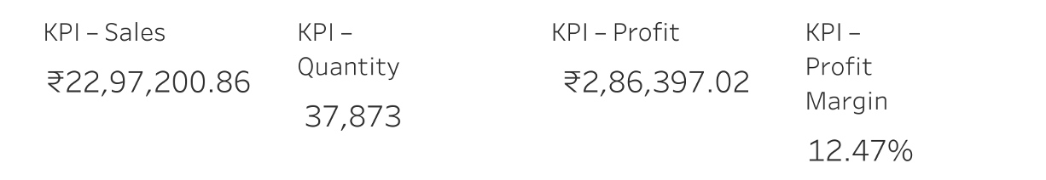
Key Performance Indicators

Slide 3
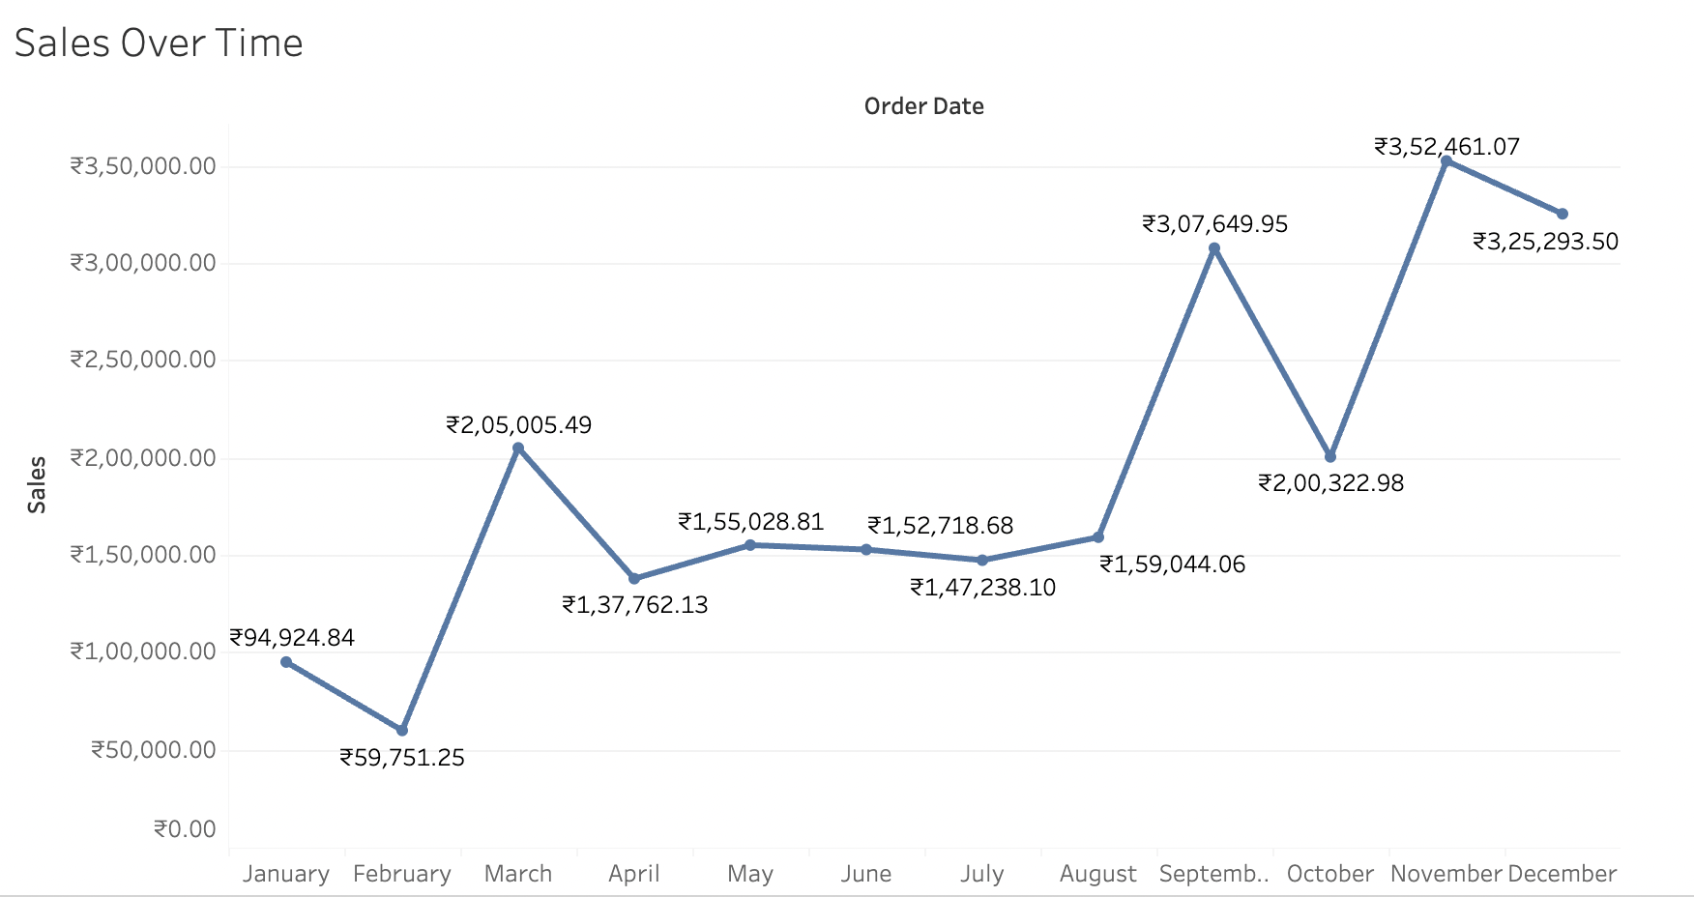
Sales Over Time

Slide 4
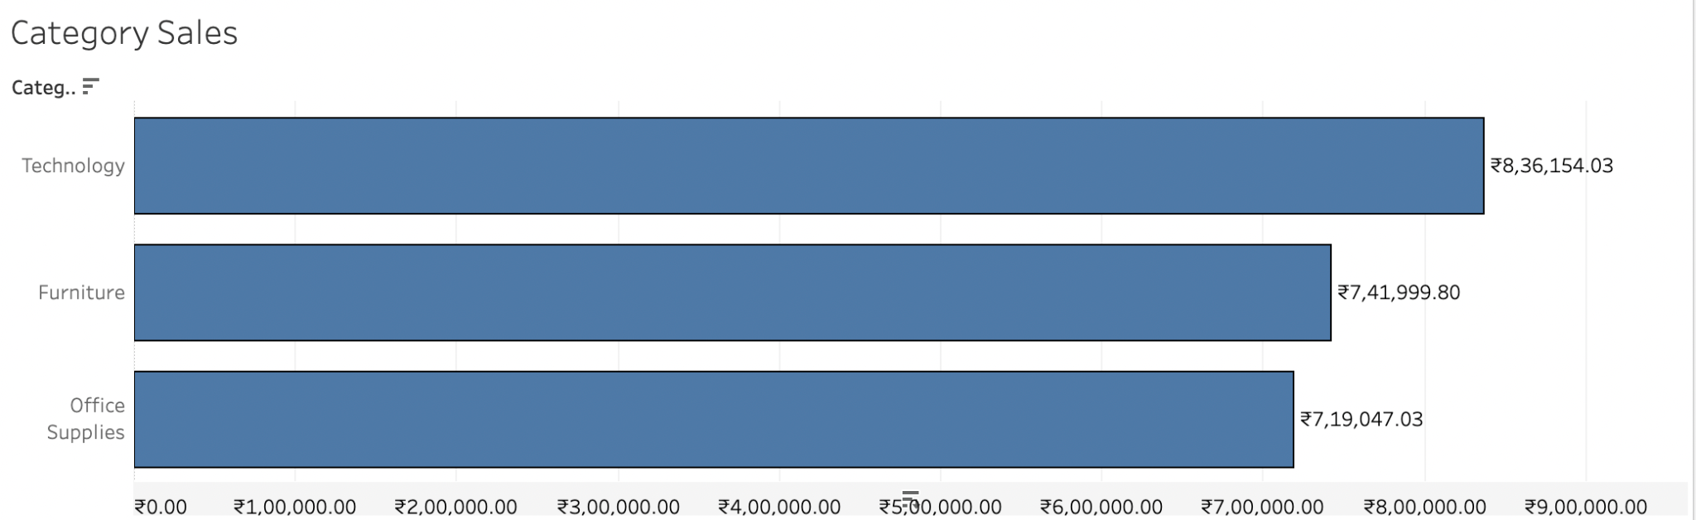
Category Sales

Slide 5
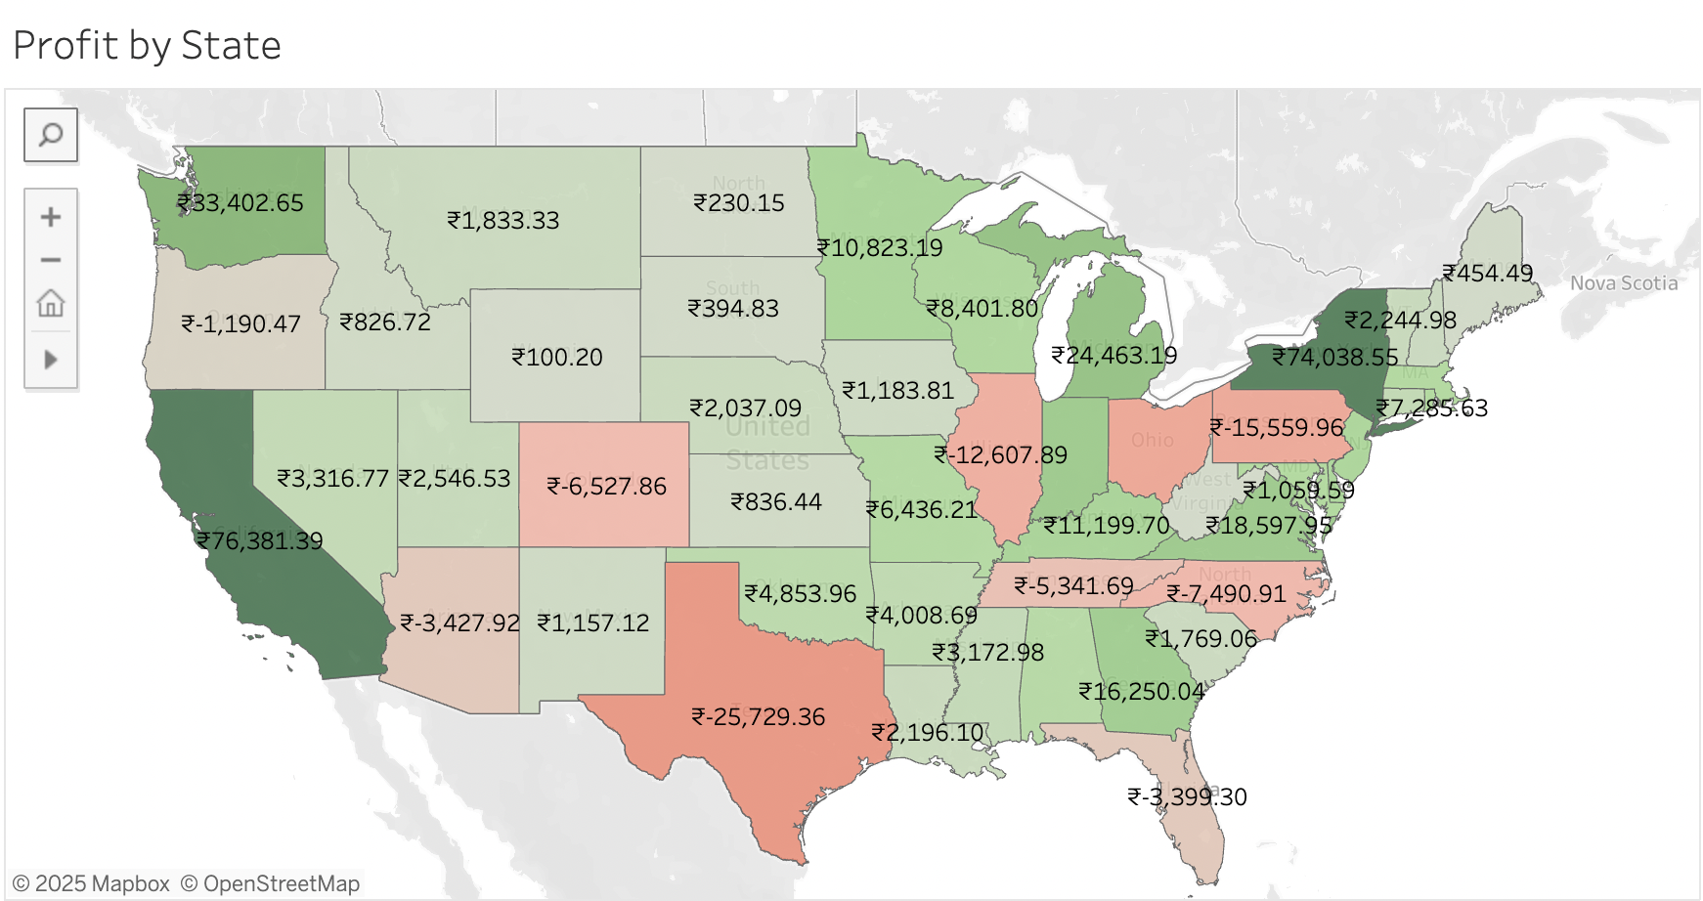
Profit by State

Slide 6
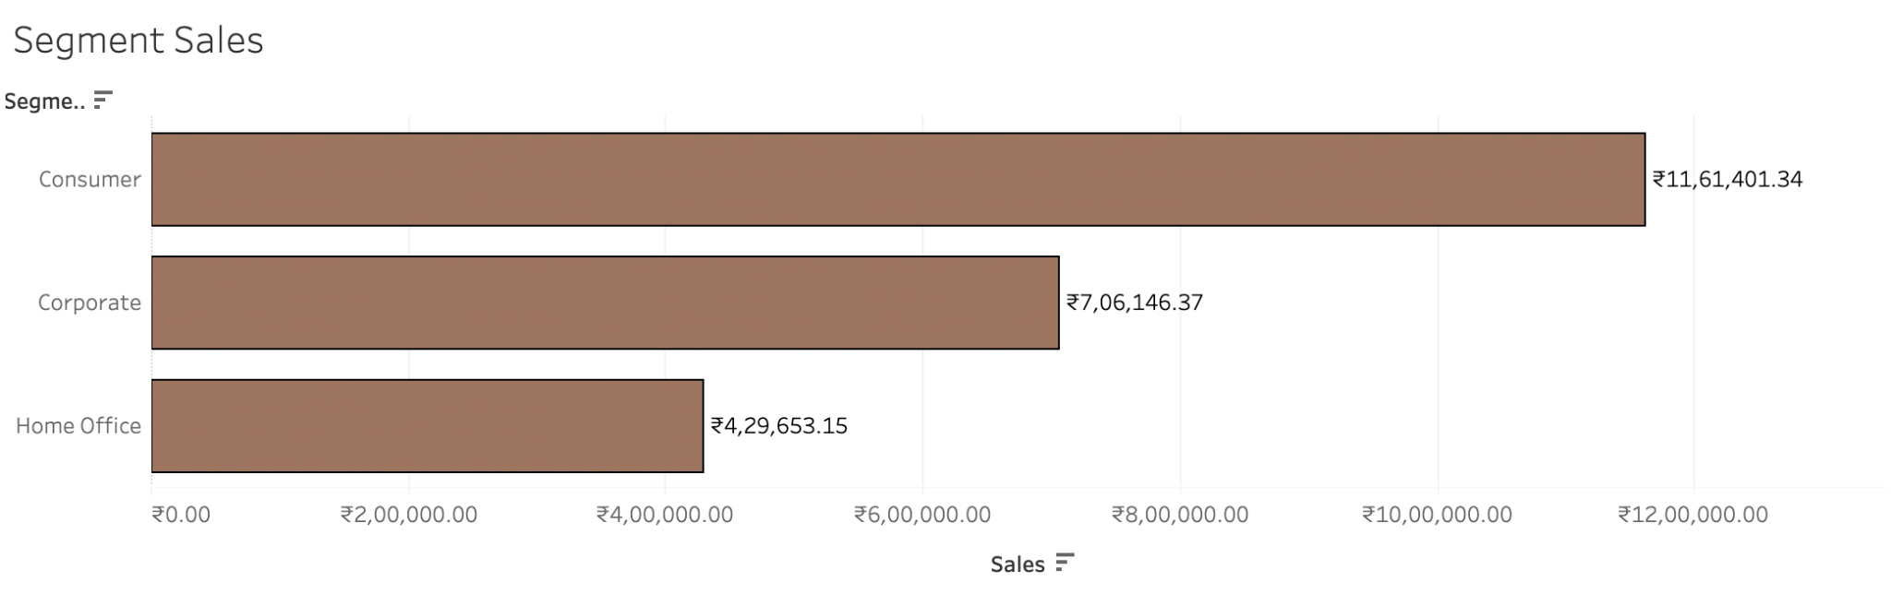
Segment Sales

