Slide 1
Olist E-Commerce Performance Review
Data-Driven Insights for Sales Growth & Operational Improvement
Anthony Viramontes
08/28/2025
🇧🇷

Slide 2
Project Overview
Analyzed 100k+ orders from Olist, Brazil's leading marketplace.
Objective 1: Identify sales trends and top-performing categories. 📈
Objective 2: Evaluate delivery performance and its impact on customer satisfaction.🚚
Objective 3: Assess customer buying behavior to identify growth opportunities.🎯

Slide 3
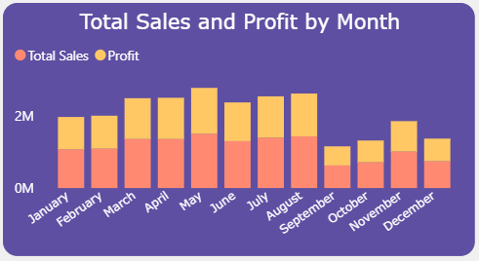
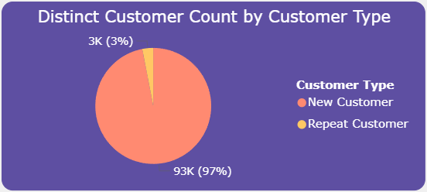
What We Learned: Sales & Customers
Seasonal Trends: Sales peak consistently from March to August.
Top Categories: Health/Beauty and Watches/Gifts are the top revenue drivers.
Customer Retention: 97% of customers are one-time buyers, representing a major opportunity.

Slide 4
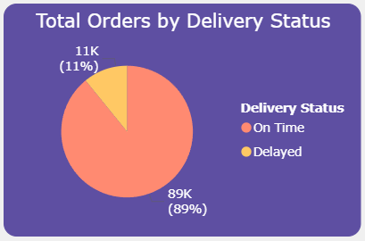
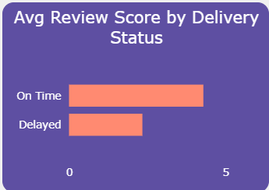
What We Learned: Logistics & Satisfaction
On-Time Rate: 89% of orders are delivered on time.
Impact of Delays: Late orders cause a ~0.4 point drop in average review score (4.2 vs. 3.8).
Geographic Insight: Delivery delays are concentrated in the São Paulo and Brazil region.

Slide 5
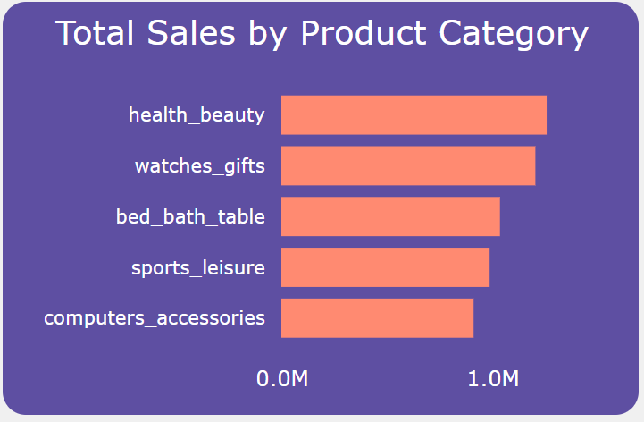
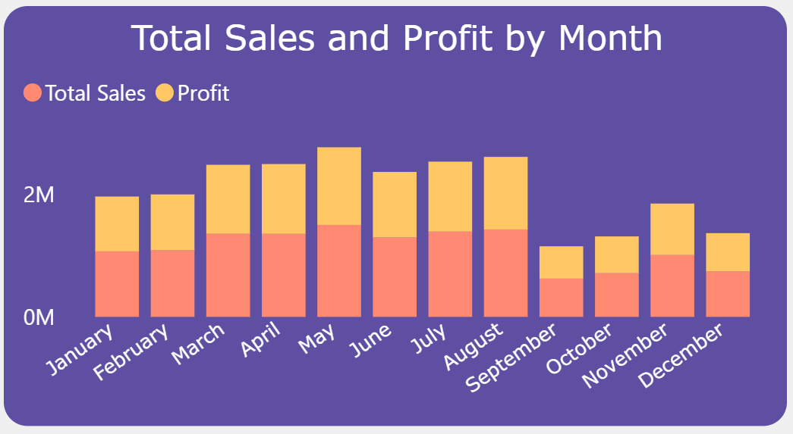
Strategic Recommendations
Launch a Loyalty Program: Convert first-time buyers into repeats to unlock stable revenue.
Optimize São Paulo Logistics: Partner with new carriers to fix regional delivery delays.
Proactive Delay Outreach: Mitify negative reviews with discounts or apologies for late orders.
Capitalize on Trends: Align marketing and inventory with top categories (Health, Watches) and peak seasons (Mar-Aug).

Slide 6
Thank You & Questions
Thank you for reviewing my work. I am eager to discuss how these insights can drive strategic decisions and am open to any questions.
Anthony Viramontes
Aspiring Business Analyst
LinkedIn: https://www.linkedin.com/in/anthony-viramontes/
Personal Portfolio: anthonyviramontes.me
Github: https://github.com/moses1252/Olist-Insights-Driving-Growth-in-Brazilian-E-Commerce

