Slide 1
BIG DATA PROJECT
Audio Analysis : Deep Learning
IS 550
Project Report

Slide 2
Audio Analysis : Beat the Beats

Slide 3
Agenda
01
Data Preparation
02
Metric Definition
03
Model Development
04
Model Deployment

Slide 4
Data Preprocessing
Data Partitioning
Data Size
Data Representativeness
Data Preprocessing
Training : 60
Validation ; 25
Testing : 15
8000 tracks 30sec.
Image Slice *10
the real world data is from a different distribution than the train/ validation/test sets
Scaling : Pixels
Normalizing
Label Encoding
Feature Addition : Beat tracking : No of beats per bar/minute

Slide 5
Metric Definition
Top 1 Accuracy metric
Top 5 accuracy metric

Slide 6
Data Development

Slide 7
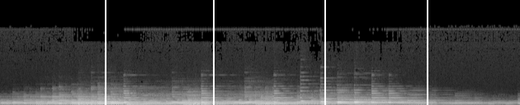
Spectrogram

Slide 8
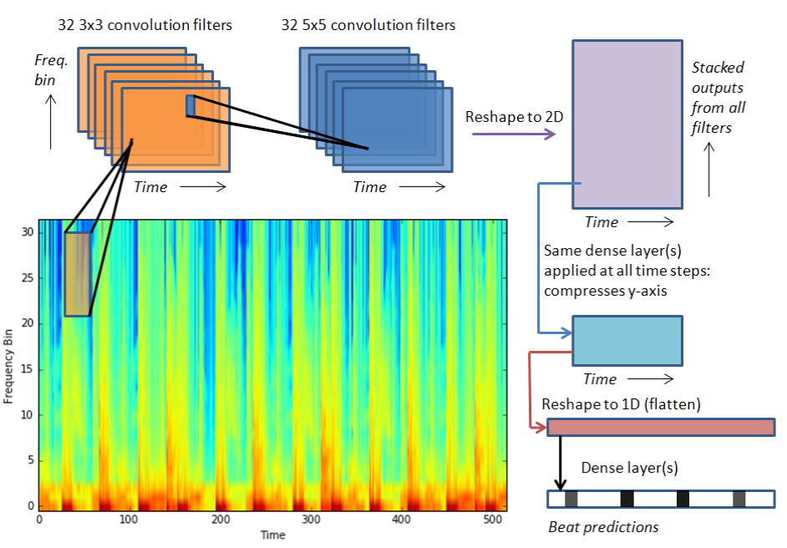

Slide 9
Data Deployment
Deploy
Fix Bottlenecks
in term of the metric defined, and different meaning different architectures, or paradigms (conv net, LSTM, tree, etc.
in deep learning, the bottleneck for this stage is usually inference time and/or network latency
LEARN

Slide 10
Important Features
Librosa
Python Library for audio analysis
TensorFlow : Wrapper - Tflearn
Convolutional Neural Networks
Layers as per required
Optimizer : Rmsprop / Adam
Spectrograms
Initialization : Weight Matrices
Regularization : Dropout layer
Analyzing the frequency over time.
Sliced Images

Slide 11
Timeline
Feature Engineering
Deployment
Week 1
Week2
Week 3
Week4
Week5
Data Preparation
Modelling
Further Improvements

Slide 12

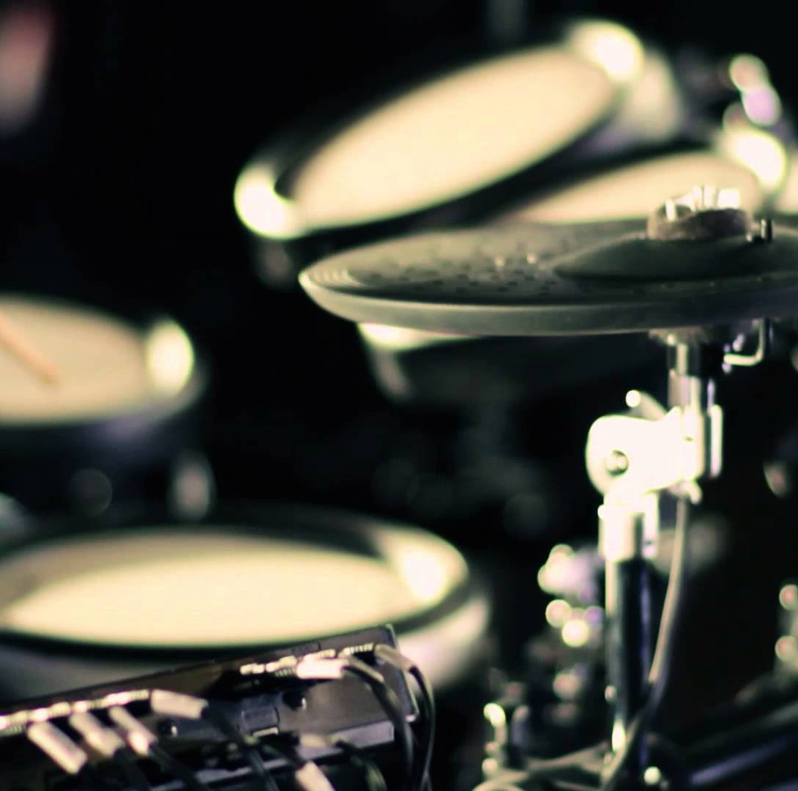


BEAT
THE
BEATS

Slide 13
Thank you!!

