Slide 1
Synchronization
Clock Synchronization & Logical clocks

Slide 2
Motivation
Synchronization is important if we want to
  control access to a single, shared resource
  agree on the ordering of events
Synchronization in Distributed Systems is much more difficult than in uniprocessor systems
Notes:
Synchronization ----
Situation in which two or more processes coordinate their activities based on a condition.

Slide 3
Synchronization
Synchronization based on “Actual Time”.
Synchronization based on “Relative Time”.
Synchronization based on Co-ordination (with Election Algorithms).
Distributed Mutual Exclusion.
Notes:
Synchronization ----
Situation in which two or more processes coordinate their activities based on a condition.

Slide 4
Clock Synchronization
& Logical clocks

Slide 5
Lack of Global Time in DS
It is impossible to guarantee that physical clocks run at the same frequency
Lack of global time, can cause problems
Example: UNIX make
  Edit output.c at a client
  output.o is at a server (compile at server)
  Client machine clock can be lagging behind the server machine clock

Slide 6
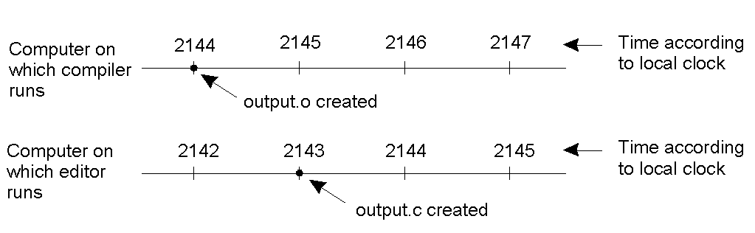
Lack of Global Time – Example
When each machine has its own clock, an event that occurred after another event may nevertheless be assigned an earlier time.

Slide 7
A Note on Real Time
Universal Coordinated Time (UTC): basis of all modern civil timekeeping
Radio stations can broadcast UTC for receivers to collect it
Notes:
Coordinated Universal Time (UTC) is the primary time standard by which the world regulates clocks and time. It has essentially replaced the old standard, Greenwich Mean Time.
WWV is the call sign of the United States National Institute of Standards and Technology's (NIST) HF ("shortwave") radio station in Fort Collins, Colorado.

Slide 8
Physical Clock Synchronization (1)
External: synchronize with an external resource, UTC source
|S(t) – C_{i}(t)| < D
Internal: synchronize without access to an external resource
|C_{i}(t) – C_{j}(t)| < D

Slide 9
Cristian’s Algorithm – External Synch
Centralised server environment
External source S
Denote clock value at process X by C(X)
Periodically, a process P:
  send message to S, requesting time
  Receive message from S, containing time C(S)
  Adjust C at P, should we set C(P) = C(S)?
Reply takes time
When P adjusts C(P) to C(S), C(S) > C(P)

Slide 10
Cristian’s Algorithm – External Synch
B
T₃
T₂
A
T₁
T₄
How to estimate machine A’s time offset relative to B?

Slide 11
Berkeley Algorithm – Internal Synch
Internal: synchronize without access to an external resource
|C_{i}(t) – C_{j}(t)| < D
Periodically,
S: send C(S) to each client P
P: calculate δ_{P} = C(P) – C(S)
send δ_{P} to S
S: receive all δ_{P}’s
compute an average Δ
send Δ-δ_{P} to client P
P: apply Δ-δ_{P} to C(P)

Slide 12
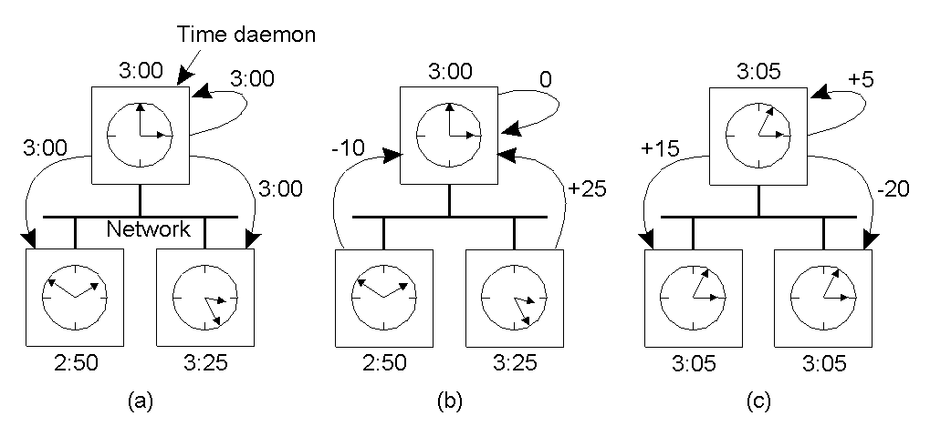
The Berkeley Algorithm
The time daemon asks all the other machines for their clock values
The machines answer
The time daemon tells everyone how to adjust their clock
Propagation time?
Time server fails?

Slide 13
Importance of Synchronized Clocks
New H/W and S/W for synchronizing clocks is easily available
Nowadays, it is possible to keep millions of clocks synchronized to within few milliseconds of UTC
New algorithms can benefit

Slide 14
Event Ordering in Centralized Systems
A process makes a kernel call to get the time
Process which tries to get the time later will always get a higher (or equal) time value
  ⇒ no ambiguity in the order of events and their time

Slide 15
Logical Clocks
For many DS algorithms, associating an event to an absolute real time is not essential, we only need to know an unambiguous order of events
    Lamport's timestamps
    Vector timestamps

Slide 16
Logical Clocks (Cont.)
Synchronization based on “relative time”.
      Example: Unix make (Is output.c updated after the generation of output.o?)
“relative time” may not relate to the “real time”.
What’s important is that the processes in the Distributed System agree on the ordering in which certain events occur.
Such “clocks” are referred to as Logical Clocks.

Slide 17
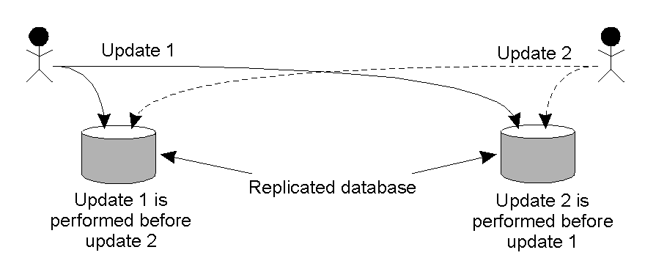
Example: Why Order Matters?

Slide 18
Lamport Algorithm
Clock synchronization does not have to be exact
  Synchronization not needed if there is no interaction between machines
  Synchronization only needed when machines communicate
  i.e. must only agree on ordering of interacting events

Slide 19
Lamport’s “Happens-Before” Partial Order
Given two events e & e’, e < e’ if:
Same process: e <_{i} e’, for some process P_{i}
Same message: e = send(m) and e’=receive(m) for some message m
Transitivity: there is an event e* such that e < e* and e* < e’

Slide 20
Concurrent Events
Given two events e & e’:
If neither e < e’ nor e’< e, then e || e’
Real Time
a
b
P₁
m₁
c
d
P₂
m₂
e
f
P₃
Notes:
Note that if two events happen without any message, then we can't say anything about their relative occurrence in time.
In this example a <= b <= c <= d <= f, but we can say little about e other than e <= f. We say that events such as a and e are concurrent.
Note also that “happens before” does not demonstrate causality. There is merely the potential for causality.

Slide 21
Lamport Logical Clocks
Substitute synchronized clocks with a global ordering of events
  e_{i} < e_{j} ⇒ LC(e_{i}) < LC(e_{j})
  LC_{i} is a local clock: contains increasing values
    each process i has own LC_{i}
  Increment LC_{i} on each event occurrence
  within same process i, if e_{j} occurs before e_{k}
    LC_{i}(e_{j}) < LC_{i}(e_{k})
  If e_{s} is a send event and e_{r} receives that send, then
    LC_{i}(e_{s}) < LC_{j}(e_{r})

Slide 22
Lamport Algorithm
Each process increments local clock between any two successive events
Message contains a timestamp
Upon receiving a message, if received timestamp is ahead, receiver fast forward its clock to be one more than sending time

Slide 23
Lamport Algorithm (cont.)
Timestamp
  Each event is given a timestamp t
  If e_{s} is a send message m from p_{i}, then t=LC_{i}(e_{s})
  When p_{j} receives m, set LC_{j} value as follows
    If t < LC_{j}, increment LC_{j} by one
      Message regarded as next event on j
    If t ≥ LC_{j}, set LC_{j} to t+1

Slide 24
Lamport’s Algorithm Analysis (1)
Claim: e_{i} < e_{j} ⇒ LC(e_{i}) < LC(e_{j})
Proof: by induction on the length of the sequence of events relating to e_{i} and e_{j}
a
b
Real Time
P₁
1
2
m₁
c
d
g
P₂
3
4
5
m₂
e
f
P₃
1
5

Slide 25
Lamport’s Algorithm Analysis (2)
LC(e_{i}) < LC(e_{j}) ⇒ e_{i} < e_{j} ?
Claim: if LC(e_{i}) < LC(e_{j}), then it is not necessarily true that e_{i} < e_{j}
a
b
Real Time
P₁
1
2
m₁
c
d
P₂
3
4
m₂
e
g
f
P₃
1
2
5

Slide 26
Limitation of Lamport’s Algorithm
e_{i} < e_{j} ⇒ LC(e_{i}) < LC(e_{j})
However, LC(e_{i}) < LC(e_{j}) does not imply e_{i} < e_{j}
  for instance, (1,1) < (1,3), but events a and e are concurrent
a
b
Real Time
P₁
(1,1)
(2,1)
m₁
c
d
P₂
(3,2)
(4,2)
m₂
e
g
f
P₃
(1,3)
(2,3)
(5,3)

Slide 27
Vector Timestamps
P_{i}’s clock is a vector VT_{i}[]
VT_{i}[i] = number of events P_{i} has stamped
VT_{i}[j] = what P_{i} thinks number of events P_{j} has stamped (i ≠ j)

Slide 28
Vector Timestamps (cont.)
Initialization
  the vector timestamp for each process is initialized to (0,0,…,0)
Local event
  when an event occurs on process P_{i}, VT_{i}[i] ← VT_{i}[i] + 1
    e.g., on processor 3, (1,2,1,3) → (1,2,2,3)

Slide 29
Vector Timestamps (cont.)
Message passing
  when P_{i} sends a message to P_{j}, the message has timestamp t[]=VT_{i}[]
  when P_{j} receives the message, it sets VT_{j}[k] to max (VT_{j}[k],t[k]), for k = 1, 2, …, N
    e.g., P₂ receives a message with timestamp (3,2,4) and P₂’s timestamp is (3,4,3), then P₂ adjusts its timestamp to (3,4,4)

Slide 30
Comparing Vectors
VT₁ = VT₂ iff VT₁[i] = VT₂[i] for all i
VT₁ ≤ VT₂ iff VT₁[i] ≤ VT₂[i] for all i
VT₁ < VT₂ iff VT₁ ≤ VT₂ & VT₁ ≠ VT₂
  for instance, (1, 2, 2) < (1, 3, 2)

Slide 31
Vector Timestamp Analysis
Claim: e < e’ iff e.VT < e’.VT
a
b
[2,0,0]
Real Time
P₁
[1,0,0]
m₁
c
d
[2,2,0]
P₂
[2,1,0]
m₂
e
g
f
[2,2,3]
P₃
[0,0,1]
[0,0,2]

