Slide 1
LOGITRACK GLOBAL
Supply Chain & Logistics
Performance Analysis
Supply Chain Business Report · June 2025
Prepared by Moses Ariyo | Data Analyst

Slide 2
CONTEXT
The Business Problem
50
LogiTrack Global is a mid-sized logistics and supply chain company managing product distribution across multiple warehouses, suppliers, and logistics partners. Despite strong operational activity, delivery reliability, partner performance, and cost efficiency have become growing concerns for management.
RECORDS ANALYZED
June 2025
REPORTING PERIOD
MY ROLE
Brought in as Data Analyst to investigate the drivers of delay and cost inefficiency, build an interactive Power BI dashboard, and deliver actionable recommendations for management.
10
DATA FIELDS
LogiTrack Global · Supply Chain & Logistics Performance Analysis
2

Slide 3
APPROACH
Scope, Data & Method
01
02
03
04
CLEAN
MODEL
VISUALIZE
RECOMMEND
Loaded and cleaned the Supply Chain Logistics dataset in Power Query — validated data types, formatted dates, and flagged a Delivery Performance status per shipment.
Built core DAX measures: total shipments, quantity, cost, delivery success rate, and delay rate — the foundation for every KPI on the dashboard.
Designed a two-page Power BI dashboard — an Executive Overview and a Supplier & Logistics Analysis page — to answer all seven business questions.
Investigated patterns across warehouses, suppliers, methods, and partners to surface insights and translate them into concrete recommendations.
Tools: Power BI · Power Query · DAX
LogiTrack Global · Supply Chain & Logistics Performance Analysis
3

Slide 4
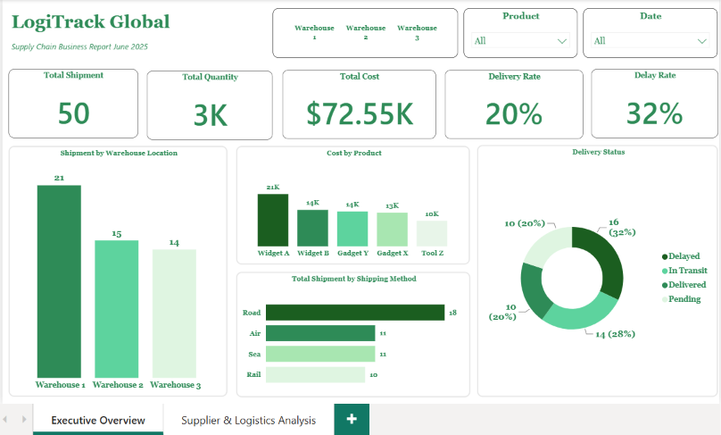
DASHBOARD · PAGE 1
Executive Overview: The Headline Numbers
32%
OF ALL SHIPMENTS ARE DELAYED
£72.55K
TOTAL SHIPMENT VALUE ACROSS 50 ORDERS
So what: nearly 1 in 3 shipments arrives late — the rest of this report investigates where that risk concentrates and what to do about it.
LogiTrack Global · Supply Chain & Logistics Performance Analysis
4

Slide 5
INSIGHT 1 & 2
Delays Concentrate in One Warehouse —
and Road Isn't the Cheap Option It Looks Like
WAREHOUSE PERFORMANCE
COST PER SHIPMENT BY METHOD
Warehouse 2 drives 46.7% of delays — the highest of any site — despite Warehouse 1 handling more total shipments (21 vs. 15). The delay problem looks operational, not volume-driven.
Road is the most-used method and the least efficient at £1.65K per shipment. Sea is cheapest at £1.30K — a real opportunity to shift non-urgent freight and cut cost.
LogiTrack Global · Supply Chain & Logistics Performance Analysis
5

Slide 6
INSIGHT 3 & 4
Two Suppliers Share the Worst Delay Rate —
and One Partner Stands Out Above the Rest
SUPPLIER DELAY RATE
DELAY SHARE BY LOGISTICS PARTNER
Epsilon Co and Gamma Inc both delay 50% of shipments — versus 18.8% for Alpha Corp, despite Alpha Corp supplying the most volume and value. Reliability doesn't track with supplier size.
FastTrans carries the highest delay share among logistics partners at 45.5%, ahead of TransEdge (40.0%) and ShipSmart (33.3%) — the clearest partner-level risk flag on the dashboard.
LogiTrack Global · Supply Chain & Logistics Performance Analysis
6

Slide 7
INSIGHT 5 & 6
Digging Deeper: Rail's Unusual Pattern,
and What's Really Behind FastTrans's Delays
RAIL: DELIVERY STATUS SPLIT
FASTTRANS: SHIPMENT MIX (n=11)
Unlike Road, Air, and Sea — each dominated by one outcome — Rail splits evenly across all four statuses, with no clear majority. Rail shipments appear to move more slowly overall, not just when delayed.
FastTrans's shipments split fairly evenly across methods (Road 4, Air 4, Rail 2, Sea 1) — Road isn't over-represented. Its 45.5% delay rate can't be blamed on method mix; the cause is likely partner-specific.
LogiTrack Global · Supply Chain & Logistics Performance Analysis
7

Slide 8
RECOMMENDATIONS
Four Actions for Management
1
Review Warehouse 2 Operations
2
Address Underperforming Suppliers
Conduct a root-cause review of staffing, dispatch, and handoff processes before addressing delays company-wide.
Set delivery-performance SLAs with Epsilon Co and Gamma Inc, or diversify sourcing toward more reliable suppliers.
3
Shift Non-Urgent Freight to Sea
4
Open a Direct FastTrans Review
Reallocate a portion of Road shipments to Sea where lead times allow, cutting cost without a proportional loss in speed.
Request delay-cause reporting from FastTrans, or pilot shifting volume to a lower-delay partner to test for improvement.
LogiTrack Global · Supply Chain & Logistics Performance Analysis
8

Slide 9
LOOKING AHEAD
Expected Impact & Next Steps
IF ACTIONED
Fixing Warehouse 2 to tackles the biggest source of delays.
NEXT STEPS
Shifting some Road shipments to Sea to cuts costs with little added risk.
Collect delay-cause detail (e.g. reason codes) to move from correlation to root cause
1
Holding weak suppliers and partners accountable reduces reliance on unreliable ones.
Introduce quarterly supplier and logistics-partner scorecards tied to the metrics in this dashboard
2
Both dashboard pages filter together automatically.
Re-run this analysis next quarter to track whether Warehouse 2 and FastTrans trends improve
3
LogiTrack Global · Supply Chain & Logistics Performance Analysis
9

Slide 10
Thank You
Questions & discussion welcome.
Moses Ariyo
Data Analyst · Glasgow, Scotland
Portfolio: LinkedIn & GitHub

