Slide 1
Security Enhancement using PowerBI and AI

Slide 2
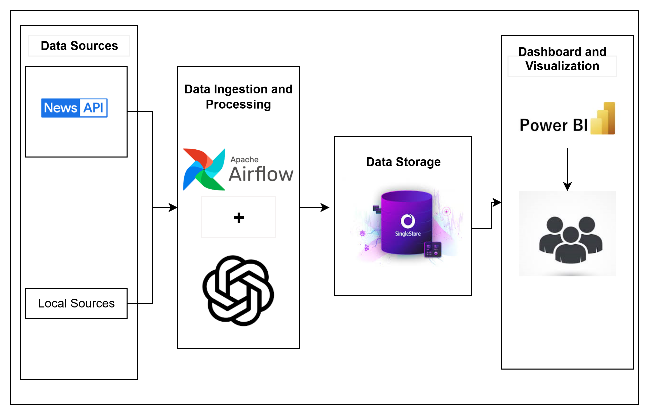
Architecture Diagram

Slide 3
System Architecture Overview
Data Sources: Data is obtained from both online news via an API or web scraping (e.g., News API) and offline local sources. These diverse inputs ensure a broad and rich dataset for analysis.
Data Ingestion and Processing: Apache Airflow orchestrates the data pipeline, automating the scheduling and flow of tasks. ChatGPT (or a custom AI component) assists with preprocessing, enriching, or summarizing the incoming data for consistency and insight extraction.
Data Storage: Processed data is stored securely in a data warehouse (represented here by Singlestore), ensuring scalability, reliability, and compliance with data protection standards.
Dashboard and Visualization: Power BI fetches data from the warehouse to create dynamic dashboards and visual reports, enabling stakeholders to gain actionable insights and make informed decisions based on real-time data.

