Slide 1
Relationship between Zillow Rent Index of CA Cities and Nearby Venues
Coursera Capstone Project

Slide 2
Introduction
Tenants are looking for an affordable city or area to live and work.The nearby venues are an important factor to consider.
Investors search a good place to buy houses and use them to collect rentals. The nearby venues can predict the capital return and potential rentals.

Slide 3
Introduction
Therefore, this project will explore the relationship between Zillow Rent Index of CA cities and nearby venues from Foursquare.
This project helps a group of stakeholders (tenants and landlord) solve a problem.

Slide 4
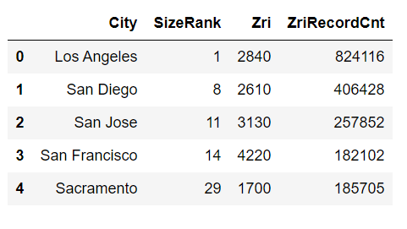
Data Source
Zillow Rent Index data from Zillow

Slide 5
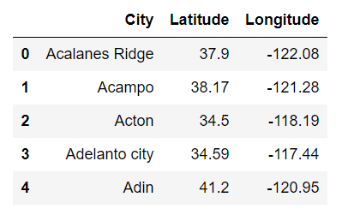
Data Source
Latitude and Longitude of California Cities

Slide 6
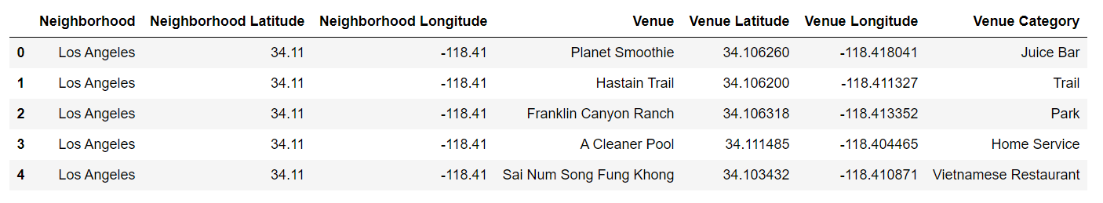
Data Source
Foursquare Location Data to Get Nearby Venues

Slide 7
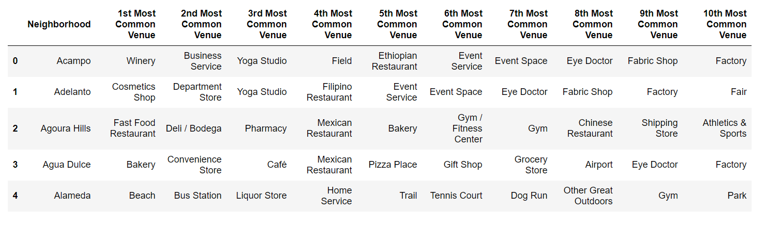
Methodology
display the top 10 venues for each city

Slide 8
Methodology
The k-means clustering aims to partition n observations into k clusters in which each observation belongs to the cluster with the nearest mean, serving as a prototype of the cluster.
This results in a partitioning of the data space into Voronoi cells.
k-Means minimizes intragroup distance, and maximizes intergroup distance.

Slide 9
Methodology
This method can group different cities according to different nearby venues. After that, we could compare cluster labels with SizeRank, Zri, and ZriRecordCnt to find the relationship between Zillow Rent Index of CA cities and nearby venues.

Slide 10
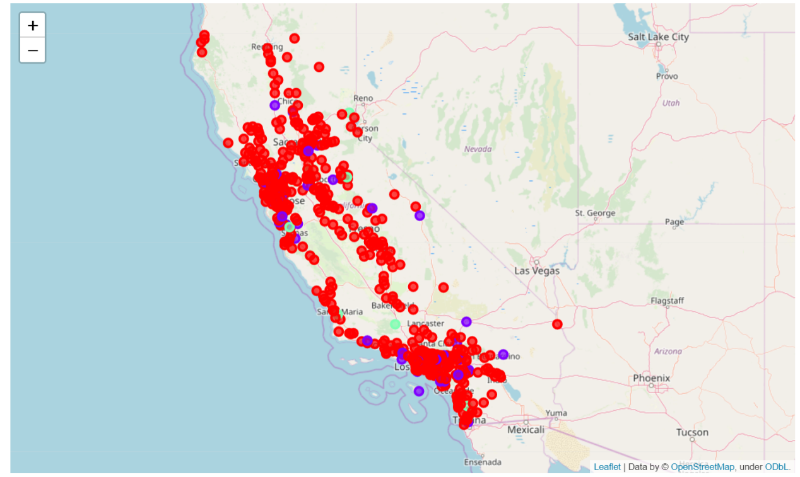
Results

Slide 11
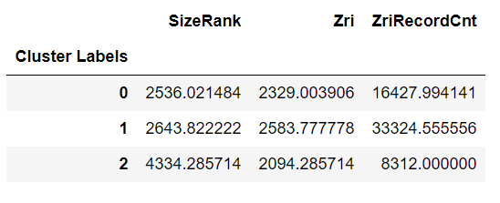
Results

Slide 12
Results
SizeRank measures the region area (lower value means a big size city group).
ZriRecordCnt is the sample size (number of rental houses) for each city.
Therefore, Label 1 city group has high rental fees with large demand (large city).
Labels 2 city group has low rental fees with low demand (small city).
Label 0 city group is between Label 1 and Label 2 (rental price and demand), but the city has a big size.

Slide 13
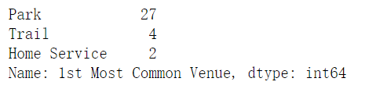
Results
Top 3 venues of 1st Most Common Venue for each city group
Label 1
The metropolitan has the relaxed common venue.

Slide 14
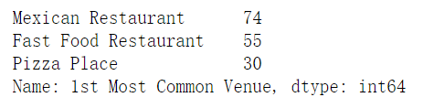
Results
Top 3 venues of 1st Most Common Venue for each city group
Label 0
The common living area provides restaurant.

Slide 15

Results
Top 3 venues of 1st Most Common Venue for each city group
Label 2
The suburb and countryside are with business service.

Slide 16
Conclusion
According to results, the metropolitan, such as downtown Los Angeles, is an expensive rental area. The tenants prefer some relaxed venues near rental houses, such as parks.
For most tenants, they prefer live in the convenient place with restaurants, supermarkets, and stores.
Investors should invest money in large and medium cities.
The good environment attracts the high-income tenants. However, convenient living service provides more opportunities to tenants and landlords.

