Slide 1

DSF-PT05
PHASE 3 PROJECT
GROUP 13

Slide 2
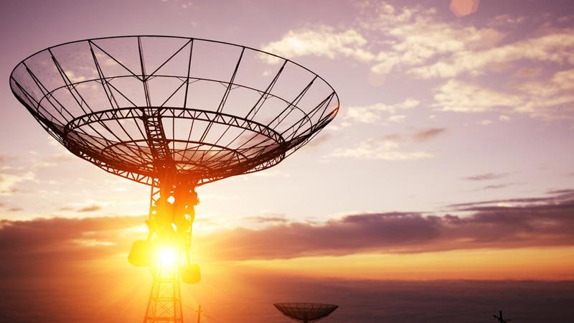

MIRIAM
MOSES
STEPHANIE
PHILIP
CHEPKEMOI
MARK

Slide 3
UNDERSTANDING CUSTOMER CHURN, A CASE OF SYRIATEL COMMUNICATIONS
A Deep Dive into Telecom Customer Behavior

Slide 4
Project Overview
Purpose: To tackle the challenge of rising customer churn by leveraging data-driven insights.
Goal: Identify and mitigate key factors leading to customer departure.
Method: Conduct a comprehensive analysis of customer behaviors, service engagement, and interaction trends to reveal underlying causes of churn.

Slide 5
Objectives
To utilize clustering techniques to segment SyriaTel's customer base into distinct groups based on usage patterns, demographics, and other relevant factors.
To assess the impact of various service features on customer retention using predictive modeling techniques.
To validate the predictive model's performance using appropriate evaluation metrics and refine it to improve accuracy and generalizability.
To evaluate the long-term effectiveness of implemented retention strategies through monitoring and analyzing churn rates over time.
To formulate and recommend bespoke retention strategies based on the analytical findings.

Slide 6
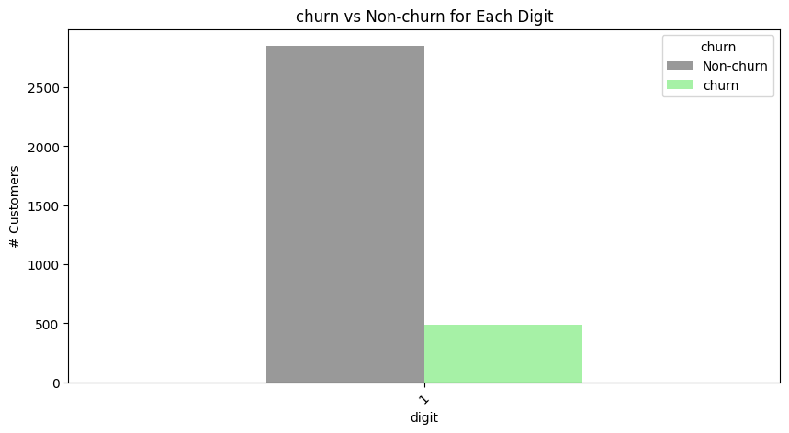
Data Pre-processing & EDA
An analysis to extract meaningful insights from the data and identify the best features to be used for modeling
Data preprocessing
Missing values
Data types
Categorical variables
EDA
Statistical Summary
EDA Univariate Analysis
EDA Bivariate Analysis
Outliers or errors
Feature Engineering/Creating
Assumptions about data shape
EDA Multivariate Analysis
Conclusion

Slide 7
Visualizations are critical to providing insights into the relationships between different variables and the target variable (churn).
Customer Service calls by state
Customer Churn by State
Mean customer service calls by churn
Pre- processing visualizations

Slide 8
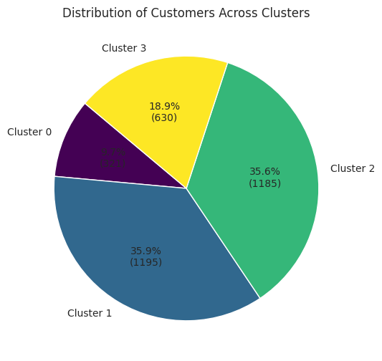
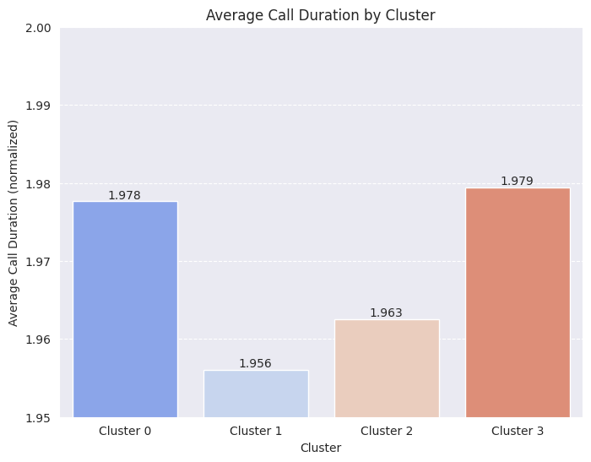
Segmentation and Clustering
Use Elbow Method to determine the most appropriate number of clusters for K-means.
Features selected for Clustering: Total Usage Minutes, Total Calls, Customer Service Calls, International Plan, and High International Usage with some of the results below.

Slide 9
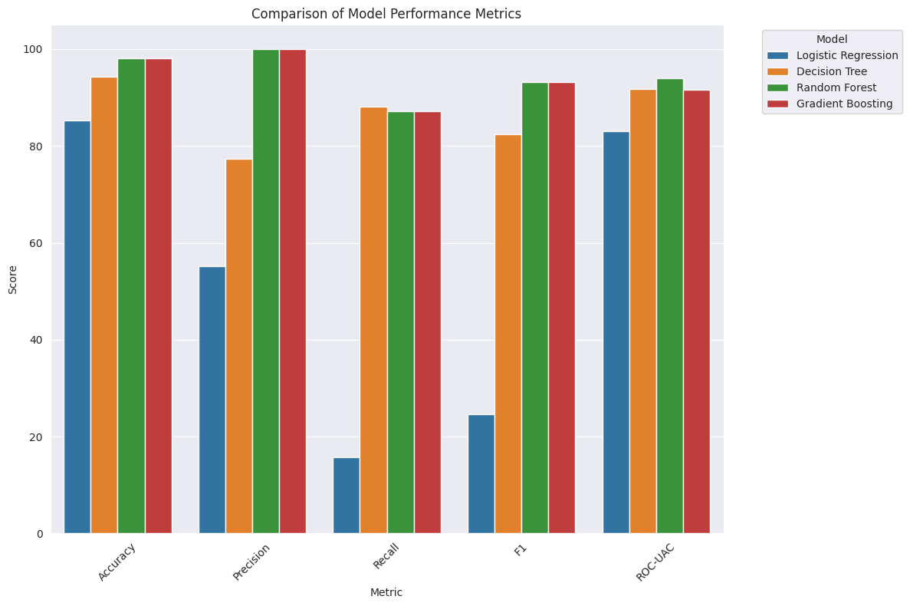
Modelling
Taking an iterative approach to the classifier models and using 3 models to analyze the accuracy, precision, recall, and F1 scores, with ROC/AUC Score and providing a classification report for;
Logistic Regression
Decision Tree Classifier
Random Forest Classifier
Gradient Boosting Classifier

Slide 10
Model Performance Overview
Gradient Boosting Classifier
Random Forest Classifier
Logistic Regression
Highest accuracy for churn prediction.
A strong balance of accuracy and class distinction capabilities (high ROC-AUC score).
Slightly lower ROC-AUC score vs. Random Forest suggests limitations in prediction confidence across thresholds.
Offers simplicity and interpretability.
Valuable for scenarios requiring insight into the influence of individual features, despite lower performance metrics
Robust choice for churn prediction, offering reliable performance.

Slide 11
Feature Importance Visualization

Slide 12
Conclusions
Churn Analysis
Customer Behavior Insights
International Plan Impact: Customers with international plans show higher churn rates, signaling a need for deeper analysis on dissatisfaction causes.
Geographical Patterns
Observation: Churn rates vary across different states, indicating potential geographical influences on customer behavior.
Service Usage Analysis
Finding: No significant correlation between churn and service usage patterns like total day and evening minutes.
Customer Service Calls Correlation: A weak positive correlation with churn implies that increased customer service interaction might not directly enhance retention.
Action Item: Further exploration needed to understand regional differences and tailor retention strategies accordingly.
Churn Rate: At 14.5%, it highlights a notable customer departure rate.
Influential Factors:International plans and the frequency of customer service calls exhibit a moderate positive correlation with churn, significantly impacting customer retention efforts.
Next Steps: Further analysis is recommended to assess the potential impact on customer retention more deeply.

Slide 13
Targeted Retention Strategies
Enhanced Customer Support
Geographically Targeted Campaigns
Continuous Monitoring and Analysis
Data-driven Decision Making
Collaboration Across Departments
Recommendations

Slide 14
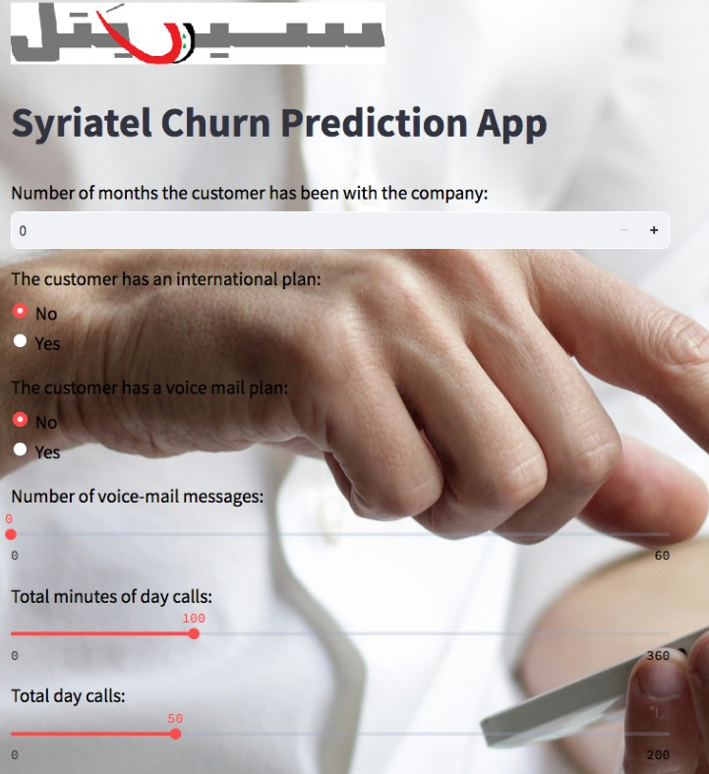
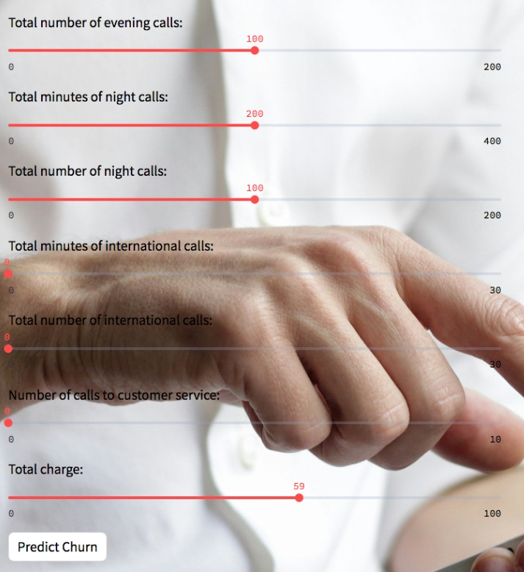
Model Deployment App

