Slide 1

Revolutionizing Real Estate Analysis
American Mortgage Bank & Vita Group Collaboration

Slide 2



THE CLIENT
Established at the turn of the 20th century, AMB now stands as a pillar of innovation, at the confluence of traditional values and cutting-edge technology. With an eye toward sustainable growth and a commitment to customer-centric services, AMB has harnessed advanced data analytics to understand and adapt to the rapidly shifting sands of the real estate landscape.

Slide 3







Rodgers Odhiambo
Ann Karuga
James Kibunja
Linet Wangui
Moses Kigo
THE TEAM

Slide 4

Background Summary
American Mortgage Bank (AMB) is at the forefront of a dynamic real estate market, where changing trends present challenges in maintaining effective lending strategies and risk assessment. The bank's drive for innovation underpins its commitment to gaining deeper market insights to refine its mortgage services.

Slide 5

The challenge
AMB is confronted with the complex task of analyzing an intricate real estate market. Traditional methods fall short of providing the nuanced understanding necessary to stay competitive. The bank needs to enhance its data analysis capabilities to better serve its diverse clientele with innovative mortgage products.

Slide 6

The Objective
AMB targets to acquire unmatched market insights and predictive analysis tools that will allow the bank to fine-tune lending strategies, elevate risk assessment, and innovate their mortgage products in line with emerging market trends.

Slide 7

The Solution
Vita Group proposes a solution involving advanced analytics and machine learning to conduct a data-driven market analysis for AMB. The plan includes using;
sophisticated models to analyze time series data,
predict future trends,
innovate mortgage products based on these insights.

Slide 8

Implementation Summary
The implementation strategy consists of four phases:
Data acquisition and preprocessing
Analytical modeling
Strategy optimization and product innovation
Continuous learning and adaptation.
These steps aim to provide AMB with actionable insights from extensive real estate data.

Slide 9

Dataset Summary
The dataset from Zillow provides a comprehensive time series of the Zillow Home Value Index, offering insights into home values, market changes, and trends across various regions from 2000 to 2024. This data is pivotal in understanding property value trends and informing strategic decisions.

Slide 10
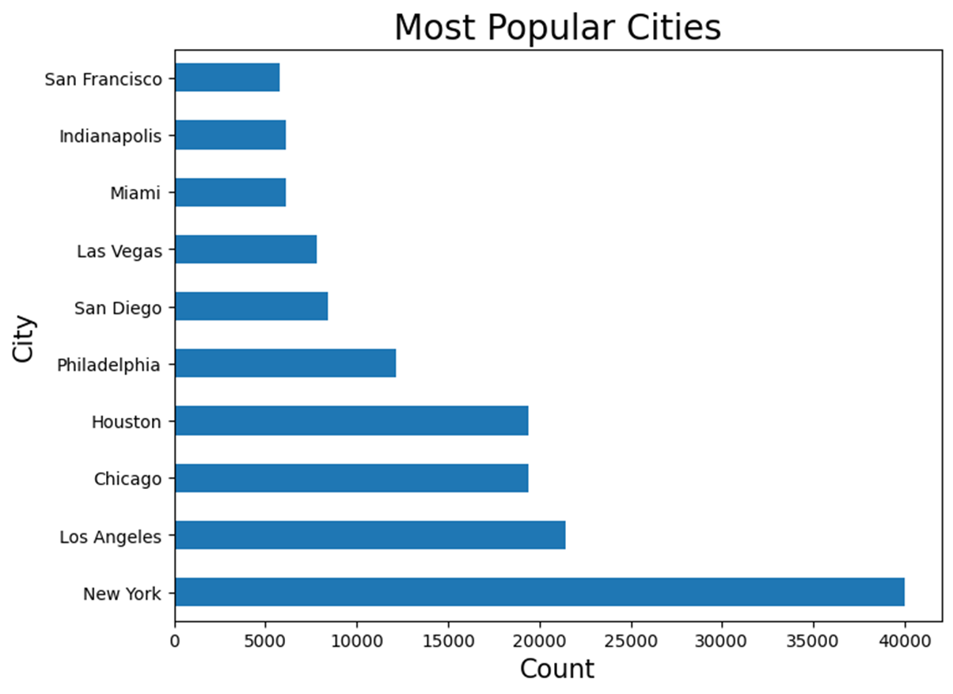
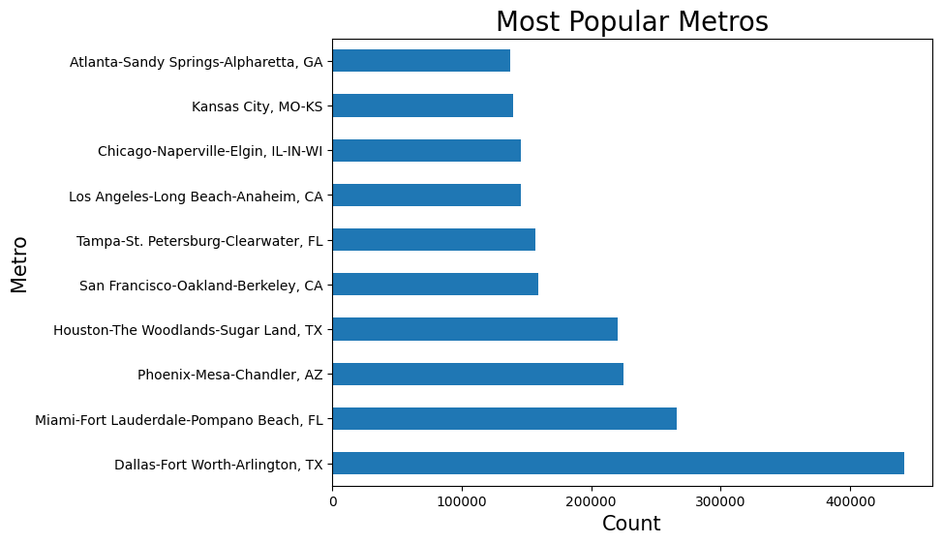
Most popular areas
These are the most popular areas by home values.

Slide 11

MODELLING Time Series Components
Level - The level component represents the baseline or average value around which the time series fluctuates.
Trend - The trend component depicts the long-term upward or downward movement in the time series data.
Seasonality - Seasonality refers to the recurring patterns or cycles that occur at fixed intervals within the time series.
Residuals - residuals capture the random or unpredictable fluctuations in the data that the other components cannot explain.

Slide 12
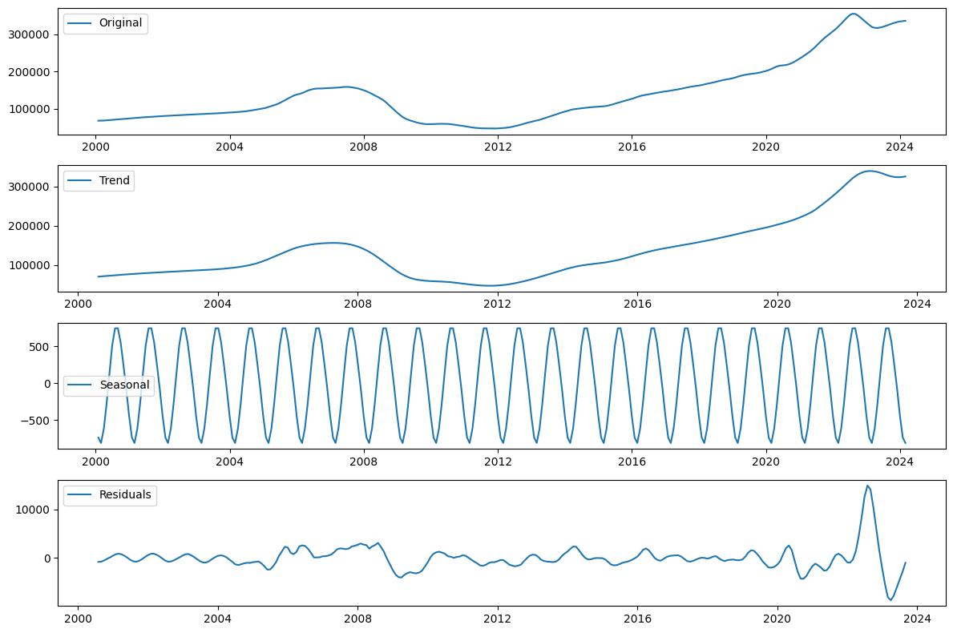
Time Series Decomposition
Breaking the non-stationary time series into its three components
trend, seasonality, and residuals

Slide 13

Modelling the Time Series
Using an iterative approach to select the most appropriate model for predicting Home Values
1. Moving Average (Base Model)
2. Autoregressive Model
3. ARMA Model
4. ARIMA Model
5. SARIMA Model
6. Facebook Prophet

Slide 14
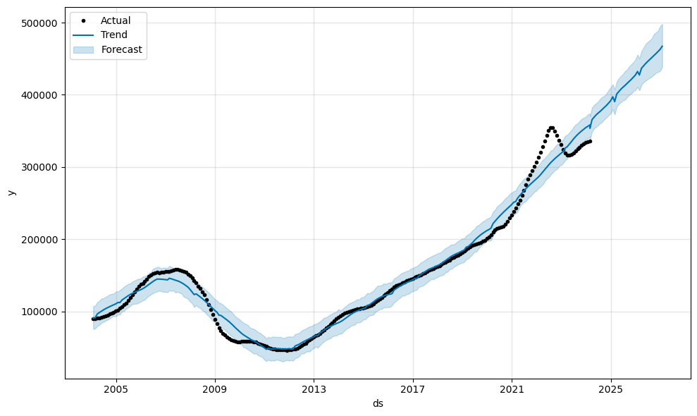
Model Evaluation and Performance
There is a general upward trend in home prices throughout the timeframe.
This suggests that, on average, home prices in the United States have increased over the past two decades.
There are periods of rapid increase followed by periods of stagnation or slight decrease.
This is indicative of housing bubbles and bursts that have occurred throughout history.

Slide 15
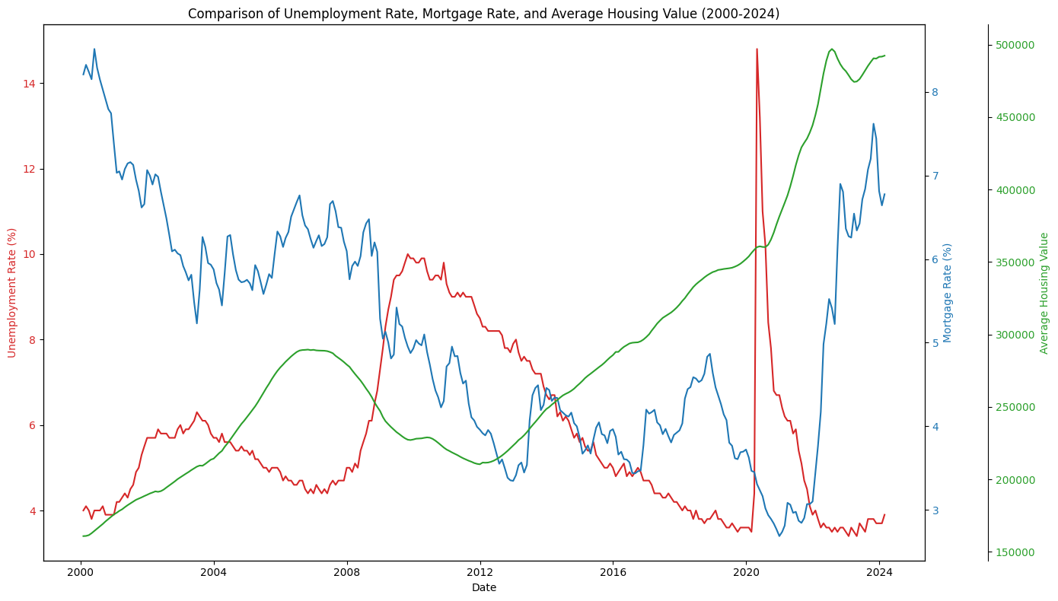
Market Drivers Analysis
Comparison of trends of indices between the years of 2000 and 2024
Unemployment Rate (Red): Reflects economic health; peaks often indicate downturns affecting housing demand and prices.
Mortgage Rate (Blue): Influenced by monetary policy; lower rates can stimulate demand and potentially increase housing values.
Housing Value Trend (Green): Shows long-term growth despite occasional declines during economic crises

Slide 16

Model Deployment
Why the SARIMA model?
Integration
Real-Time Insights
Decision Support
Accessibility
Continuous Improvement
Outcome: Empowering American Mortgage Bank with the foresight to navigate the real estate market confidently, ensuring our competitive edge and customer satisfaction.

Slide 17

CONCLUSION
Data-Driven Decisions
Enhancing Customer Satisfaction
Driving Sector Growth
Revolutionizing Lending and Risk Assessment
Innovating Products
Leadership in Mortgage Finance

Slide 18
Recommendations
Innovate Mortgage Products
Enhance Risk Management
Embrace data-driven decision-making
Monitor Market Drivers

Slide 19

Q and A

Slide 20
Thank you

