Slide 1
Predicting Injury Severity Risk Factors using US Accidents Data MSIS 5633 PREDICTIVE ANALYTICS
TERM PROJECT PRESENTATION – TEAM 2
Satheneni Nithya Sri – A20341237
Paul Davis - A20357720
Shirley She - A20252695

Slide 2
What is CRISP-DM?
CRISP-DM stands for cross-industry process for data mining.
This is a method for planning a data mining project.
It starts with a thorough understanding of the company's goals and ends with the project's deployment.
CRISP-DM can be used in any Data Mining project, regardless of the domain.
This method is cost-effective since it incorporates several processes that eliminate basic data mining activities.

Slide 3
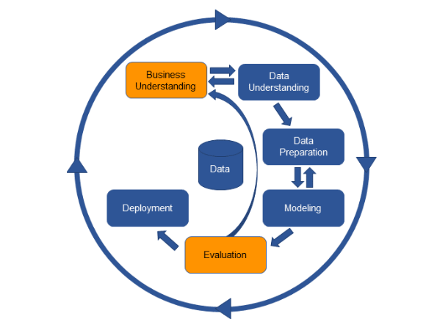
Phases of CRISP-DM
Business Understanding
Data Understanding
Data Preparation
Modeling
Evaluation
Deployment

Slide 4
BUSINESS UNDERSTANDING
The major goal is to discover the risk factors that cause accidents and car crashes, minimize the chance of accidents occurring, and lower the severity of injuries, all of which benefit society.
In the United States, road safety is a serious problem, with 1.36 fatalities per 100 vehicles in 2021, up from 1.35 fatalities in 2020.
To do so, we'll use historical data that covers all the components that contributed to the accidents, such as environmental conditions, car technical factors, and collision scenarios, among others.

Slide 5
BUSINESS UNDERSTANDING (Cont.)
The data might be structured or unstructured, and it can come from a variety of sources. This is referred to as Big Data.
On this data, we will undertake data mining, also known as Big Data Analytics, which is increasingly popular these days in many fields such as health care systems, analyzing road safety measures etc.
We will apply machine learning approaches to our given datasets and determine the causes of rising car accidents/collisions and obtain reliable data that will assist us in reducing risks and injuries, potentially saving many lives.

Slide 6
DATA UNDERSTANDING
The accidents data file contains the data related to the situation of accident; the vehicle data file has the parameters related to the vehicle. The person data file contains parameters related to each person that was involved in the crash and whether the person is a driver or a passenger. The Distract file describes the data that was a distraction causing the accident.
We have a total of 130,228 number of records and 207 variables from all the files combined. We will clean and transform the data by removing missing values or unwanted data, reducing the variables to only that are an important factor for the analysis.

Slide 7
DATA PREPARATION
Data Preparation is the most significant and time-consuming element in the Data Mining process.
This is because it is at this point that we must prepare the data for modelling and obtain reliable findings. If we squander our data, there's a good chance that our models will have a very poor efficiency rate.
There will be missing data in certain variables, and a few variables may be irrelevant to our research, necessitating the removal of such variables in order to obtain proper results.

Slide 8
DATA PREPARATION (Cont.)
We eliminated most of the non-essential variables, reducing the total number of variables to 37. We believe that these are the most essential elements to estimate the severity of an accident's injuries based on all the information presented and our expertise.
For the data cleaning and model training processes, we used KNIME, a data mining tool. We used several nodes from KNIME's node repository that were critical for data manipulations.

Slide 9
DATA PREPARATION (Cont.)
Variables included in the Data Mining Process:
REGION | Geographic region | Nominal
URBANICITY | Urban/Rural | Binary
NUM_INJ | Number Injured in Vehicle | Nominal
MONTH | Month of Crash | Nominal
YEAR | Year of Crash | Nominal
MAN_COLL | Number Injured co Vehicle | Nominal
RELJCT1 | Relation to Junction- Within Interchange Area | Binary
WRK_ZONE | Work Zone | Binary
REL_ROAD | Relation to Trafficway | Nominal
WEATHER | Atmospheric Conditions | Nominal
INT_HWY | Interstate Highway | Binary
WKDY_IM | Imputed Day of Week | Nominal
HOUR_IM | Crash Time (Hour) | Nominal
LGTCON_IM | Imputed Light Condition | Nominal
MOD_YEAR | Vehicle Model Year | Nominal
J_KNIFE | Jackknife | Binary
GVWR | Gross Vehicle Weight Rating | Nominal
HAZ_INV | Hazardous Materials Involvement | Binary
DEFORMED | Extent of Damage | Nominal
TOWED | Vehicle Removal | Binary
FIRE_EXP | Fire Occurrence | Binary
BDYTYP_IM | Imputed Body Type | Nominal
PCRASH1_IM | Pre-Event Movement | Nominal
AGE | Age of Person | Nominal
INJ_SEV | Injury Severity | Binary
REST_USE | Restraint System Use | Nominal
AIR_BAG | Air Bag Deployed | Binary
DRINKING | Police-Reported Alcohol Involvement | Binary
ALC_RES | Alcohol Test Result | Nominal
DRUGS | Police Reported Drug Involvement | Binary
SEX_IM | Sex of Person | Binary
EJECT_IM | Ejection | Binary

Slide 10
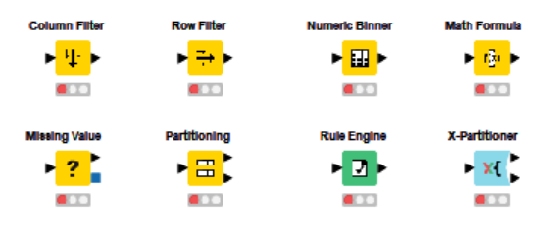
DATA PREPARATION (Cont.)

Slide 11
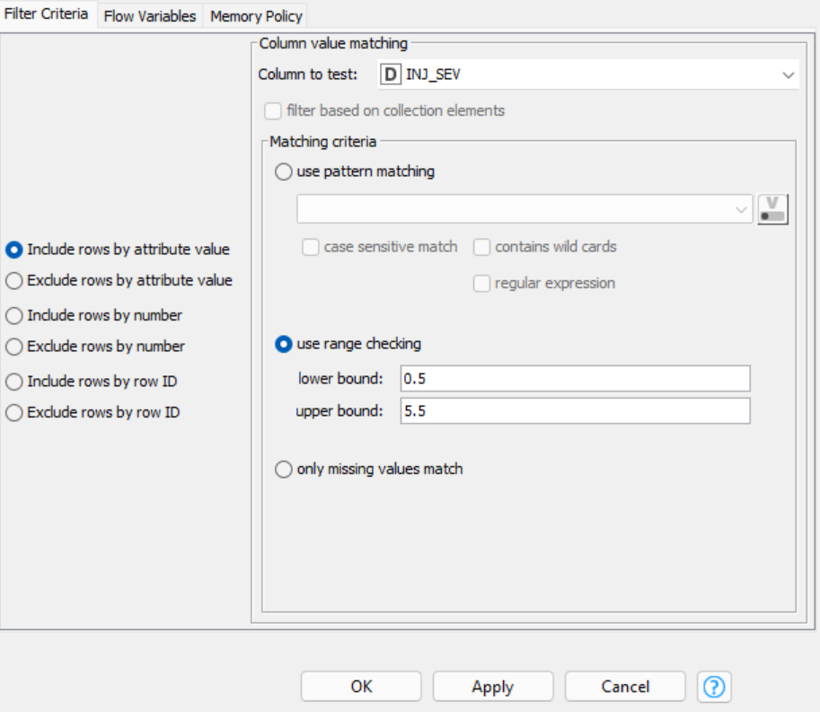
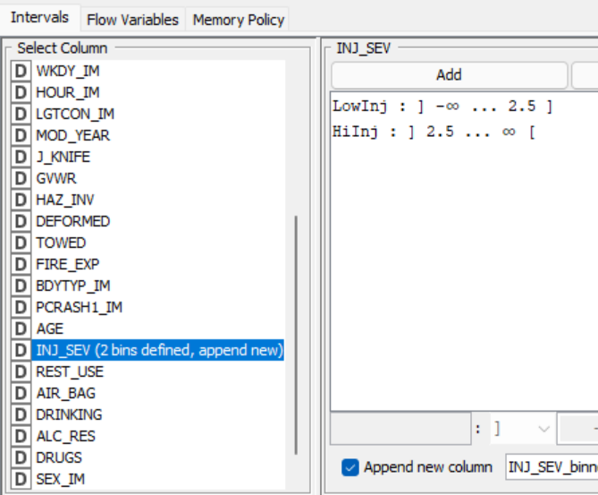
DATA PREPARATION (Cont.)
The variable INJ_SEV is used to describe the severity of an injury. The numbers that are relevant range from 0.5 to 5.5, and the remaining values are unknown or missing. To include only the relevant values, we utilize a row filter and numeric binner.
In this way, we use various filters to get only the appropriate data from variables.

Slide 12
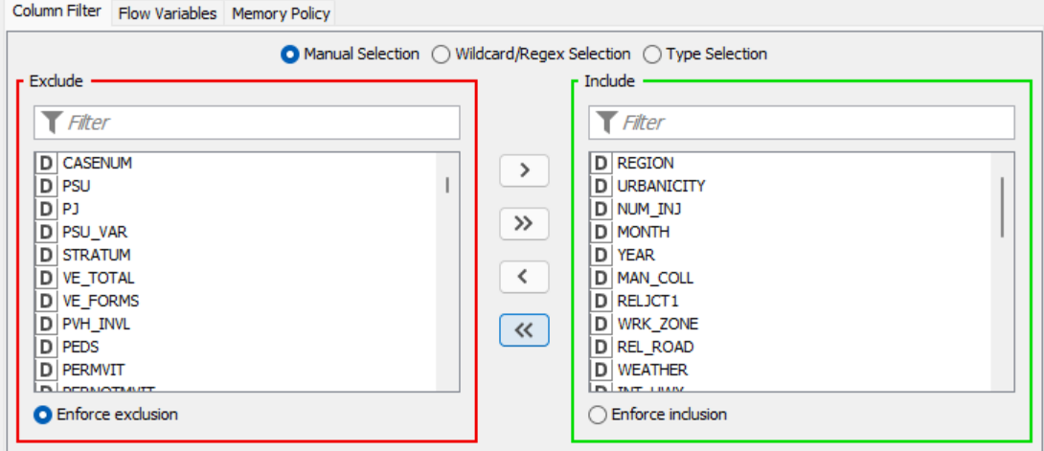
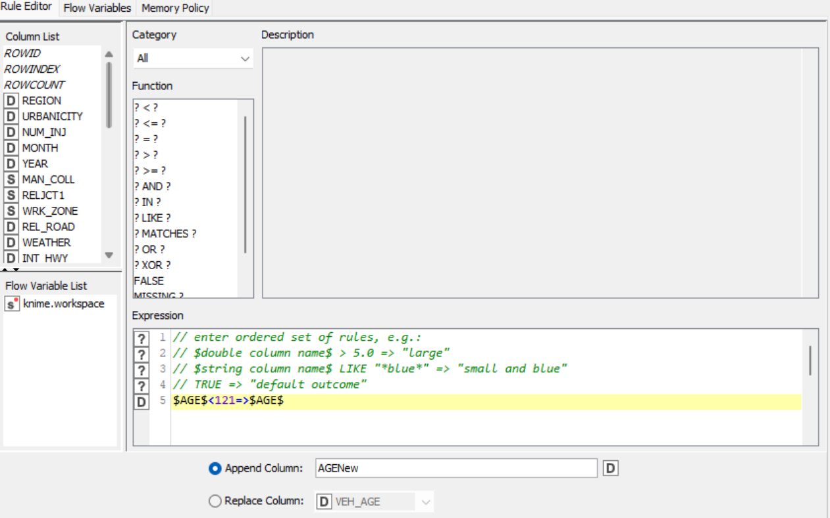
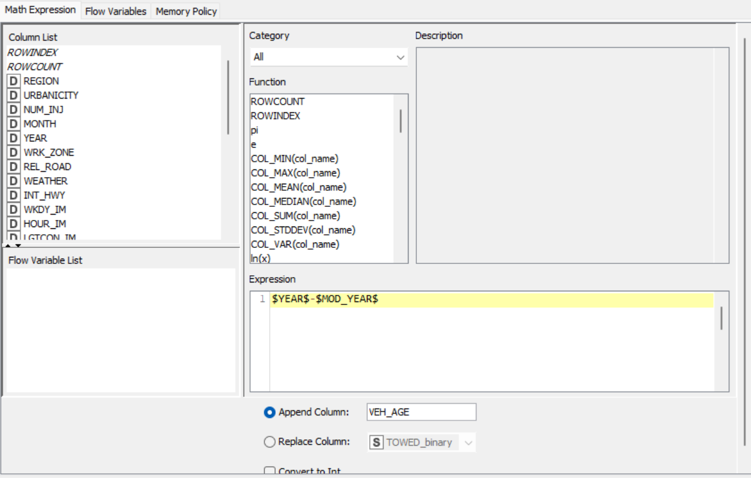
DATA PREPARATION (Cont.)

Slide 13
DATA PREPARATION (Cont.)
After deciding the suitable variables, the next step is to partition the data that is used for training various machine learning models. In our model, we used two ways to partition the data into training and testing sets.
X-Partitioner Node and Partitioner Node.
X-Partitioner Node: This node divides the data into N number of folds as specified by the user and combines all the data using an aggregator after modeling.
Partitioner Node: This node partitions the data into a single training and testing set based on the percentage we provide in the configurations.

Slide 14
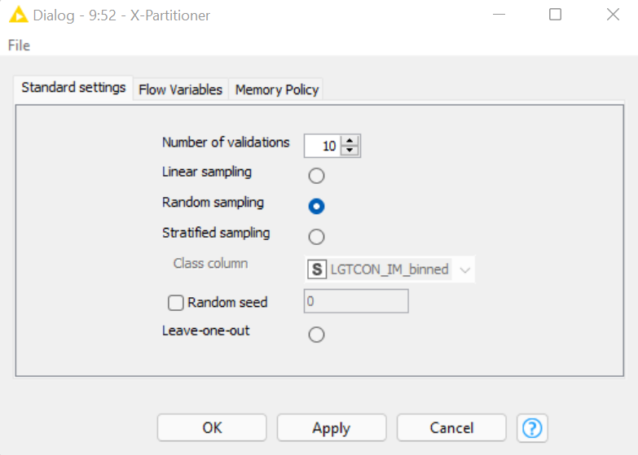
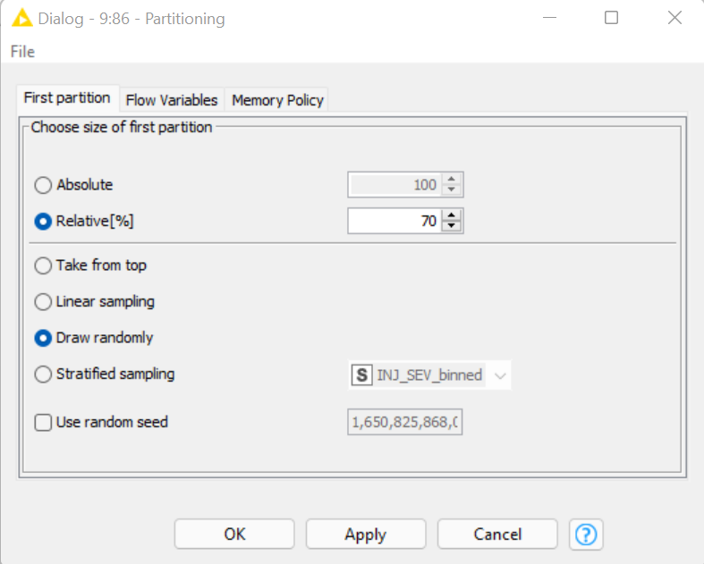
DATA PREPARATION (Cont.)
X-Partitioner Node:
Partitioner Node:

Slide 15
DATA PREPARATION (Cont.)
Data balancing is another key aspect of data preparation. We won't be able to get reliable findings for our machine learning models until we have properly balanced data, which will be a big disadvantage. We employed two alternative methods of data sampling to address this problem: SMOTE and Equal Size Sampling.
SMOTE: Smote node usually oversamples the minority classes or under samples the majority classes in our data based on the k-nearest neighbors.
Equal Size Sampling: This node removes the rows from input data to balance all the classes that are involved in the data. We used exact sampling for each of the model to have exactly same number of rows in our data for few models.

Slide 16
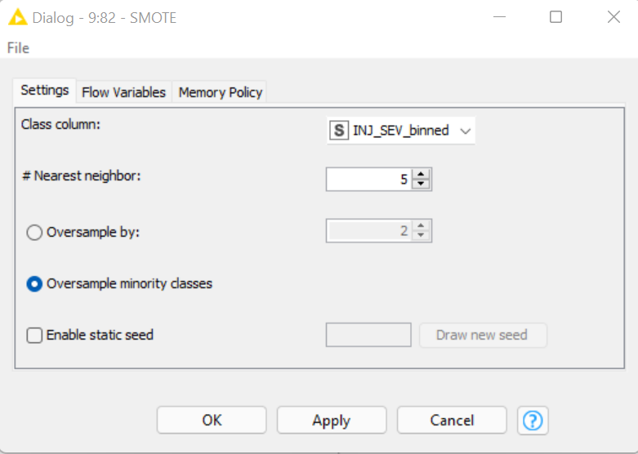
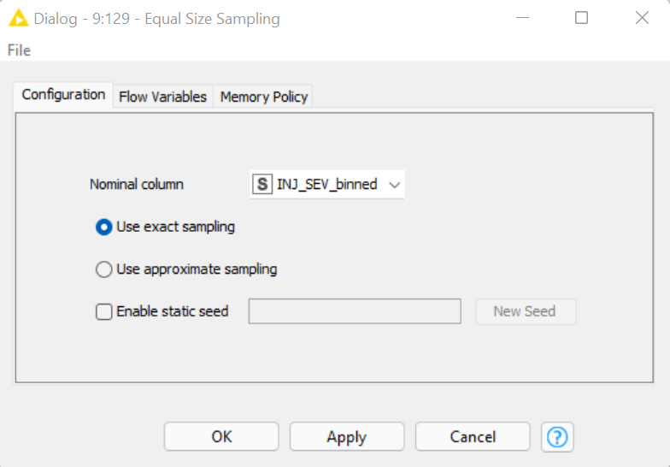
DATA PREPARATION (Cont.)
SMOTE Node:
Equal Size Sampling Node:

Slide 17
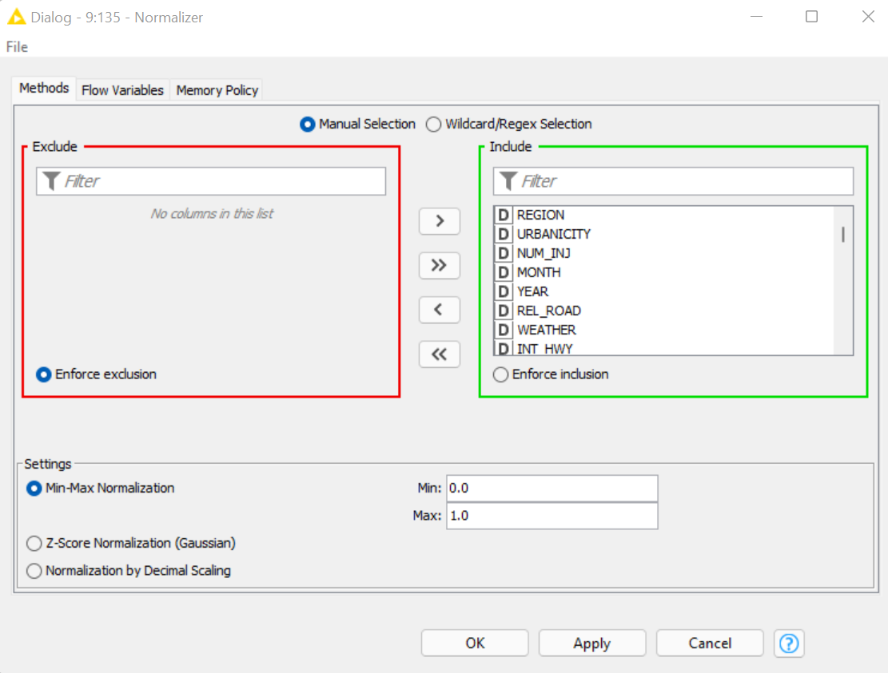
DATA PREPARATION (Cont.)
The normalizer node, which is used to normalize numerical data into a specific range/boundary, is another significant node. Typically, we employ Min-Max Normalization, which transforms all input data to lie inside the specified range. We can pick and select the variables we want to standardize.

Slide 18
MODELING
We used a few different machine learning models. Set-based predictive models and numerical predictive models are both available in KNIME. The majority of numerically based predictive models use nominal data, which is ideal for our data. With the modified variables from the data preparation phase, we also applied set-based approaches. Each model has its own value, and once we've trained and tested them, we'll choose one to use for our data mining project based on the accuracy statistics. We'll pick the greatest model that aligns with our business goals.
The models which we used for our data mining project are each shown in the below slides.

Slide 19
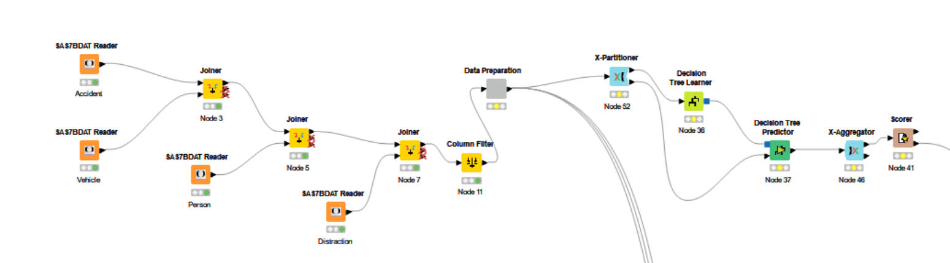
MODELING
Decision Tree Model:

Slide 20
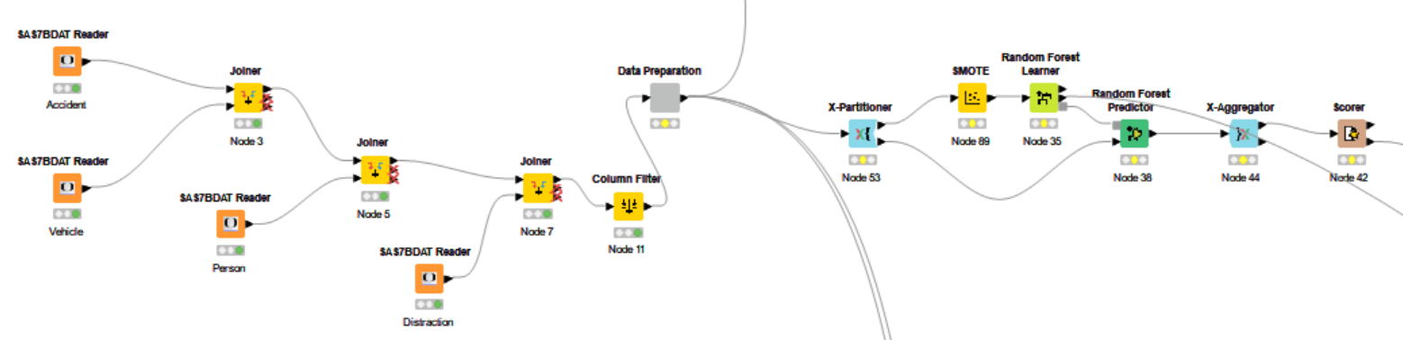
MODELING
Random Forest Model:

Slide 21
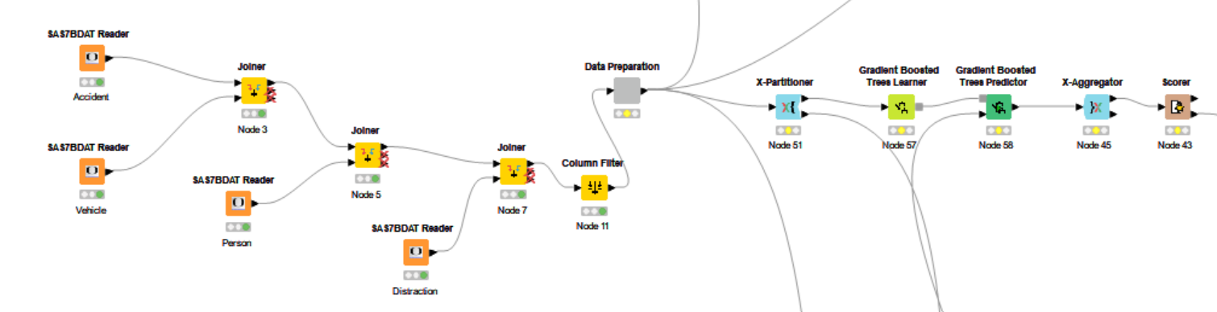
MODELING
Gradient Boosted Tree Model:

Slide 22
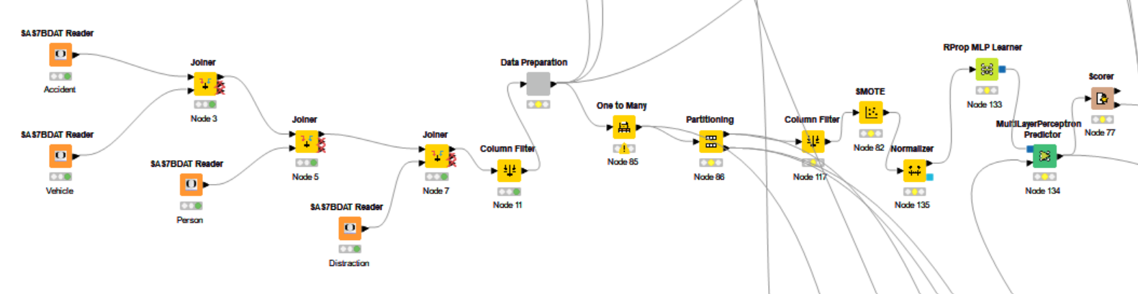
MODELING
RProp Model:

Slide 23
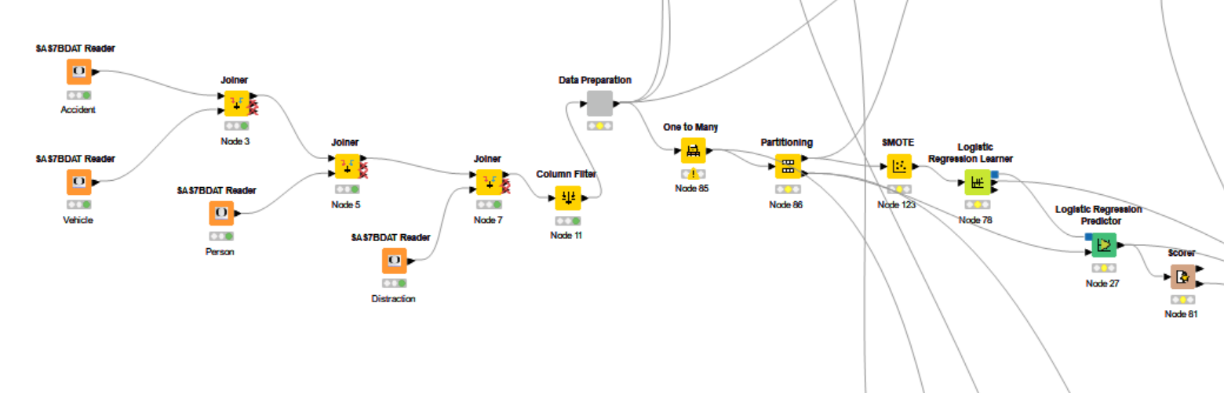
MODELING
Logistic Regression Model:

Slide 24
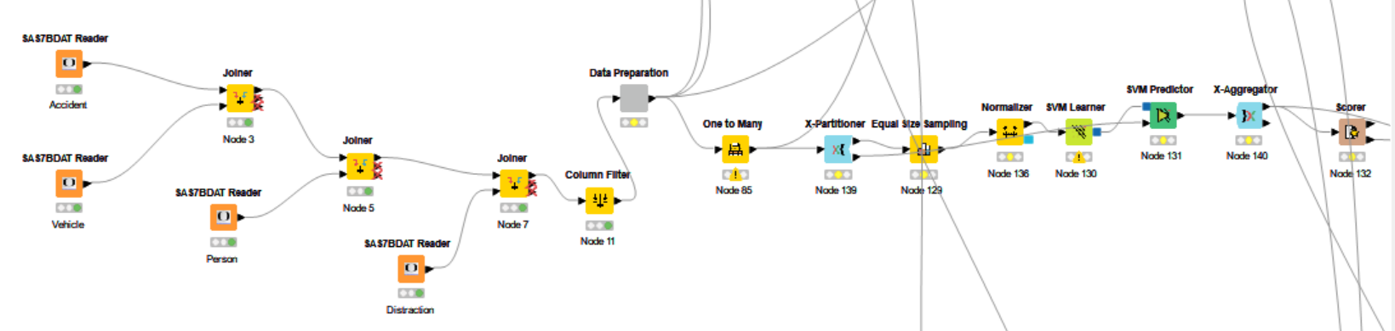
MODELING
Support Vector Machine Model:

Slide 25
EVALUATION
We compared the accuracy statistics for each model based on the findings obtained from each of the above models. We will cross-check if we are meeting our business goal or not in this step.
The model's accuracy specifies the percentage of correct predictions we obtained from our models.
The percent of genuine positives we predicted is measured by sensitivity, whereas the percent of true negatives is measured by specificity.
ROC Curves depict the link between our model's sensitivity and specificity and take the original class value and the forecasted one to calculate the percent that was correctly predicted.

Slide 26
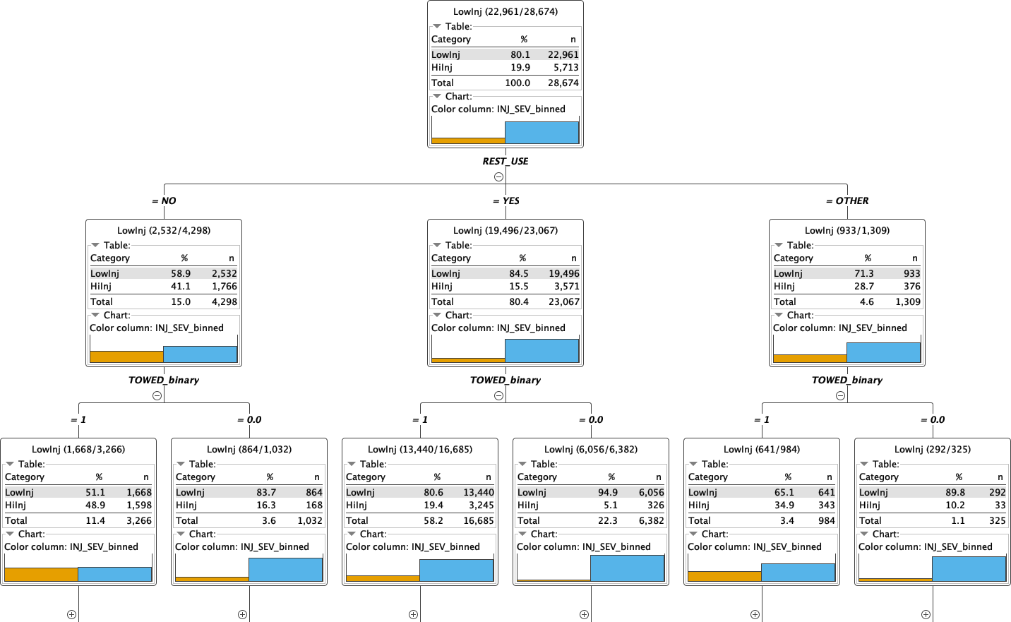
EVALUATION
Decision Tree (Up to 3 Levels):

Slide 27
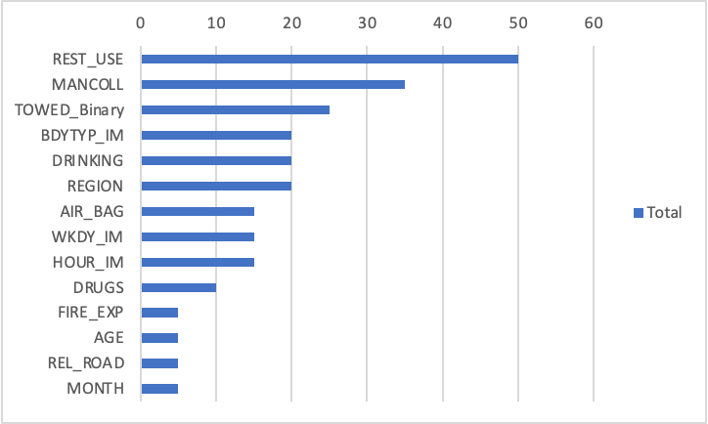
EVALUATION
Decision Tree Variable Importance, Variables in Top 4 Splits:

Slide 28
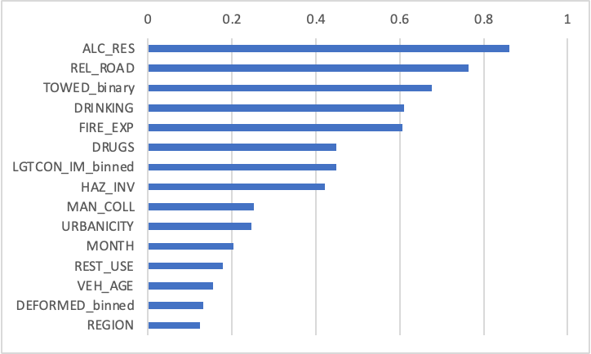
EVALUATION
Random Forest Variable Importance, Top 10 Variables:

Slide 29
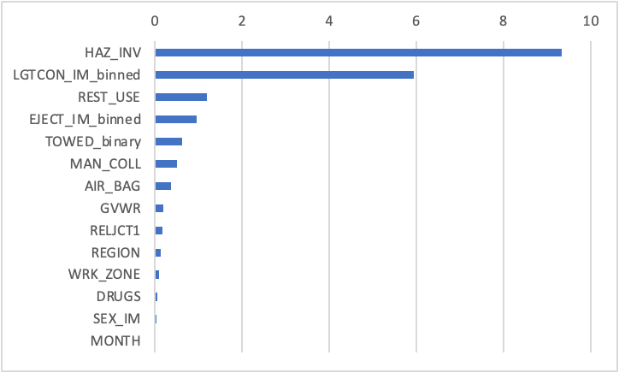
EVALUATION
Logistic Regression Variable Importance, Top 15 Variables:

Slide 30
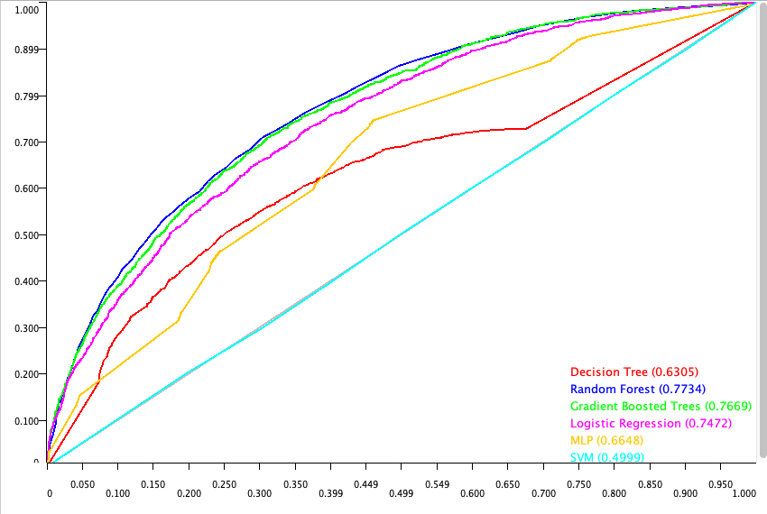
EVALUATION
Combined ROC Curve:

Slide 31
EVALUATION
Below is the table that compares the accuracy, sensitivity, specificity, and ROC value for each model.
Model | Accuracy | Sensitivity | Specificity | ROC
Decision Tree | 0.754 | 0.354 | 0.857 | 0.631
Random Forest | 0.819 | 0.293 | 0.950 | 0.773
Gradient Boosted Trees | 0.817 | 0.195 | 0.972 | 0.767
RProp | 0.796 | 0.007 | 0.999 | 0.665
Logistic Regression | 0.706 | 0.623 | 0.728 | 0.747
Support Vector Machines | 0.808 | 0.000 | 1.000 | 0.500

Slide 32
EVALUATION – COMBINED VARIABLE RANK
Variable Name | Count of Models | Importance Score
HAZ_INV | 2 | 1.490
TOWED_Binary | 3 | 1.351
REST_USE | 3 | 1.335
LGTCON_IM_binned | 2 | 1.159
DRINKING | 2 | 1.109
ALC_RES | 1 | 1.000
REL_ROAD | 2 | 0.986
FIRE_EXP | 2 | 0.804
DRUGS | 3 | 0.727
MANCOLL | 1 | 0.700
REGION | 3 | 0.556
BDYTYP_IM | 1 | 0.400
MAN_COLL | 2 | 0.347
AIR_BAG | 2 | 0.338
MONTH | 3 | 0.338
HOUR_IM | 1 | 0.300
WKDY_IM | 1 | 0.300
URBANICITY | 1 | 0.287
VEH_AGE | 1 | 0.181
DEFORMED_binned | 1 | 0.152
EJECT_IM_binned | 1 | 0.102
AGE | 1 | 0.100
GVWR | 1 | 0.019
RELJCT1 | 1 | 0.017
WRK_ZONE | 1 | 0.010
SEX_IM | 1 | 0.004

Slide 33
DEPLOYMENT
The final and most critical phase in our data mining process is deployment. Here, we put our data mining findings to good use.
The process must be regularly monitored and maintained. The results must be reported as part of this phase.
So, depending on the predictive models we selected during the review phase, we must put one into practice and monitor the results.
The business understanding phase is examined again in this step to ensure that we are on the right route.

Slide 34
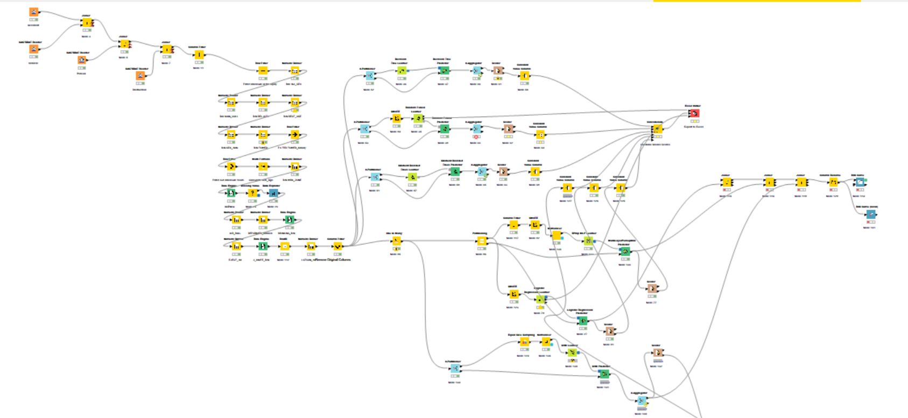
KNIME WORKFLOW:

