Slide 1

Group Project Presentation
MSIS 5633 – Predictive Analytics Technologies
Present By Group 4
Andrea Zerman
Seonwoo Ko
Wes Maxwell
Zach Morey

Slide 2
Table of Contents
CRISP-DM Model
Business Understanding
Data Understanding
Data Preparation
Modeling
Evaluation
Deployment

Slide 3
Business Understanding
Goal
1) Accurately predict the severity of an accident.
2) Determine which variables play a more significant role in this outcome.
Dataset distributed by the U.S. Department of Transportation, National Highway Traffic Safety Administration (NHTSA).
Data comes from the Crash Report Sampling System (CRSS).
This sample set is nationally represented by more than 6 million police reported crashes in 2019.
Notes:
By predicting and finding the most relevant variables of accidents, it is expected that a more accurate and preventive accident system can be implemented.

Slide 4
Data Understanding
Accident Files
Information about the severity of the crash: manner of collision, whether it was on the highway, and maximum injury severity.
Vehicle Files
Information about the vehicles: Year, Make, Model, if the vehicle caught fire, if there was rollover, and other factors.
Person Files
Information about the persons: Age, Sex, Gender, Alcohol or Drug Use, and Ejection.
Distract Files
Information about driver distractions: Occupied hands, inner vehicle distractions, outer vehicle distractions, etc.

Slide 5
Data Preparation
Rough Logical Filter
Removed variables not pertinent to the accident and not manipulatable in implementation, such as TRLR1VIN, TRLR2VIN, and TRLR3VIN.
Fine Logical Filter
Removed variables that were pertinent to the accident but not manipulatable in implementation
Rough Analysis Filter
Removed variables that contained an excess of 'null' or 'missing' values
Fine Analysis Filter
Removed variables that were lowest ranking on 'variable importance graph'

Slide 6
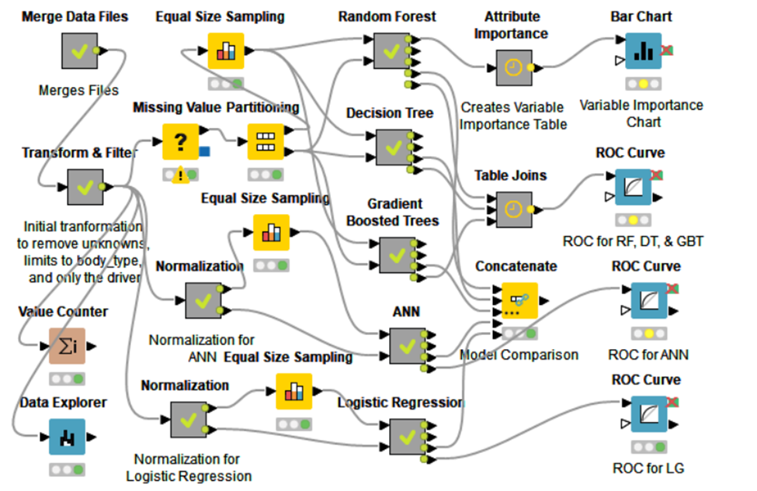
Modeling
Five different models used for training.
Three set-based models: Random Forest, Decision Tree, Gradient Boosted Trees.
Two number-based models: Artificial Neural Networks and Logistic Regression.
Main KNIME outline.

Slide 7
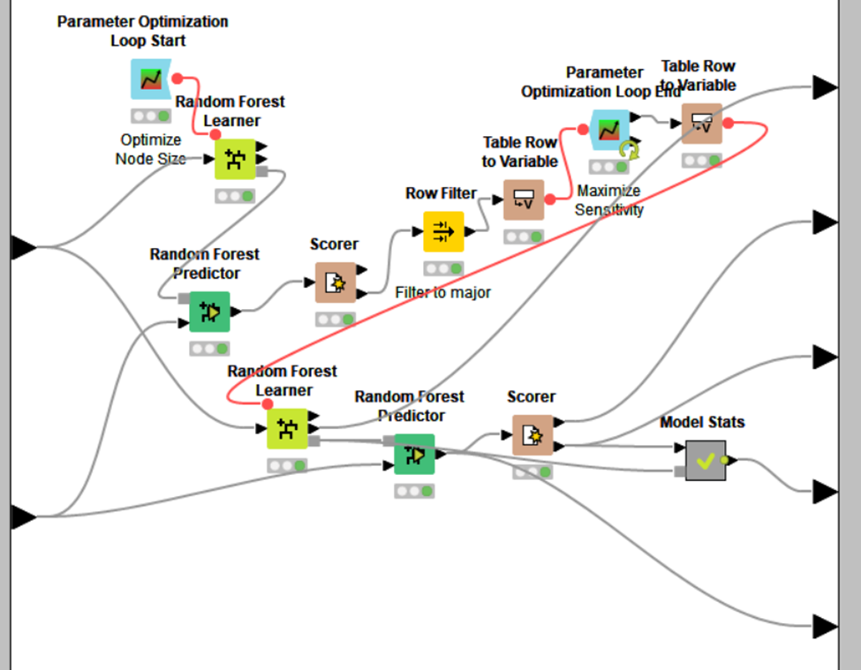
Modeling – Random Forest
Decision Tree ensemble model.
Does well with large datasets, missing data, and outliers.
Great for determining variable importance to further refine as needed.
Parameter Optimization Loop on the minimum node size looped through integers 1-10 to decide that 1 produced the best outcome.
Inside the Random Forest metanode: Random Forest learner and predictor.

Slide 8
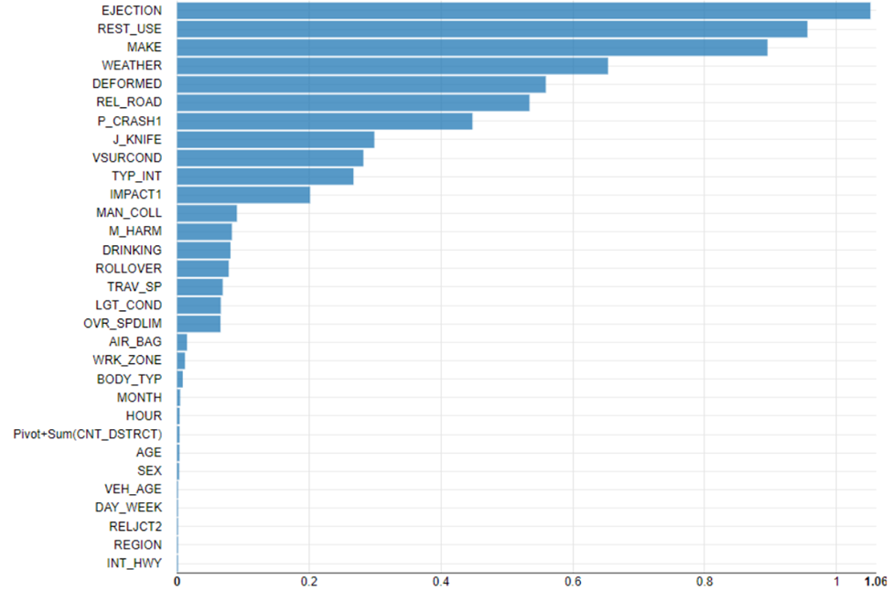
Modeling – Random Forest Variable Importance
Top 5 variables are Ejection, Rest_Use, Make, Weather, and Deformed.
Less important were int_hwy, region, reljct2, day_week, and veh_age.
Removing less important variables did not improve model results.
Random Forest variable importance chart.

Slide 9
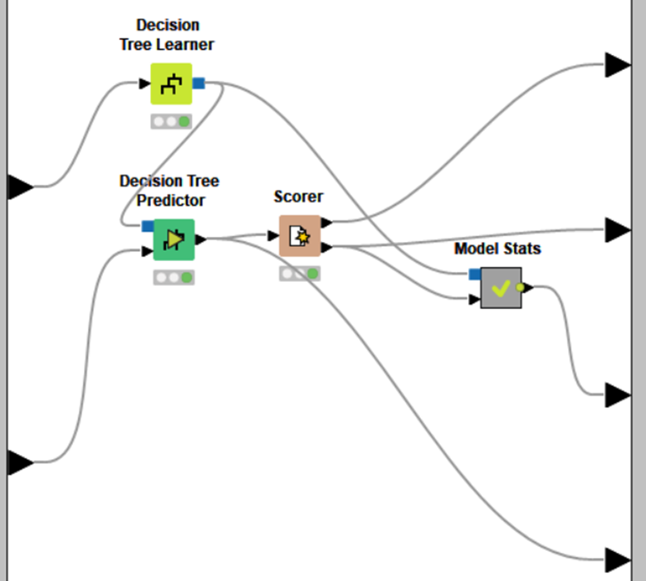
Modeling – Decision Tree
Easy to visualize and handles missing data well.
Set the class column to inj_sev, quality measure to gini index and minimum number of records per node to 2.
Inside the Decision Tree metanode: Decision Tree learner and predictor.

Slide 10
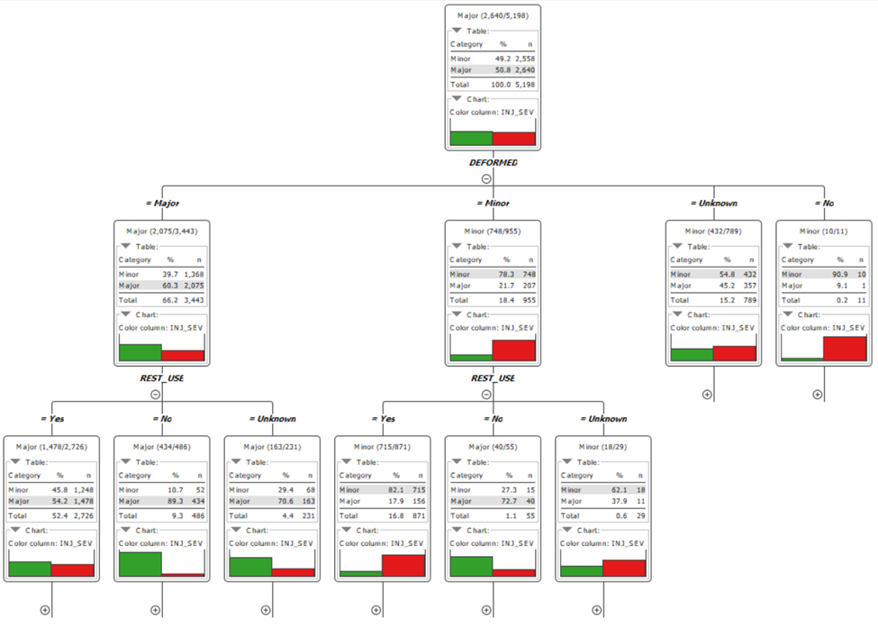
Modeling – Decision Tree
Deformed is the top choice for the first split.
Followed by rest_use and p_crash1 which are tied for 2nd.
Decision Tree first three splits.
Notes:
Deformed was 5th for RF and p_crash was not in the top 5. Similar for rest-use

Slide 11
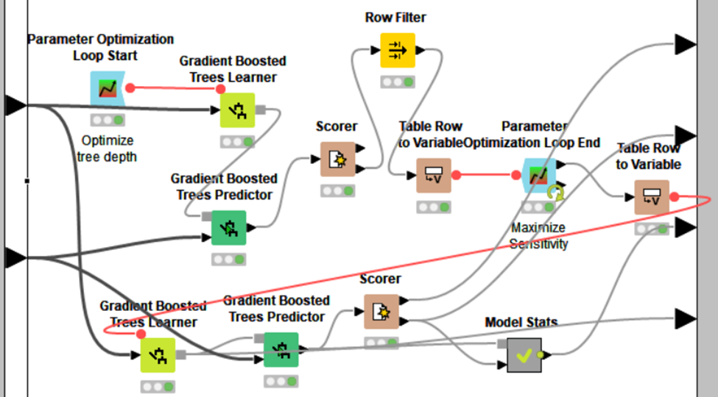
Modeling – Gradient Boosted Trees
Decision Tree ensemble model.
Adds many trees to focus on the errors from the previous tree.
Set number of models to 1,000.
Parameter Optimization Loop on the number of levels (tree depth) determined that 5 produced the best outcome.
Inside the Gradient Boosted Trees metanode: Gradient Boosted Trees learner and predictor.

Slide 12
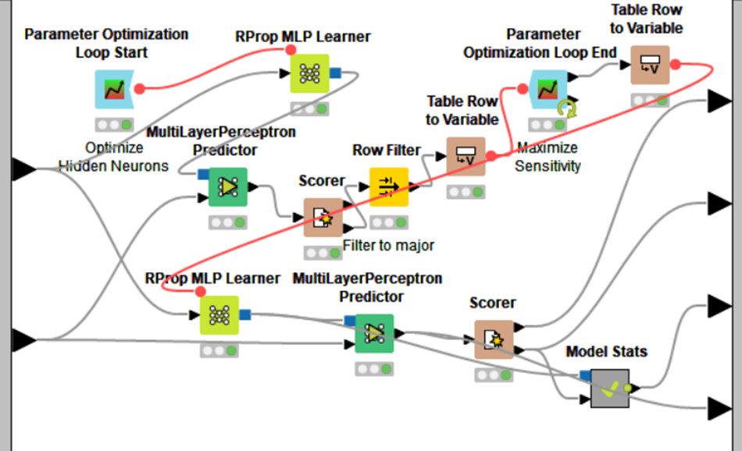
Modeling – Artificial Neural Network
Tends to do well with larger datasets having many variables.
Dataset previously normalized using min-max normalization.
Max number of iterations set to 1,000.
Number of hidden layers to 1.
Parameter Optimization Loop to determined 1 was the best number of hidden neurons per layer.
Inside the ANN metanode: Artificial Neural Network learner and predictor.

Slide 13
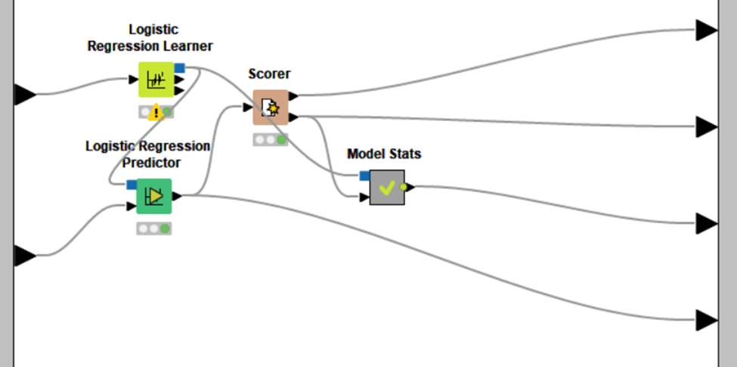
Modeling – Logistic Regression
Easier to implement and train.
Does not require normalization; however, using z-score normalization produced better results.
Set solver to stochastic average gradient.
Inside the Logistic Regression metanode: Logistic Regression learner and predictor.

Slide 14
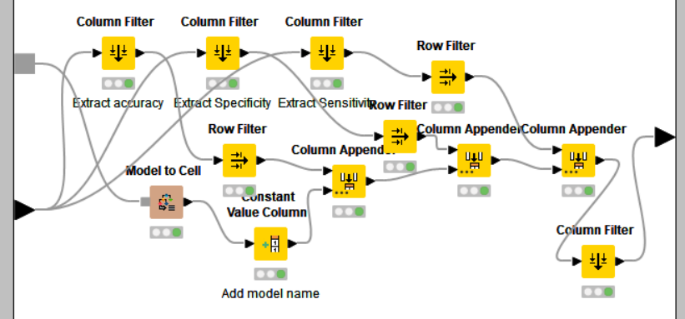
Modeling – Model Stats Metanode
Each model's metanode also contained a model stats metanode.
This arranged the accuracy statistics in way to concatenate together for easier evaluation in the next section.
Inside the Model Stats metanode.

Slide 15
Evaluation
Two processes were used to analyze each model:
Scorer Node
ROC Curve
Question to answer?
"What causes the most severe injuries in vehicle crashes?"

Slide 16
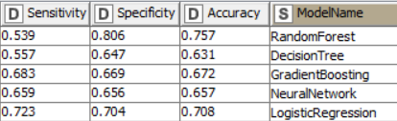
Evaluation
Sensitivity refers to model's ability to correctly identify a positive outcome
Specificity measures the model's ability to predict a negative outcome
Accuracy measures the number of times the model correctly predicted the value of the sample attribute

Slide 17





Evaluation
Random Forest
Logistic Regression
Confusion matrices show the predictions for each model
The models to the left were very accurate when predicting minor injuries
Logistic Regression was the most accurate when predicting major injuries
Decision Trees
Gradient Boosting
Artificial Neural Networks

Slide 18

Evaluation
Our analysis found EJECTION and REST_USE to be the top contributors
Further analysis between these two attributes may show a deeper correlation
MAKE was also a top contributor, further analysis required to determine why

Slide 19
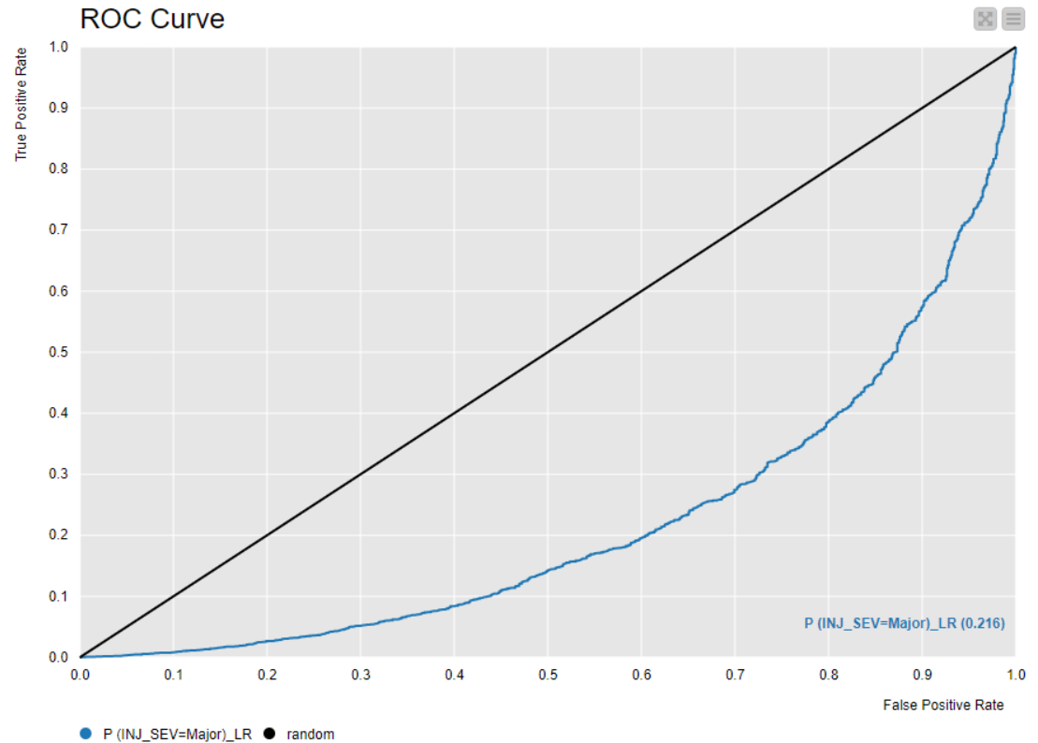
Evaluation
The Receiver Operating Characteristic (ROC) Curve compares the True Positive and True Negative predictions of the model
The Area Under the Curve measures the accuracy of the model's predictions
ROC Curve for Logistic Regression

Slide 20
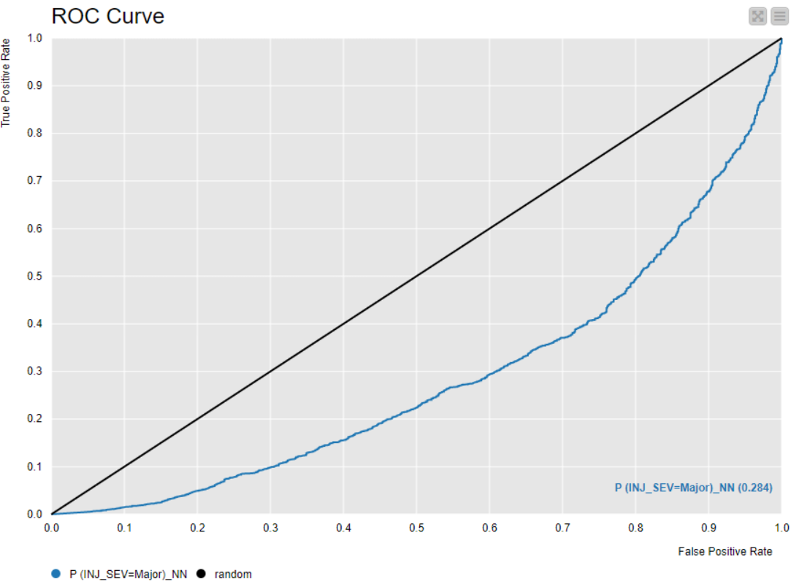
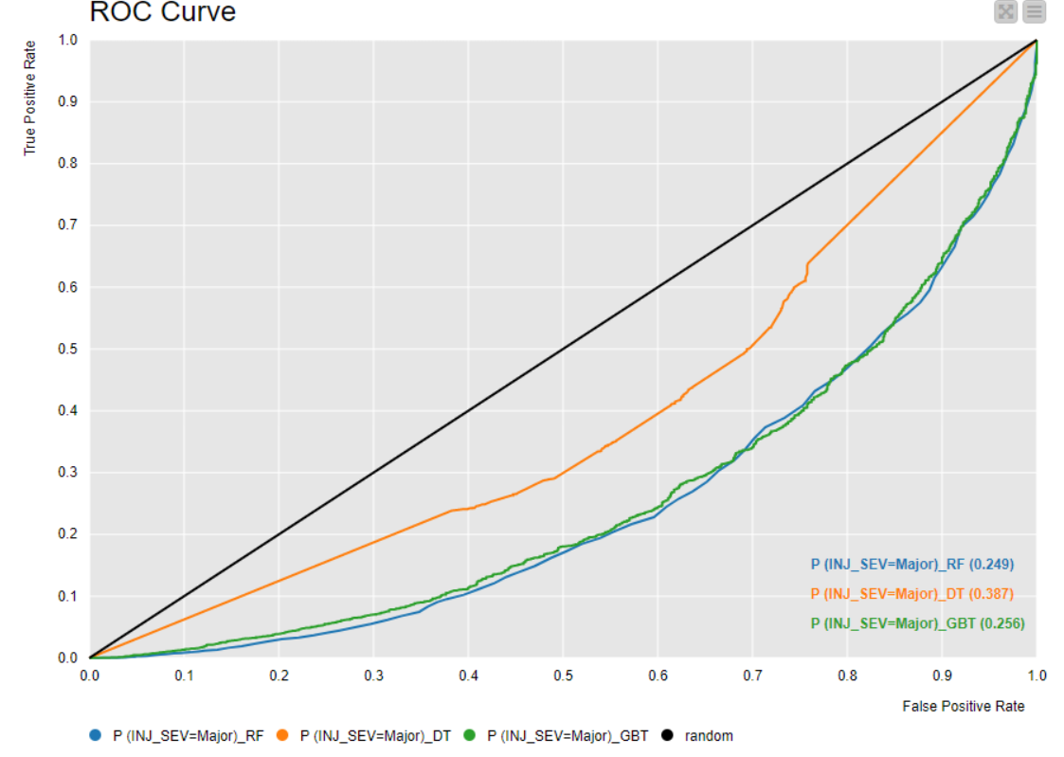
Evaluation
ROC Curve for Artificial Neural Networks
ROC Curve for Random Forest, Decision Trees, and Gradient Boosting

Slide 21
Evaluation
In summary:
The Logistic Regression model was the most accurate in predicting major injuries
The leading attributes for major injuries were:
EJECTION
REST_USE
MAKE

Slide 22
Deployment
Predict the severity of injuries from accidents and figure out which variables have a significant impact
Data dictionary
Data Preprocessing: Rule Engine, Math Formula, Number to String, Normalizer
3 Set-based Models (Random Forest, Decision Tree, Gradient Boosted Tree)
2 Number-based models (Artificial Neural Networks, Logistic Regression)
Ejection, Rest_Use, Make, Weather, Deformed

Slide 23
Deployment
Passengers need to be informed of some factors that cause major injuries. They also need to know how to use restraint equipment properly.
Car Manufacturers/Developers need to make and develop cars with some features that existing safer cars have, decreasing the severity of injuries in the long term.
Decision Makers (Policy Makers) should consider making stricter policies or rules regarding the restraint use. They also have to be aware of the direct relationship between lack of restraint use and severity of ejection. Most injuries and accidents can be decreased and be better if the passengers and drivers use the restraint equipment in their vehicle.

