Slide 1


Predictive Models for Automobile Accident Injury Severity
MSIS 5633 – Predictive Analytics Technologies
Team 5 - Rudrakumar Ankaiyan, Md Suman Ahammed, and Jacob Wood

Slide 2
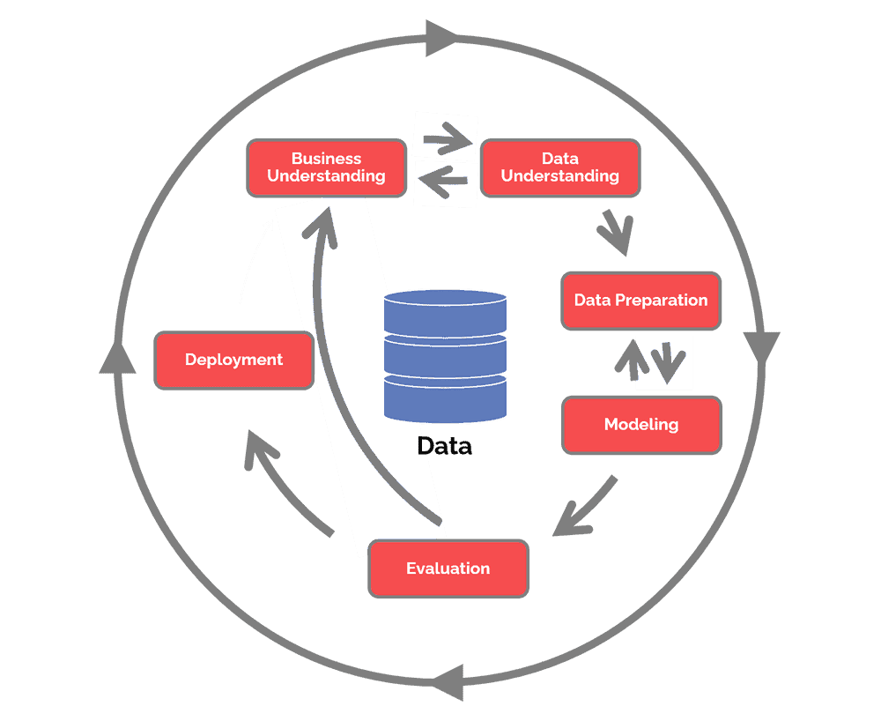
Introduction
Objective – Use predictive analytics to understand risk factors in automobile crashes
Data Source – Crash Report Sampling System CRSS Analytical User's Manual 2016-2019 from NHTSA
Cross Industry Standard Process for Data Mining (CRISP-DM) –

Slide 3
Business Understanding
What risk factors determine the severity injuries resulting from automobile accidents?
Approx. 6 million accidents each year in the U.S.
40,000 lives are lost
Accident-related factors
Demographic factors
Environmental factors
Technical features

Slide 4
Business Understanding
Injuries are increasing
Increase of 1082 fatalities from 2011 to 2012
2.36 million injuries in 2012
2.22 million injuries in 2011

Slide 5
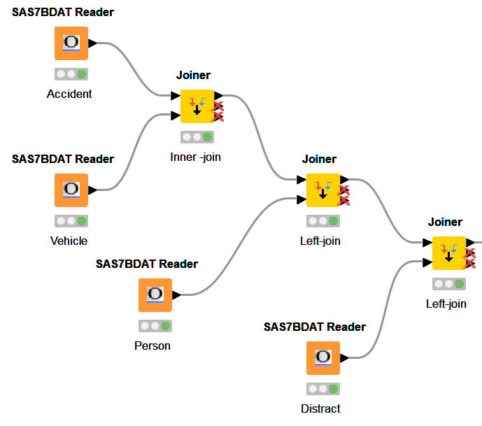
Data Understanding
4 files from NHTSA were used
Accident – 1 record per crash; 54,409 rows and 50 columns
Vehicle – 1 record per vehicle; 96,717 rows and 90 columns
Person – 1 record per individual involved; 135,410 rows and 56 columns
Distract – Each row is a distraction; 96,751 rows and 11 columns

Slide 6

Data Preparation
File merge
Analyze/select variables
Create attributes
Impute values
Remove blank fields
Splitting training and testing data sets
Notes:
Introduce yourself
Data Preparation or preprocessing
Estimates from 50-80% of time
Ours took approximately 70%
Approached PP with these steps
File merge
Select Variables
Create Attributes
Impute Values
Remove blanks
Split training and testing
ALSO some data balancing
Starting point of the 4 tables
Accident
Vehicle
Person
Distract
Merged using PKs in KNIME with JOINER NODES.
207 columns and approx. 130k rows
Variable selection was very important. Reviewed literature
Reviewed and read the CRSS Analytical User's Manual
Contains data definitions, comments, and provides a general understanding
Used our best judgment on which variables are important.
some obviously would not be predictive
STRATUM -
Each of us took 1 or 2 tables to determine which variables were predictive.
Used column filter to leave important variables
NEXT we
created attributes
imputed values
removed blank fields

Slide 7
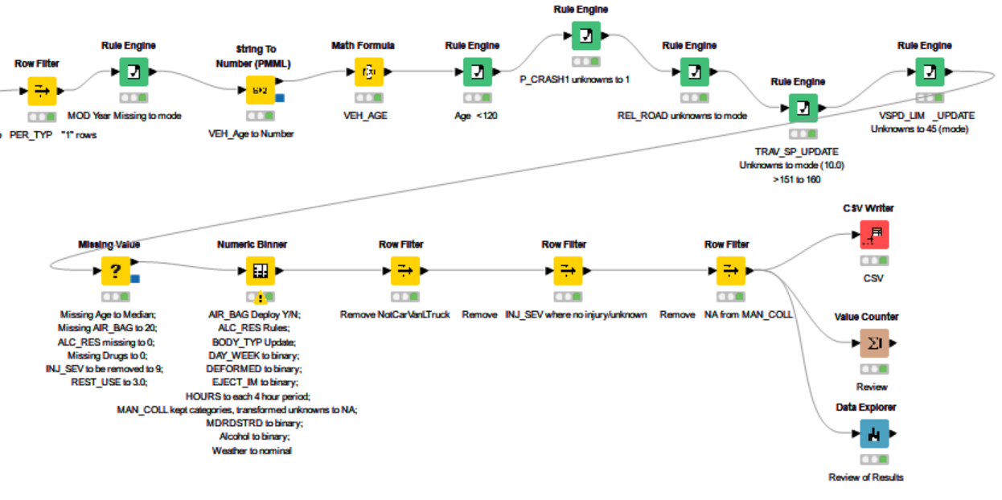
Data Preparation cont.

Slide 8
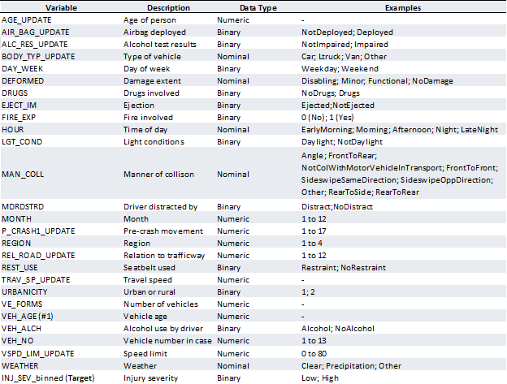
Data Preparation cont.

Slide 9







Data Preparation cont.
Notes:
NUMERIC BINNER, MATH FORMULA, RULE ENGINE, MISSING VALUE
SAMPLING USING
X partitioner used for 10 fold cross validation
X Aggregator
This was better than a simple train/test split
Equal Size sampling
Helped to manage the data imbalance
Minority class – High severity for injury about 30%

Slide 10
Model Building
Please find the below models we have used,
Logistic Regression
Decision Tree
Tree Ensemble
Gradient Boosted Trees
We tried to include both number-based and set-based models.

Slide 11
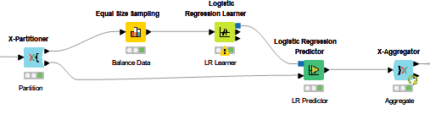
Model Building – Logistic Regression

Slide 12
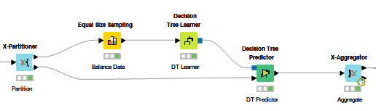
Model Building – Decision Tree

Slide 13
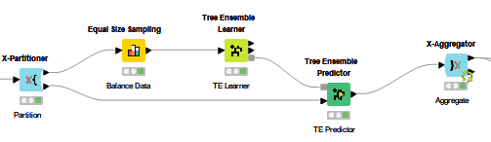
Model Building – Tree Ensemble

Slide 14
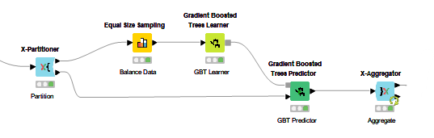
Model Building – Gradient Boosted Trees

Slide 15
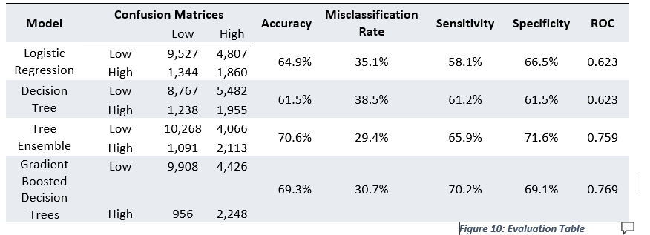
Evaluation
Evaluation Table

Slide 16
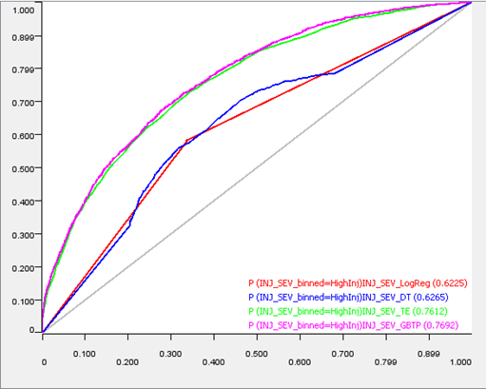
Evaluation
Combined ROC Curve

Slide 17
Deployment
After comparing all the results, Gradient Boosted Decision Trees model was the most predictive model followed by Tree ensemble Model.
Also, the following variables were found to be crucial in describing the injury severity:
MAN_COLL
REST_USE
DEFORMED
EJECT_IM
TRAP_SV_UPDATE
BODY_TYPE_UPDATE

Slide 18
Deployment
While the Tree Ensemble performed similarly, Gradient Boosted Decision Trees had the slightly better result overall.
On the other hand, if further training and on-going evaluation of these models is to take place, it would be useful to utilize both models in coming years to see if one emerges as clearly a better model in subsequent years.
The results can be used to help reduce the severity of the accidents.
The authorities can use the factors predicted to prevent or prepare for the severity of the accident.
These models can be used as a blueprint to perform similar predictions in other locations.

Slide 19
Conclusion
Using KNIME analytics platform was a positive experience.
We learned so much from the challenges faced in various stages of the project.
Data processing is the most time-consuming and crucial step.
We performed many iterations and have to re-do steps to achieve the results.
Finally, We were able to achieve the results by correcting our shortcomings like selecting the variables, data imbalance.
We believe the models developed will help in future predictions with inclusion of more crucial variables.

Slide 20
References
•NHTSA (2019) National Highway Traffic Safety Administration (NHTSA’s) General Estimate System (GES), 〈www.nhtsa.gov〉 (accessed March, 2022).
•NHTSA (2020) National Highway Traffic Safety Administration (NHTSA’s) Traffic Safety Facts Annual Report Tables (Annual Report Tables), (https://cdan.dot.gov/) (accessed April 27, 2022).
•Sharda, R., Delen, D., Turban, E., Aronson, J. E., Liang, T.-P., & King, D. (2018). Data Mining Process. In Business Intelligence, analytics, and Data Science: A Managerial Perspective (pp. 208). Pearson.
•Delen, D., Sharda, R., Bessenov, M. (2006). Identifying significant predictors of injury severity in traffic accidents using a series of artificial neural networks. Accis. Anal. Prev. 38 (3), 434-444.

