Slide 1
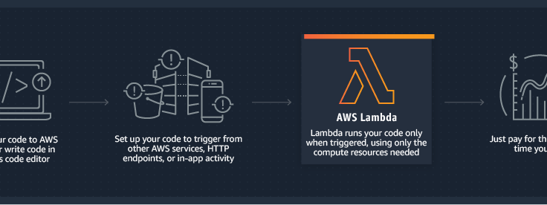
Beginning AWS Lambda Learn to write AWS Lambda Functions in Python
Noah Gift, UC Davis & Northwestern Lecturer (Cloud, ML,AI), Founder @Pragmatic AI Labs, Author: Pragmatic AI

Slide 2
Schedule
Part 1: Using Cloud9 to Develop Python Lambda Functions (90 min)
QA (15 min)
Break (15 min)
Part 2: Creating Timed Lambdas (45 min)
QA (10 min)
Break (5 min)
Part 3: Creating Event-Driven Lambdas (45 min)
QA (15 min)

Slide 3
Survey: Experience with AWS
Novice (No experience)
Beginner (< 1 Year)
Intermediate (1-3 Years)
Advanced (3+ Years)

Slide 4
Survey: Experience with Python
Novice (No experience)
Beginner (< 1 Year)
Intermediate (1-3 Years)
Advanced (3+ Years)

Slide 5
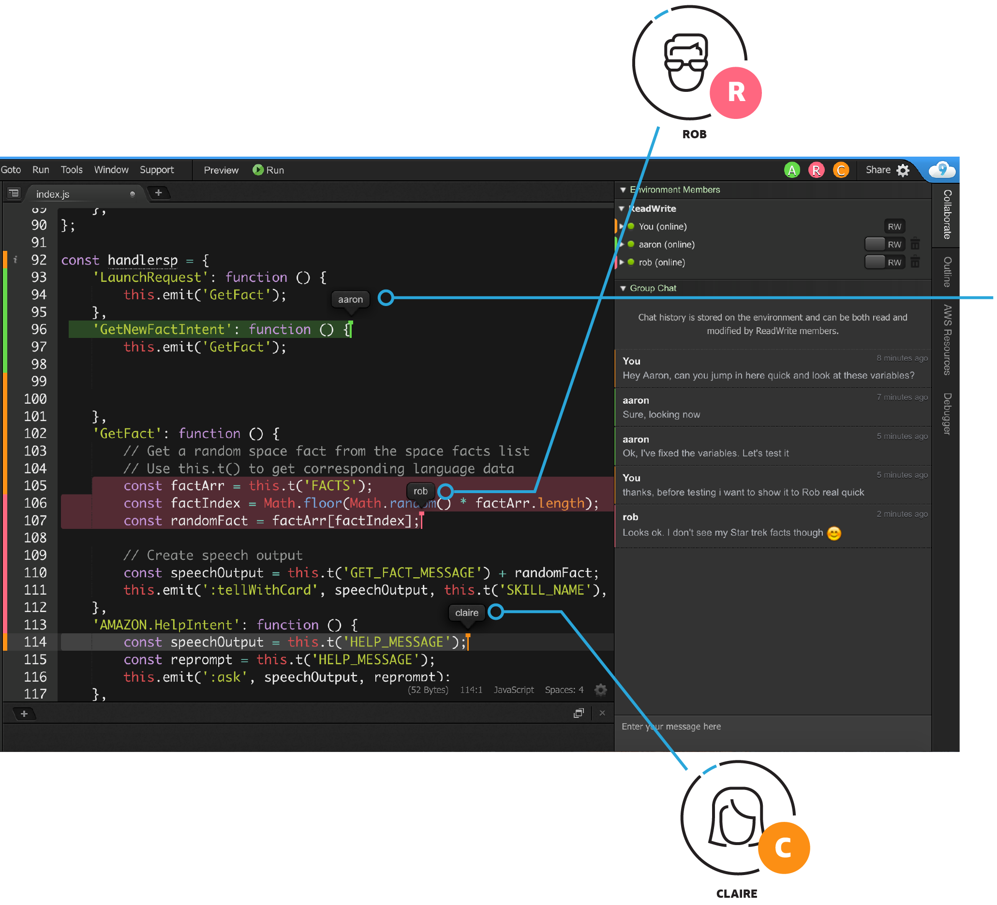
Part 1: Using Cloud9 to Develop Python Lambda Functions (90 min)
Developing with Cloud9
Launching Cloud9 and Workspace Configuration
Creating and Deploying Lambda functions
Importing Lambda functions
Invoking Lambda functions
Invoking Lambda function inside API Gateway

Slide 6
QA & Break Part 1
QA (15 min) Break (15 min)

Slide 7
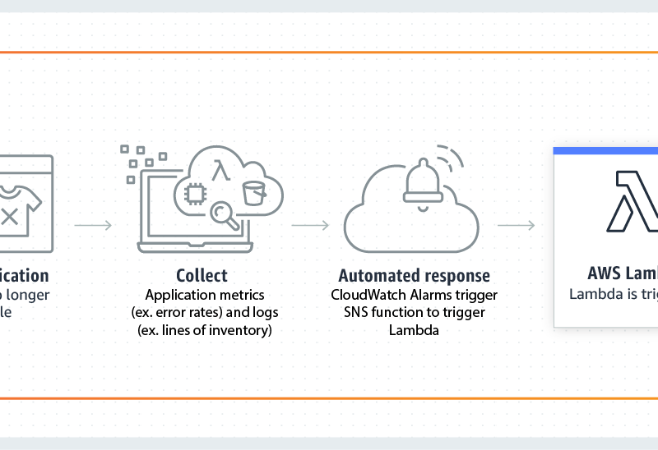
Part 2: Creating Timed Lambdas (45 min)
Using AWS Lambda with Cloudwatch Events
Using AWS Lambda to populate AWS SQS (Simple Queuing Service)
Using AWS Cloudwatch logging with AWS Lambda

Slide 8
QA and Break Part 2
QA (10 min) Break (5 min)

Slide 9
Part 3: Creating Event-Driven Lambdas (45 min)
Triggering
Triggering AWS Lambda with AWS SQS Events
Reading
Reading AWS SQS Events from AWS Lambda
Writing
Writing results to AWS DynamoDB

Slide 10
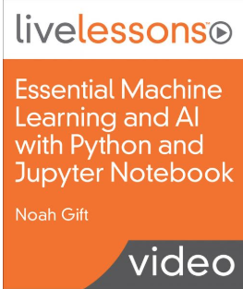
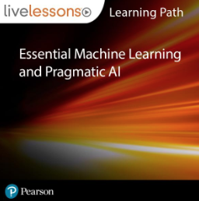
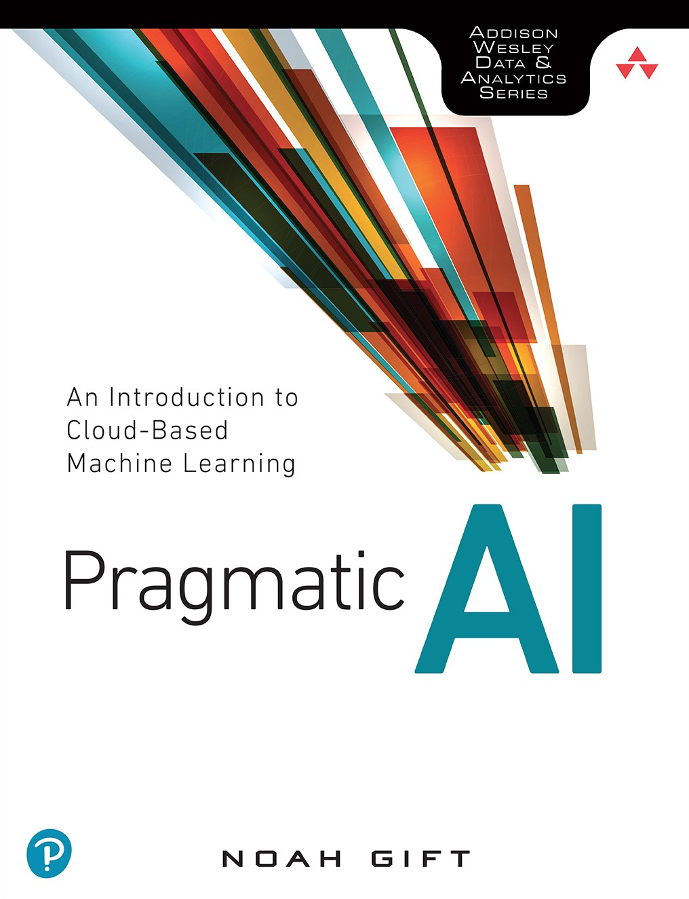
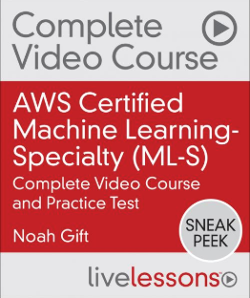
Related Safari Properties
Pragmatic AI (Book)
Essential Machine Learning and AI (Video)
AWS Certified Machine Learning-Specialty (Video)
Essential Machine Learning and Pragmatic AI (Learning Path)
Python for Data Science (Video)-Coming Soon
AWS Certified Big Data-Speciality ( Video)-Coming Soon

