Slide 1
ADOPTING CI/CD
Moses Mbadi, ICT Officer

Slide 2
What is CI/CD?
Say you have four developers working on a project. They each take tasks and when each task is complete at the end of the day or week or month they push all their work to on source code platform. This might create untold conflicts which take time to resolve.
Enter CI/CD. CI/CD is a way to have multiple developers working on the same project deliver value in short periods of time and seamlessly making it easy to work collaboratively.

Slide 3
Continuous Integration
Continuous integration (CI) is the strategy of building and validating a software-based solution automatically whenever a file is checked into your source code. Validation can occur via several strategies such as automated testing and even static or dynamic code analysis. CI enables developers to develop a high-quality working solution safely in small, regular steps by providing immediate feedback on code defects.

Slide 4
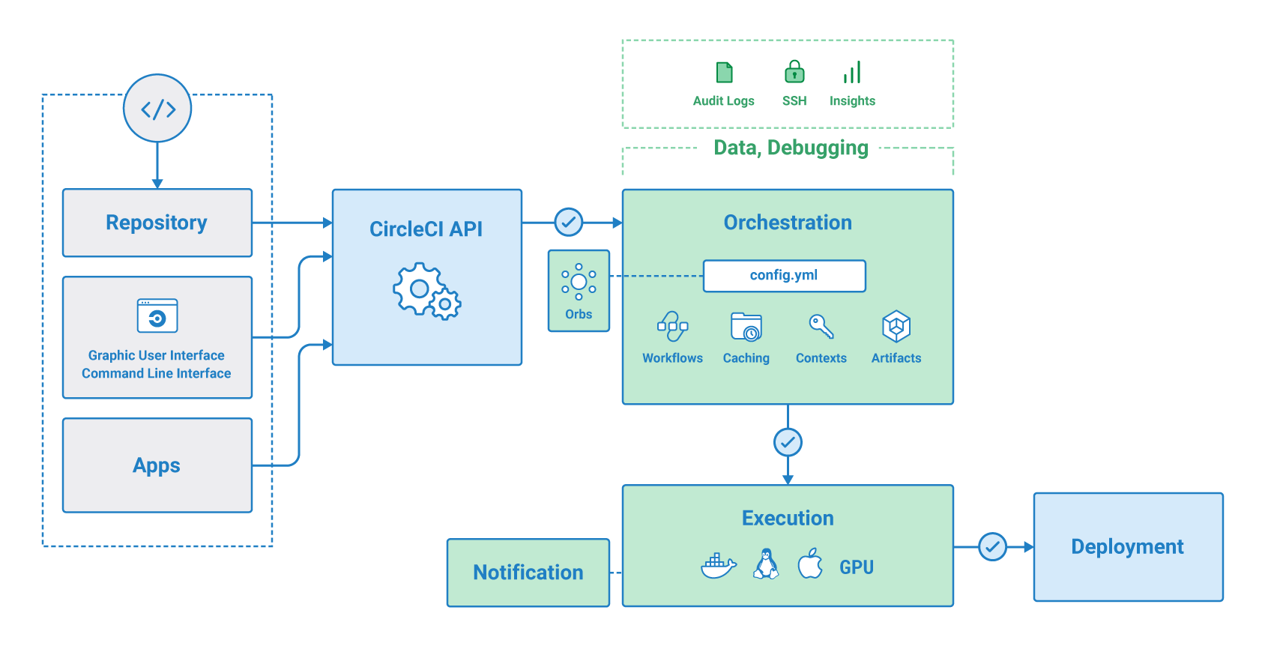
Visual Representation.

Slide 5
Benefits of Continuous Integration
Expend less manual effort as almost everything is automated
Reduce risk. Finding and fixing bugs late in the development process is expensive and time-consuming
Deliver faster. Organizations are moving toward releasing features multiple times a day.
Generate extensive logs which are better for troubleshooting.
Make easier rollbacks incase of a fatal system error.

Slide 6
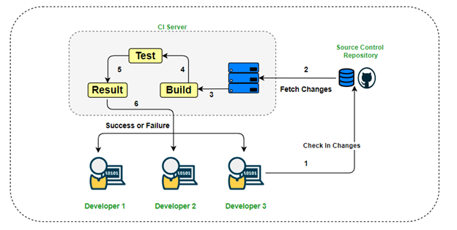
Visual representation, CI

Slide 7
Continuous Deployment
With the existing system, developers have to manually deploy their code. This means spinning up a server, provisioning the infrastructure and moving the code to server. This method is long, tedious and is not error tolerant. This is where Continuous deployment comes in. Continuous deployment means every step involved in deployment is automated, with better feedback and error handling.

Slide 8
The Process
The process of integrating CI/CD into our current framework is rather easy and worthwhile. There are several methods we can use to switch, these methods include:
Big bang
Canary
Blue Green
The method we’ll use is Blue green. In this deployment strategy we will transfer user traffic to our new infrastructure, then delete the old infrastructure once the new one is up and running with no errors.

Slide 9
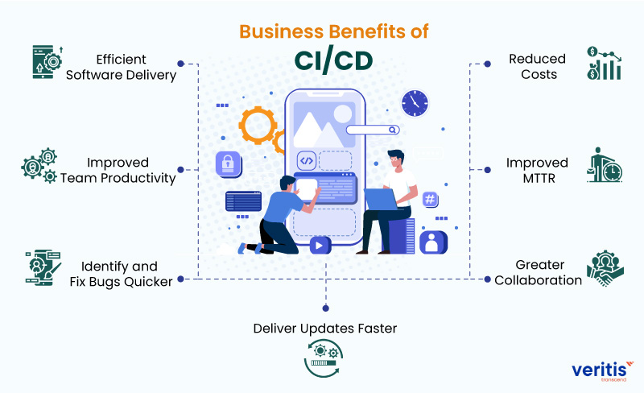
Benefits of CI/CD, in general.

Slide 10

Questions?

