Slide 1

Algorithm of Electromyography Signal Analysis
By
moses Peace Mccabe

Slide 2
indroduction
What is Electromyography ?
Electromyography (EMG) is the method of measuring the electrical activity within muscle fibers during activation.
Each time when the body muscle moves, the muscle fibers are activated with the signals passed down from the brain, through the central nervous system and motor neurons, to the muscle fibers.
EMG involves measuring this signals travelling thought the muscle

Slide 3
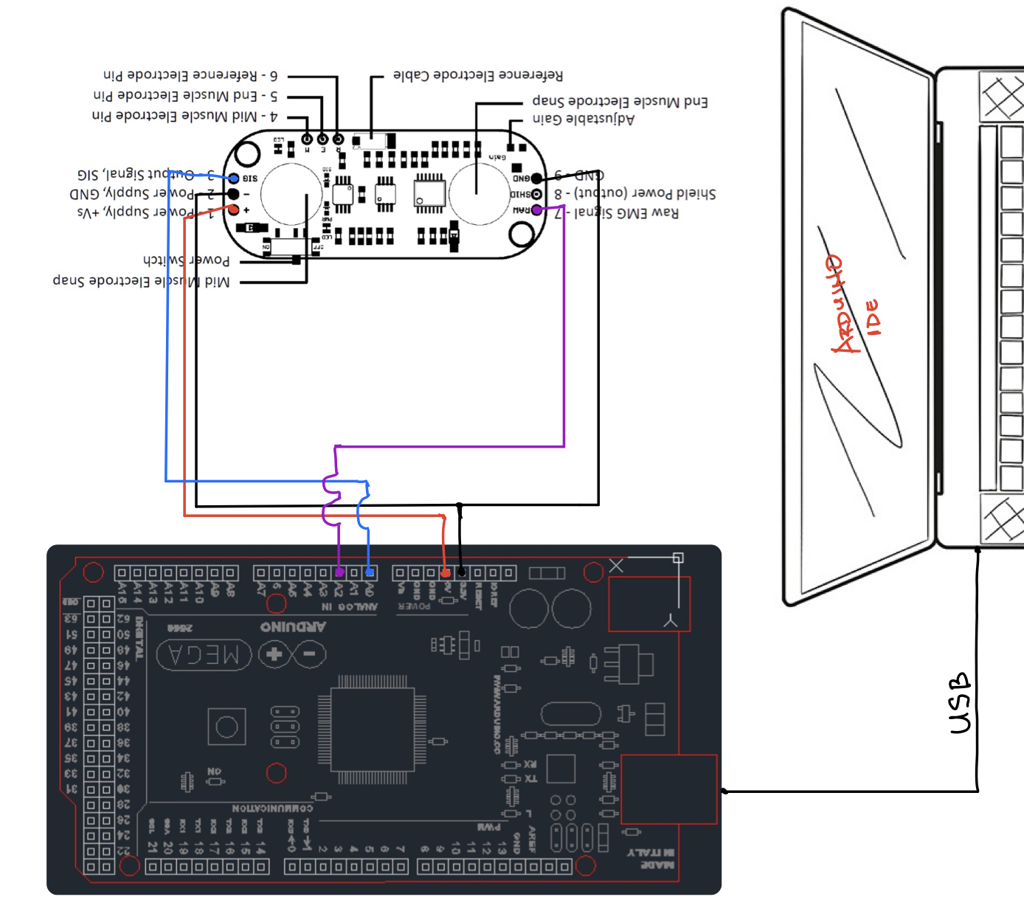
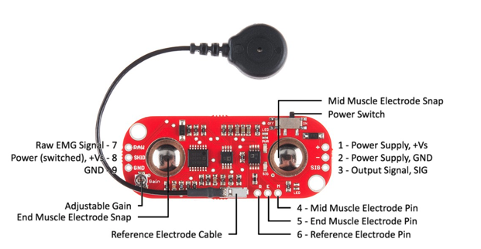
Data collection
We use a MyoWare Muscle Sensor
We connected the Muscle Sensor to an Arduino

Slide 4
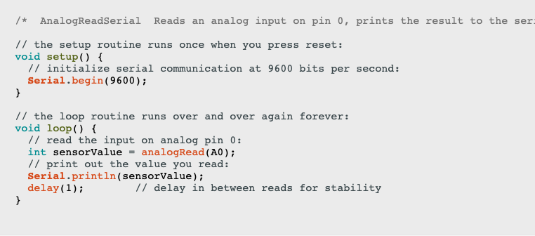
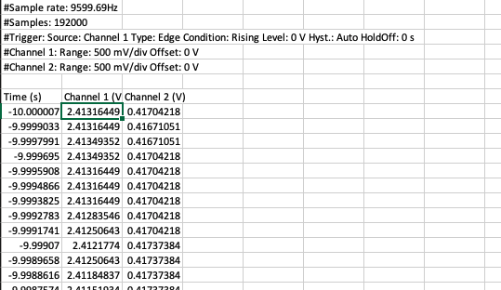
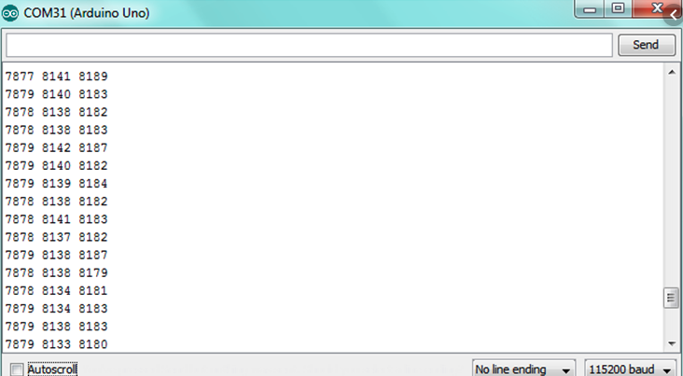
Data collection Cont.
Arduino Code use to collect Data
Copy the data from Arduino IDE to excel

Slide 5
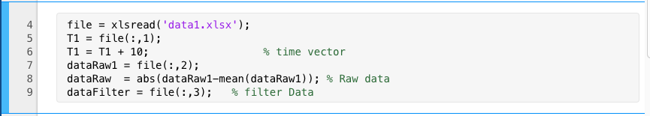
Import Data in MATLAB
Input into a variable
Using MATLAB Matrix operation
Input the time vector into “T1”
Input Raw data into “dataRaw1”
Input Filter data into “dataFilter”

Slide 6
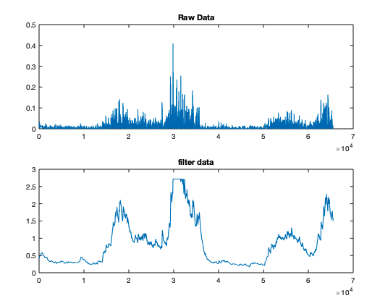
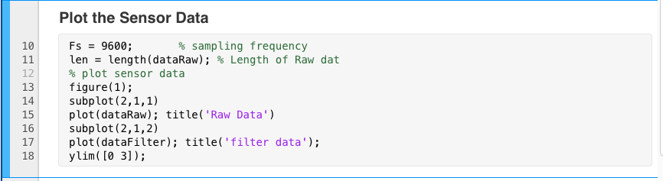
Import Data in MATLAB Cont.
I plot the data collected from the sensor

Slide 7
Filter design
IIR Low Pass Butterworth Filter
At the expense of steepness in transition medium from pass band to stop band this Butterworth filter will provide a flat response in the output signal.
The rate of falloff response of the filter is determined by the number of poles.

Slide 8
Butterworth Filter Design
I use the provided Butterworth filter which returns the transfer function coefficients of an nth-order lowpass digital
The provider Butterworth filter required stop and passband
My passband and stopband was determined for the Raw data fft plot.

Slide 9
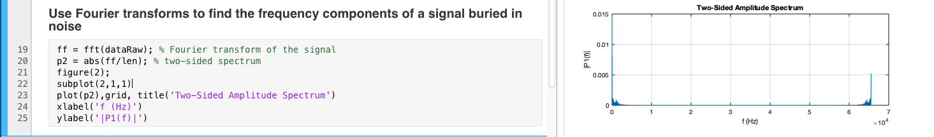
Find stopband and passband
I used MATLAB to compute the discrete Fourier Transfer (DFT of the Raw data using a Fast Fourier Transform (FFT) algorithm
fft Algorithm find the frequency components of a signal buried in noise
But MATLAB fft Algorithm product two two-sided spectrum

Slide 10
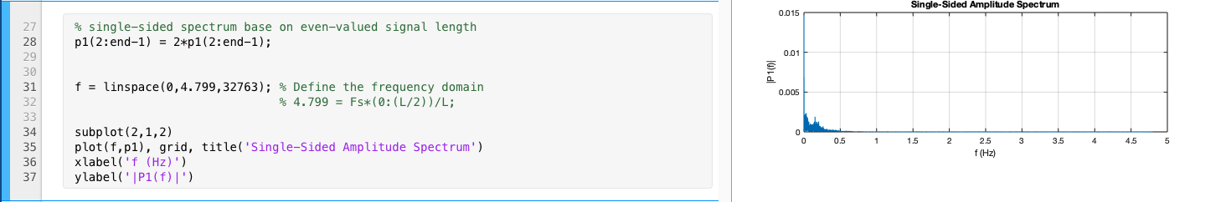
Find stopband and passband
Using the two-sided spectrum produce by the fft
I generate the signal-sided spectrum by dividing the two-sided spectrum in half
I compute the single-sided spectrum based on P2 and the even-valued signal length.
I define the frequency domain f and plot the single-sided amplitude spectrum

Slide 11
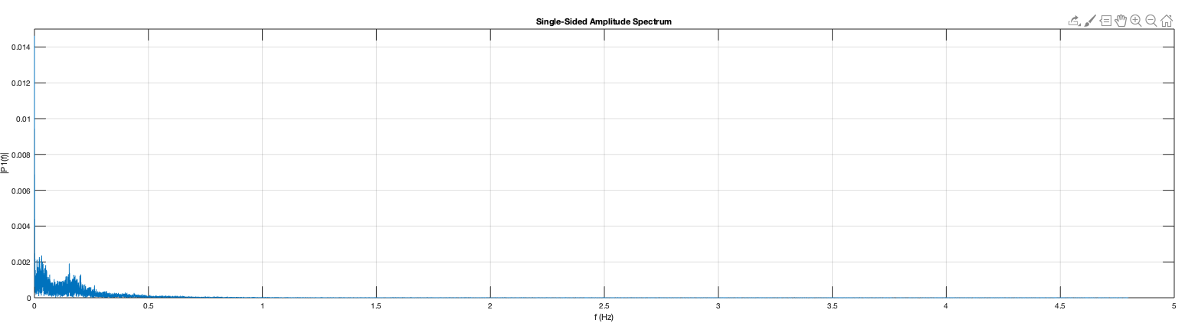
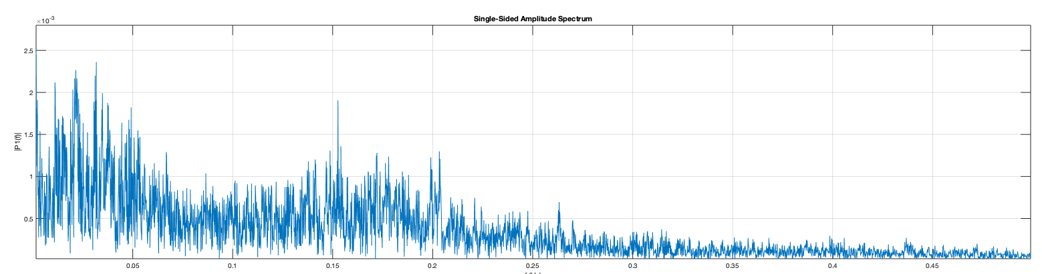
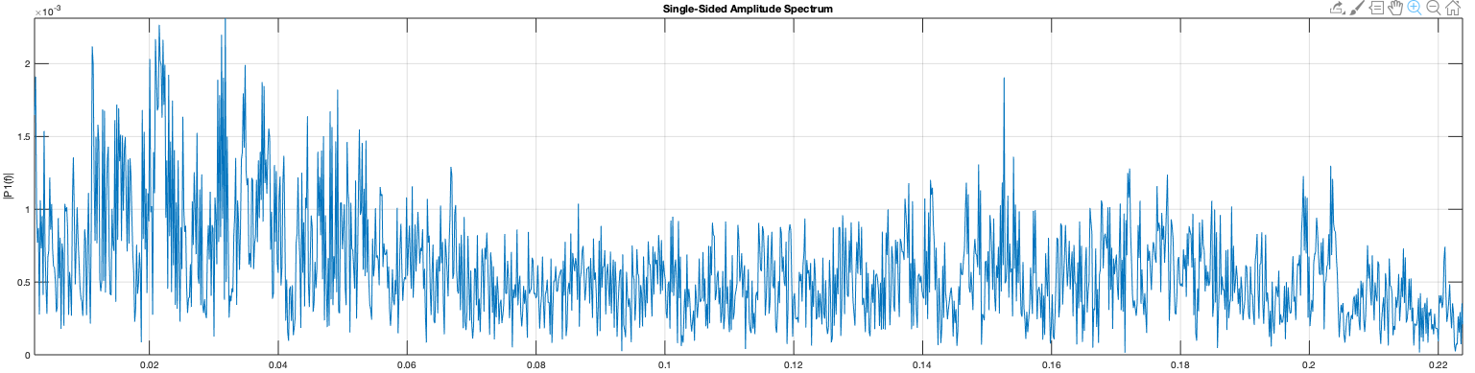
Finding stop and passband cont.
From the single sided Amplitude Specture plot we can see that most of the data led between 0 to 0.5
Zooming into 0 – 0.5 we found that most of the data led between 0 – 0.23
Zooming int 0 – 0.24
we defined: passband = 7.13e-3
stopband = 0.24

Slide 12
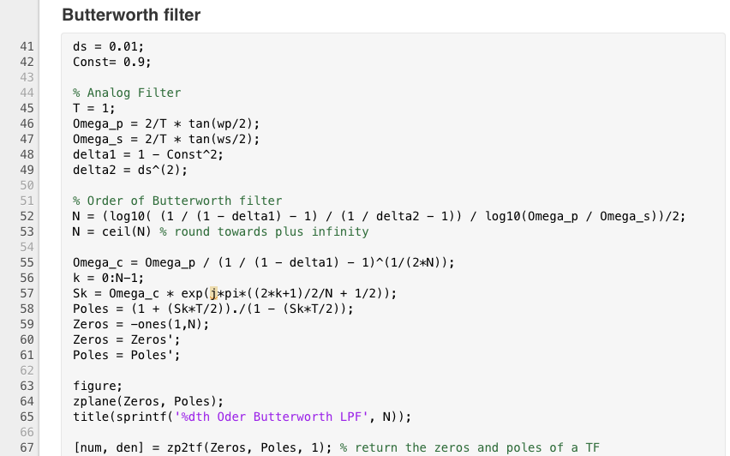
Butterworth filter code

Slide 13
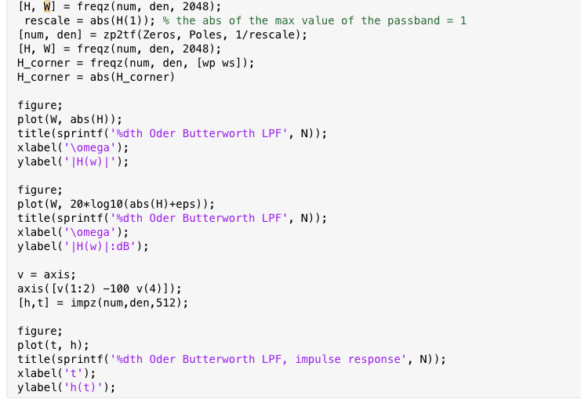
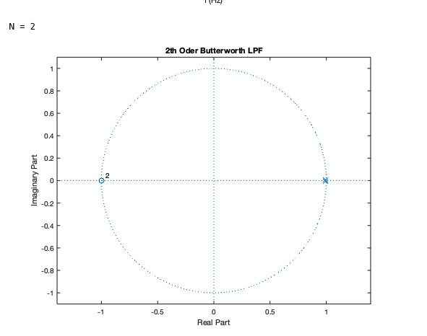
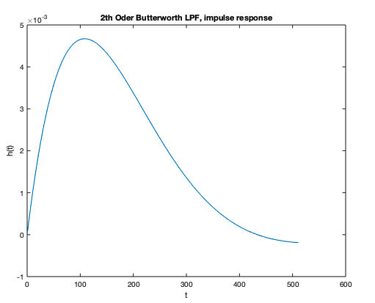
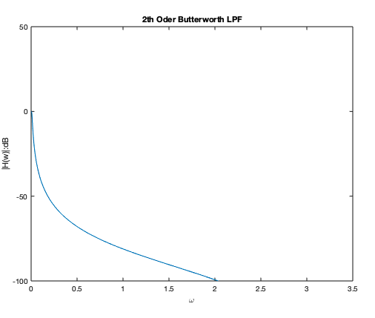
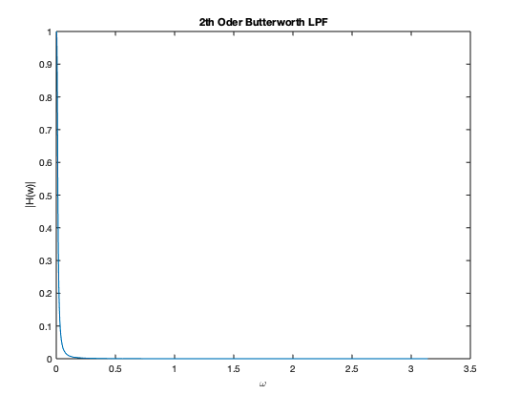
Butterworth filter plot
Pole and zero plot show order of the filter

Slide 14
Filter our data
I Used MATLAB “filter” function
This function filters the input data dataRaw using a rational transfer function defined by the numerator and denominator coefficients num and den

Slide 15
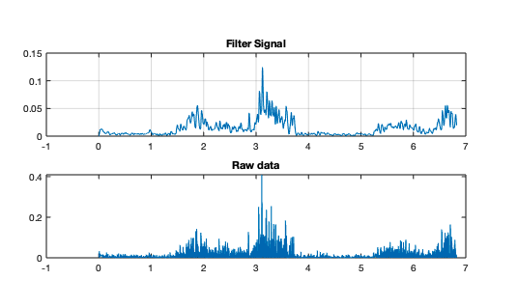
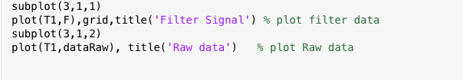
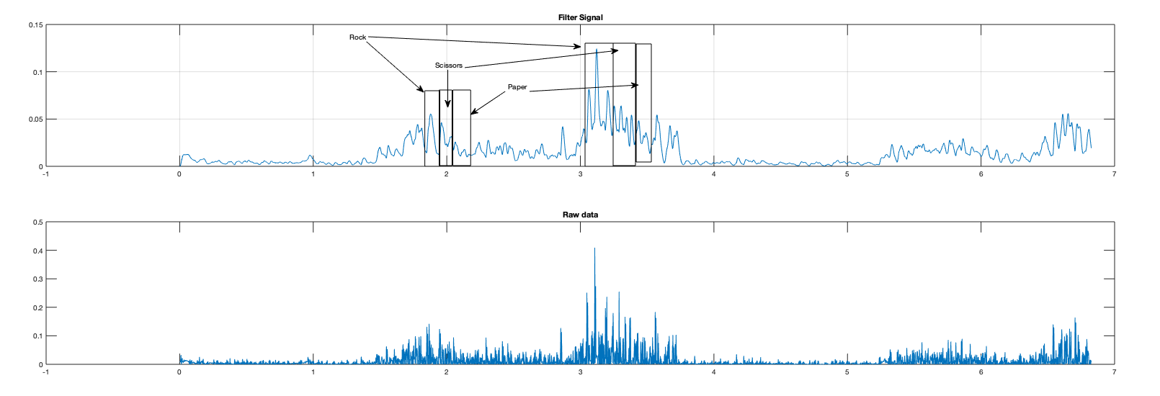
Plot the filtered data and Raw data

Slide 16
Thanks
Any Question?

