Slide 1
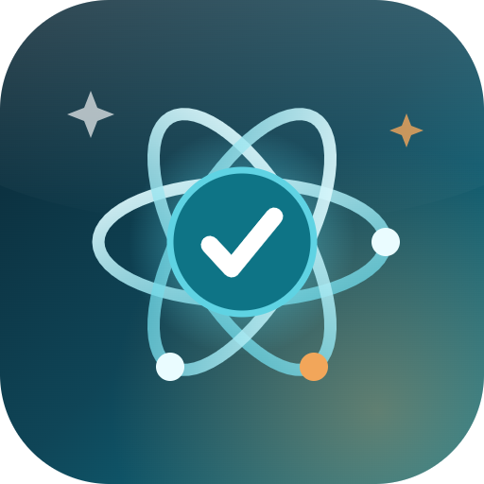
JAMES CLEAR’S ATOMIC HABITS, MADE TANGIBLE
Atomic
Habit Streak Tracker
Why every feature earns its place — explained in the words of the book it is built on.
Android app · free web hosting on Render · open source MEAN stack
Notes:
Opening: the deck walks feature by feature through the app, pairing each one with the Atomic Habits idea it implements. All quotes are verified against James Clear’s own site.

Slide 2
THE IDEA THE APP IS BUILT ON
“Habits are the compound interest of self-improvement.”
— James Clear, Atomic Habits
Atomic turns that loop — small votes, repeated — into something you can actually see.
Notes:
Set the frame: compound interest is why the app obsesses over daily repetition rather than big goals.

Slide 3
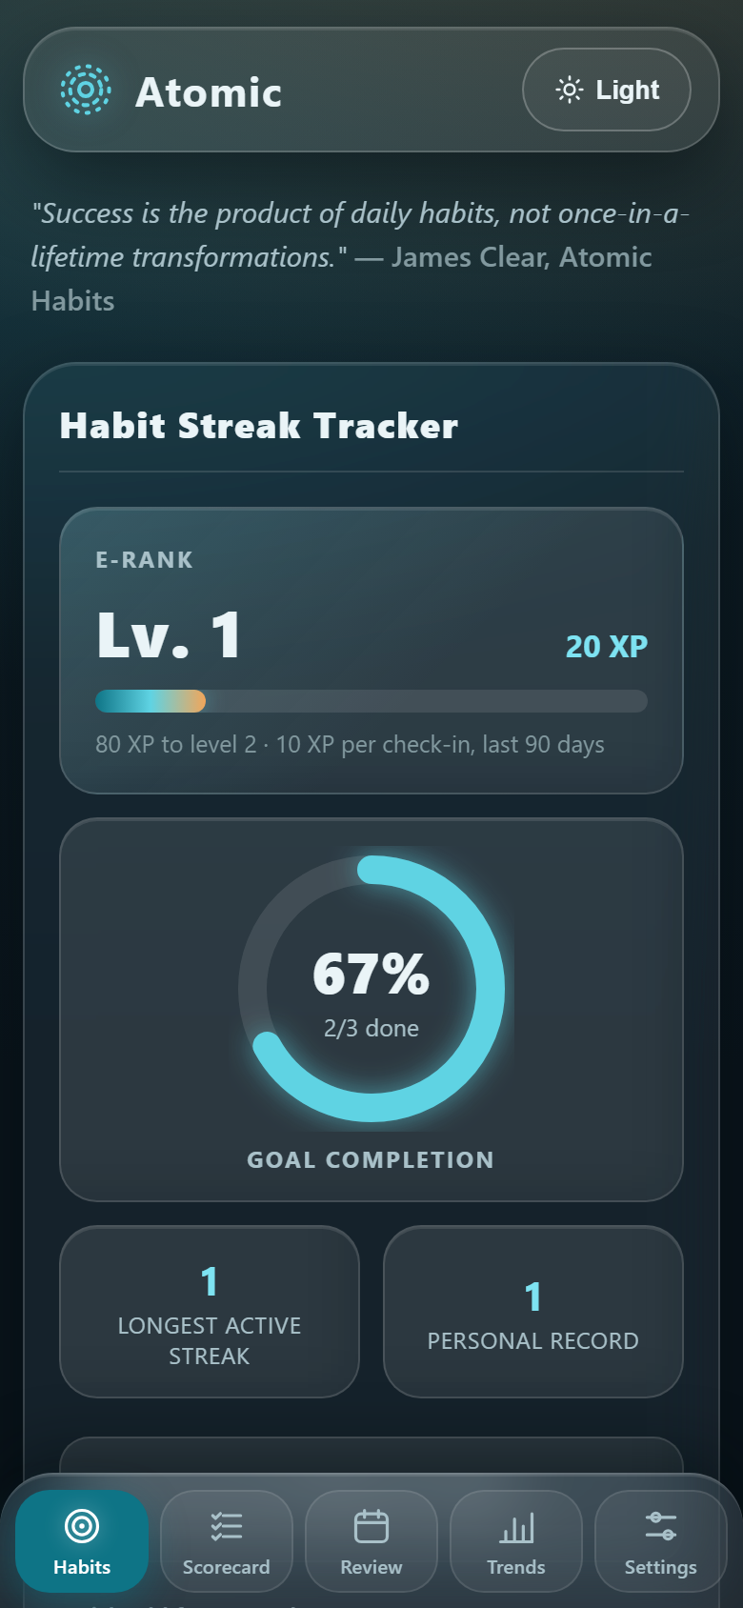
Identity: every check-in is a vote
Each habit starts with who you want to become. You write the identity — “I am a reader” — and the app plays witness: every check-in is logged as evidence, and a badge proves it — “Proven 12× this month”.
“Every action you take is a vote for the type of person you wish to become.”
— James Clear, Atomic Habits (p. 38)
Notes:
Identity field + proven-count badge are the direct implementation of the vote metaphor.

Slide 4
The four laws — four fields on every habit
“How can I make it obvious? How can I make it attractive? How can I make it easy? How can I make it satisfying?” — James Clear
1
Make it obvious
2
Make it attractive
Cue field on every habit: when and where it happens — “After breakfast, I read.”
Identity + reward: who you become, and what you get to enjoy after.
3
Make it easy
4
Make it satisfying
The 2-minute version — “Read 1 page” — so starting is never a debate.
Check it off and watch streak, XP and the goal ring fill up instantly.
Notes:
One habit form = the four laws. Cue, identity/craving, 2-minute version, reward are the four fields.

Slide 5
Start absurdly small
2:00
“All big things come from small beginnings. The seed of every habit is a single, tiny decision.”
— James Clear, Atomic Habits (p. 22)
the size of a new habit
The mini-version toggle swaps the habit name on your home screen — “Read 10 pages” becomes “Read 1 page” — until the identity sticks.
Beside the tiny habit sits its cue — time and place — so the smallest version is always the obvious next move. Miss the big one, do the small one: the chain survives.
Notes:
Two-minute rule implemented as the miniVersion field + toggle. Quote verified: Atomic Habits p.22.

Slide 6
Habit stacking: one habit hitched to another
“After [CURRENT HABIT], I will [NEW HABIT].”
— the habit-stacking formula, Atomic Habits
After I pour my coffee
→
Read 10 pages
reward: a fresh chapter
After I brush my teeth
→
Floss
reward: a clean smile
Notes:
Chains from the book are stored per habit and shown as Stacks on the Habits page.

Slide 7
Streaks: miss once, never twice
90-DAY HEATMAP
“Missing once is an accident. Missing twice is the start of a new habit.”
— James Clear, Atomic Habits
Current streak, personal best and a 90-day heatmap keep the chain visible. “Done today” is one tap; a gap shows up as something you can feel — the app never lets day two become the new normal.
missed
done
this week
58
check-ins in the last 90 days — each one a vote
Best: 12 days
Today: ✓ done
Notes:
Never-miss-twice line verified on jamesclear.com. Heatmap is the app’s 90-day grid, drawn here as shapes.

Slide 8
Scorecard: rate the day, not the dream
Chapter 1’s method — every evening, + if it moved you forward, − if it set you back, = if you stayed level. The weekly pattern is what the review reads.
+
−
=
Good habit kept
Slipped today
Stayed level
It moved the identity forward.
Not a verdict — just data for the tweak.
No step forward, no step back.
“Success is the product of daily habits — not once-in-a-lifetime transformations.”
— James Clear, Atomic Habits
Notes:
Scorecard = book chapter 1 technique; quote verified on jamesclear.com.

Slide 9
Trajectory over results
“You should be far more concerned with your current trajectory than with your current results.”
— James Clear, Atomic Habits
The 12-week completion trend, Level/XP and the goal ring measure the system while it runs — not one Monday morning. A missed day barely bends the curve; showing up compounds it.
Illustrative example — your curve is drawn from real check-ins.
Notes:
Trend chart, XP and ring all answer one question: is the system running? Quote verified.

Slide 10
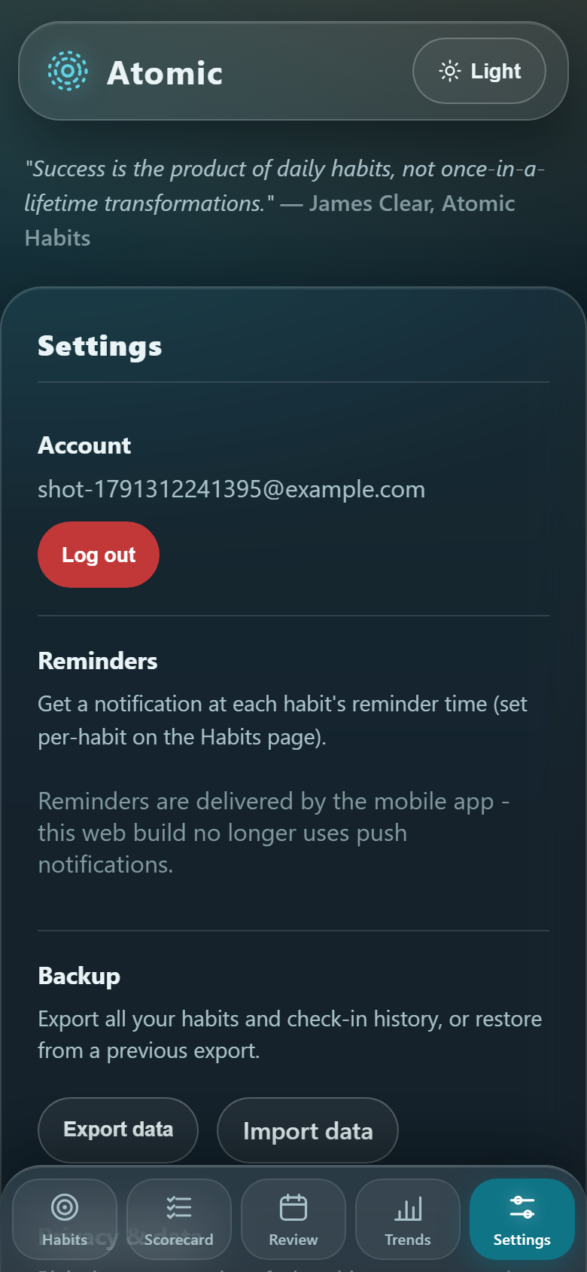
Reminders: explain first, then notify
1
Per-habit reminder time
Each habit carries its own time — 07:00 water, 08:30 reading — and reschedules itself every time the list loads.
2
Nothing leaves the phone
Native notifications are scheduled on-device. No push service, no tracking, no marketing — ever.
3
Permission with consent
An in-app explanation comes first; the system dialog opens only after you tap Continue. Settings always shows Allowed / Not asked / Blocked.
“The most practical way to change who you are is to change what you do.”
— James Clear, Atomic Habits
Notes:
Permission rationale + status pill are the P0 quality items. Quote is one of the app’s own six.

Slide 11
Weekly review: one small tweak
Five minutes every week: what won, what slipped, and exactly one change — never two.
Wins
Misses
One tweak
Checked in 6/7 days. Longest chain: reading, 12 days straight.
Gym slipped twice — both on late-at-work evenings.
Move the gym cue to 07:00, before work can negotiate.
“In order to improve for good, you need to solve problems at the systems level. Fix the inputs and the outputs will fix themselves.”
— James Clear, Atomic Habits
Notes:
The review is deliberately one tweak: change the input (cue), let the output fix itself.

Slide 12
Designed to be calm — and trustworthy
Glass, not glare
Private by default
Frosted panels over a morning-haze backdrop, teal pill buttons, dark + light themes, contrast tuned to WCAG AA.
A plain-language privacy notice in Settings: what is stored, where, and the fact that nothing tracks you. Export everything as JSON, any time.
Accessible
Hard to misuse
44 px touch targets, visible focus rings, live regions for errors, and reduced-motion respected everywhere.
JWT + bcrypt, strict per-user scoping (404, not 403), rate limits — and a two-step confirm on anything destructive.
“The more disciplined your environment is, the less disciplined you need to be.” — James Clear
Notes:
Design = environment design. The interface is the disciplined environment for the habit.

Slide 13
Get Atomic — three steps
1
Install the APK
2
Host it free on Render
3
Point the app at it
Copy Atomic-habit-tracker.apk from the Desktop to your phone and open it. Allow the install when Android asks.
New › Blueprint › this repo. render.yaml supplies build, start, health check and a generated secret.
On the login screen tap “Can’t connect?”, paste your Render URL, Test connection, Save & reload.
“You do not rise to the level of your goals.”
“You fall to the level of your systems.”
— James Clear, Atomic Habits
Notes:
The app is the system. Closing quote is the one shown on the home screen of the app itself.

