Slide 1
Beam Analysis using MATLAB GUI

Slide 2

Content
Design view GUI
Input requirements
Result beam calculations
MATLAB Code
Applications
Advantages
Disadvantages
Conclusion

Slide 3
INPUT FLOWCHART
INPUT
Length
Breadth
Thickness
Material
Type of Beam
Type of Load
Steel
Concrete
Simple Supported Beam
Point Load
Uniformly Distributed Load
Fck value
Cantilever Beam
Magnitude
Magnitude
Fixed Beam
Position from left support
Start position from left support
Output for Specific position
Length of UDL
Output for specific position

Slide 4
OUTPUT FLOWCHART
CALCULATE
RESET
Plots
Shear Stress
Bending Stress
Shear Force
Bending Moment
Shear Force
Deflection
Bending Moment
Deflection
Bending Stress
Shear Stress
Beam Profile

Slide 5
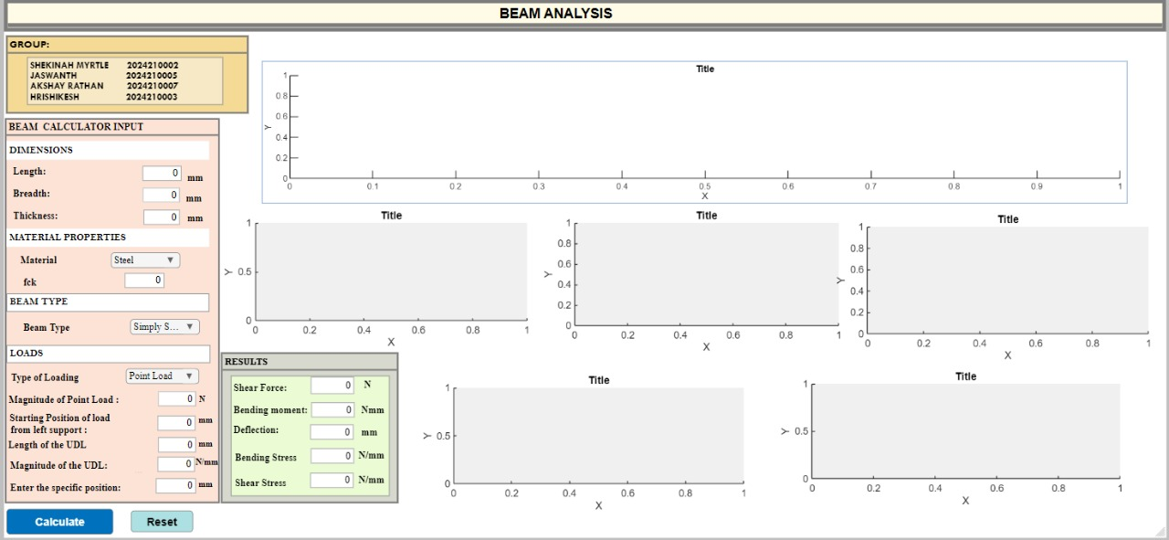
DESIGN VIEW

Slide 6
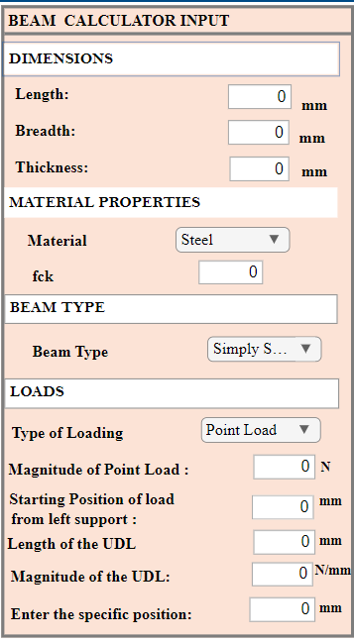
INPUT BOX:

Slide 7
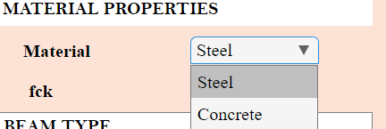
Material Dropdown

Slide 8
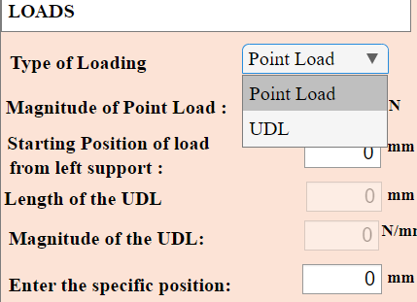
Type of load - Dropdown

Slide 9
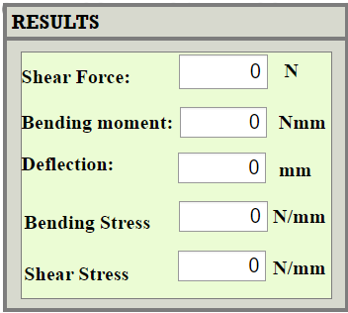
OUTPUT BOX:

Slide 10
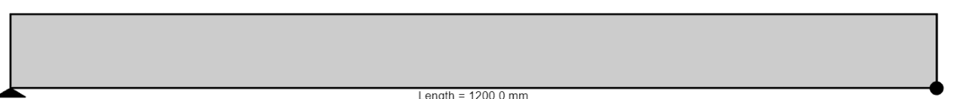
TYPES OF BEAMS AND ITS PORTFOLIO
SIMPLY SUPPORTED BEAM
CANTILEVER BEAM
FIXED BEAM

Slide 11
TYPES OF LOADS AND CALCULATIONS
POINT LOAD
UDL
SHEAR FORCE
BENDING MOMENT
DEFLECTION
BENDING STRESS
SHEAR STRESS
AND THEIR RESPEECTIVE PLOTS

Slide 12
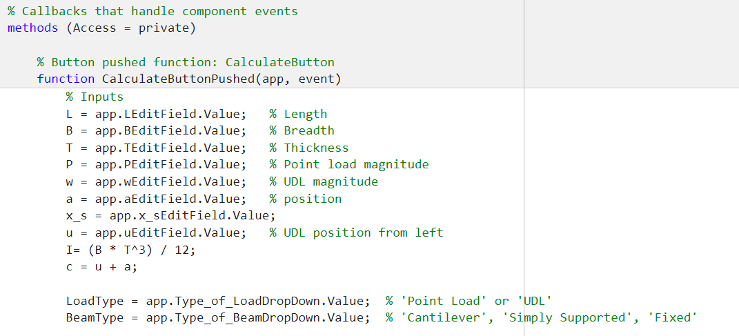
MATLAB CODE
Initializing the inputs:

Slide 13
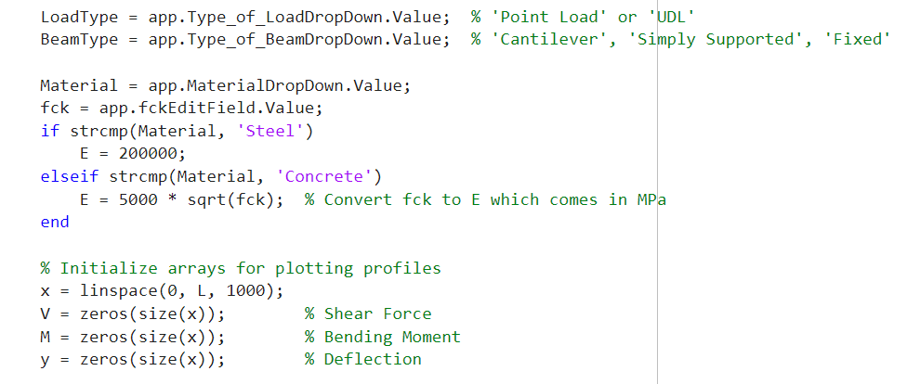
MATLAB CODE
Initializing the dropdown inputs:

Slide 14
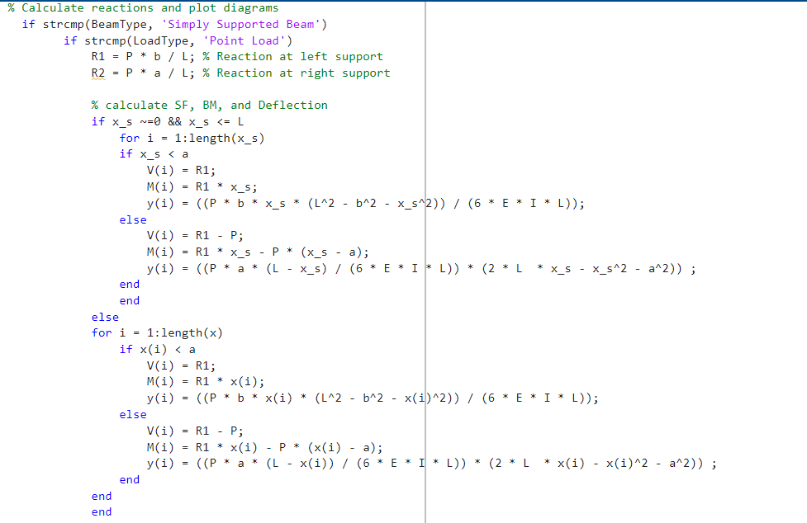
MATLAB CODE
Simple Supported Beam → point load (for specific position output):

Slide 15
MATLAB CODE
Simple Supported Beam → point load :

Slide 16
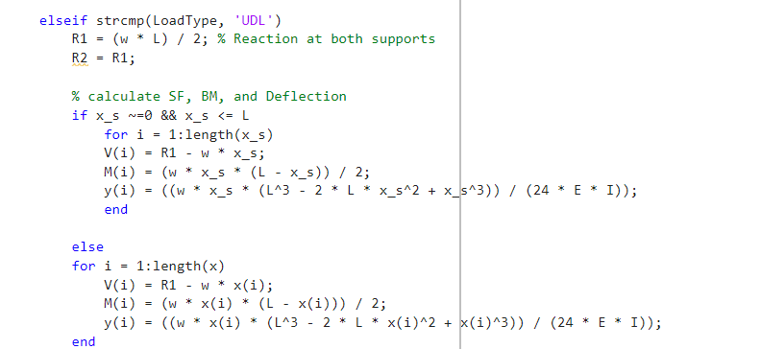
MATLAB CODE
Simple Supported Beam → UDL (for whole length):
FOR SPECIFIC POSITION
FOR WHOLE LENGTH

Slide 17

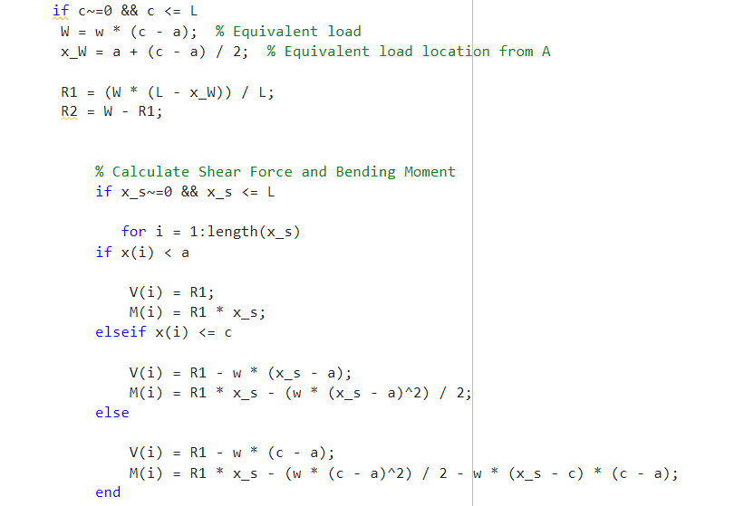
MATLAB CODE
Simple Supported Beam → specific length UDL (output for specific position):

Slide 18
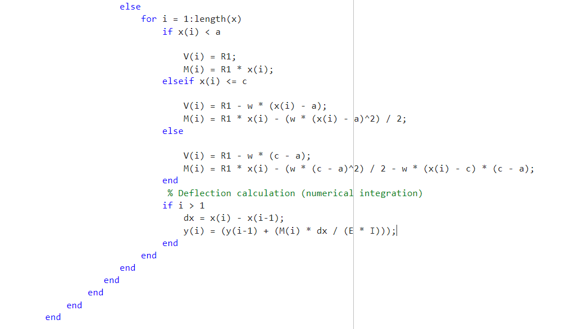
Simple Supported Beam → specific length UDL (for any given length):

Slide 19
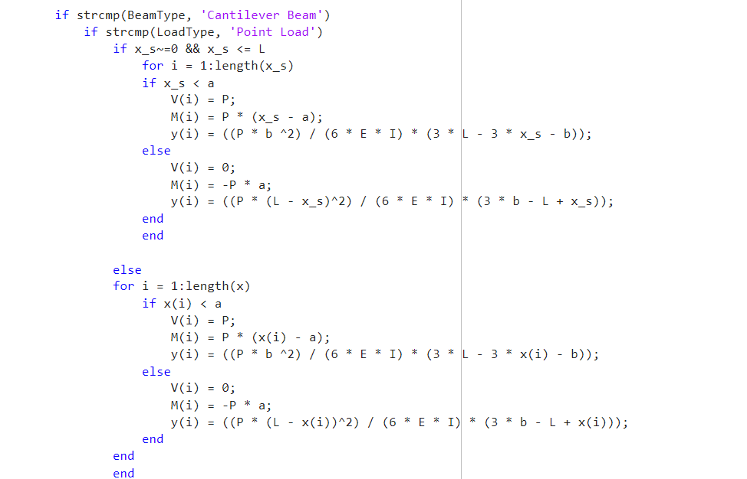
Add a Slide Title - 3
Cantilever Beam → point load :
FOR SPECIFIC POSITION
FOR WHOLE LENGTH

Slide 20
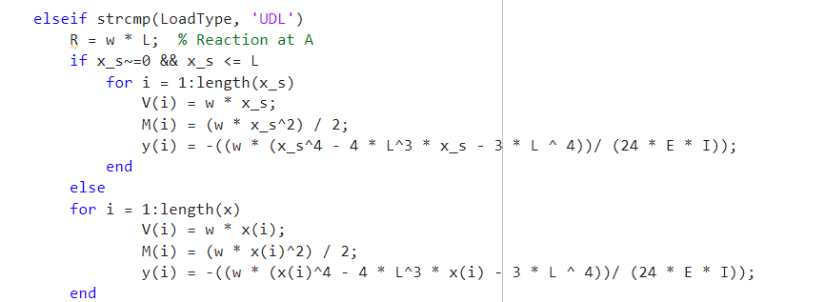
Cantilever Beam → UDL(whole span):
FOR SPECIFIC POSITION
FOR WHOLE LENGTH

Slide 21
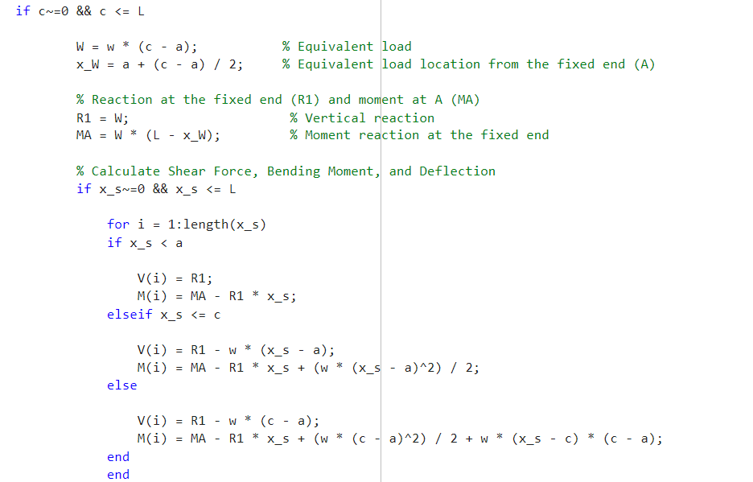
Cantilever Beam → SPECIFIC LENGTH-UDL- (Output for Specific position):

Slide 22
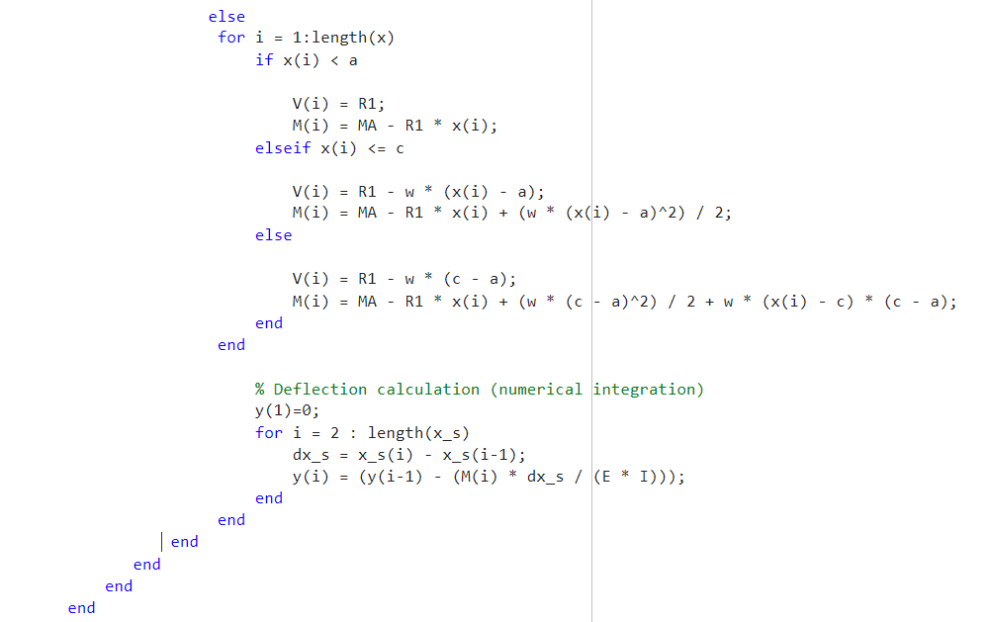
Cantilever Beam → SPECIFIC LENGTH UDL- (output: for a whole length of beam):

Slide 23
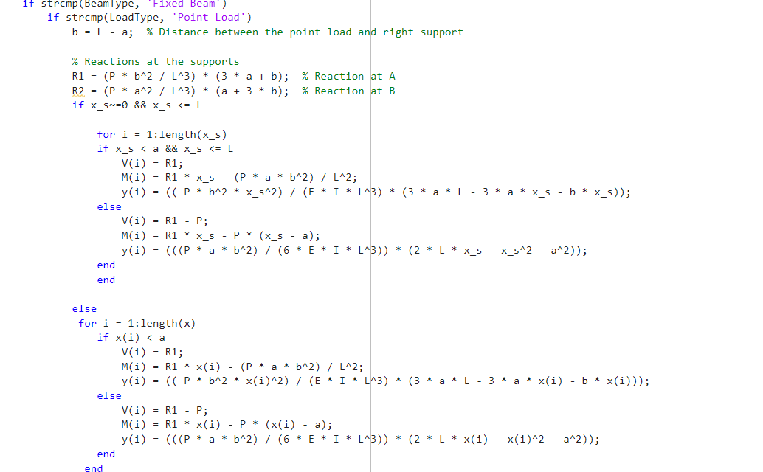
Fixed Beam → Point Load:
FOR SPECIFIC POSITION
FOR WHOLE LENGTH

Slide 24
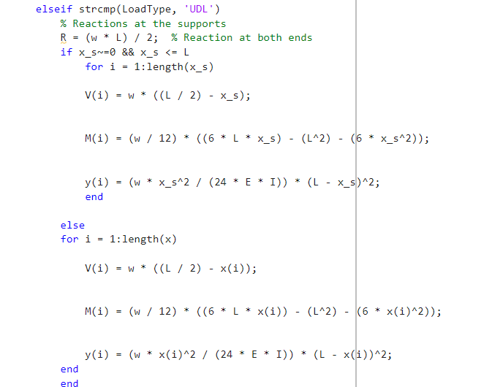
Fixed Beam → UDL (whole span):
FOR SPECIFIC POSITION
FOR WHOLE LENGTH

Slide 25
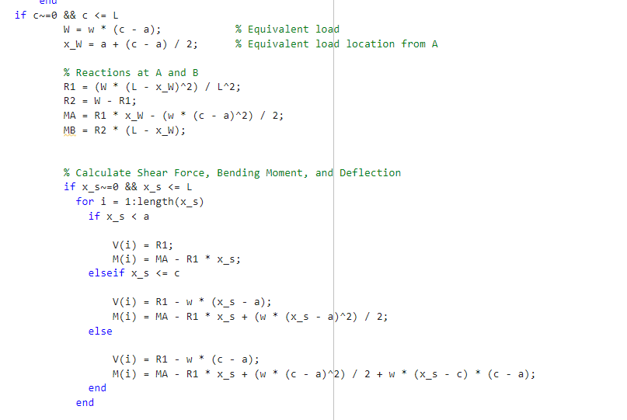
Cantilever Beam → SPECIFIC LENGTH UDL- (output: for specified position of beam):

Slide 26
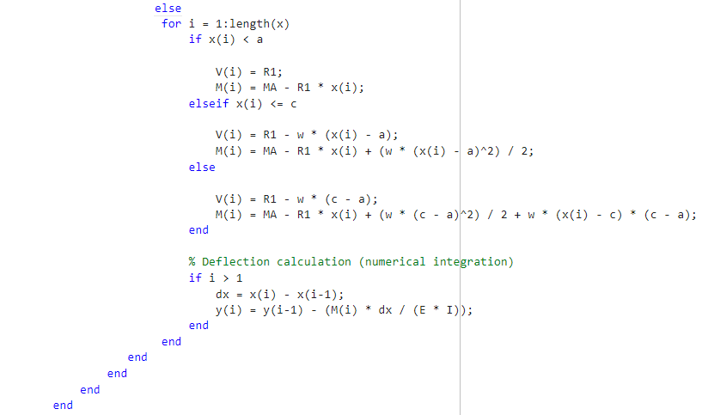
Cantilever Beam → SPECIFIC LENGTH UDL- (output: for Whole length of beam):

Slide 27
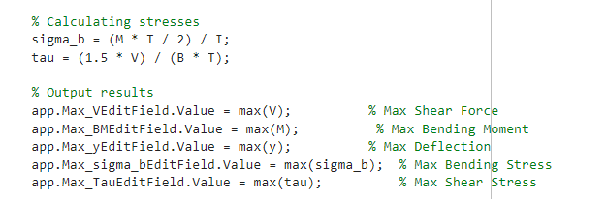
Calculating Stress and Output values :

Slide 28
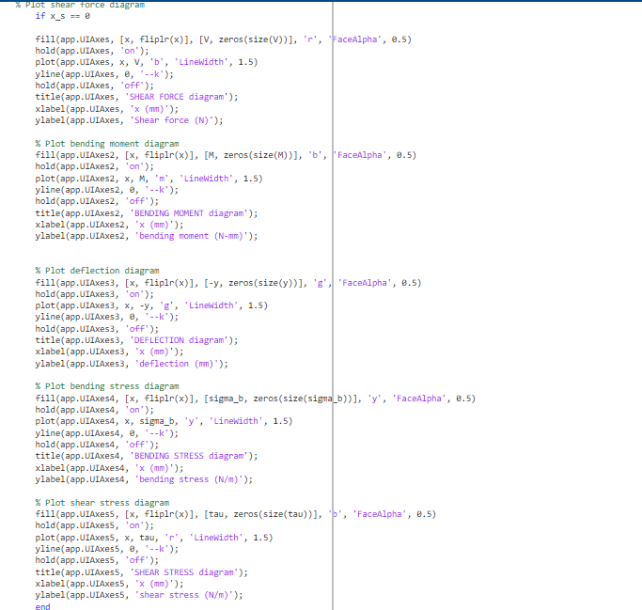
Plots for Shear Force, Bending moment, Deflection, Bending stress, Shear stress

Slide 29
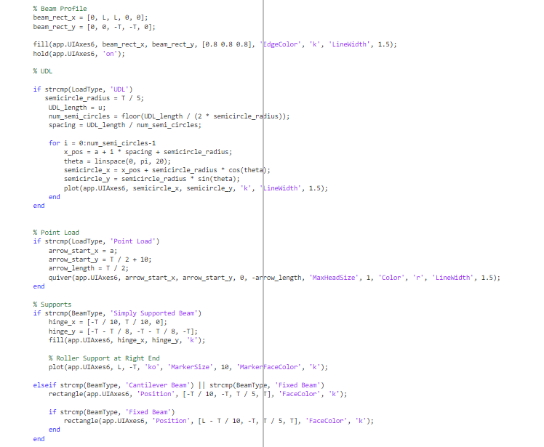
BEAM PROFILE CODE:

Slide 30
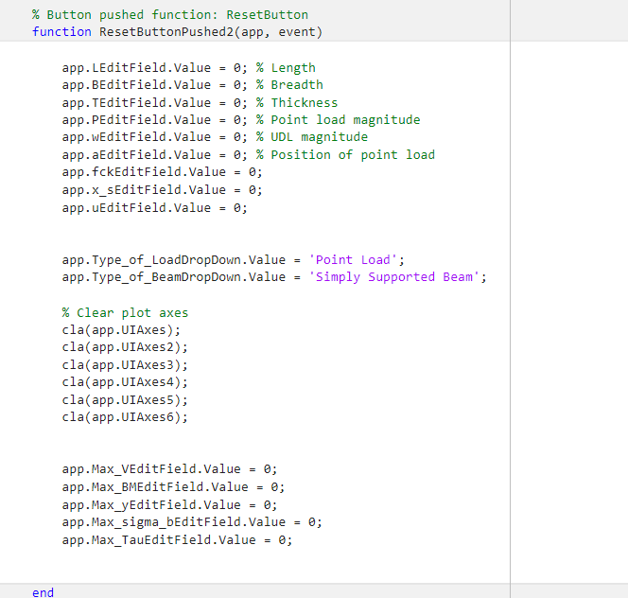
RESET BUTTON:

Slide 31

Application
Structural Engineering: Analyzing load effects on
beams for safe design.
Education: Visualizing structural behavior to aid
student learning.
Research: Testing structural responses under
various conditions.
Construction: Quick on-site design validation for
safety compliance.

Slide 32
Advantages
Efficiency: Automates complex calculations, saving time.
Visualization: Provides clear graphical plots for SFD, BMD, and deflection.
Accuracy: Delivers precise results essential for safety.

Slide 33
Disadvantages
Learning Curve: Requires MATLAB knowledge, which might be challenging for beginners.
Cost: MATLAB licenses can be expensive for some users.
Computational Limits: Large models or complex analyses may require significant computational power.

Slide 34
CONCLUSION
In conclusion, a MATLAB-based tool for generating shear force, bending moment, and deflection plots is an invaluable asset in structural engineering and education. It combines high efficiency, precise calculations, and intuitive visualization, enabling engineers, researchers, and students to analyze structural responses quickly and accurately. The tool’s flexibility to accommodate different beam types and load conditions makes it versatile for a wide range of applications. While there may be a learning curve, the investment in learning MATLAB pays off with significant benefits in speed, accuracy, and insight. Overall, it’s a powerful solution that enhances both understanding and practical design capabilities in structural analysis.

