Slide 1
NBA Rookie All Star And Hall of Fame Predictions
Moses Xie
Victoria Spann-Burton

Slide 2
Methodology
Retrieved the stats of the rookies’ players during the 1979-1980 season and of the 2017 draft class
In each model used to predict hall-of-famers and all stars
0 was assigned to a player is not predicted to be a Hall-of-Famer or all-star
1 is assigned to someone who is
Support Vector Machine and Deep Neural Network to try and make the predictions
Prepared rookie dataset with only columns that are needed
Created data split for the model with 25% test set

Slide 3
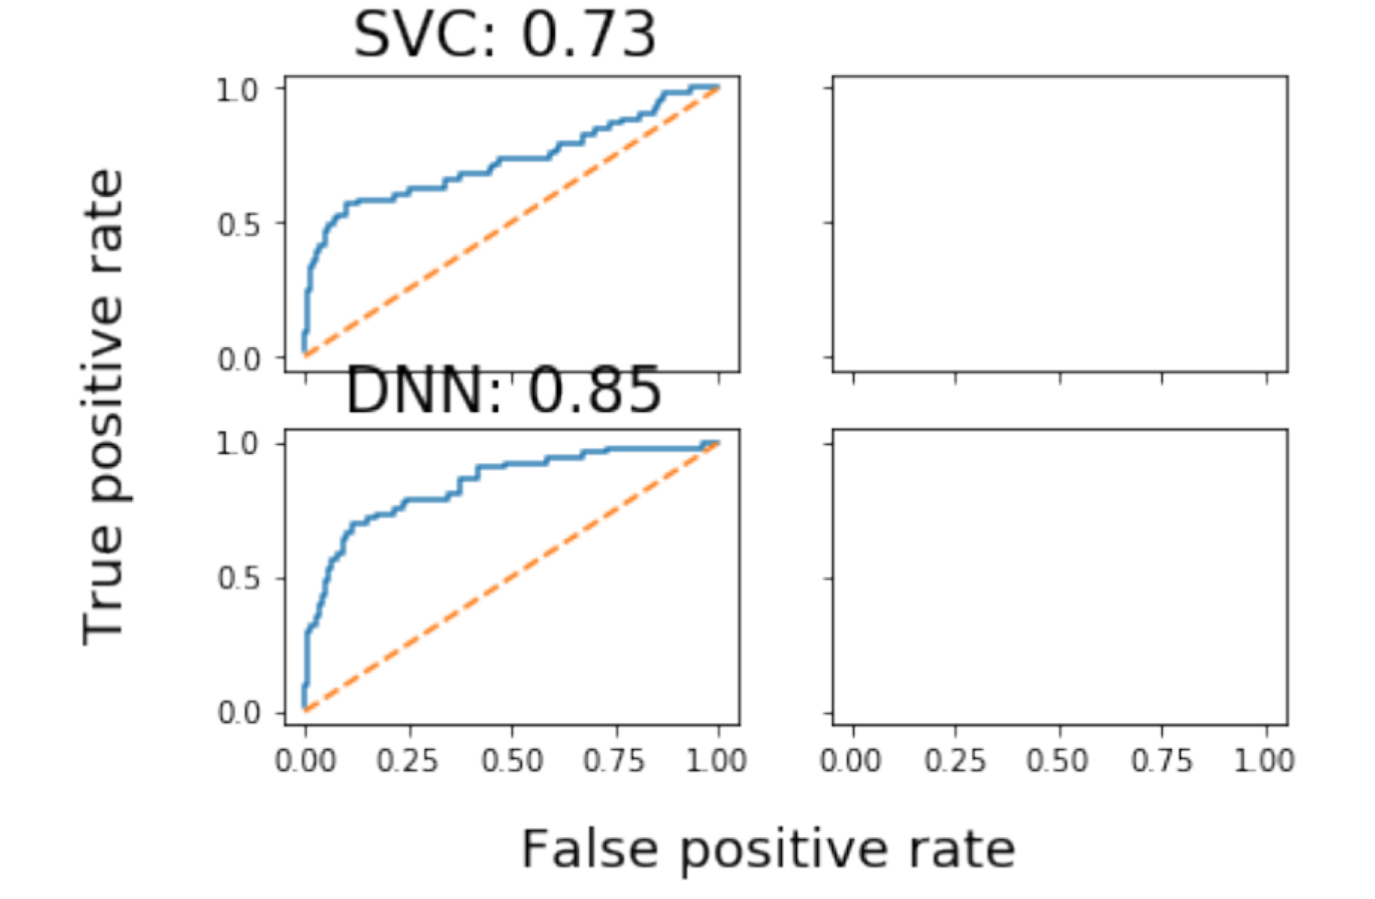
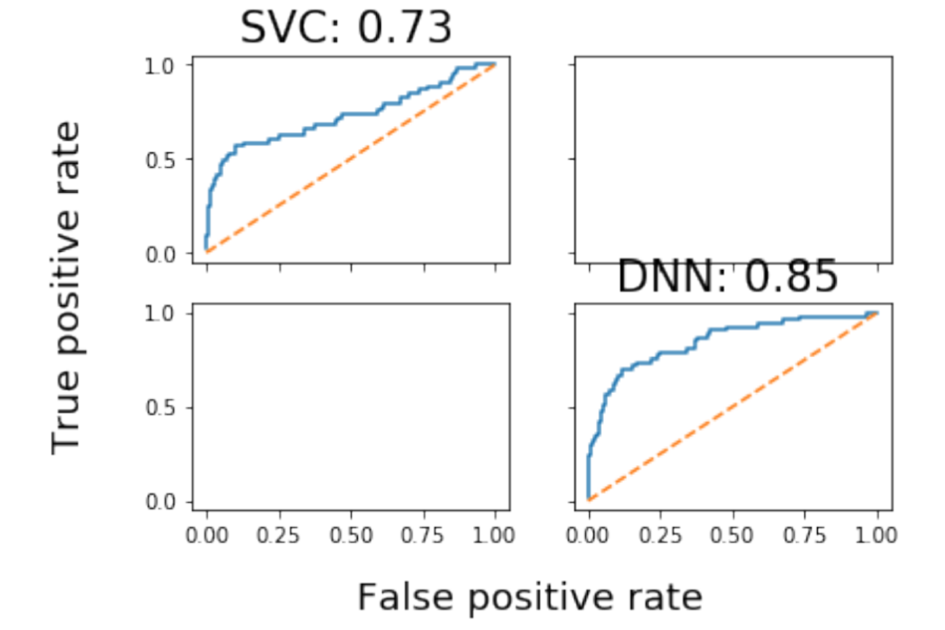
Log Loss and ROC Curve
Hall of Fame Predictions Log Loss and ROC Curve
All Star Predictions Log Loss and ROC Curve
Notes:
Log loss measures the models' performance when given probability values between 0 and 1 as inputs
The receiver operating characteristic curve (ROC curve) plots the true positive rate (TP / (TP + FN)) against the false positive rate (FP / (FP + TN))

Slide 4
Results
Future Hall of Famers
Support Vector Machine - Predicted no one would be hall-of-famers
Deep Neural Network - Predicted no one would be hall-of-famers
Future All Stars
Support Vector Machine - Predicted that Ben Simmons would be an all-star
Deep Neural Network - Predicted that Ben Simmons and Donovan Mitchell would be all-stars

Slide 5
Shortcomings and Future Work
Create simple logistic regression model
Predict a likelihood of being an all star or hall of famer instead of 0 or 1
Use career totals instead of per game of rookie season
Doesn’t take into account narrative because often times all stars are determined by popularity
Coaching, team performance, trades, injuries can all affect all star and hall of fame status

