Slide 1
12 month outpatient mortality prediction for CKD Stage IV and V patients
Mose Wintner
Kaiser Permanente Health Innovation Studio

Slide 2
Background
Advanced CKD (chronic kidney disease) patients will need renal replacement therapy (RRT; e.g. dialysis or transplant).
Dialysis is not a cure; it replaces kidney function in filtering blood.
Kidney transplant is associated with the best outcomes among RRTs.
Mortality risk of CKD Stage IV and V patients is high: ~8% of nephrology encounters for CKD Stage IV or V patients from 2005-2017 occurred 1 year or less before the patient’s death.

Slide 3
Background
Dialysis prep includes elective surgery (vascular access) and a period for the surgery to “take” (3-9mo).
Can be long, risky, and/or unwanted, especially for frail patients.
Avoiding dialysis prep leads to a “crash start,” (central venous catheter), which is associated with poor outcomes.
“Optimal Start” program seeks to decrease incidence of central venous catheters.
Patients may pass away after beginning prep but before receiving treatment benefit from dialysis.
Patients on dialysis may want to transition off of dialysis at some point.

Slide 4
Problem: Encouraging “Optimal Start” of Dialysis
Patients may pass away after beginning dialysis prep but before receiving treatment benefit.
Patients on dialysis may want to transition off of dialysis at some point.

Slide 5
Research question
Assuming patient does not get a transplant in the next 12 months, what is the probability they will die in the next 12 months?

Slide 6
Base table logic
 | Definition | Measurement/proxy
patients | patients most likely to consult prediction in the past if it had been available | patients with chronic GFR ≤ 30 (i.e. CKD Stage IV/V)
initial prediction consultation date | for given patient, first time prediction would have most likely been consulted in the past if it had been available | first nephrology appointment after chronic GFR ≤ 30
terminus date | for given patient, last time prediction would have most likely been consulted in the past if it had been available | minimum date among: chronic GFR ≤ 10 last nephrology appointment 12 months before transplant death date
prediction consultations | for given patient, snapshots of patient features when prediction would have most likely been consulted in the past if it had been available | non-dialysis inpatient / outpatient encounters in nephrology departments between initial prediction consultation date and terminus date
Notes:
We’d like the training data to look as much as possible like the patients who will be consulting the model in the future AT THE TIME they will be consulting it.

Slide 7
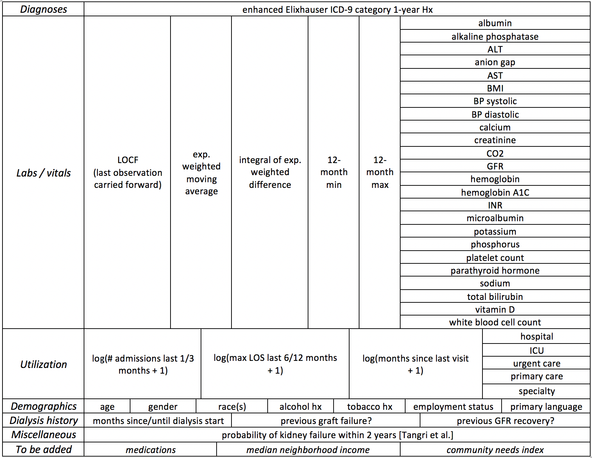
Input data

Slide 8
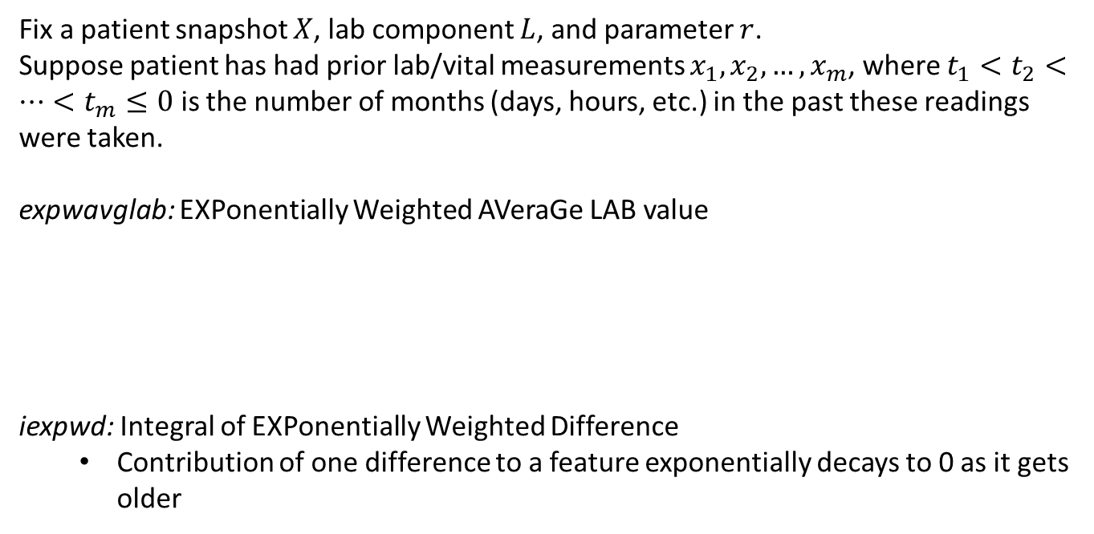
Engineered features: longitudinal data
Fix a patient snapshot $X$, lab component $L$, and parameter $r$.
Suppose patient has had prior lab/vital measurements $x_{1},x_{2},…, x_{m}$, where $t_{1}<t_{2}<…<t_{m}≤0$ is the number of months (days, hours, etc.) in the past these readings were taken.
expwavglab: EXPonentially Weighted AVeraGe LAB value
iexpwd: Integral of EXPonentially Weighted Difference
Contribution of one difference to a feature exponentially decays to 0 as it gets older
Notes:
Assumes linear trend between measurements

Slide 9
Feature selection
Clinically valid
Checked only with one clinician (more scheduled)
Missingness
Drop all variables which are too highly missing
Check missing at random assumptions
Variance analysis
Drop all variables which appear to completely determine 12-month mortality outcome
Feature attribution in pilot models
Train xgboost (with internal missing data support) on several random train sets and drop all variables which were never chosen for splits
Correlation analysis
Examine correlations between remaining variables and drop highly correlated variables

Slide 10
Missing data imputation
Simple imputation
months_since_* was imputed as 15 if missing
only 12 months of utilization and lab/vitals history were used
missForest (CRAN)
want to reflect high uncertainty in missing values
few trees, large min node size to encourage high variance in imputed values
multiple imputation

Slide 11
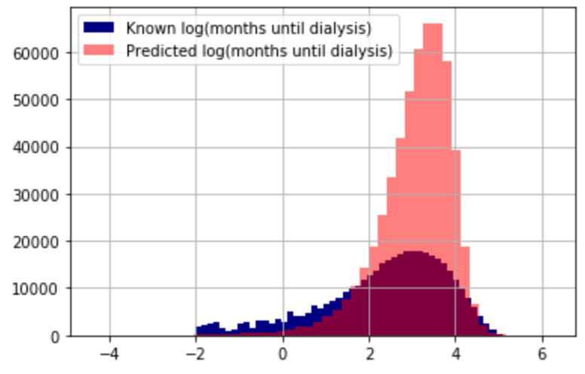
Missing data imputation
Regression submodel: How many months
until patient will begin dialysis?
Itself of interest to clinicians
Partially known for training data; completely unknown for prediction data
Trained during mortality model training
Trained on bootstrapped, weighted subset of concatenated, imputed training data consisting of patient snapshots who began dialysis at least 3 days after snapshot
Predicted on missing data in training set, i.e. snapshots of patients who have not begun dialysis
Predicted on missing data in prediction set, i.e. snapshots of patients who have not begun dialysis
Notes:
Future:
Multiclass classification: What mode of RRT will patient eventually begin?
fistula, graft, peritoneal dialysis, central venous catheter, death before dialysis start

Slide 12
Missing data imputation
Competing risks of death and
planned-no-dialysis (ignored)
Alternative “months until dialysis start or planned no dialysis date or death” problematic
Patients rarely (and inadvisably) choose definitively to decline dialysis in perpetuity, so “planned no dialysis date” is hard to measure
Including death date in label leaks information to subsequent mortality prediction task
Goal is to increase regionwide incidence of “planned no dialysis therapy”, therefore target would shift earlier over time as patients elected “planned no dialysis”
Factors associated with these three outcomes are probably not common
Notes:
Future:
Multiclass classification: What mode of RRT will patient eventually begin?
fistula, graft, peritoneal dialysis, central venous catheter, death before dialysis start

Slide 13
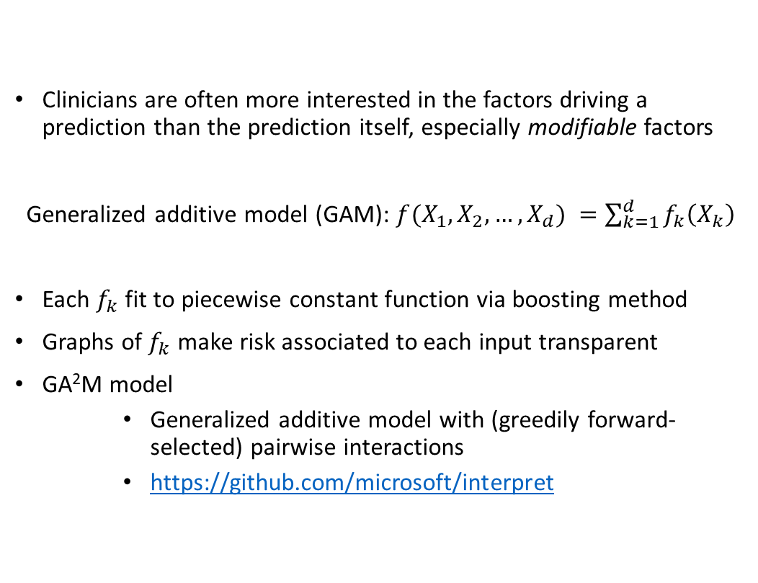
Globally explainable dialysis arrival and mortality models
Clinicians are often more interested in the factors driving a prediction than the prediction itself, especially modifiable factors
Generalized additive model (GAM): ${f(X_{1},X_{2},…,X_{d})}^{ }=\sum_{k=1}^{d}{f_{k}\left(X_{k}\right)}$
Each $f_{k}$ fit to piecewise constant function via boosting method
Graphs of $f_{k}$ make risk associated to each input transparent
GA²M model
Generalized additive model with (greedily forward-selected) pairwise interactions
https://github.com/microsoft/interpret

Slide 14
Validation readout for developer/data expert and clinician-in-the-loop (in progress)
After merge
summary/histograms of data
variable descriptions: normal ranges, details of data collection and measurement, what abnormal values indicate, links to online resources
summary of differences between new training data and previous training data
description of feature selection method and variables excluded
outlier detection
After imputation
summary of imputed data
summary of differences between imputed data and measured data
details of imputation fit/transform
RRT arrival model training performance statistics: loss metric(s), sample of model predictions vs. actual and local explanations, feature attributions, model explanations
outlier detection
After training
training performance: confusion matrix and summaries, calibration plot, PR curve, ROC
comparison of training performance to previous training performance
global explanations: averaged feature attributions,
local explanations: sample of model training error cases and corresponding local explanations
elevated to clinician partner at training/prediction time
included in prediction dashboard

Slide 15
Validation readout for developer/data expert and clinician-in-the-loop (in progress)
Before prediction
test for distribution shift: repeated K-S tests (with randomly selected training/testing imputed datasets) on hypothesis that group comprising training data is not same as group comprising prediction data
outlier detection
After prediction
sample of prediction cases and predictions
(local) explanations for each prediction
elevated to clinician partner at training/prediction time
included in prediction dashboard

Slide 16
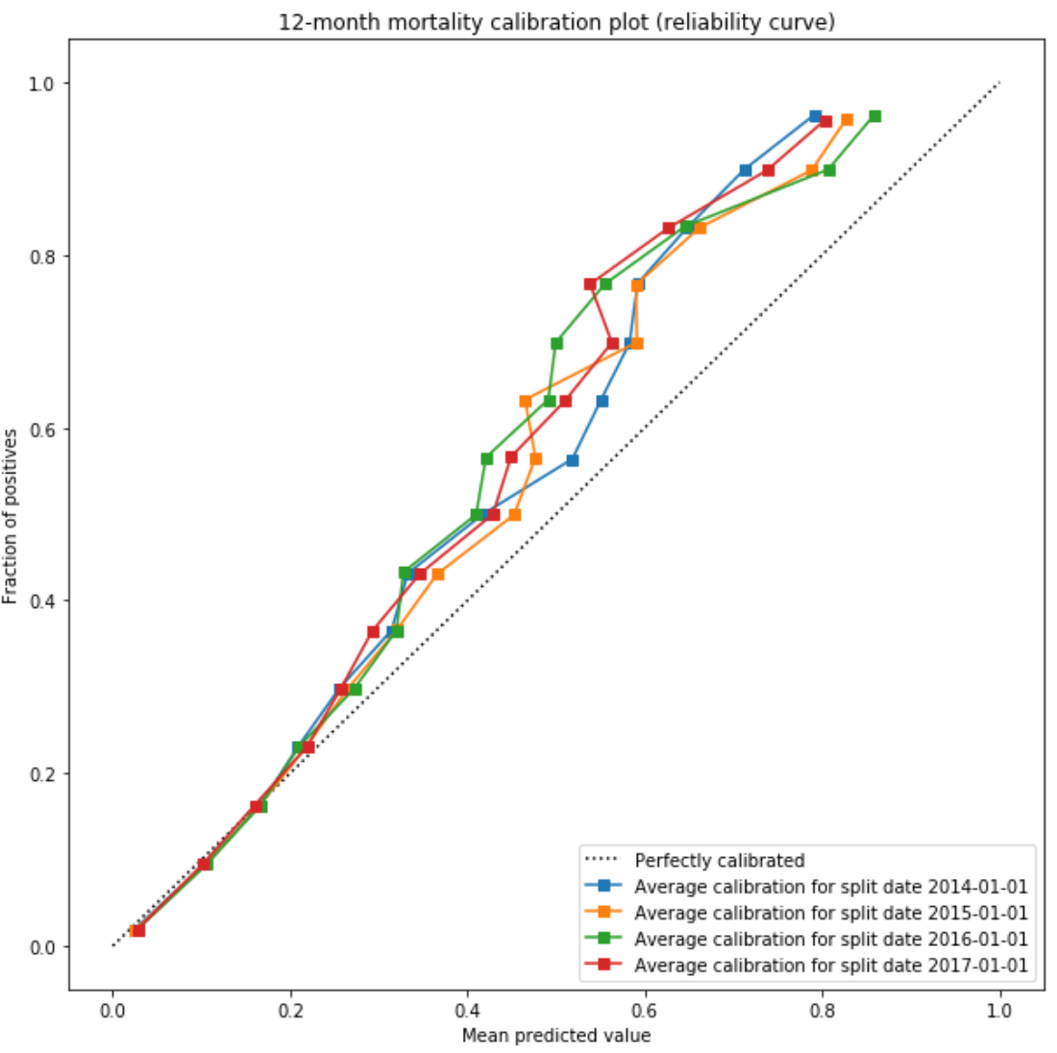
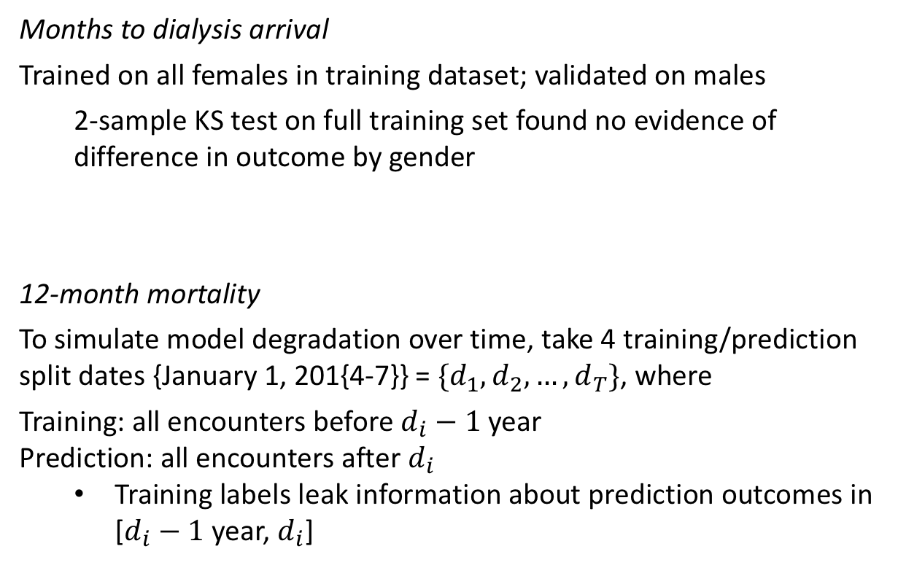
Validation results
Months to dialysis arrival
Trained on all females in training dataset; validated on males
2-sample KS test on full training set found no evidence of difference in outcome by gender
12-month mortality
To simulate model degradation over time, take 4 training/prediction split dates {January 1, 201{4-7}} = $\{d_{1}, d_{2},…,d_{T}\}$, where
Training: all encounters before $d_{i}−1$ year
Prediction: all encounters after $d_{i}$
Training labels leak information about prediction outcomes in [$d_{i}−1$ year, $d_{i}$]

Slide 17
Extracted data
validation module
Composite of training and prediction pipelines
Validation readout
developer/data expert
clinician
Cleaning and de-identification
Merge tables
Multiple imputation of missing data
Engineer features
mostly imputed
imputed dataset
if task=training,
sequential/time series validation split
Classification: will patient pass away in the next 12 months?
mostly imputed
Feature selection:
clinical validity, missingness, variance and correlation analysis,
feature attribution in pilot models
imputed dataset
mostly imputed
Split mostly imputed data
If task=prediction,
test for distribution shift
train: began RRT after snapshot
predict: did not begin RRT
12-month mortality prediction dashboard
imputed dataset
Merged input data
Regression: How many months until patient will begin dialysis?
data preparation
missing data imputation

Slide 18
Assumptions
Assumption | Validation source | Strength of evidence | Explanation of evidence
12-month mortality risk is estimable from observational data. | Previous published research; panel of KPSC nephrologists. | Strong | Many published, validated, used, trusted mortality models exist for subpopulations of ESRD patients
Number of months until dialysis start is estimable from observational data. | Previous internal (KPSC) research | Strong | (Random forest) model is already validated and in production
Missing data are missing at random, i.e. estimable from other variables in the model. | Nephrologist co-lead | Moderate/Weak | Clinician judgment; unsure about selection bias. Future research needed.

Slide 19
Choosing an operating point: savings and cost
The current immediate gap in care is in assessment of patient wishes around end-of-life priorities.
The benefits associated with this assessment do not depend on the prediction; every patient arguably stands to benefit from such an intervention.
Therefore the predictions are most like a risk assessment to prioritize patients for these conversations.
The practical difference between an expected intervention for a true positive and false positive is that the latter may have a conversation about end-of-life care with their physician “too early” – in other words, a relatively benign error in prioritization.
The real cost of an error is therefore attributable to the false negatives.

Slide 20
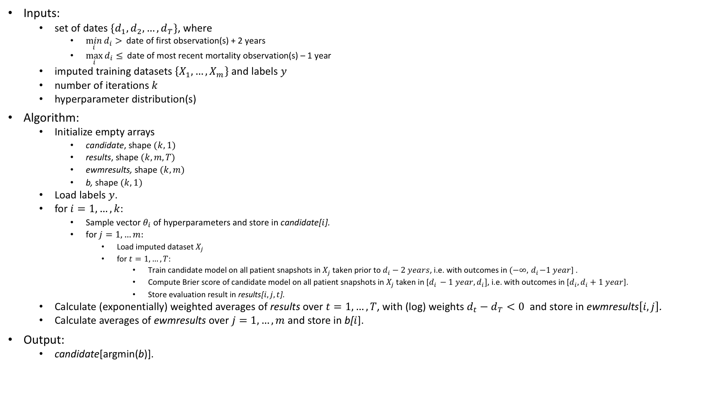
Sequential cross-validation algorithm for old xgboost model
Inputs:
set of dates $\{d_{1}, d_{2},…,d_{T}\}$, where
$\min_{i}{d_{i}> }$date of first observation(s) + 2 years
$\max_{i}{d_{i}≤ }$date of most recent mortality observation(s) – 1 year
imputed training datasets$\left\{X_{1},…,X_{m}\right\}$ and labels $y$
number of iterations $k$
hyperparameter distribution(s)
Algorithm:
Initialize empty arrays
candidate, shape $(k,1)$
results, shape $(k,m,T)$
ewmresults, shape $(k,m)$
b, shape $(k,1)$
Load labels $y$.
for $i=1,…,k$:
Sample vector $θ_{i}$ of hyperparameters and store in candidate[$i$].
for $j=1,…m:$
Load imputed dataset $X_{j}$
for $t=1,…,T$:
Train candidate model on all patient snapshots in $X_{j}$taken prior to $d_{i}−2 years$, i.e. with outcomes in $(−∞, { d}_{i}−1 year$] .
Compute Brier score of candidate model on all patient snapshots in $X_{j}$taken in [$d_{i }−1 year, d_{i}]$, i.e. with outcomes in [$d_{i}, d_{i}+1 year$].
Store evaluation result in results[$i,j,t$].
Calculate (exponentially) weighted averages of results over $t=1,…,T$, with (log) weights $d_{t}−d_{T}<0$ and store in ewmresults$\left[i,j\right]$.
Calculate averages of ewmresults over $j=1,…,m$ and store in b[$i$].
Output:
candidate[argmin(b)].
Notes:
Training labels leak information about snapshots taken between $d_{i}−2 years$ and $d_{i}−1 year$
(i.e. so that models performing better on more recent data are preferred)

Slide 21
Globally explainable dialysis arrival and mortality models
Why?
Model debugging - Why did my model make this mistake?
Detecting bias - Does my model discriminate [inappropriately]?
Human-AI cooperation - How can I understand and trust the model's decisions?
Simpler sensitivity analysis - How might the model’s decision change if one of the inputs changes?
Regulatory compliance - Does my model satisfy legal requirements?
High-risk applications - Healthcare, finance, judicial, ...

Slide 22
Assumptions
Assumption | Validation source | Strength of evidence | Explanation of evidence
12-month mortality risk is estimable from observational data. | Previous published research; panel of KPSC nephrologists. | Strong | Many published, validated, used, trusted mortality models exist for subpopulations of ESRD patients
Number of months until dialysis start is estimable from observational data. | Previous internal (KPSC) research | Strong | (Random forest) model is validated, used, and trusted
Missing data are missing at random, i.e. estimable from other variables in the model. | Nephrologist co-lead | Moderate/Weak | Clinician judgment; unsure about selection bias
Accurate prediction of 12-month mortality risk will empower nephrologists and their support staff to initiate a more palliative approach to dialysis care, i.e. to initiate and maintain end-of-life discussions with high-risk patients. | Nephrologist co-lead, panel of KPSC nephrologists | Weak | - Palliative care referral rates among nephrologists are very low regionwide. Medicare does not reimburse based on palliative metrics; health systems do not have financial incentive to assess patient end-of-life wishes. External research suggests clinicians are generally loath to begin these serious conversations; some see it as akin to giving up on their patients

