Slide 1


Slide 2
Project Request:
The name of our project is “Enumeration Mathematical Library” acronym as EML.
This will be a numerical Math library for C and C++ programmers. Firstly, we will start with Number Theory, and subsequently, explore other areas of mathematics.
Our project will be an open source one, which will be published under the GNU General Public License.
Our intention is to follow the open source business model. So, it will be really useful for the scientific computing community.
As it will be developed in an open source environment, the development cost will be minimal, and our main profit will be through donations and supporting corporations.

Slide 3
Scope OF Effort:
Critical priority →
Enumeration Mathematical Library will support:
Arbitrary Large Integers
Arbitrary Precision Numbers
Basic Number Theory
Power Series
Polynomials
P-adic fields
Complex, Quaternion's and Higher Fields
Matrix Algebra

Slide 4
Scope OF Effort [Continued]:
Critical priority →
It’ll depend on Glibc C Standard Library but will be strictly implemented in ANSI C format, for portability.
For each part of the library there will be a single header file which will contain all function definitions, type definitions, structure definitions and constants.
We will provide the library only in Linux operating system and the architecture support will be limited to x86-64 processor types.
It will compiled as 64-bit and 32-bit binaries for some specific operating systems such as Ubuntu or other Debian based OS.
A tar file will also be provided for all other distributions.

Slide 5
Scope OF Effort [Continued]:
Future Updates:→
EML will support more architectures, especially ARM, ARM64, Itanium-64,POWERPC, etc..
We will support parallel programming for these so that cluster computation can be achieved.
We will try to write some heavy duty parts in assembly for different architectures for a more fast and robust library.
We will add more math modules and bindings for different programming languages such as Java, Rust, etc.
We also intend to support other development platforms such as WIN32 an Mac OS developer platform.

Slide 6
Project Approach:
Our library will follow the following structure, and each library will be implemented in the order shown below.
Arbitrary Large Integers:
The library will have a separate package for arbitrary large integers and possible operations with it.
Arbitrary Precision Numbers:
The library will have a separate package for arbitrary precision floating point umbers and operations on it.
Combinatorial Objects:
The library will support combinatorial objects like combinations, permutations, power series, recurrences, tabuleax, q-analogues, etc.

Slide 7
Project Approach [Continued]:
Graphical Library:
It will support a graphical library for plotting, drawing mathematical objects and other graphical renderings and data.
Complex, Quaternions and Higher Fields:
The library will have a package for different fields starting with complex numbers and quaternions, p-adic fields. It will include axioms and operations for those fields.
Performance matters for this library and hence we will like our library to have the following features:
Fast Library:
EML will be carefully designed to be as fast as possible, both for small operands and for huge operands. The speed is achieved by using full words as the basic arithmetic type, by using fast algorithms, with highly optimized C code for the most common inner loops for a lot of CPUs, and by a general emphasis on speed.

Slide 8
Project Approach [Continued]:
Fast Algorithms :
The mathematical algorithms will be as fast as possible.
Easy User Interface:
In C programs, EML library can be accessed by including the header files. For example, to include arbitrary precision library from EML, #include <eml/arb.h>.
Then while compiling use the proper flags for EML like -leml in GCC. For C++, you need to #include <eml/arb>.
Parallel Programming:
The library will support parallel programming by using OpenMP and MPI libraries.

Slide 9
Project Deliverables:
By the spring term, we are planning to deliver a stable working library as our alpha release.
We will make our source code available to public as an archive .zip or .tar of source code per open source ideology.
We will also provide a dynamic compiled library as .so file. with complete documentation and system manual.

Slide 10
Project Deliverables[Continued]: Major Deliverables →
Static Library:
A .a file that has no dependencies but cannot be shared and can be used for development purposes that choose to distribute this library. Library of object code which is linked with, and becomes part of the application.
Dynamic Library:
A .so file or dynamic library that is dynamically linked at run time but statically aware. The libraries must be available during compile/link phase. The shared objects are not included into the executable component but are tied to the execution.
Source Code:
We will deliver the source as a .zip or tar archive. The source can be used to modify the library and build upon different platforms.

Slide 11
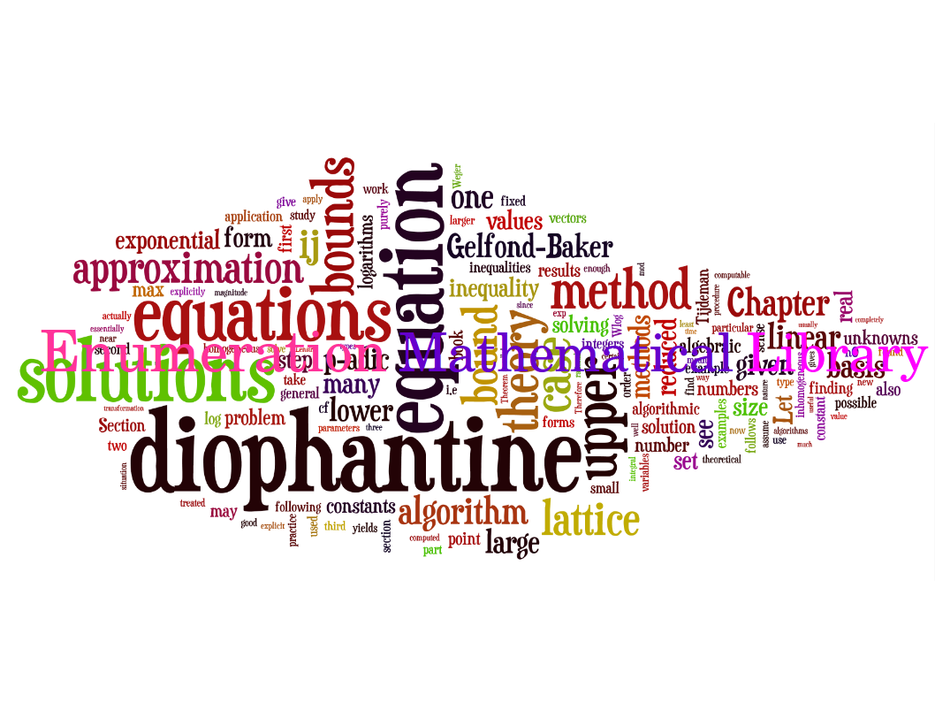
Now, Any Questions?

