Slide 1
ME FIT User Manual
2023-03-30/Stockholm/Documented by Mosleh Silvia Lovisa Miwa

Slide 2
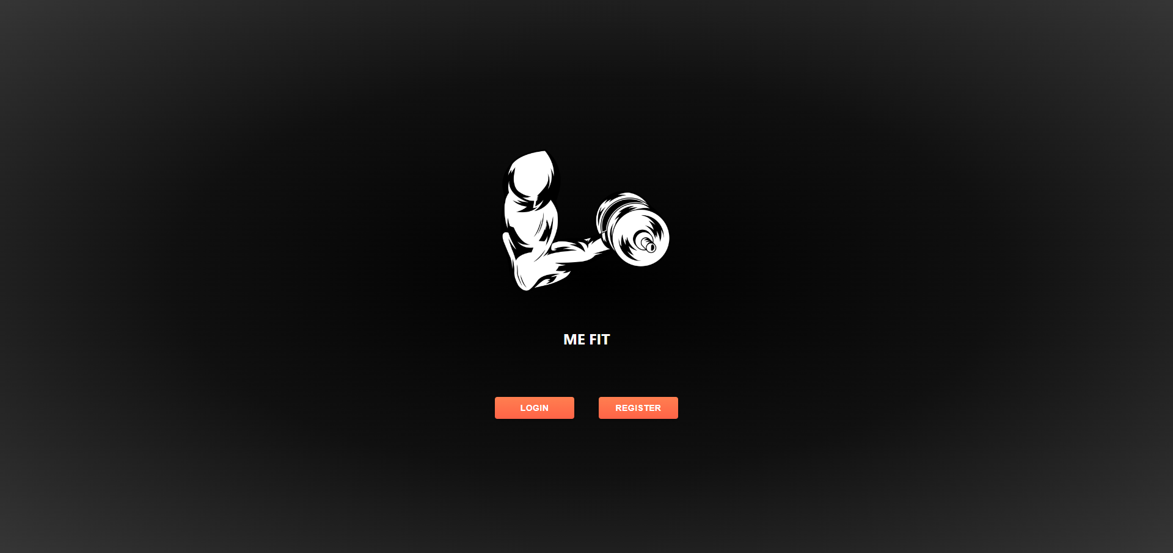
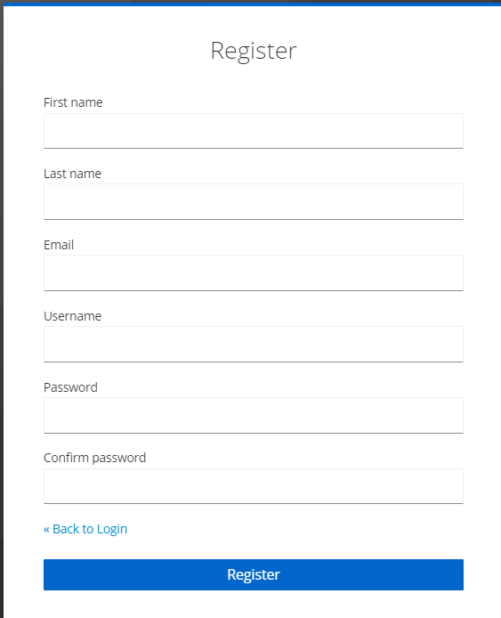
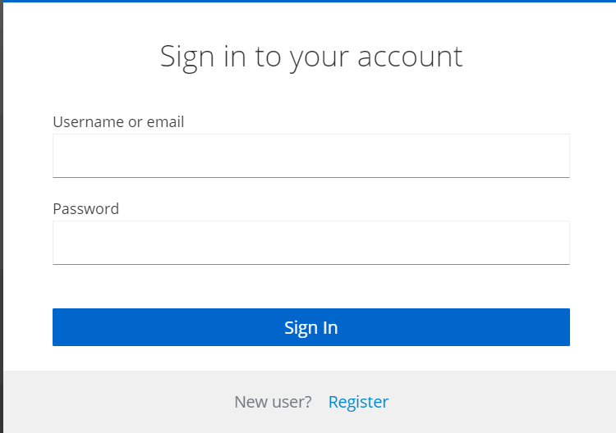
Login or Register
You have your account
-> Click Login button
Input your username or email
Input Password
You do not have account
->Click Register button
Input your information

Slide 3
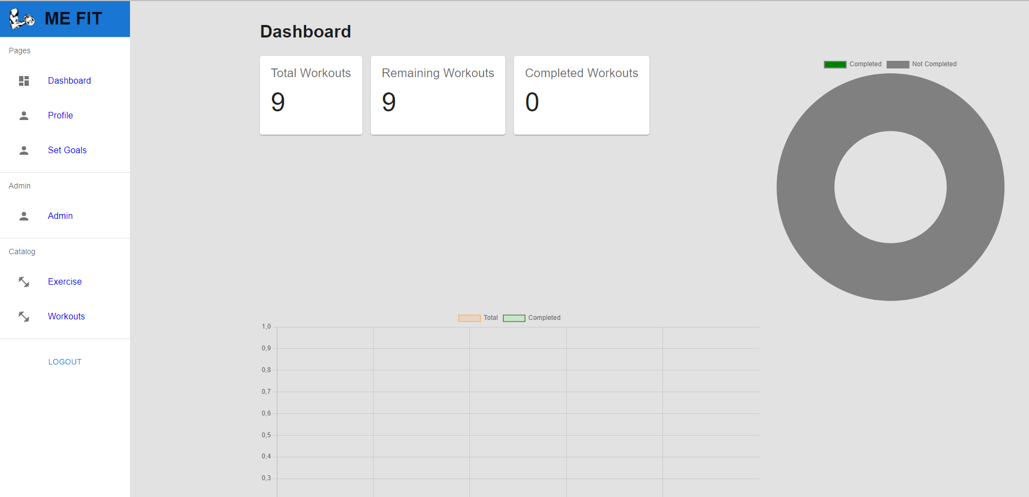
Admin page
1
1. View your own Dashboard Check your completed workouts
2. Create/ View/ Update your own Profile
3. Set your own Goals
4. View Create /Update/Delete Exercise
5. View Update Workouts
(Create and Delete: Backend only)
6. View Token and User List
2
3
6
4
5

Slide 4
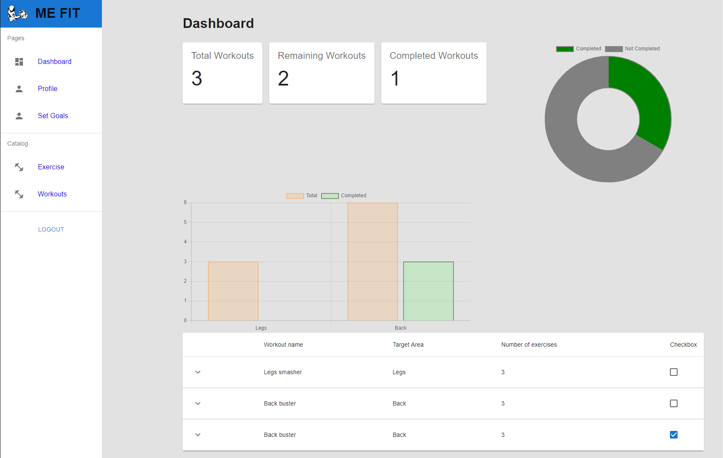
User page
1
1. View your own Dashboard Check your completed workouts
2. Create/ View / Update your own Profile
3. Set your own Goals
4. View Exercise
5. View Workouts
2
3
4
5

Slide 5
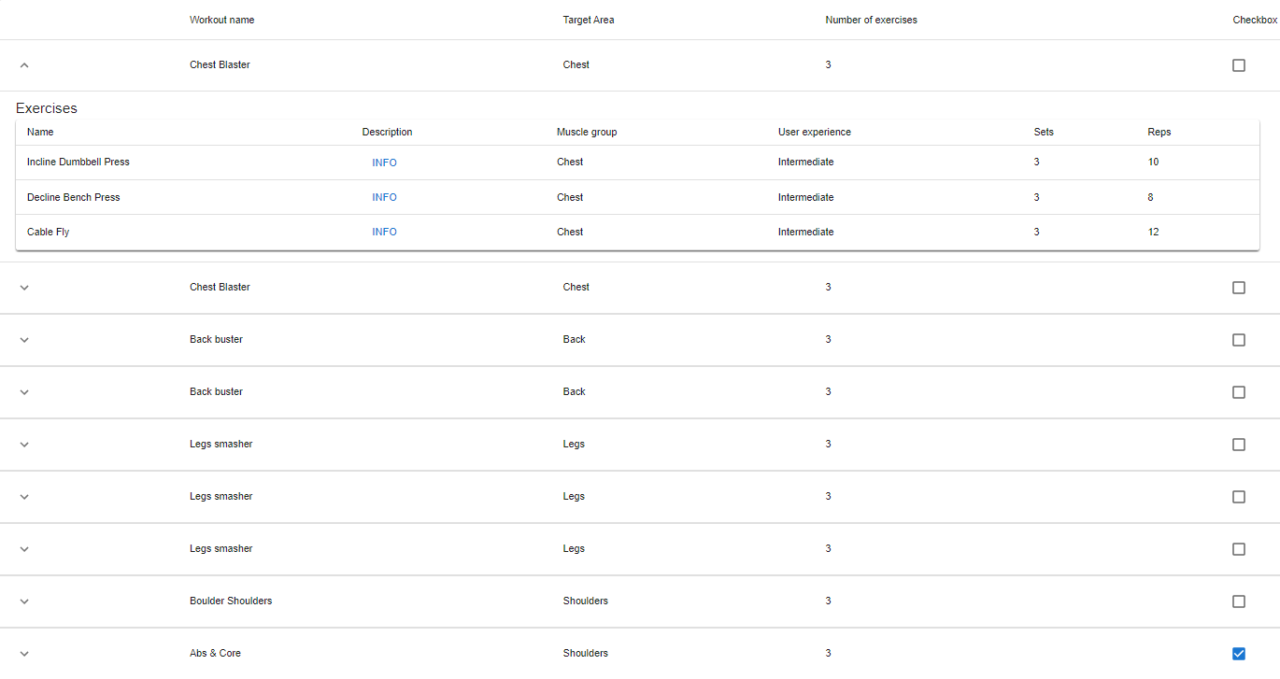
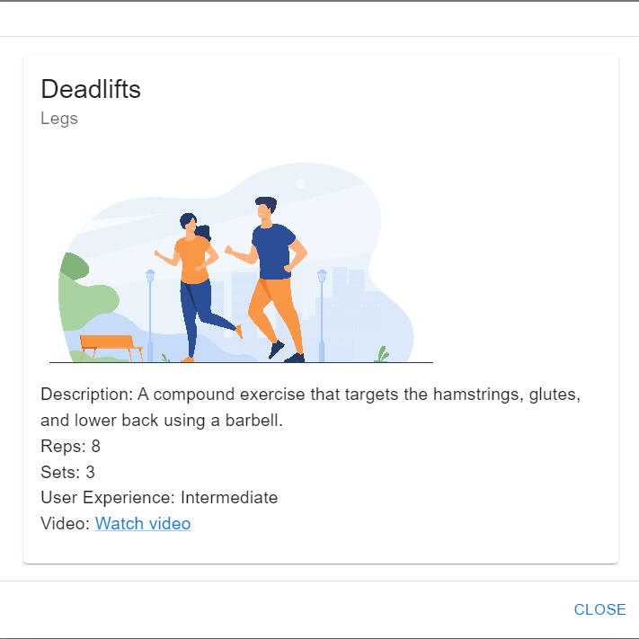
1. View your own Dashboard / Check your completed workouts
Click checkbox If your Workouts is completed
-> Your Dashboards information(Data /Charts) will be updated
Click Info If you want to see exercise information

Slide 6
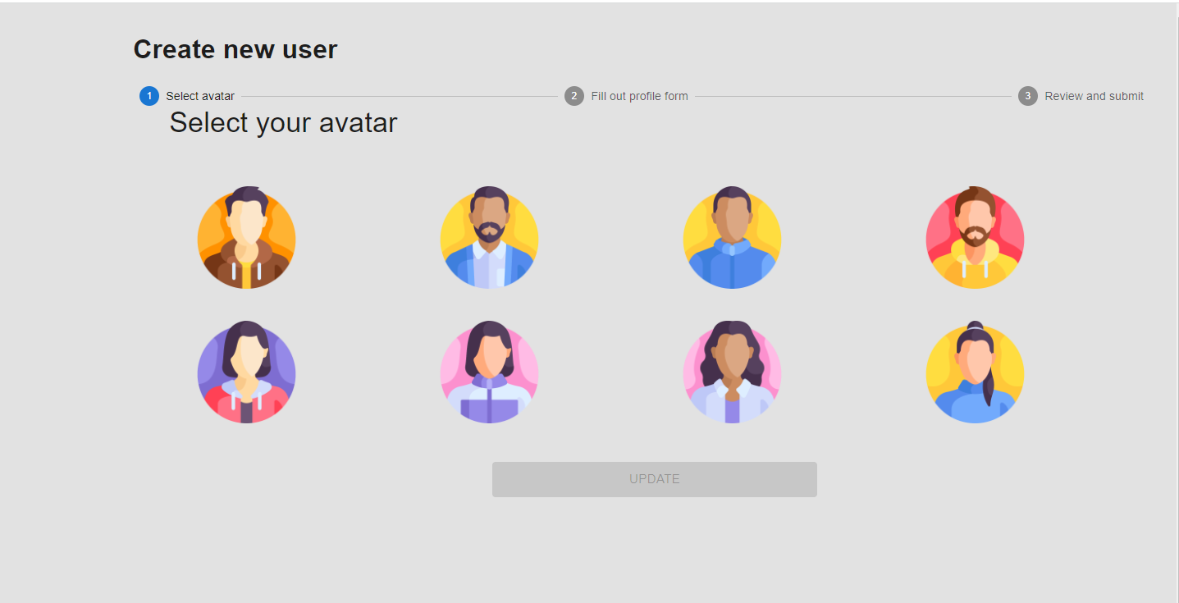
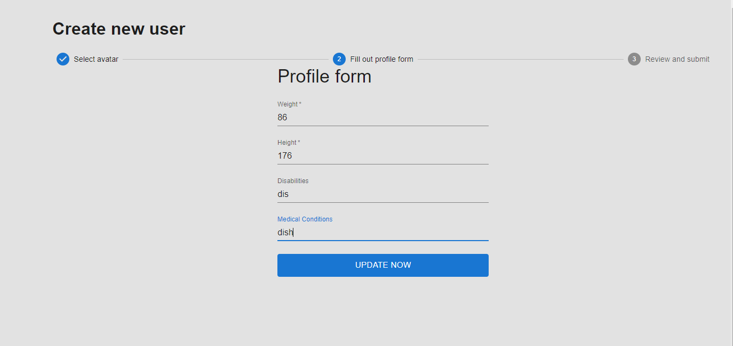
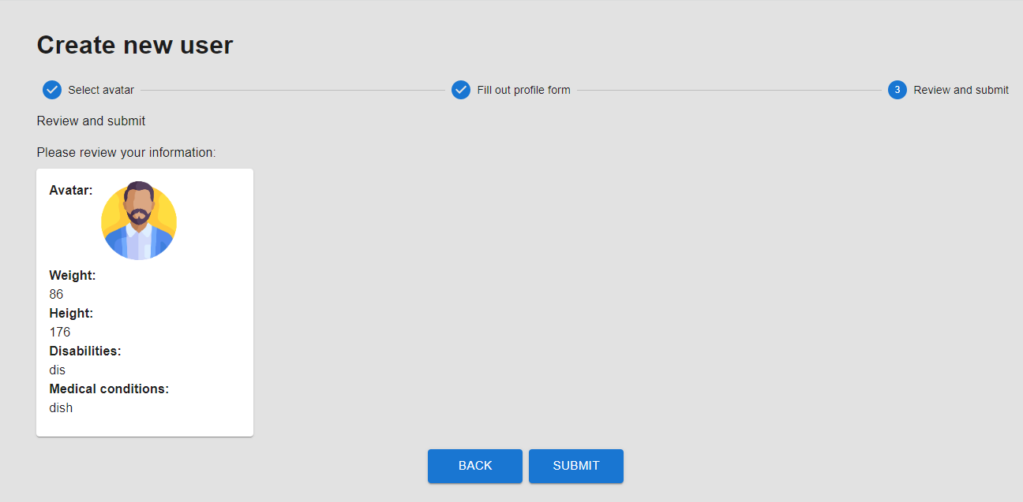
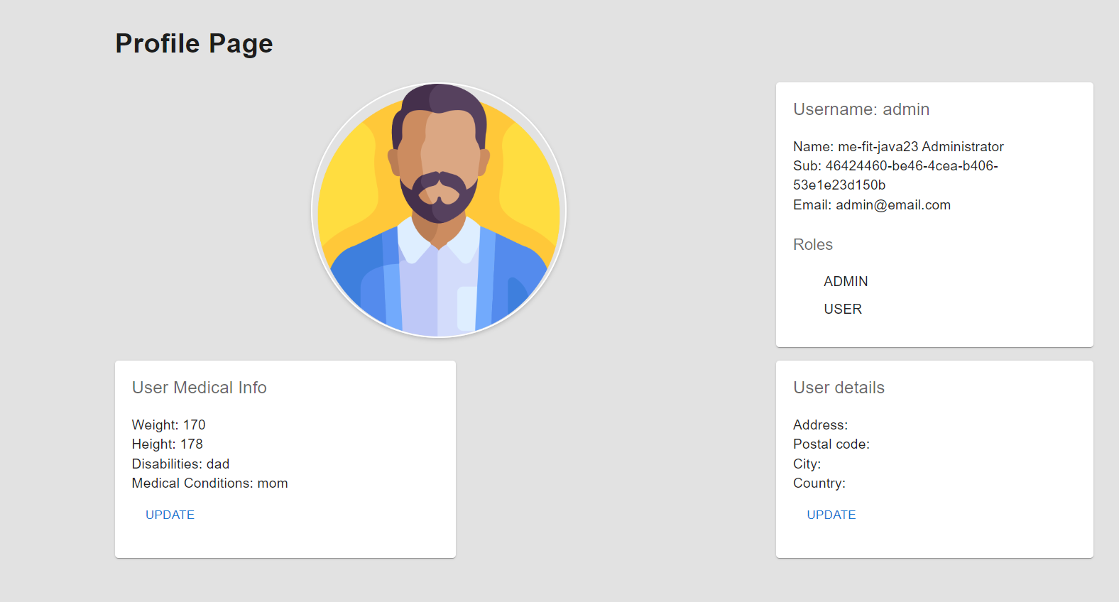
2. Create/ View/ Update your own Profile
Create new user
Select your avatar
Fill Profile form
Review and submit your information
Update
User Medical Info/ User details

Slide 7
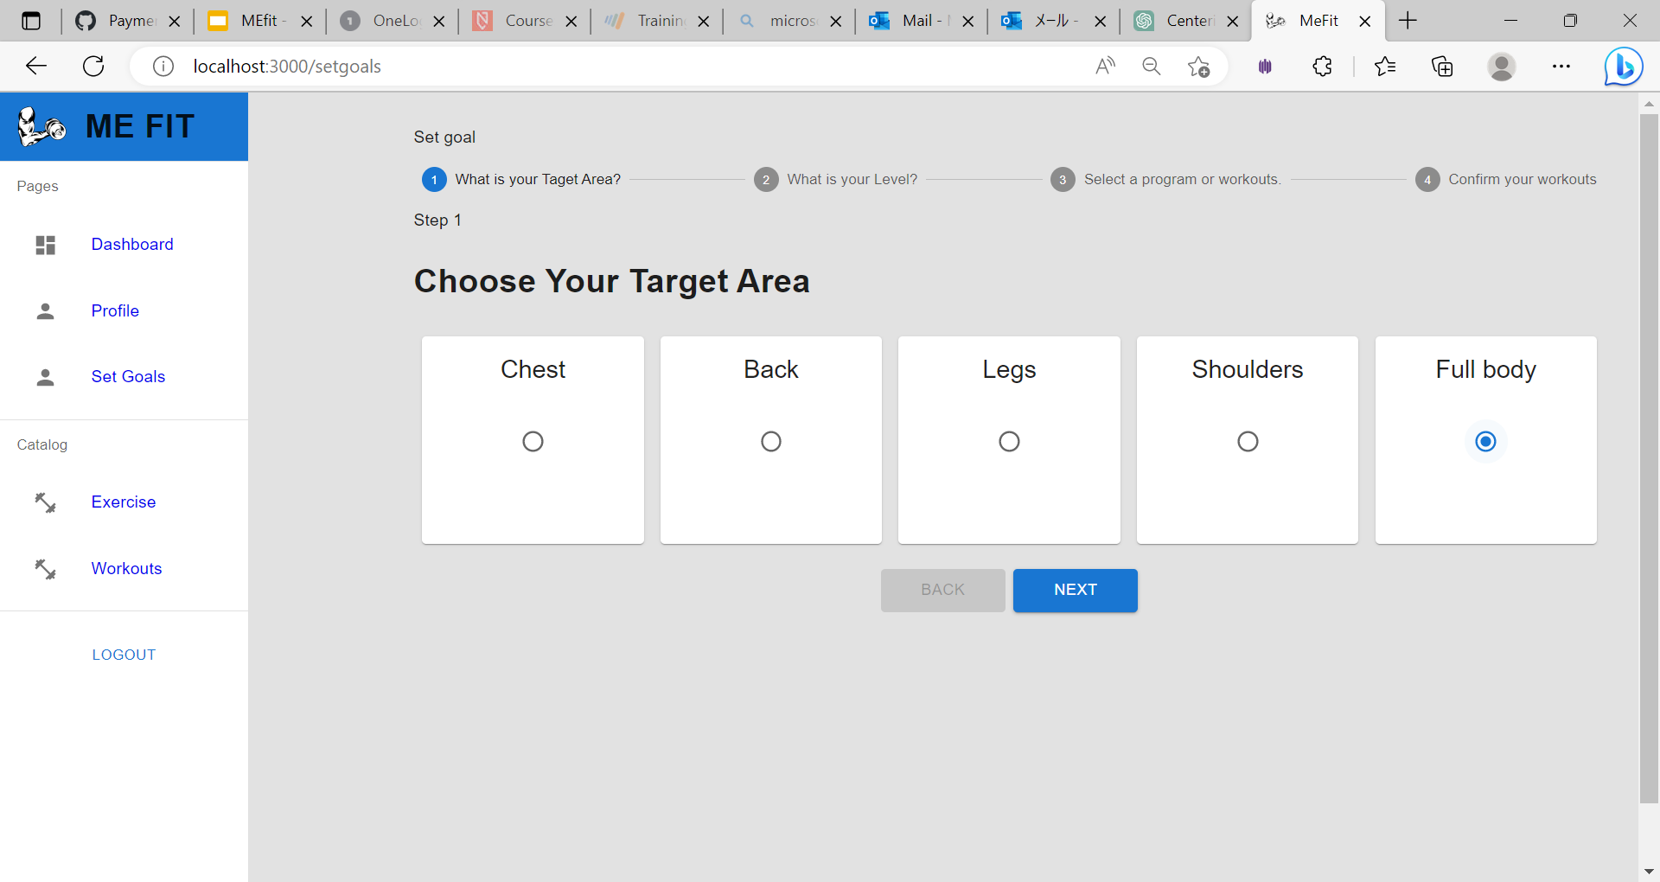
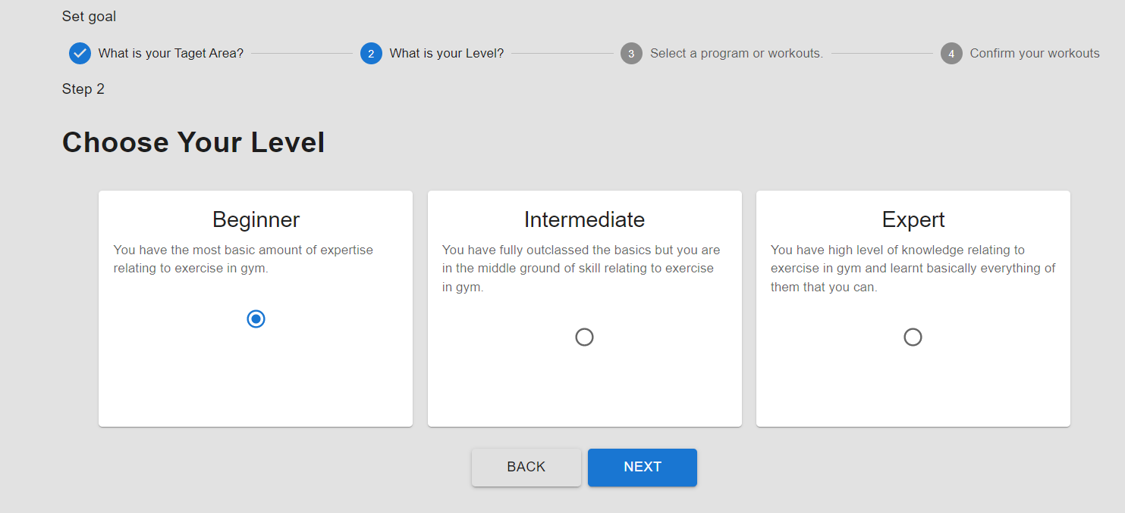
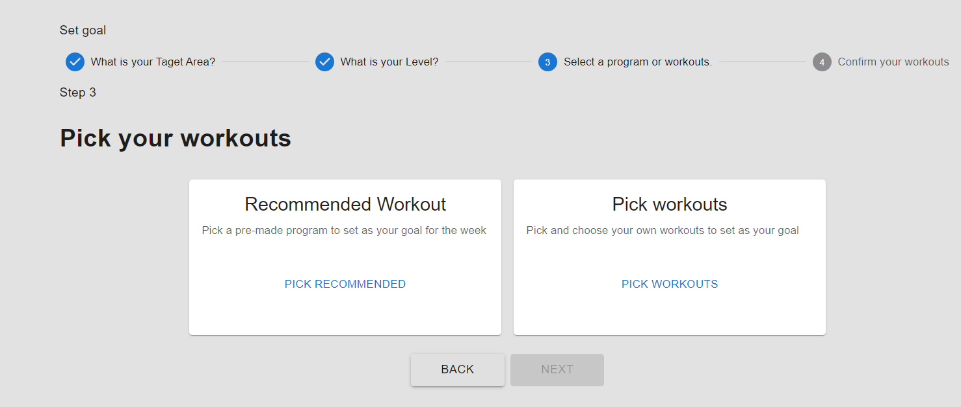
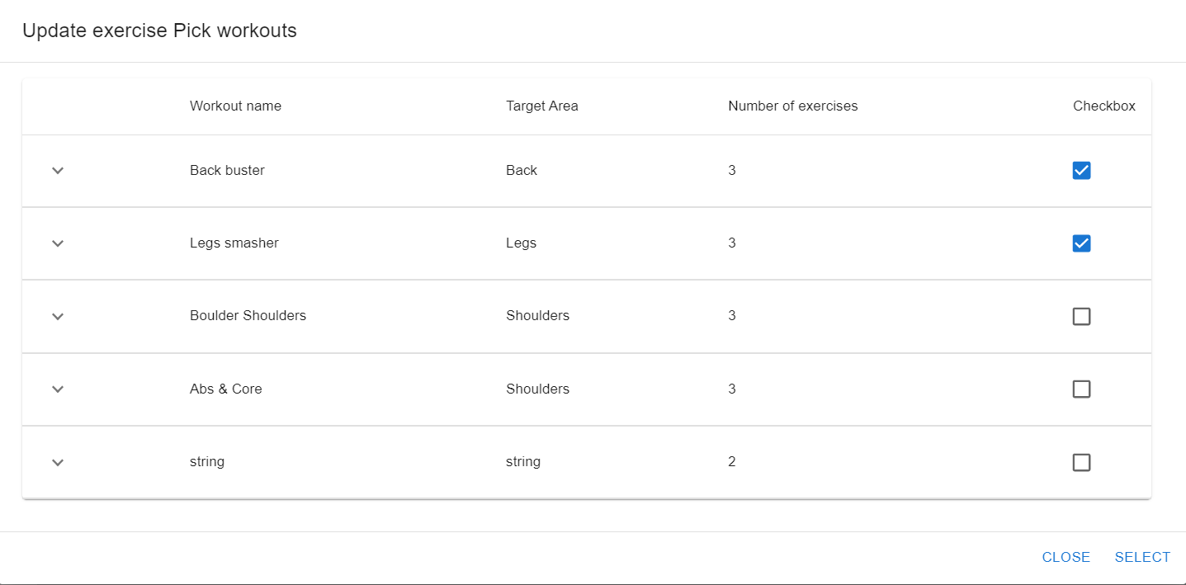
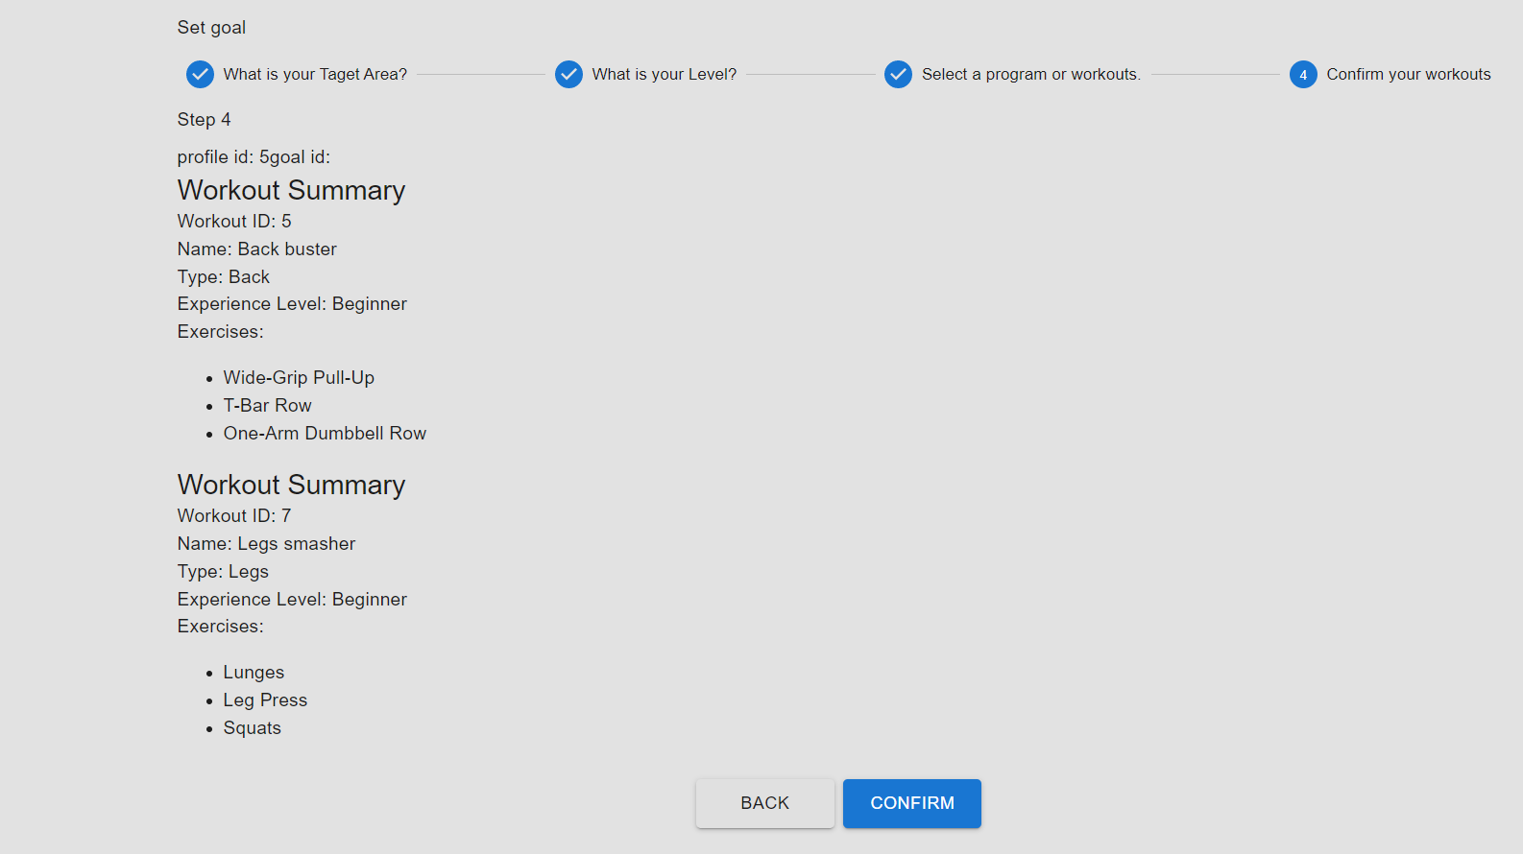
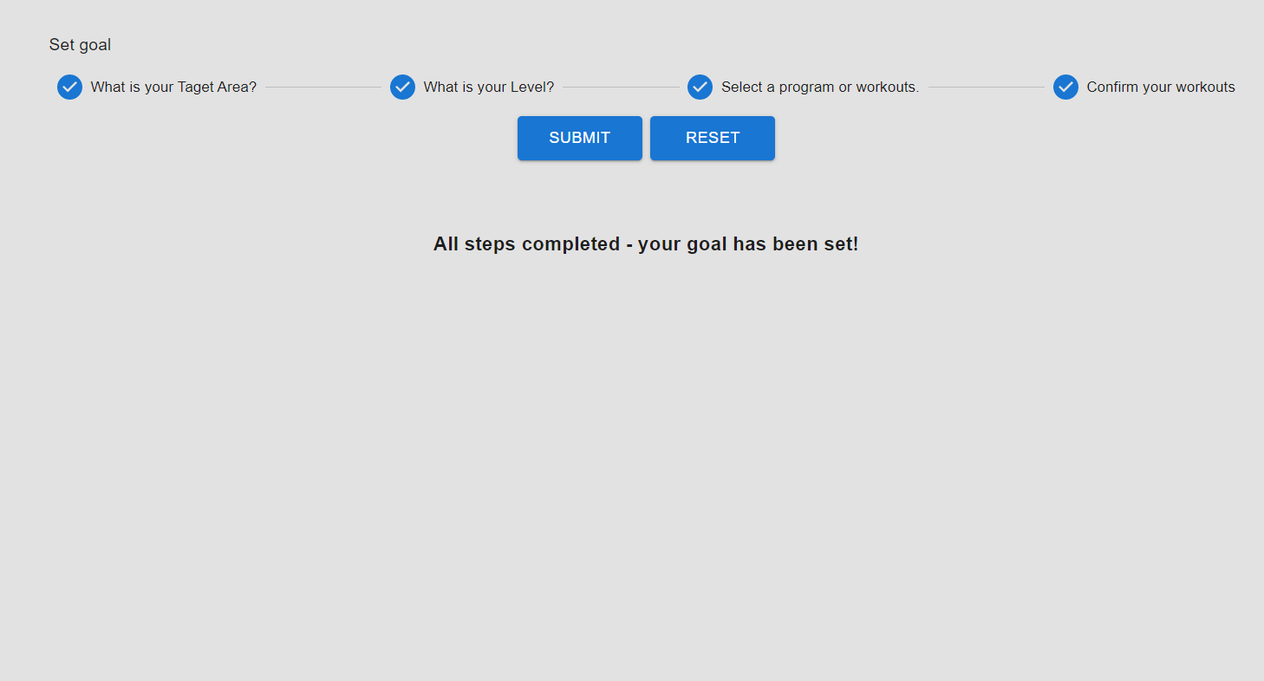
3. Set your own Goals
Select Target Area
Choose level
Pick workouts -> Click pick workouts and check checkbox and click select
Confirm workouts
Submit IF you want to reset Click reset button and to start from in the beginning

Slide 8
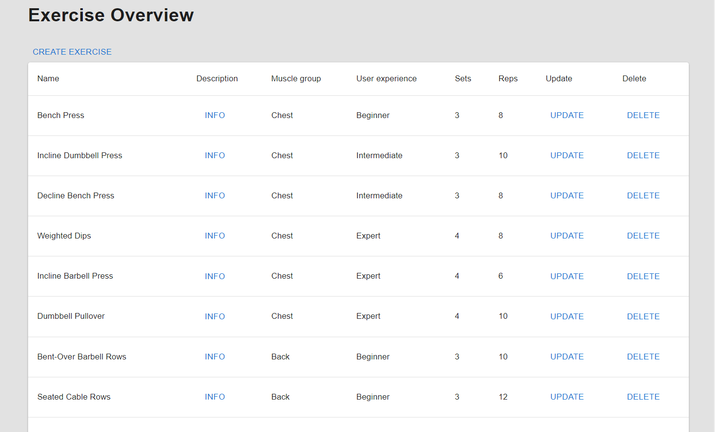
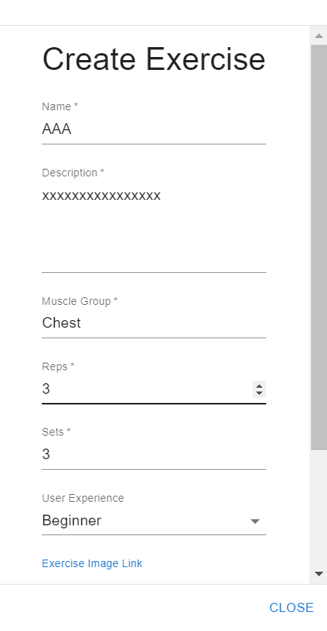
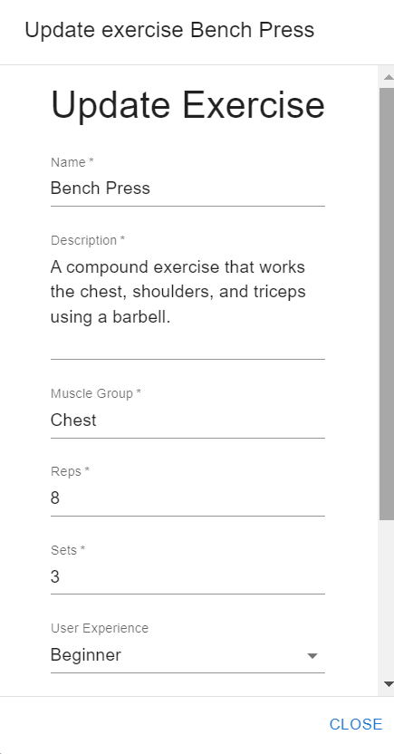
4. View Create /Update/Delete Exercise
Click Create Exercise
Input all information and
click Create
Click Update
Input or change information and
click update
Click Delete

Slide 9
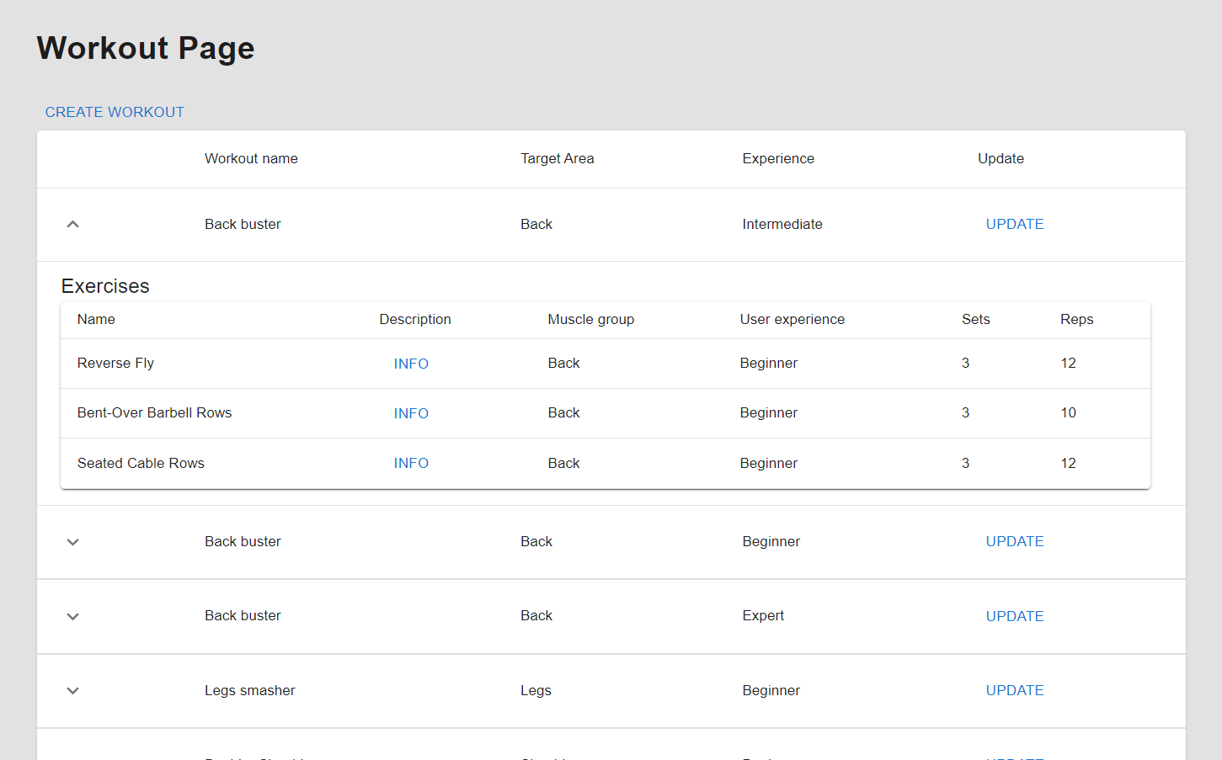
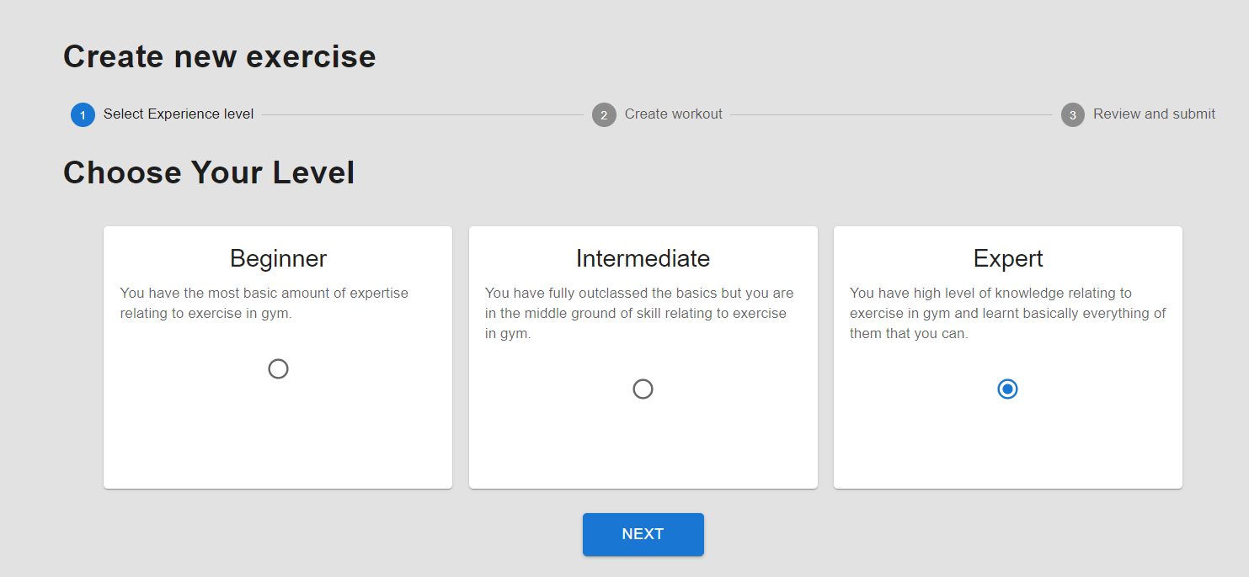
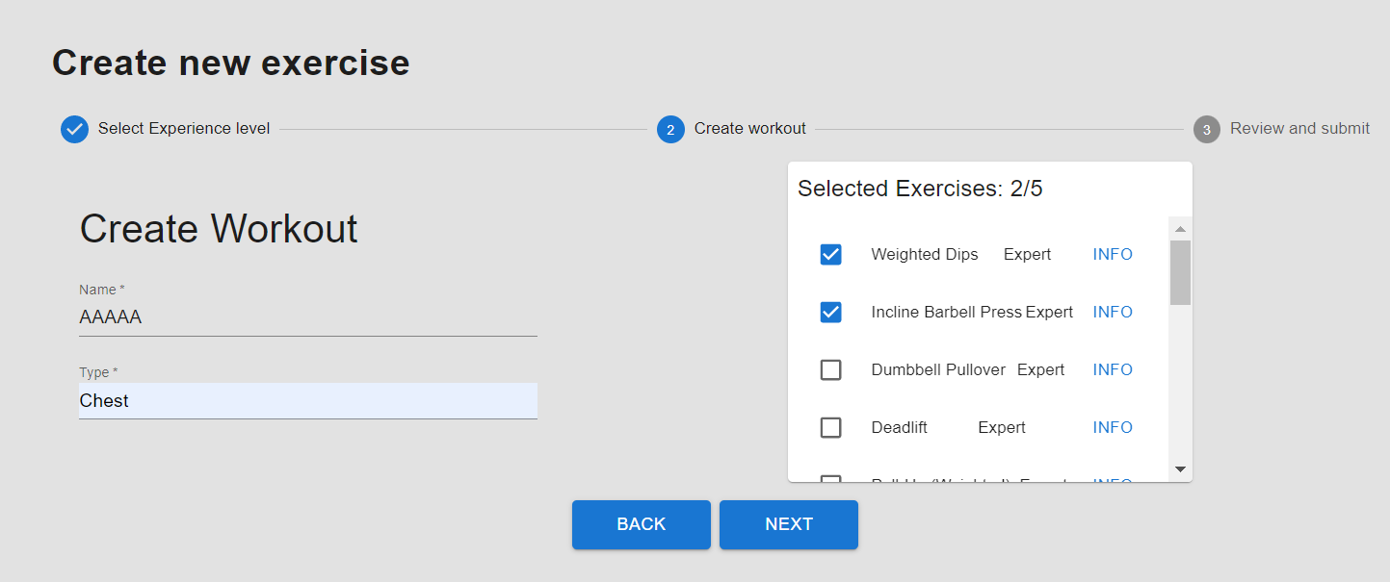
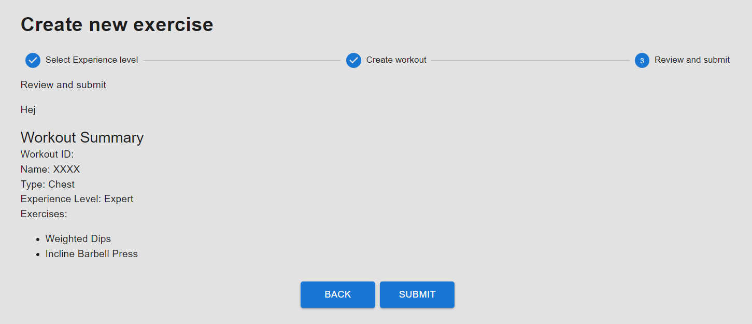
5. View Update Workouts
Click Create Workout
1.Choose your level
2.Create Workout
3.Review workout and submit
Click Update

Slide 10
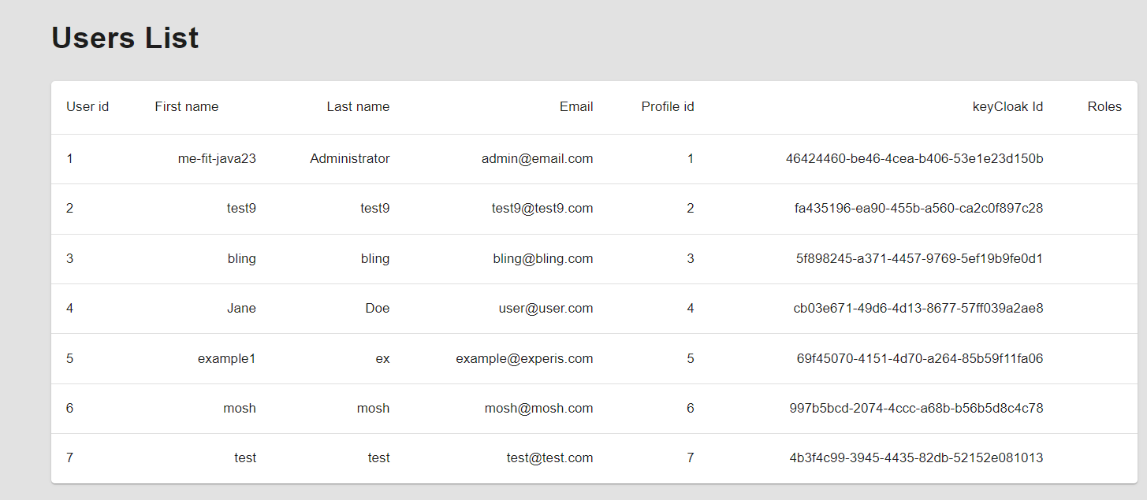
6. View Token and User List
View All users

