Slide 1

CSE 585: Advanced Scalable Systems for GenAI
Mosharaf Chowdhury

Slide 2
Today’s Agenda
Administrivia
Topics
Projects

Slide 3




About Mosharaf
ViNEYard
virtual network embedding (2008-2012)
in-memory computing (2009-2014)
Associate Professor of CSE
http://www.mosharaf.com/
https://symbioticlab.org/
Office hours:
Appointment-only
Coflow
data-parallel communication (2010-2016)
Infiniswap
memory disaggregation (2016-2022)
Salus
GPU resource management (2017-2022)
systems for federated learning (2019-2024)
AI energy optimization (2021-)
…
systems for multimodal AI (2022-)

Slide 4

Jae-Won Chung (GSI)
5th-year PhD student at SymbioticLab
Office hours from next week
Check course website
No office hours this week
jwnchung@umich.edu

Slide 5
Status
As of today: 63 registered or w/ override
If you are not planning to take the class, drop ASAP
Existing overrides that have not converted will be revoked

Slide 6
Course Schedule
Webpage: https://github.com/mosharaf/cse585
Meetings
10:30 AM – 12PM (T/Th for lectures and seminars)
1:30 PM – 2:30 PM (Fri for makeups and projects)
Pay attention to the online announcements and schedule
On average, two meetings per week
Friday makeups will be added on a need-to-add basis

Slide 7
Prerequisites
EECS 482 / 484 / 489 / 491
Equivalent courses are acceptable as well
Good programming skills
Build substantial systems for course project

Slide 8
Course Requirements
Paper Summary | 15%
Paper Presentation | 15%
Participation | 10%
Project Report | 40%
Project Presentations | 20%

Slide 9
Topics (#Lectures)
Basics (3)
Pre-Training (4)
Post-Training (2)
Inference (5)
Agentic Systems (2)
Hardware/Infrastructure (1)
Power and Energy (2)
Ethical Considerations (1)

Slide 10
Group-Based Work
ALL activities will be done in groups except for participation
Paper presentation
Paper summary
Research projects

Slide 11
Form Groups ASAP
Submit Google Form
By September 4 the latest, but right now is better
We need a group to pickup duties for Sep 4!!!
Use Ed to find group members
Group size should be 4

Slide 12
Readings
~40 papers/articles across
Primarily from systems venues like SOSP, OSDI, NSDI, ASPLOS, FAST, etc.
A couple from traditional AI/ML venues but still with systems-y flavor

Slide 13
Paper Presentation
This is a seminar-style course
Each group must present at least one lecture (required papers and the rest)
Paper presentation account for 15% of the total grade
The entire class will be dedicated to the assigned paper(s)
Aim for 40-minute presentation without interruption
But there will be intermittent discussions
Lead the discussion
Go through the paper in details, along with its strengths and weaknesses
Include companion papers and other related papers

Slide 14
Paper Presentation
Share your slides to cse585-staff@umich.edu 24 hours before the class
Use Google Sheets so we can provide in-place comments/feedback
Prepare early
Practice a lot
Also, read
How to Give a Bad Talk, by David A. Patterson

Slide 15
Paper Summaries
This is a paper-reading course
Paper summaries account for 15% of the total grade
Roughly 1-2 summary per-group (assigned)
Each summary must follow the template and address the following
What is the problem and why is it important?
What is the hypothesis of the work?
What is the proposed solution, and what key insight guides their solution?
What is one (or more) drawback or limitation of the proposal, and how will you improve it?
Summary must include the gist of class discussion

Slide 16
Paper Summaries
Reviews must be shared to cse585-staff@umich.edu within 24 hours of class presentation
Use Google docs so we can provide in-place comments/feedback
Delayed submission will receive NO CREDIT
There will be NO extensions

Slide 17
Panel Discussion
The Authors
Groups that present and write summary
The Reviewers
Each group will be assigned to at least one of these slots
Will have their own questions to ask to the authors
Will receive questions raised by the class (described below) from the GSI before the lecture
Rest of the Class
Submit one insightful question for each presented papers by 3PM the day before
Ask questions directly too

Slide 18
In general,
No extensions
Everyone must come to class after reading the required papers of the day

Slide 19
What Do We Talk About When We Talk About “Advanced Scalable Systems for GenAI”

Slide 20
Resource-Centric View

Slide 21

What’s in a (Simplified) Server?
Interconnected compute and storage resources
Different bandwidth and latency constraints
Simplified diagram
Doesn’t include faster networks such as RDMA, CXL, dedicated GPU interconnects such as NVlink, etc…
(64 GB/s)
DDR5
(8 GB/s)*
PCIe v6
(25 GB/s)
SATA 3
(600 MB/s)
Ethernet
NVMe
(7.5 GB/s)
* Per channel

Slide 22
Typical Memory/Storage Hierarchy
Fundamental Goals of (SW/HW) System Design
Minimize time to access data
Maximize compute utilization
Balanced System
Register
0.2ns
Main Memory
NVM
Network Attached Memory
SSD
HDD
CXL-Memory
L1/L2/L3 Cache
1-40ns
Higher Bandwidth/
Lower Latency
80-140ns
170-280ns
300-400ns
2-4μs
10-40μs
3-10ms
Maruf et al, SIGMETRICS 2023

Slide 23
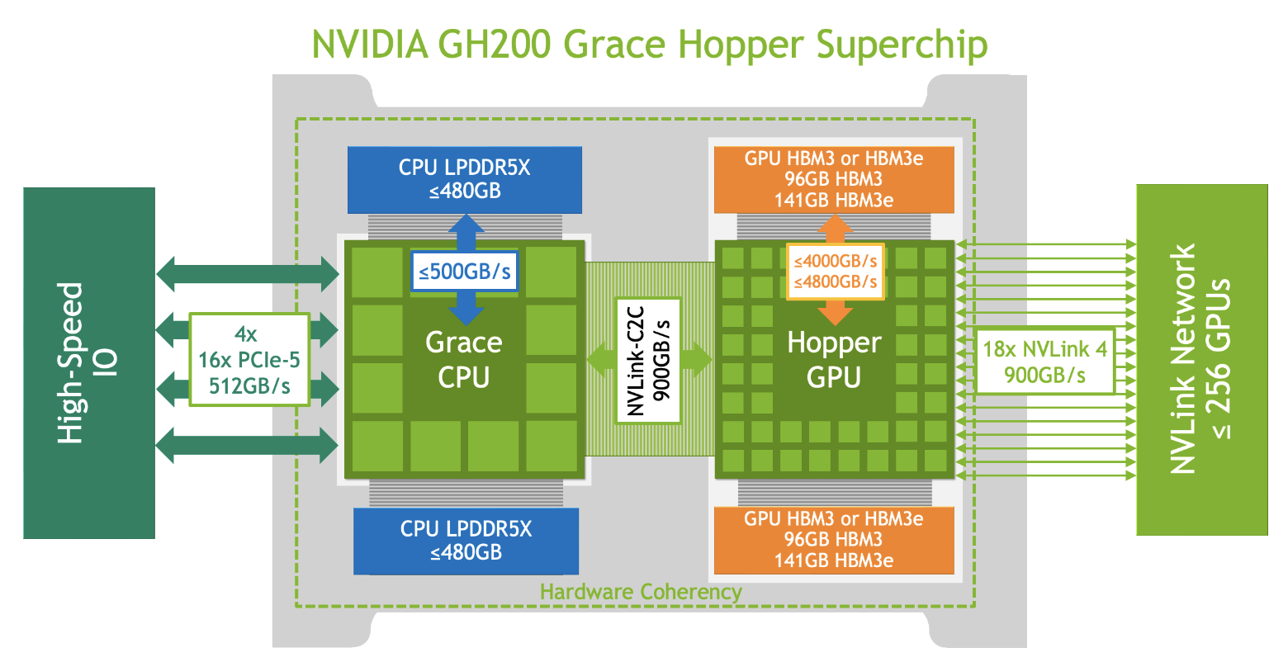
What’s in a Modern-ish AI Server?
https://resources.nvidia.com/en-us-grace-cpu/nvidia-grace-hopper

Slide 24
Scale Out: Warehouse-Scale Computer (WSC)
Single organization
Homogeneity (to some extent)
Cost efficiency at scale
Multiplexing across applications and services
Rent it out!
Many concerns
Infrastructure
Networking
Storage
Software
Power/Energy
Failure/Recovery
…

Slide 25
WSC/Datacenter Architecture
DDR5
PCIe v6
SATA 3
Ethernet
NVMe
Server
Server

Slide 26
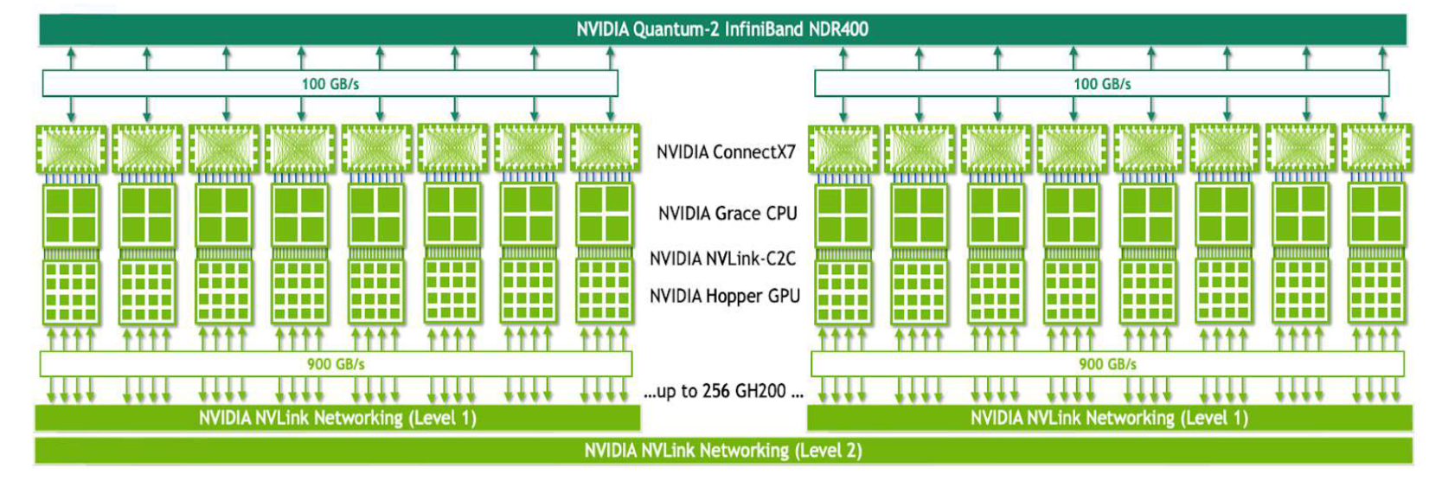
Example: Scaling Out Using NVIDIA GH200
https://resources.nvidia.com/en-us-grace-cpu/nvidia-grace-hopper

Slide 27
Datacenter Needs an Operating System
Datacenter is a collection of
Compute
Memory
All connected by an interconnect
Not unlike a computer
Some differences
VERY high level of parallelism
VERY large scale
Diversity of workloads
Resource heterogeneity
Failure is the norm

Slide 28
Three Categories of Software
Platform-level
Software firmware that are present in every machine
Cluster-level
Distributed systems to enable everything
Application-level
User-facing applications built on top

Slide 29
Common “Systems” Techniques
Technique | Performance/Efficiency | Availability/Resilience
Replication & Erasure coding | X | X
Sharding/partitioning | X | X
Scheduling & Load balancing | X
Health & Integrity checks |  | X
Compression & Quantization | X
Centralized controller | X
Canaries |  | X
Speculation & Redundant execution | X

Slide 30
Break!

Slide 31
Workload-Centric View

Slide 32
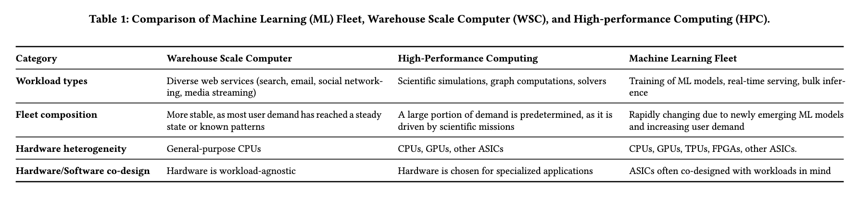
Machine Learning Fleet Efficiency @ Google

Slide 33
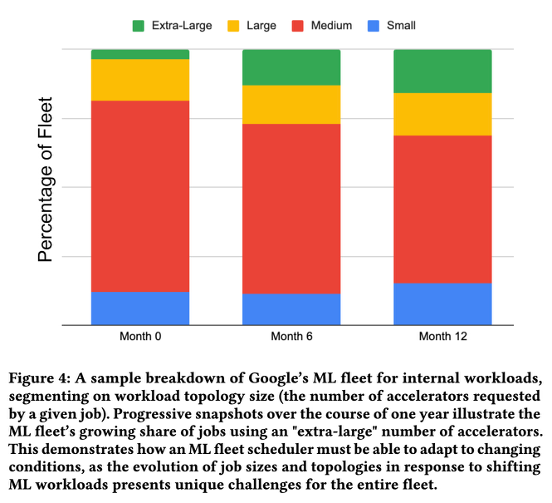
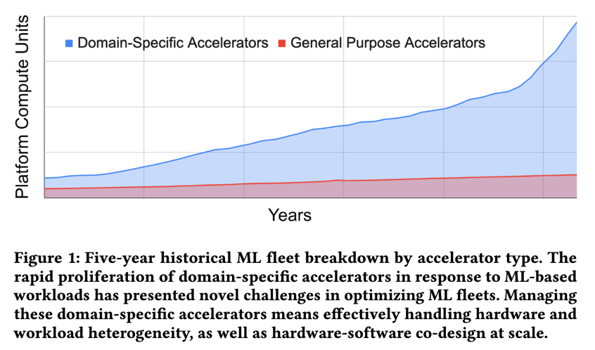
Anatomy of an ML Fleet: Hardware and Software Infrastructure
Accelerators
Scheduler

Slide 34
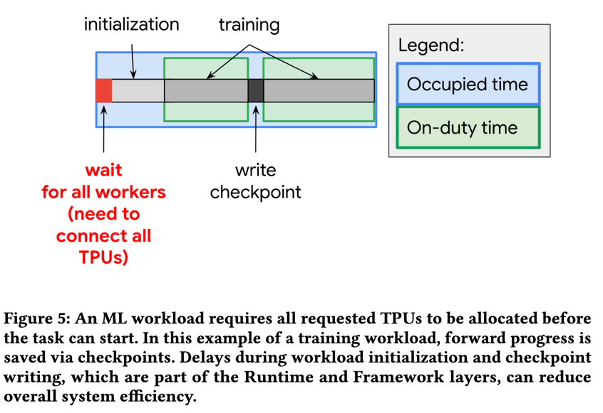
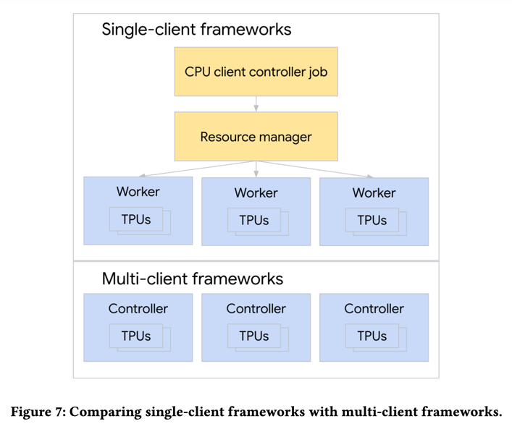
Anatomy of an ML Fleet: Programming
Runtime/Compiler
Frameworks

Slide 35
Anatomy of an ML Fleet: Workloads
Model
Data
Drives computation demands and patterns, both over time and spatially
Changes frequently as new models, training paradigms, etc. emerge and become popular
Data pipeline/IO (system memory, storage, networking) can easily bottleneck the overall fleet
Both quality and quantity matters
Both pre- and post-processing matters

Slide 36
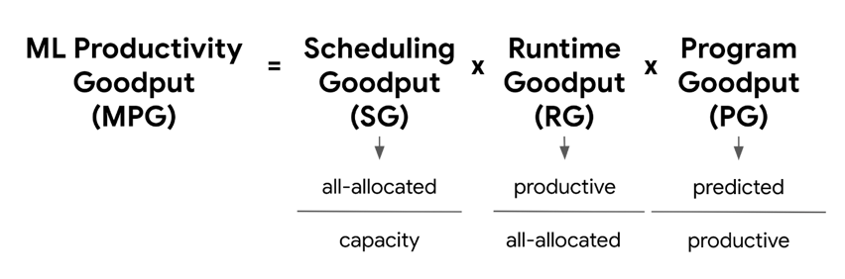
MPG: ML Productivity Goodput
Scheduling Goodput (SG)
How often does an ML application have all necessary resources to make progress?
Runtime Goodput (RG)
When it does, how often does it make progress?
Program Goodput (PG)
When it’s progressing, how close is it to maximum achievable efficiency?

Slide 37
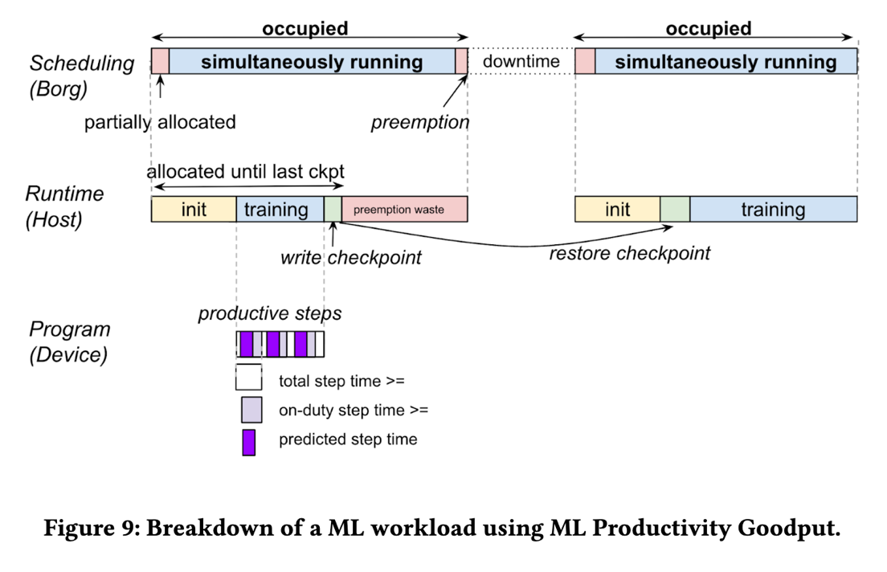
MPG: ML Productivity Goodput
Utilization
≠
Productivity

Slide 38
Projects

Slide 39
Research-Oriented Course!
The final project accounts for 60% of total grades
What can and cannot be a project?
Just surveys are not allowed
Measurements of new environments or of existing solutions on new environments are acceptable
Reproducing results from existing solutions is also acceptable
An ideal project should answer the questions you asked during paper reviews and points you cared about for presentations

Slide 40
How to Approach it?
Find a problem and motivate why this is worth solving
Quickly survey background and related work
Might require you to go back to the first step
Form/update your hypothesis
Test your hypothesis
Go back to 3 until you are happy
Present your findings on poster and in writing
Discuss known limitations

Slide 41
Milestones
Date | Milestone | Details
09/04/25 | Form Group | Find like-minded students
09/18/25 | Submit Proposal | Send your proposal by email to receive feedback either via email or in-person or both
10/21/25 10/23/25 | Mid-Semester Presentations | Define and motivate a problem, overview related work, and form initial hypothesis and idea
12/04/25 | Poster Presentation | Present your findings
12/15/25 | Research paper | Submit a report like the papers you read

Slide 42
Draft Proposal (Sep 18)
Two pages including references that must include
What is the problem?
Why is it important to solve?
Any initial thoughts on what you want to do?
How would you evaluate your solution?
Include team members
Meaning, form a group ASAP
Approved by the instructor and agreed upon by you
Forms the basis of expectation

Slide 43
Mid-Semester Checkpoint (Oct 21,23)
In-class short presentation over two days
This is to make sure you are making progress
Must include
What is the problem?
Why is it important?
What are the most related work?
What’s your hypothesis so far?
How are/will you evaluate it?

Slide 44
Presentation & Paper (Dec 4, 15)
Research paper
The key part
Should be written like the papers you’ve read
As if you’d submit it to a workshop with ~3 more months of work or to a conference after ~6 more months of work
How to Write a Great Research Paper by Simon Peyton Jones
Extended from the mid-semester checkpoint

Slide 45
Next Class…
Read the required readings
Form groups of 3-4 and fill out Google Form by Sep 4
Decide if you’ll drop, before you fill it
If you are to drop, drop immediately

