Slide 1
Quantization and Inference Optimizations
Christopher Jiang, Lingxiao Mou, Shoma Sawa

Slide 2
What is Quantization?
In Neural Network, the weights and activation tensors are usually stored in 16 or 32 bit precision
Quantization: process of reducing the precision of these weights and activation tensors, by mapping input value of large set to a output value of a smaller set.
32 bit → 8 bit:
Memory overhead decrease by a factor of 4!
Computation cost for matrix multiplication reduce quadratically by a factor of 16!

Slide 3
LLM.Int8()
*Many slides in this section were obtained and used with permission from Tim Dettmers

Slide 4

Quantizing 16-bit normal distributed data to 4-bit integers
-65520
16-bit float
65520
Slide Credit: Tim Dettmers

Slide 5

Quantizing 16-bit normal distributed data to 4-bit integers
-65520
16-bit float
65520
-7
7
4-bit integer
Slide Credit: Tim Dettmers

Slide 6
Quantizing 16-bit normal distributed data to 4-bit integers
-65520
16-bit float
65520
-7
7
4-bit integer
Slide Credit: Tim Dettmers

Slide 7
Quantizing 16-bit normal distributed data to 4-bit integers
-65520
16-bit float
65520
-7
7
4-bit integer
Slide Credit: Tim Dettmers

Slide 8

Quantizing 16-bit normal distributed data to 4-bit integers
-7
16-bit float
7
-7
7
4-bit integer
Slide Credit: Tim Dettmers

Slide 9
Quantizing 16-bit normal distributed data to 4-bit integers
-7
16-bit float
7
-7
7
4-bit integer
Slide Credit: Tim Dettmers

Slide 10
Quantizing 16-bit normal distributed data to 4-bit integers
Outlier
-65520
16-bit float
65520
Outlier
-7
7
4-bit integer
Slide Credit: Tim Dettmers

Slide 11
Quantizing 16-bit normal distributed data to 4-bit integers
-7
16-bit float
7
-7
7
4-bit integer
Slide Credit: Tim Dettmers

Slide 12
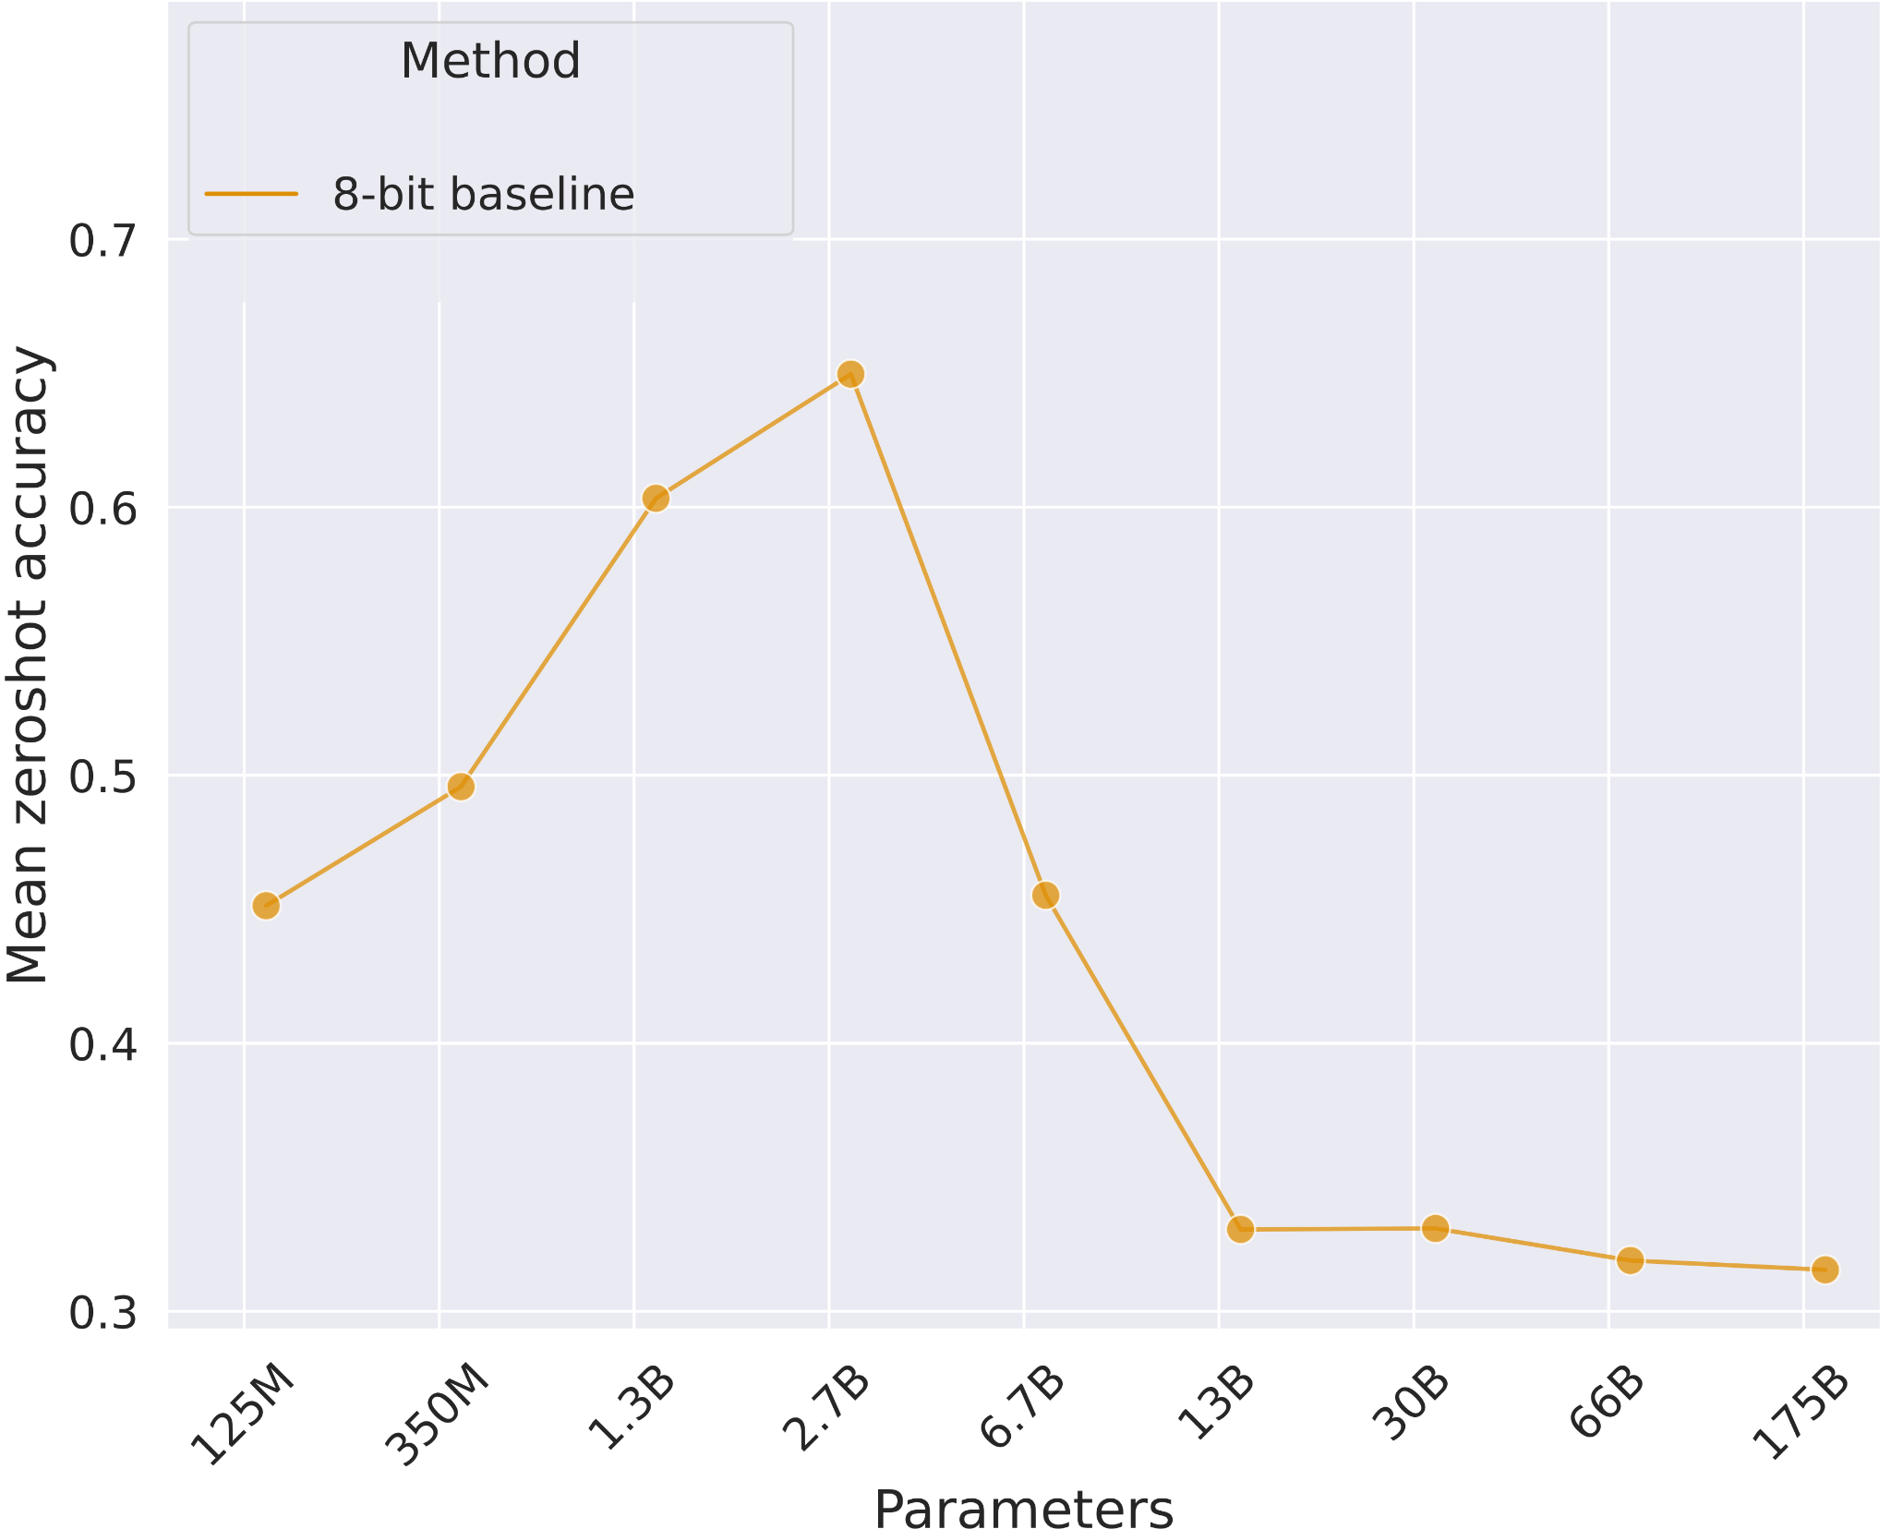
8-bit Foundation Models Fail at Scale
Slide Credit: Tim Dettmers

Slide 13
Outlier patterns in small neural networks (350M parameters)
Outlier at 6 sigma
Slide Credit: Tim Dettmers

Slide 14
Outlier patterns in small neural networks (350M parameters)
Outlier at 6 sigma
Slide Credit: Tim Dettmers

Slide 15
Outlier patterns in small neural networks (350M parameters)
Outlier at 6 sigma
Slide Credit: Tim Dettmers

Slide 16
Outlier patterns in small neural networks (350M parameters)
Outlier at 6 sigma
Slide Credit: Tim Dettmers

Slide 17
Outlier patterns in small neural networks (1.3B parameters)
Outlier at 6 sigma
Slide Credit: Tim Dettmers

Slide 18
Outlier patterns in small neural networks (1.3B parameters)
Outlier at 6 sigma
Slide Credit: Tim Dettmers

Slide 19
Outlier patterns in small neural networks (1.3B parameters)
Outlier at 6 sigma
Slide Credit: Tim Dettmers

Slide 20
Outlier patterns in small neural networks (2.7B parameters)
Outlier at 6 sigma
Slide Credit: Tim Dettmers

Slide 21
Outlier patterns in small neural networks (2.7B parameters)
Outlier at 6 sigma
Slide Credit: Tim Dettmers

Slide 22
Outlier patterns in small neural networks (2.7B parameters)
Outlier at 6 sigma
Slide Credit: Tim Dettmers

Slide 23
Outlier patterns in large neural networks (6.7B parameters)
Outlier at 6 sigma
Slide Credit: Tim Dettmers

Slide 24
Outlier patterns in large neural networks (6.7B parameters)
Outlier at 6 sigma
Slide Credit: Tim Dettmers

Slide 25
Outlier patterns in large neural networks (13B parameters)
Outlier at 6 sigma
Slide Credit: Tim Dettmers

Slide 26
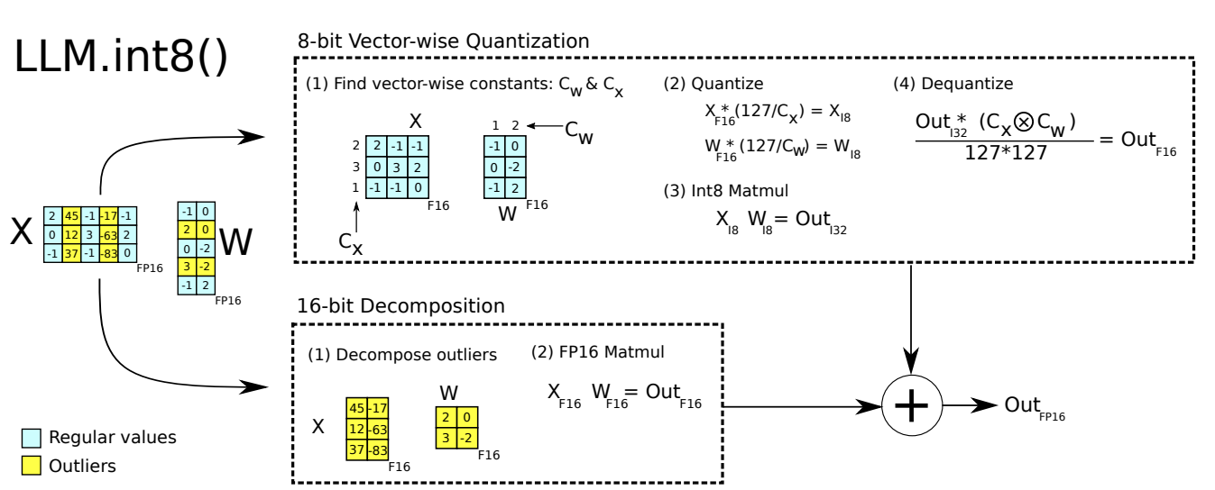
LLM.int8 schematics
Performs row-wise quantization using vector-wise quantization
Mixed-precision decomposition: outliers are kept in 16 bit (0.1%), while others are quantized to 8 bit (99.9%).

Slide 27
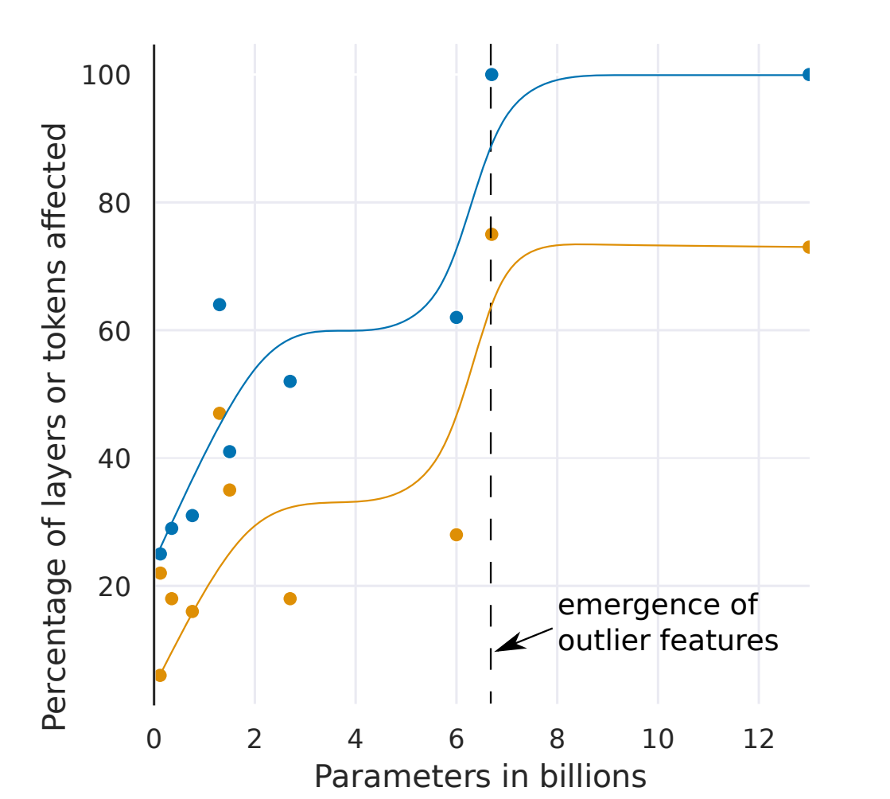
Main Result 1
Starting with 6B-6.7B parameter model, emergence of large magnitude features: from 65% to 100% of all layers affected by outliers - phase shift
Coincides with the point where quantization begins to fail

Slide 28
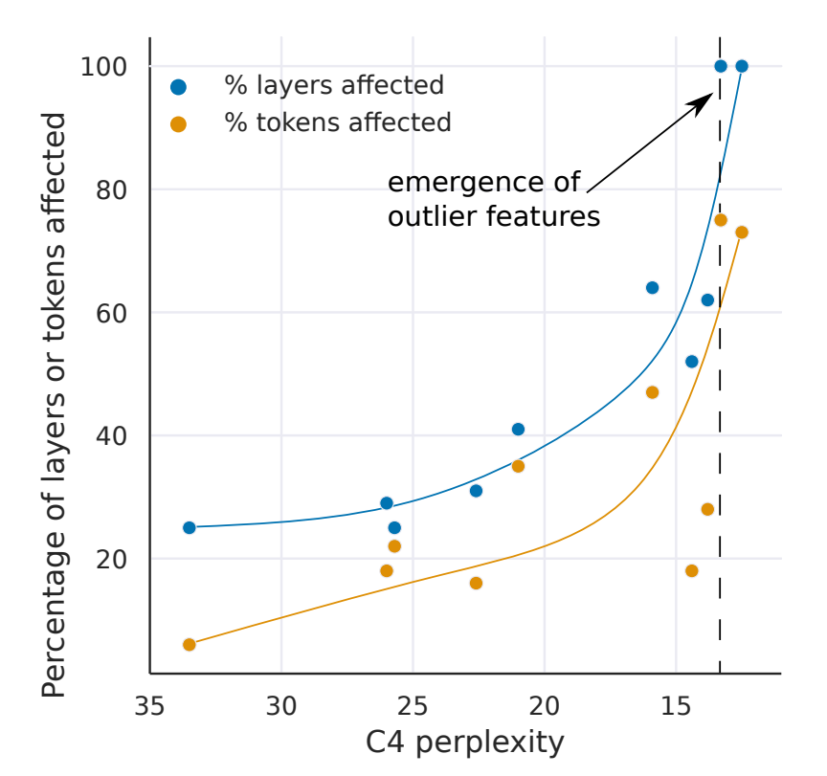
Main Result 2
Percentage of affected layers/tokens increases smoothly as perplexity decreases

Slide 29
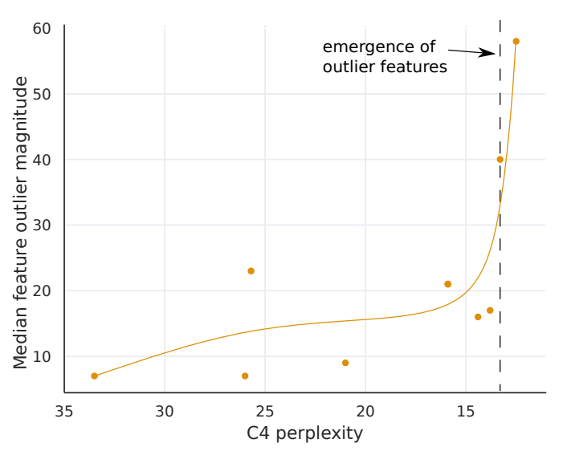
Main Result 3
Once we reach the point where outlier features are in all layers, the magnitude of such outliers increases rapidly
Explains why quantization fails at this scale

Slide 30
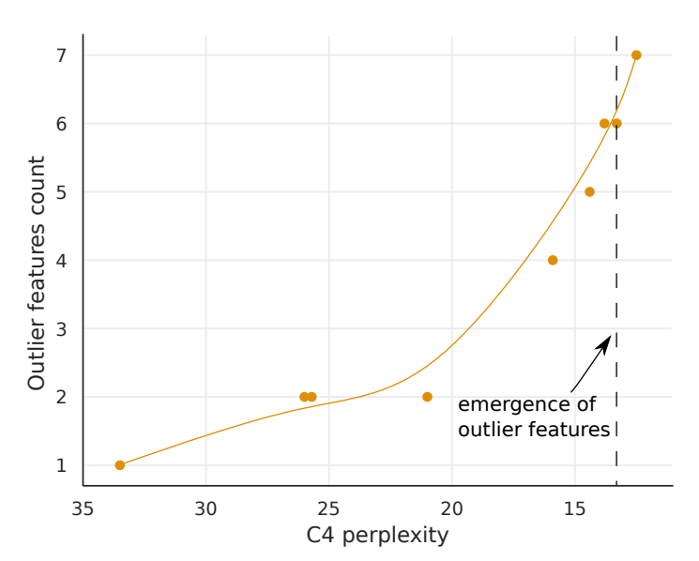
Main Result 4
Monotonic relation between number of outlier and perplexity
Non-Monotonic relation between number of outlier and model size
Suggests that perplexity determines phase shift rather than just model size

Slide 31
8-bit Foundation Models Fail at Scale
Slide Credit: Tim Dettmers

Slide 32
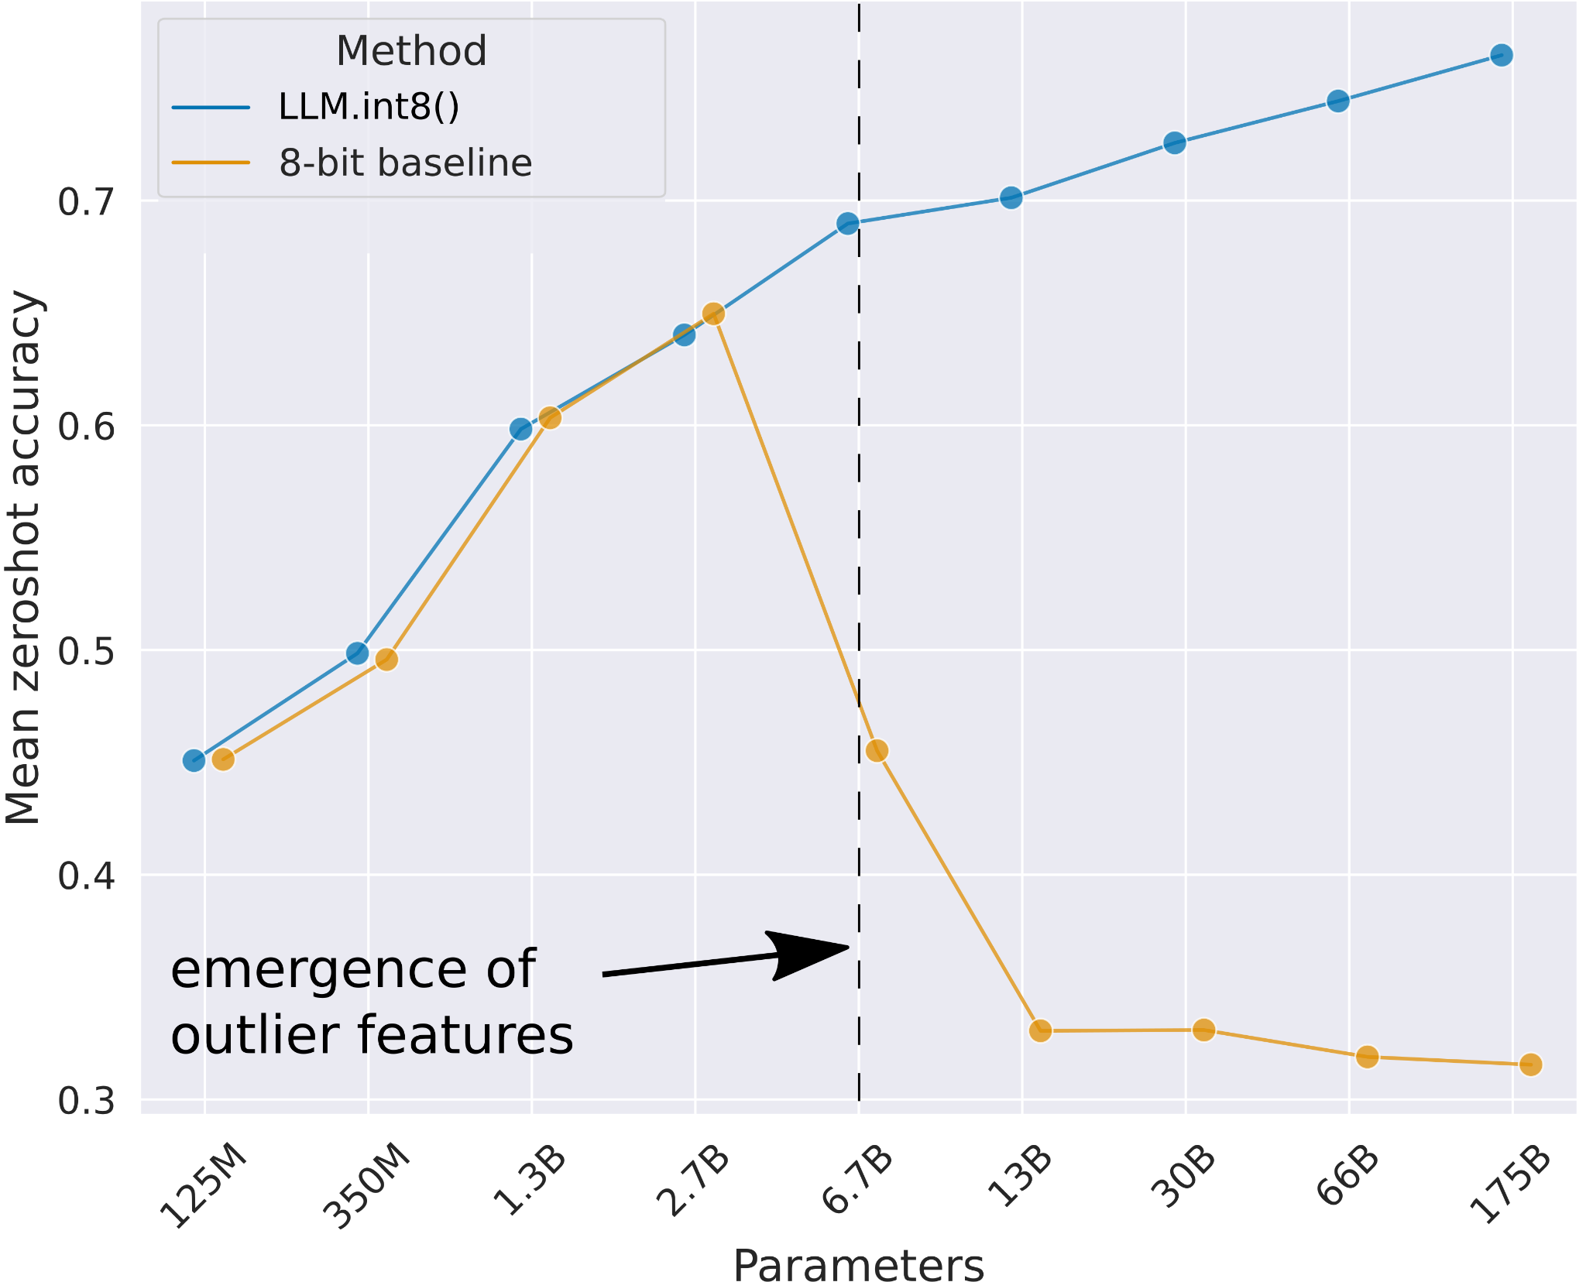
LLM.int8() method is the first method that works at scale
Slide Credit: Tim Dettmers

Slide 33
Future Research
Int8 might not sufficiently small, further compression may be necessary to fit into smaller memory devices. (Ex. 2 bit or 1 bit quantization
FP 8 wasn’t studied due to hardware restriction
Only model size up to 175B model size has been studied, bigger model may have other behavior

Slide 34
OPTQ: ACCURATE POST-TRAINING QUANTIZATION FOR GENERATIVE PRE-TRAINED TRANSFORMERS

Slide 35
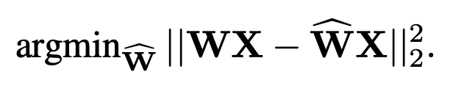
Layer-Wise Quantization
OPTQ performs quantization layer by layer, that solves a reconstruction problem for each layer
Layer input
Weight layer
Quantized weight layer
Objective: find matrix W^ that minimize the squared error

Slide 36




Optimal Brain Development Series
OBD(Optimal Brain Damage)
Taylor approximation of objective function + Removing first and 3rd order approximation
OBS(Optimal Brain Surge)
No assumption on weight element independency. wq is the weight after removing row q of w

Slide 37


Optimal Brain Quantization(OBQ)
Does not perform pruning(make entries of w into 0), it only quantizes to lower precision.
Each row of Hessian inverse is calculated as above. As it handles each row separately, it allows parallel computing
Question: How do you choose q? Greedy Algorithm, go with smallest

Slide 38
Key Methods
OPTQ Algorithm includes the following steps:
1) Arbitrary Order Insight
2) Lazy Batch-Updates
3) Cholesky Reformulation

Slide 39


Arbitrary Order Insight
OBQ quantize weight in a greedy order(pick the row order, that has least additional quantization error).
OBQ: quantize row of W independently, in a specific order.
OPTQ: quantize the W of all rows in the same order, that performs similar to OBQ.
Time complexity

Slide 40
Lazy Batch-Updates
Previously, column i is been updated every time when column 0~i-1 is been quantized.
However, GPTQ noticed
The final rounding decisions for column i are only affected by updates performed on this very column, and so updates to later columns are irrelevant at this point in the process.
Essentially, column i will only be updated until column i needs to be quantized.
As we are accumulating a lot of information to calculate together in the end, it is called batch update

Slide 41

Cholesky Reformuation
becomes indefinite, which can cause the algorithm to aggressively update the remaining weights in incorrect directions
Calculate by choleskey upfront

Slide 42
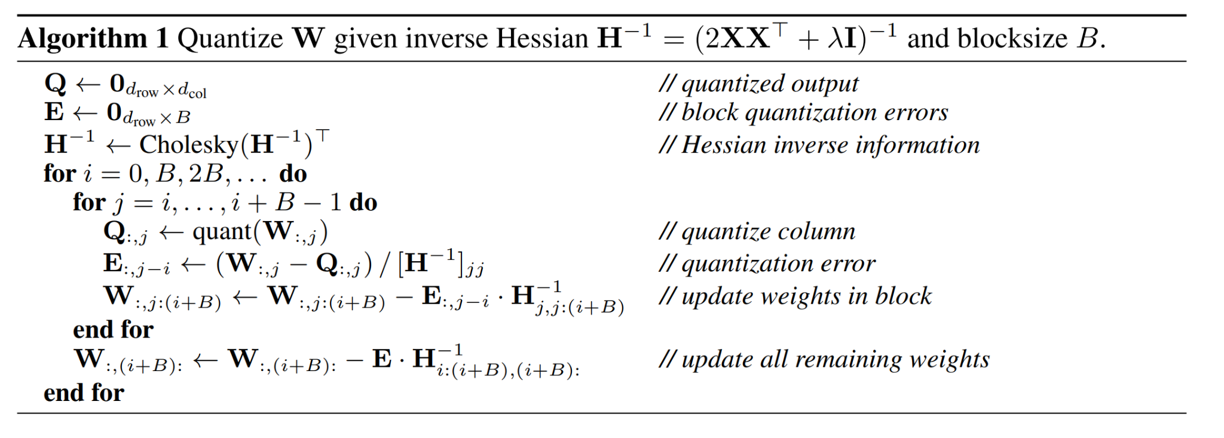
Final Algorithm

Slide 43
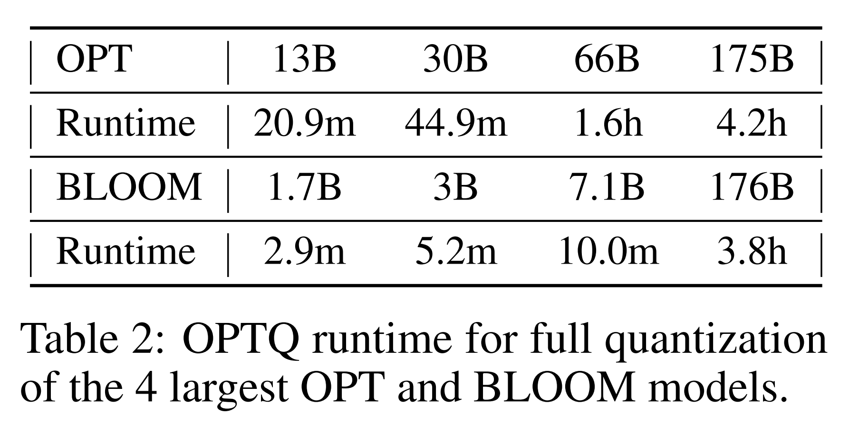
Results: Quantization time
Fast at quantizing
Comparison: ZeroQuant-LKD runs in ~3 hours for 1.3B model.

Slide 44
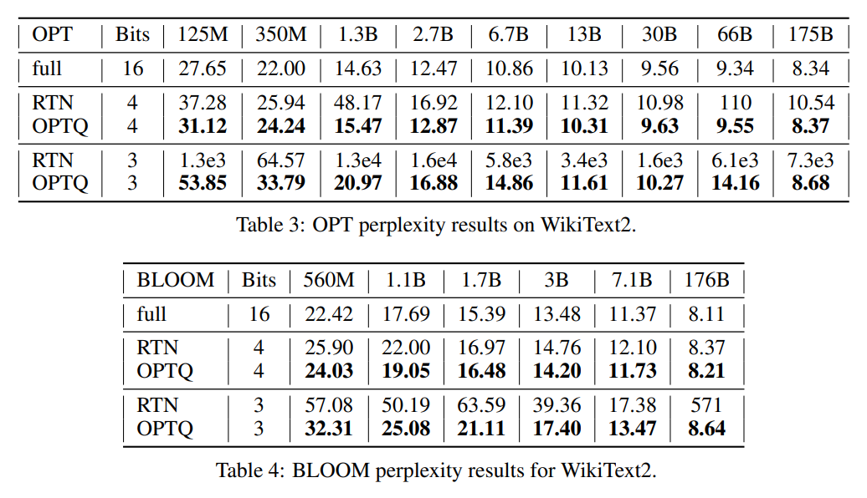
Results: Perplexity for Language Generation
Better performance than RTN, especially for 3-bit
Performance degrades less for larger models

Slide 45
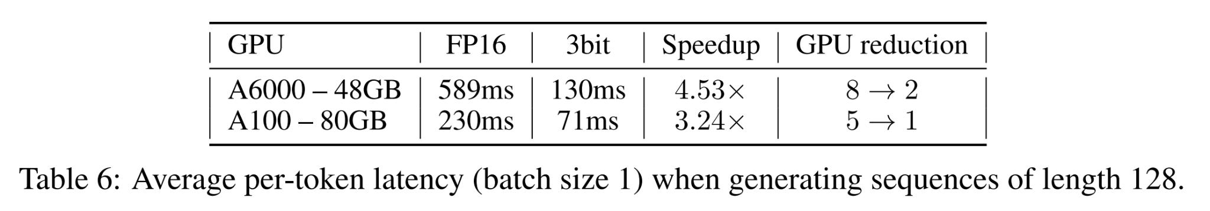
Results: Inference Latency for Language Generation
Significant speedups for inference latency
Comparison: LLM.int8 reduces memory but not end-to-end runtime

Slide 46
Future Research
Method obtains speedups from reduced memory movement, and does not lead to computational reductions
Focusing on generative tasks, and does not consider activation quantization.

Slide 47
Summary
Performance doesn’t degrade too much
Fast quantization
Inference speedup
Applies to model weights, not activation

Slide 48
Large Transformer Model Inference Optimization

Slide 49
Motivations
Large Transformer models are very expensive to train and conduct inference
Why?
Large memory footprint
Require model parameters and immediate state in memory during inference
Low parallelizability
Inference is autoregressive, making the decoding process hard to parallelize

Slide 50
Methods Overview
For model inference optimization we want to…
Reduce the memory footprint
Reduce the computation complexity
Reduce the inference latency

Slide 51
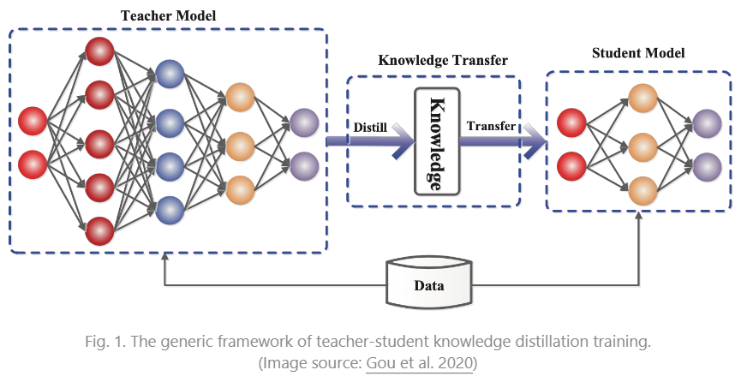
Distillation
Transfer knowledge from bigger model to smaller model to accelerate inference time
Ex. DistillBert reduced BERT parameter by 40% and accelerated inference time by 71% while maintaining 97% accuracy
Distillation loss

Slide 52
Quantization
Category
Post-Training Quantization: Convert a converged model’s weight into lower precision without training
Quantization aware Training: Apply lower precision weight during pre-training or fine-tuning
Challenge
Larger model have layers of extreme outlier that would heavily affect the performance

Slide 53
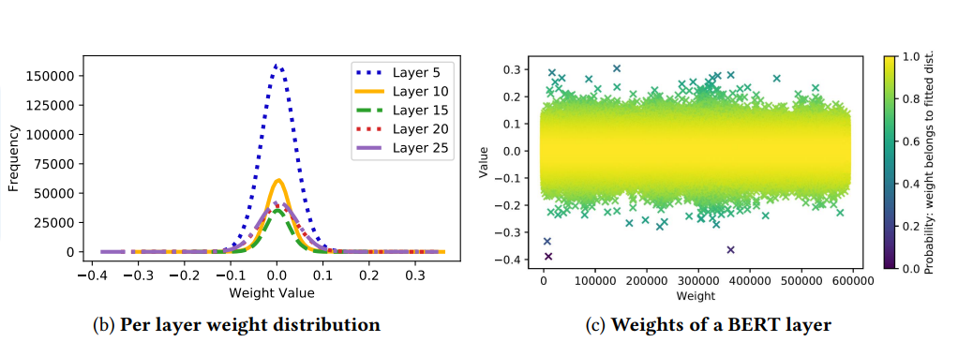
Post-training quantization(PTQ)
Mixed precision quantization:
Quantize at a different precision for weight and activations
GOBO(2020) was one of the first models to apply PTQ on Transformers
Assumes the model weight of each layers follows an Gaussian distribution. Detects the outliers by tracking the mean and standard deviation per layer
Splits the weight into two group, G: Gaussian and O: Outliers
Outliers remains in original form(FP32), non-outliers are clustered and assigns a representative value per cluster

Slide 54
Post-training quantization(PTQ)
Observation that only certain activation layers in BERT caused a significant performance drop, it introduced a mixed-precision quantization(Bondarenko et al. 2021).
Using 16 bit quantization on the problematic activation layers
While, quantizing to 8 bit for others
LLM int8() is a mixed precision quantization that implements two mixed decomposition.
Impose independent quantization per inner product
Outliers activation features remains in FP16

Slide 55
Post-training quantization(PTQ)
Quantization at fine-grained granularity:
Quantizing the entire weight matrix in one layer is easy, but does not lead to a good granularity of quantization
Q-BERT(2020) applied group-wise quantization to fine tune BERT
Treating an individual matrix W with respect to each head in multi-head self attention as one group, then applies Hessian based mixed precision quantization

Slide 56
Post-training quantization(PTQ)
Per-embedding group (PEG) activation quantization:
Motivated by the observation that outliers appears only in a few out of the d dimension(hidden state/ model size).
PEG quantization “splits the activation tensors into several evenly groups along the embedding dimensions and share quantization parameters among elements in the same group”(Bondarenko et al. 2021)

Slide 57
Post-training quantization(PTQ)
Second order information for quantization
Q-BERT developed Hessian AWare Quantization for its mixed precision quantization.
Motivation: parameters with higher Hessian spectrum(larger top eigenvalues) are more sensitive to quantization, thus requires more precision.

Slide 58
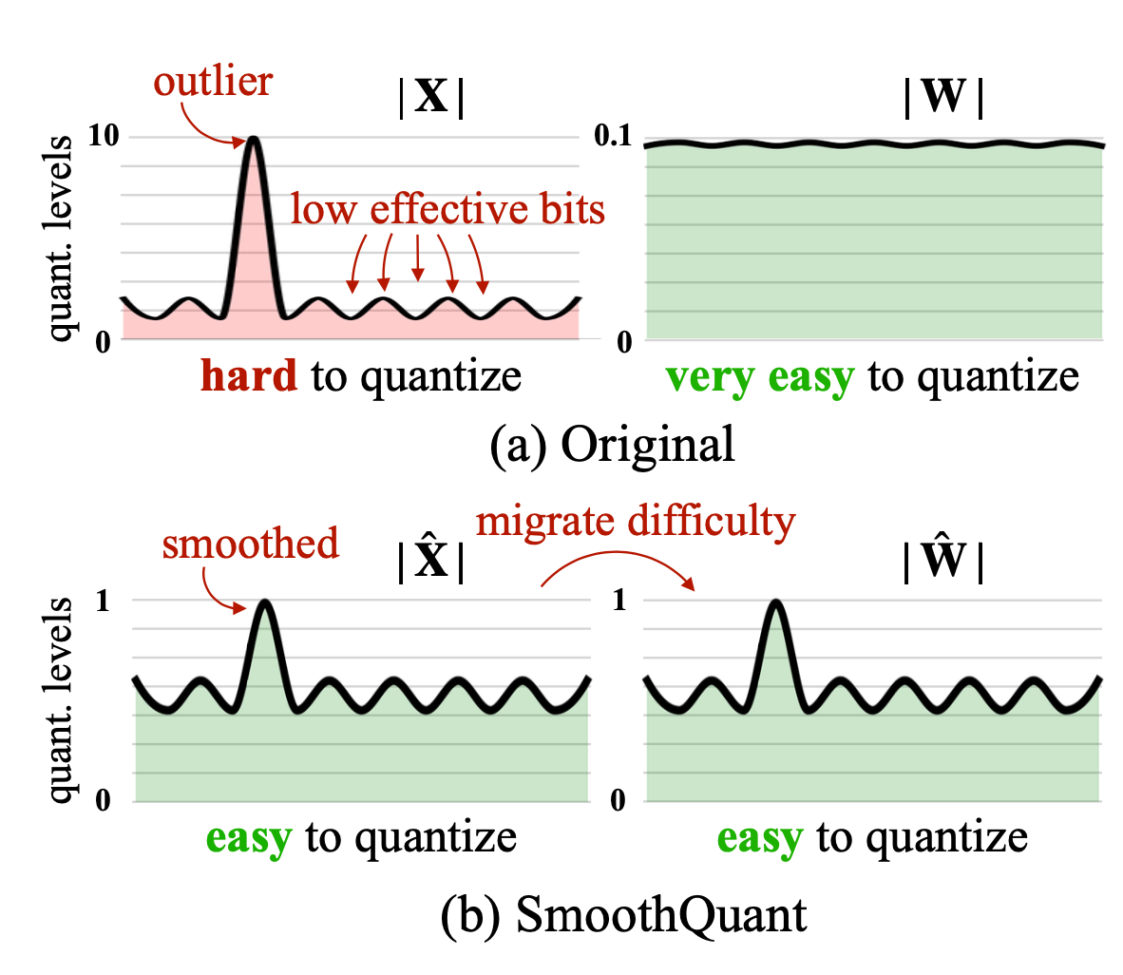
Post-training quantization(PTQ)
Outlier Smoothing
Activation functions are harder to quantize than weights in Transformers.
Smooth Quant(Xiao & Lin 2022)
Proposed a solution to smooth outlier features from activation to weights through mathematically equivalent transformation, enabling quantization on weights and activation

Slide 59
Training Aware Quantization
Methods
Fine-tuning after quantization with similar quality dataset as the pretraining
Training objective: Same as the general pre-training or fine-tuning
Weight has lower bits
Distillation(full precision teacher, low precision student)
Objective: Mean square loss between the multiplication with layer weights and the multiplication of quantized layer weights

Slide 60
Pruning
Trim unimportant model weights and connections while maintaining model capacity
Unstructured Pruning:
Drop any weight or connection
Does not maintain original architecture
Usually does not work well with modern hardware
Structured Pruning
Aims to maintain the dense structure of network by replacing unimportant weights with 0
High sparsity
Examples:
Magnitude pruning
Iterative pruning
How to retrain?
Weight Rewinding
Learning rate Rewinding

Slide 61
Sparsity
Sparsity is an effective way to scale up model capacity while keeping model inference computationally efficient
There are two types sparsity for Transformers
Sparsified Dense Layers (self-attentions and FFN layers)
Sparse Model Architecture (incorporating MoE components)

Slide 62
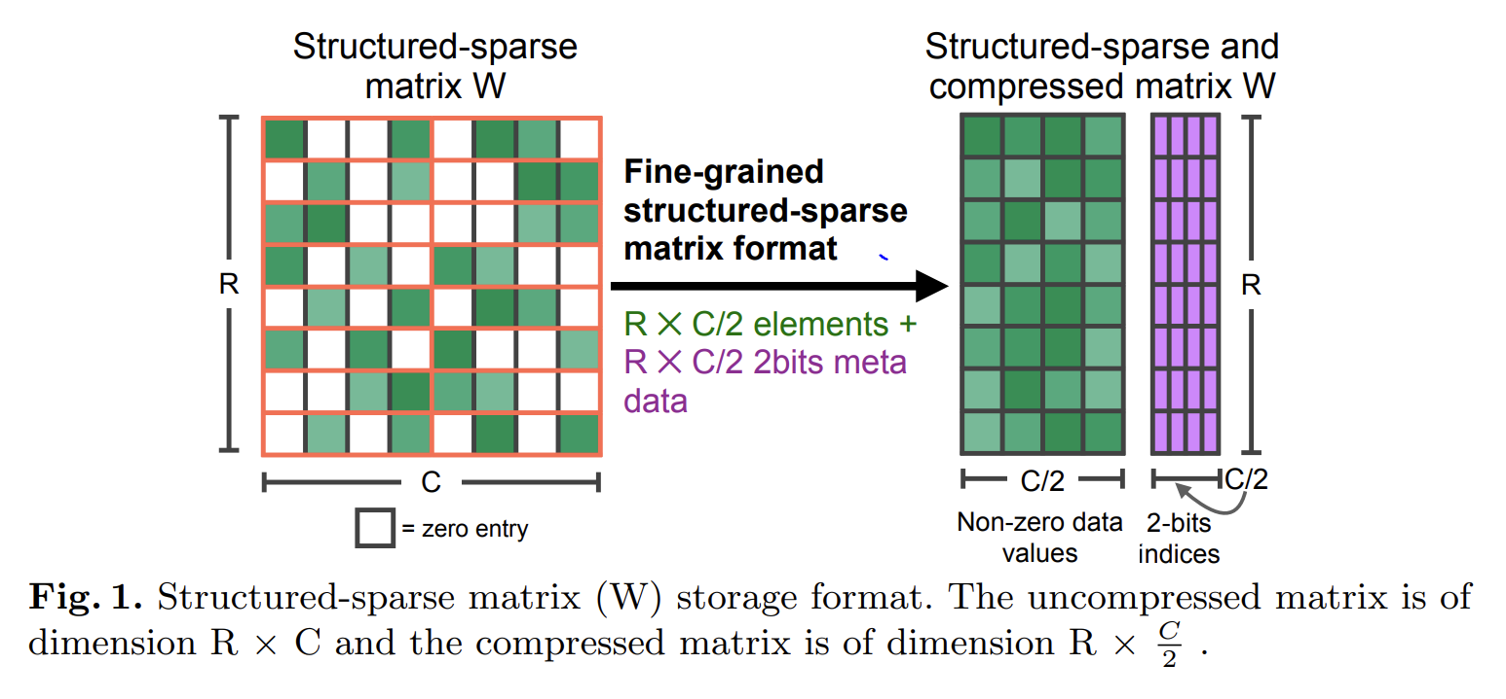
Sparsity
N:M Sparsity via Pruning
N:M Sparsity : structured sparsity pattern that works well with modern GPU hardware optimization. N out of every M consecutive elements are zero
To sparsify a dense neural net to follow a N:M(e.g 2:4) pattern,it is suggested to use the three step routine training for training a prune network
Train a model without sparsity
Prune the model in a N:M sparse pattern
Retrain the pruned model while maintaining N:M sparsity

Slide 63
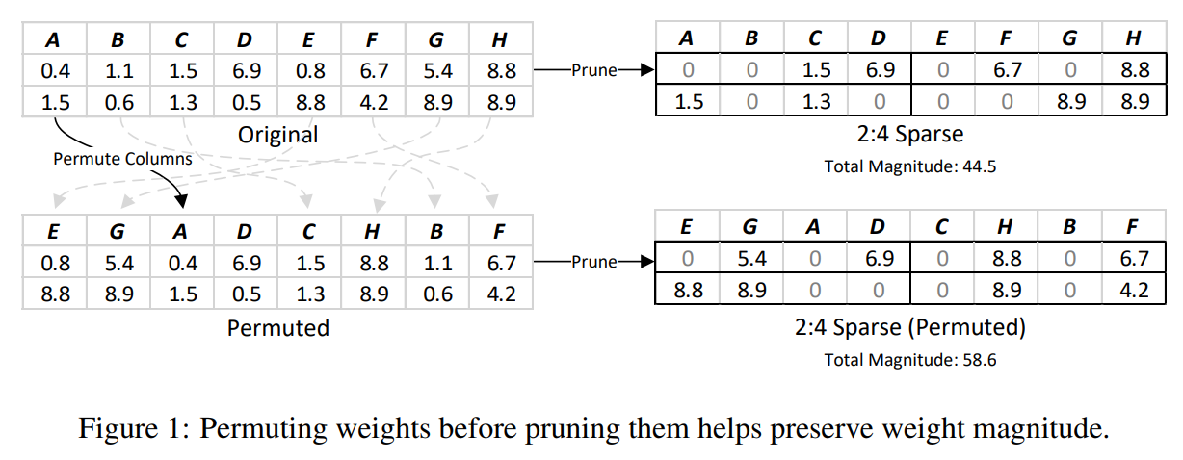
Applying a Permutation before Pruning
Pruning step can prune a large, important value
If we permute the columns of the weights before pruning, then we may be able to avoid pruning some important values

Slide 64
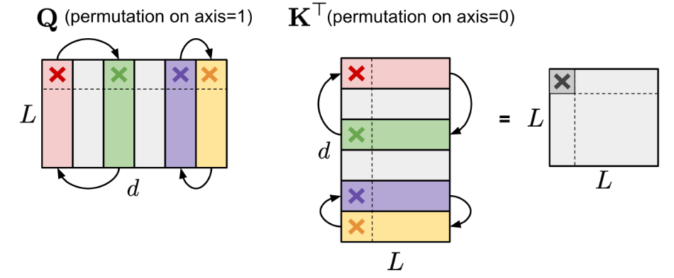
Applying a Permutation before Pruning
Permuting columns of a matrix doesn’t affect results as long as we also permute the corresponding rows of the matrix we multiply by

Slide 65
Applying a Permutation before Pruning
Permuting columns can improve pruning step
Goal: find the best permutation
Issue: too many permutations to try
Can cut down on the number of permutations to try by observing that some permutations are redundant - still too many
Greedy approach: build your permutation step-by-step in a greedy fashion (must use techniques to “escape” local minima)

Slide 66
Greedy Algorithm
Greedy Permutation Algorithm
Think of permutation as a composition of swaps
Iterate over all possible swaps and greedily pick the best swap, adding it to your permutation
Repeat until we hit local min
Issue: get trapped in local minimum, must escape
2 techniques to escape local min
Bounded regressions: after hitting local min, apply a randomly chosen swap to our permutation and repeat greedy loop
Narrow, deep search: instead of iterating over all possible swaps, for all pairs of “stripes,” exhaustively search for the best permutation for that pair of stripes, choose the best permutation found over all pairs

Slide 67
Future Research
Heuristic of increasing weight magnitude empirically results in improved network accuracy, this may not hold in general; other heuristics may perform better
Notes:
Specify what the definition of heuristic measurement here

Slide 68
Sparsified Transformer
Scaling Transformer (Jaszczur et al. 2021): method to sparsify FFN and Attention layers in transformers

Slide 69
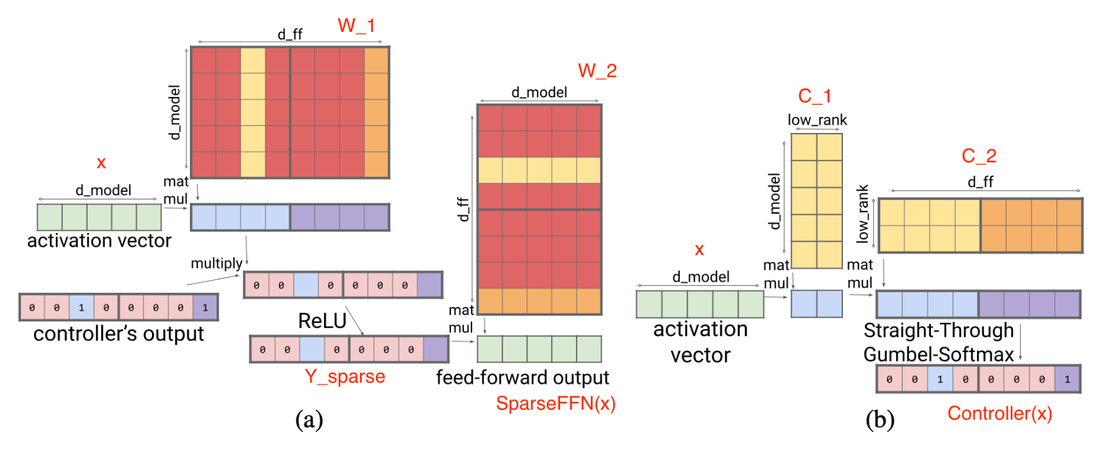
Sparsifying FFN
FFN layer of Transformer has ReLU: introduces a bunch of 0s
Instead, we can train a controller to dynamically pick which columns get zeroed out
Columns that get set to 0 don’t need to be loaded into memory

Slide 70
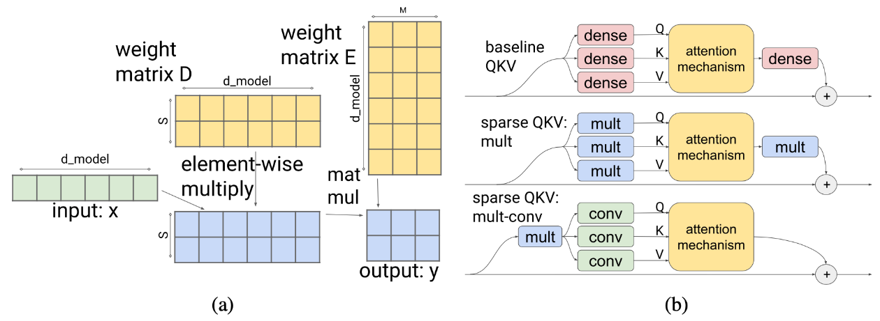
Sparsifying Attention
Attention has dense layers
Instead, divide the input and dimensionality of the model into S modules
Introduce a multiplicative layer: fewer parameters than dense layer, but still expressive enough to represent arbitrary permutations
Also, add convolutional layer to further reduce parameters
Reduces # parameters and computation time

Slide 71

Mixture of Expert(MoE)
A collection of “expert” networks and each example only activates a subset of networks to get predictions
K–top k expert networks
C–Capacity factor. Greater C->better performance, but computationally expensive
Save time, as only partial parameters are used instead of all expert networks

Slide 72
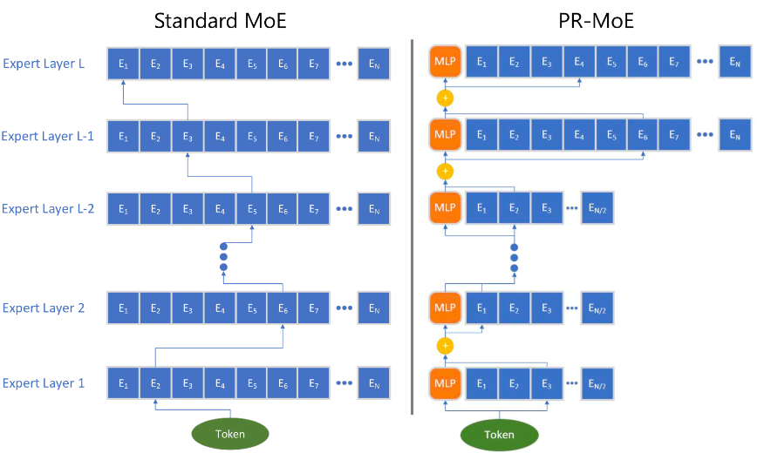
Routing Strategies
V-MoE
Add MoE layer to vision transformer
Route the token
Each expert has limited capacity->assign experts to tokens with a high priority score first
Score: Sum or max of top-k router score
Dynamic with disjoint routing decision for each token
Need to preload all experts during inference
Task-MoE
Route the task
Categorize a distribution of tasks according to predefined heuristics and incorporate such human knowledge into the router
Static
Only need to load k experts during inference
PR-MoE
Token needs to pass extra MLP layer
Greater number of experts at later as it brings more benefits
Notes:
All-to-all communication between experts is used by following tree based algorithm or graph based algorithms

Slide 73
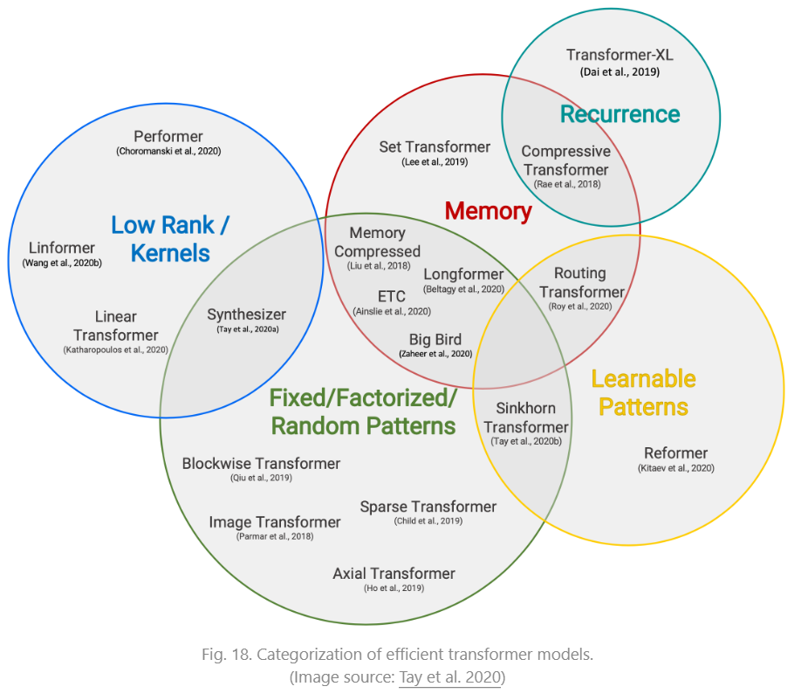
Architectural Optimization
Sparse Attention Patterns
Fixed Pattern:
Limit the field of view for the attention matrix, using predefined, fixed patterns(Sparse Transformer)
Combined Pattern: combine multiple patterns
Learnable Pattern: Identify the attention pattern by learning
Notes:
Combined Pattern: learn to sort/cluster the input tokens - enabling a more optimal global view of the sequence while maintaining the efficiency benefits of fixed patterns

Slide 74
Recurrence
Connects the different blocks via recurrence(Ex. RNN like structure, hidden state reuse) - can allow for longer contexts
Memory Saving Design
A design that saves memory
Leverage low rank approximation in attention
Parameter sharing within attention layer
Mathematical optimization for attention

Slide 75
Adaptive Attention
learn the optimal attention span or decide on when to do early exiting for different input tokens.
learn the optimal attention span
Dynamically decide recurrent steps
Early exit using some confidence measures

Slide 76
Q&A
Thanks for listening!
Questions?

