Slide 1
Break Memory Wall of LLM by Data Offloading
Presenter: Juechu Dong, Xueshen Liu
Notes:
Break Memory Wall

Slide 2
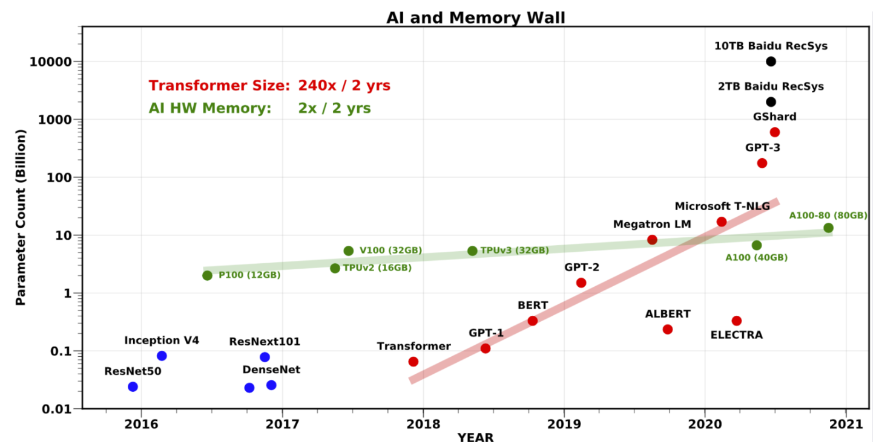
Background: Model size vs. GPU memory size
Notes:
https://github.com/microsoft/DeepSpeed/blob/master/docs/assets/files/SC21-ZeRO-Infinity.pdf

Slide 3
Background: Memory hierachy
Efficient offloading between heterogeneous storage?
Infiniband / NVLink
60-100GB/s
GPU (hbm)
More capacity
Higher bandwidth
PCIe = ~12GB/s
Host (ram)
NVMe = ~12GB/s
NVME (disk)

Slide 4
Background: Memory hierachy
Efficient offloading between heterogeneous storage?
Infiniband / NVLink
GPU (hbm)
More capacity
Higher bandwidth
Host (ram)
NVME (disk)

Slide 5
Background: Memory hierachy
Efficient offloading between heterogeneous storage?
Infiniband / NVLink
GPU (hbm)
More capacity
Higher bandwidth
Host (ram)
CXL attached memory
NVME (disk)

Slide 6
Background: Partitioning by layer
token #i
...
token #i+1
Trans. #1
Trans. #2
Trans. #3
Parameters
KV cache
Optimizer States
Activations
Gradient

Slide 7
Papers
Flexgen (Sheng, Ying, et al., 2023)
Inference
Single GPU
Zero-infinity (Rajbhandari, Samyam, et al., 2021)
Training
Large-scale cluster

Slide 8
FlexGen: High-Throughput Generative Inference of Large Language Models with a Single GPU

Slide 9
Background: Throughput Oriented Low Resouce Inference
“back of house” tasks :
Solutions:
typically executed in large batches. Relaxed latency constrains.
model compression
decentralized inference
offloading to host mem / disk
larger batches
benchmarking
information extraction
form processing
Notes:
https://github.com/microsoft/DeepSpeed/blob/master/docs/assets/files/SC21-ZeRO-Infinity.pdf

Slide 10
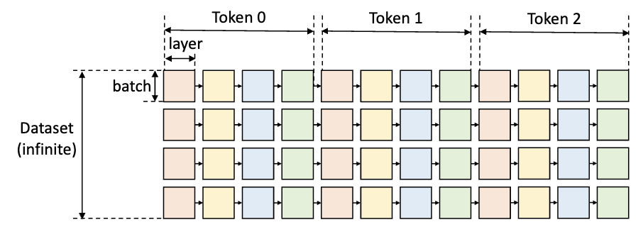
Computational Graph: Row-by-row
w1
w2
w3
w4
A small batch cannot fully utilize the resource
Notes:
https://github.com/microsoft/DeepSpeed/blob/master/docs/assets/files/SC21-ZeRO-Infinity.pdf

Slide 11
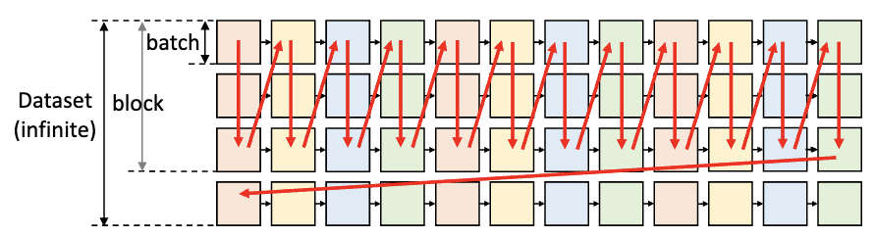
Computational Graph: Zig-zag block
w1
w2
w3
w4
Notes:
https://github.com/microsoft/DeepSpeed/blob/master/docs/assets/files/SC21-ZeRO-Infinity.pdf

Slide 12
Search Space: block size
KV cache
KV cache
.....
large block
Activations
Weights
KV cache
Activations
Weights
small block
.....
Reuse weights
Frequent offloads weights between GPU and other storage
Activations

Slide 13
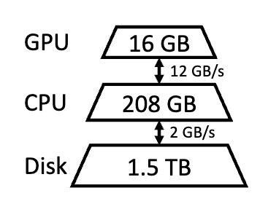
Search Space: Data placement
Weights
Weight #1
Activations
KV cache
Weight #1

Slide 14
Search Space: Compute delegation
Activation
Very large KV cache
KV
KV

Slide 15
Search Space: Compute delegation
Activation
KV
Activation
KV
Activation
KV
Fall back to CPU computation if offloading data is too costly

Slide 16

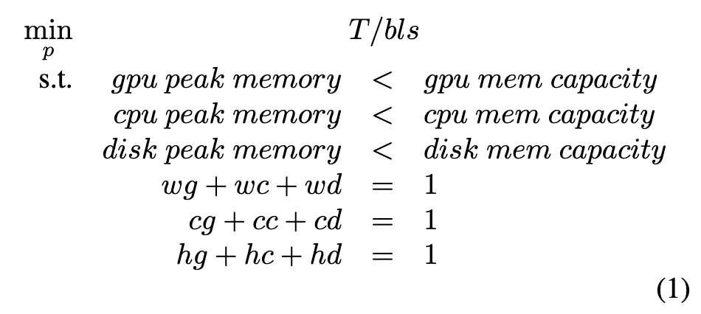
Policy Search
Assume all the memory movement is overlapped with computation
Search through a pre-defined set of batch size and block size
Find optimal placement policy by linear programming
= Maximum tokens per second

Slide 17

Approximation: Group-wise Quantization
Compress KV cache & weights into quantimized 4-bit integers while stored.
min of 64 continuous weights / KV entries
max of 64 continuous weights / KV entries
convert back to FP16 at compute.
=> reduced I/O cost. ? increased computation?
Notes:
https://github.com/microsoft/DeepSpeed/blob/master/docs/assets/files/SC21-ZeRO-Infinity.pdf

Slide 18
Approximation: Sparse Attention
Top K indices of
Notes:
https://github.com/microsoft/DeepSpeed/blob/master/docs/assets/files/SC21-ZeRO-Infinity.pdf

Slide 19
Summary
Flexgen defines a search space of possible offloading strategies and use linear programming to find the optimal solution.
Flexgen is able to compress both the weights and KV cache for LLMs like OPT-175B to 4 bits without retraining or calibration, all with negligible accuracy loss.

Slide 20
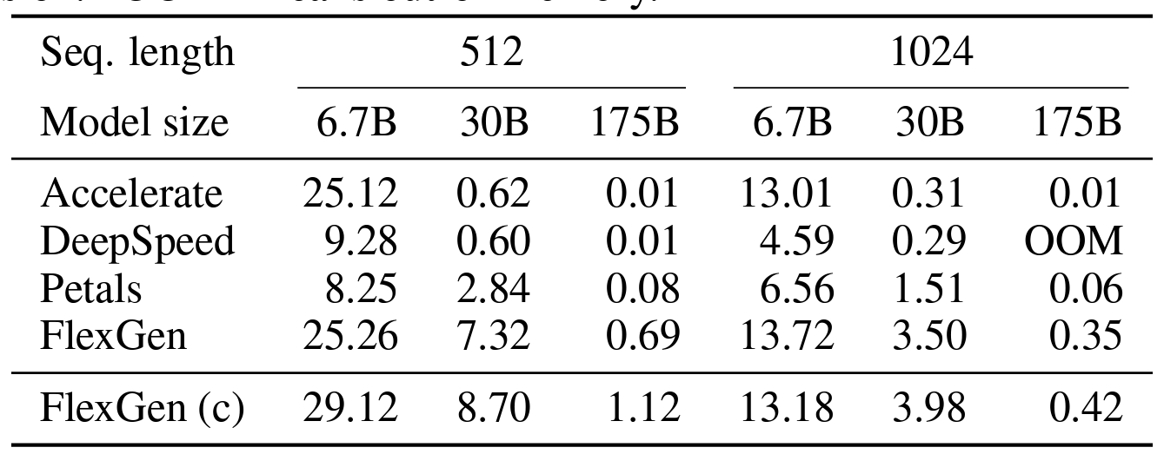
Throughput vs. Prior Works
Notes:
https://github.com/microsoft/DeepSpeed/blob/master/docs/assets/files/SC21-ZeRO-Infinity.pdf

Slide 21
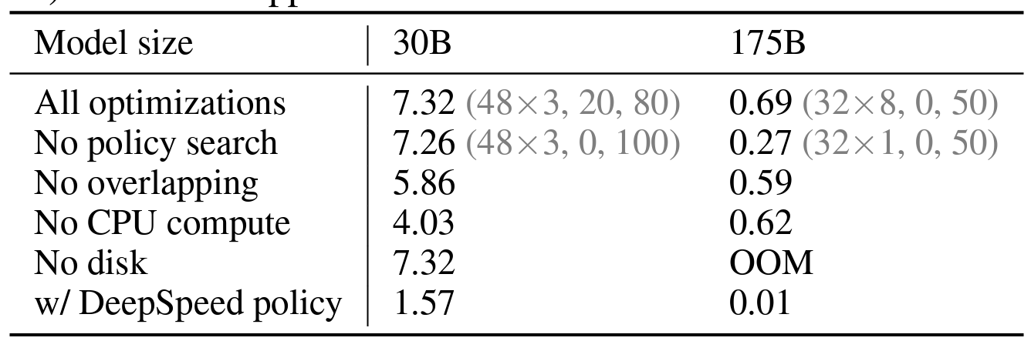
Optimization Breakdown
More likely to affect latency, not throughput

Slide 22
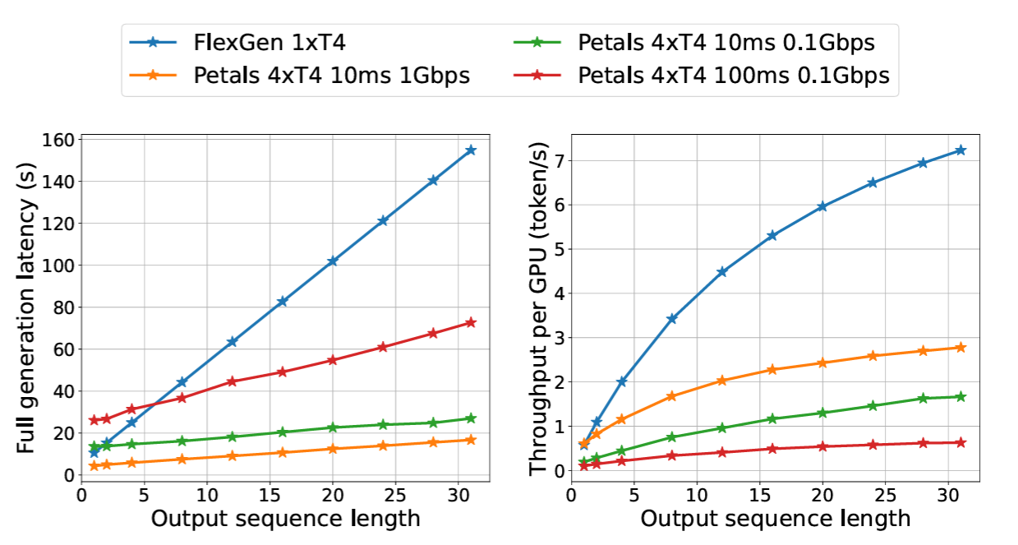
Latency / Throughput vs. Petals under different Lat.
Notes:
https://github.com/microsoft/DeepSpeed/blob/master/docs/assets/files/SC21-ZeRO-Infinity.pdf

Slide 23
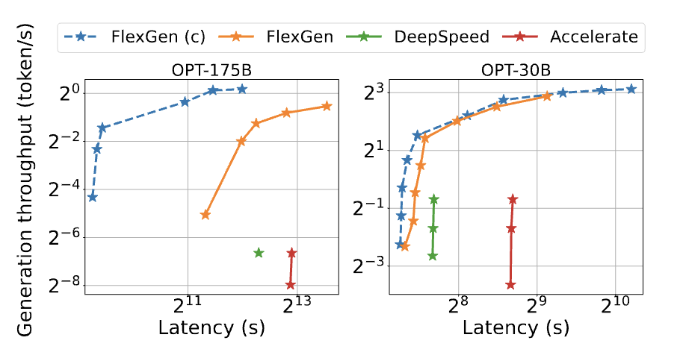
Latency - Throughput Trade-off
Notes:
https://github.com/microsoft/DeepSpeed/blob/master/docs/assets/files/SC21-ZeRO-Infinity.pdf

Slide 24
Discussion
Strength:
Flexible trade-off between throughput and latency
Large batch size achieved through offloading and compression
Weakness:
Coarse-grained computation parallelism
Non-optimal policy
Fall back to CPU affects other tasks
Notes:
https://github.com/microsoft/DeepSpeed/blob/master/docs/assets/files/SC21-ZeRO-Infinity.pdf

Slide 25

Single GPU to multiple compute nodes
Flexgen
ZeRO-Infinity
Connected by IB/NVLink

Slide 26
Inference to training
token #i
...
token #i+1
Trans. #1
Trans. #2
Trans. #3
Put on CPU
Parameters
KV cache
Optimizer States
Activations
Gradient

Slide 27
ZeRO-Infinity: Breaking the GPU Memory Wall for Extreme Scale Deep Learning

Slide 28
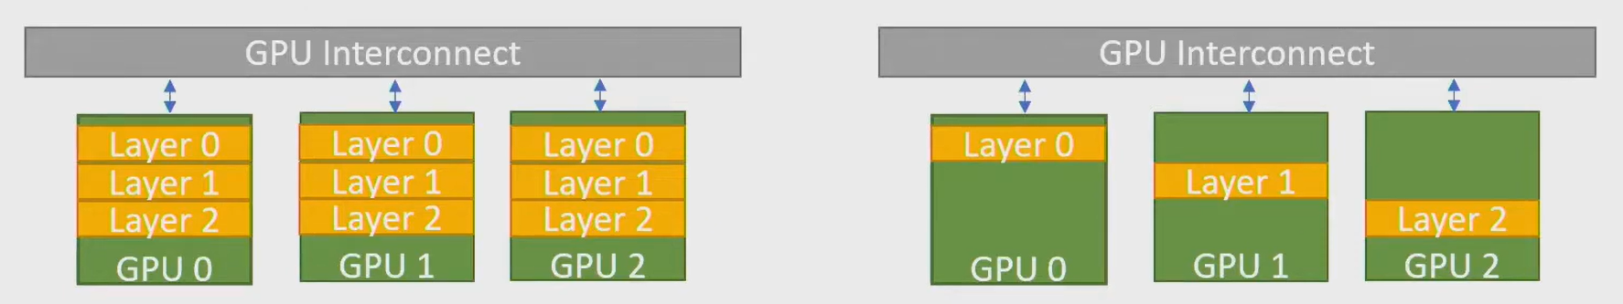
Background: Memory Explosion
Data Parallelism between Devies:
requires data redundancy (multiple copies of weights)
Tensor-Slicing
does not scale beyond a single node / to host mem
Pipeline-Parallelism
scales across a node
require code refactoring
ZeRO
scales across a node
does not require code refactoring
Notes:
https://github.com/microsoft/DeepSpeed/blob/master/docs/assets/files/SC21-ZeRO-Infinity.pdf

Slide 29

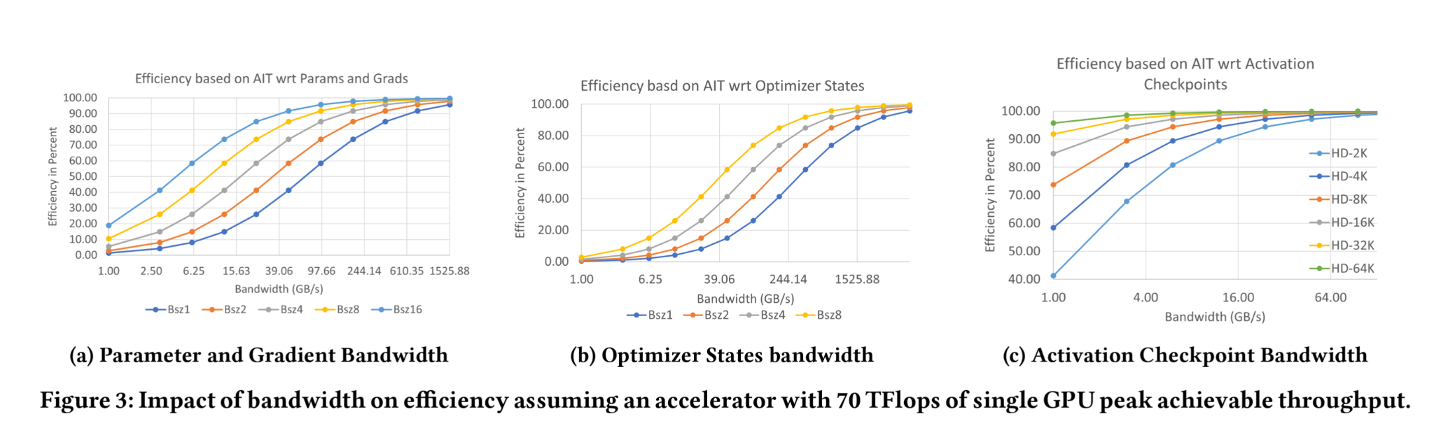
Bandwidth Requirements: Para. & grad.
70GB/s to achieve 50% efficiency
Hide latency by overlapping layers
Notes:
https://github.com/microsoft/DeepSpeed/blob/master/docs/assets/files/SC21-ZeRO-Infinity.pdf

Slide 30
Bandwidth Requirements: Opt. states
Cannot be overlapped as it is the last step after all layers
Bandwidth Requirement is too high to be efficient
Notes:
https://github.com/microsoft/DeepSpeed/blob/master/docs/assets/files/SC21-ZeRO-Infinity.pdf

Slide 31
Bandwidth Requirements: Activation ckpt.
Not a problem
Notes:
https://github.com/microsoft/DeepSpeed/blob/master/docs/assets/files/SC21-ZeRO-Infinity.pdf

Slide 32
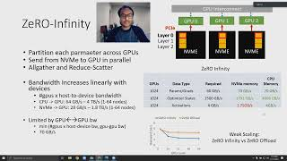

Slide 33
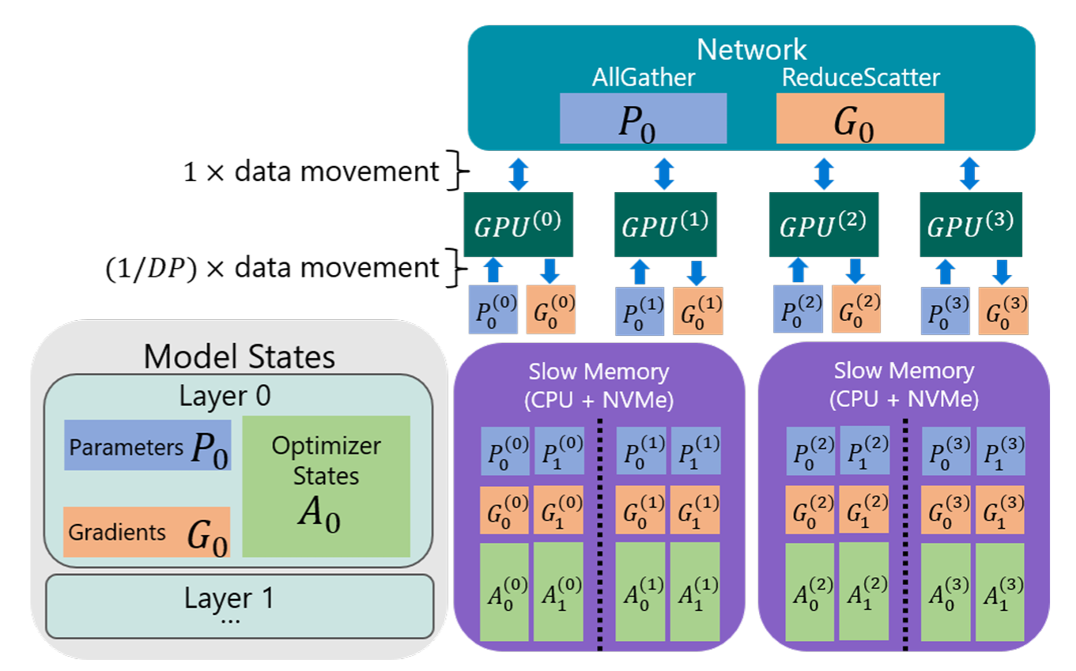
Notes:
https://github.com/microsoft/DeepSpeed/blob/master/docs/assets/files/SC21-ZeRO-Infinity.pdf

Slide 34
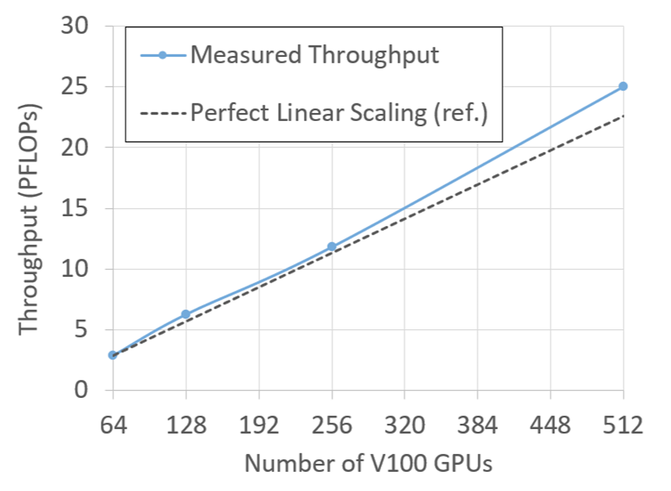
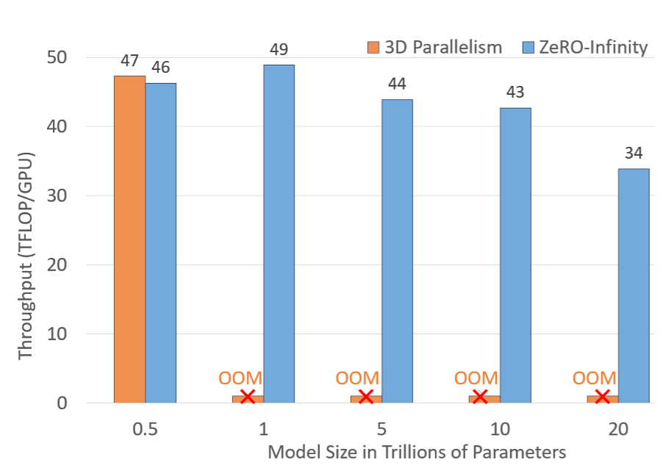
Results: ZeRO-Infinity Scaling
Notes:
https://github.com/microsoft/DeepSpeed/blob/master/docs/assets/files/SC21-ZeRO-Infinity.pdf

Slide 35
Discussion
Strength:
Enable extremely large model training
Linearly throughput and model size scaling
Easy to use with pytorch
Weakness:
Hardware requirements
Notes:
https://github.com/microsoft/DeepSpeed/blob/master/docs/assets/files/SC21-ZeRO-Infinity.pdf

Slide 36
Summary
Flexgen
Zero-infinity
LLM > GPU memory, large size storage comes with large latency
Single GPU inference, weights & KV cache
Multi-node training, model states
Notes:
https://github.com/microsoft/DeepSpeed/blob/master/docs/assets/files/SC21-ZeRO-Infinity.pdf

Slide 37
Summary
Flexgen
Zero-infinity
LLM > GPU memory, large size storage comes with large latency
Single GPU inference, weights & KV cache
Multi-node training, model states
Overlap memory transfer and computation
Notes:
https://github.com/microsoft/DeepSpeed/blob/master/docs/assets/files/SC21-ZeRO-Infinity.pdf

Slide 38
Summary
Flexgen
Zero-infinity
LLM > GPU memory, large size storage comes with large latency
Single GPU inference, weights & KV cache
Multi-node training, model states
Overlap memory transfer and computation
Zig-zag scheduling, data/compute placement
Parallel NVME, all together by IB/NVLink
Notes:
https://github.com/microsoft/DeepSpeed/blob/master/docs/assets/files/SC21-ZeRO-Infinity.pdf

Slide 39
Summary
Flexgen
Zero-infinity
LLM > GPU memory, large size storage comes with large latency
Single GPU inference, weights & KV cache
Multi-node training, model states
Overlap memory transfer and computation
Zig-zag scheduling, data/compute placement
Parallel NVME, all together by IB/NVLink
Data compression
Data compression
Notes:
https://github.com/microsoft/DeepSpeed/blob/master/docs/assets/files/SC21-ZeRO-Infinity.pdf

