Slide 1
Biological Sequence Visualization Using D3.js
Md Mosharaf Hossan(1307053) &
Tushar Ghosh(1307060)
Department of Computer Science and Engineering
Khulna University of Engineering and Technology.
Supervised By:
Mr. Jakaria Rabbi, Lecturer, Dept. of Computer Science and Engineering, KUET.
Acknowledgement:
Mr. Bishnu Sarker, Asstt. Professor, Dept. of Computer Science and Engineering, KUET.

Slide 2
Agenda
Problem Statement
Motivation and background knowledge
Working procedure and Flow diagram
Result Analysis
Learning Outcome and Challenges
Conclusion and Future Works
Sample Visualization
Tools and Technologies

Slide 3
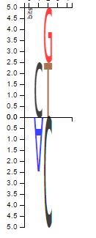
Problem statement
The problem was to develop a visualization tool that encodes the mutational variations in each position in a set of biological sequences.

Slide 4
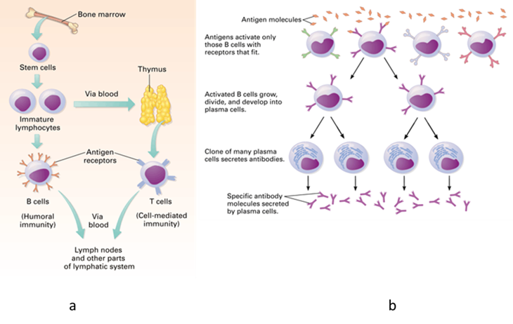
Motivation & Background Knowledge:
Uncontrolled proliferation of B-cell cause B-cell lymphoid tumors

Slide 5

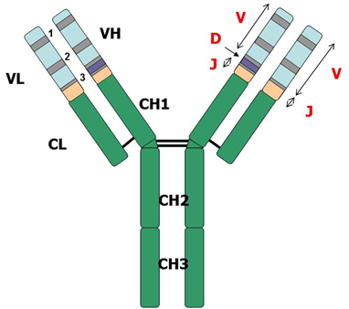
Motivation & Background Knowledge:

Slide 6

Motivation & Background Knowledge
The quest for understanding mutational changes in Biological Sequence
CDR3
* * * * *
N1
******
N2
********
IGHV
IGHJ

Slide 7
Motivation & Background Knowledge: Sample Input Sequence
Original sequence | A | C | T
Patient 1 | C | G | T
Patient 2 | A | T | T

Slide 8
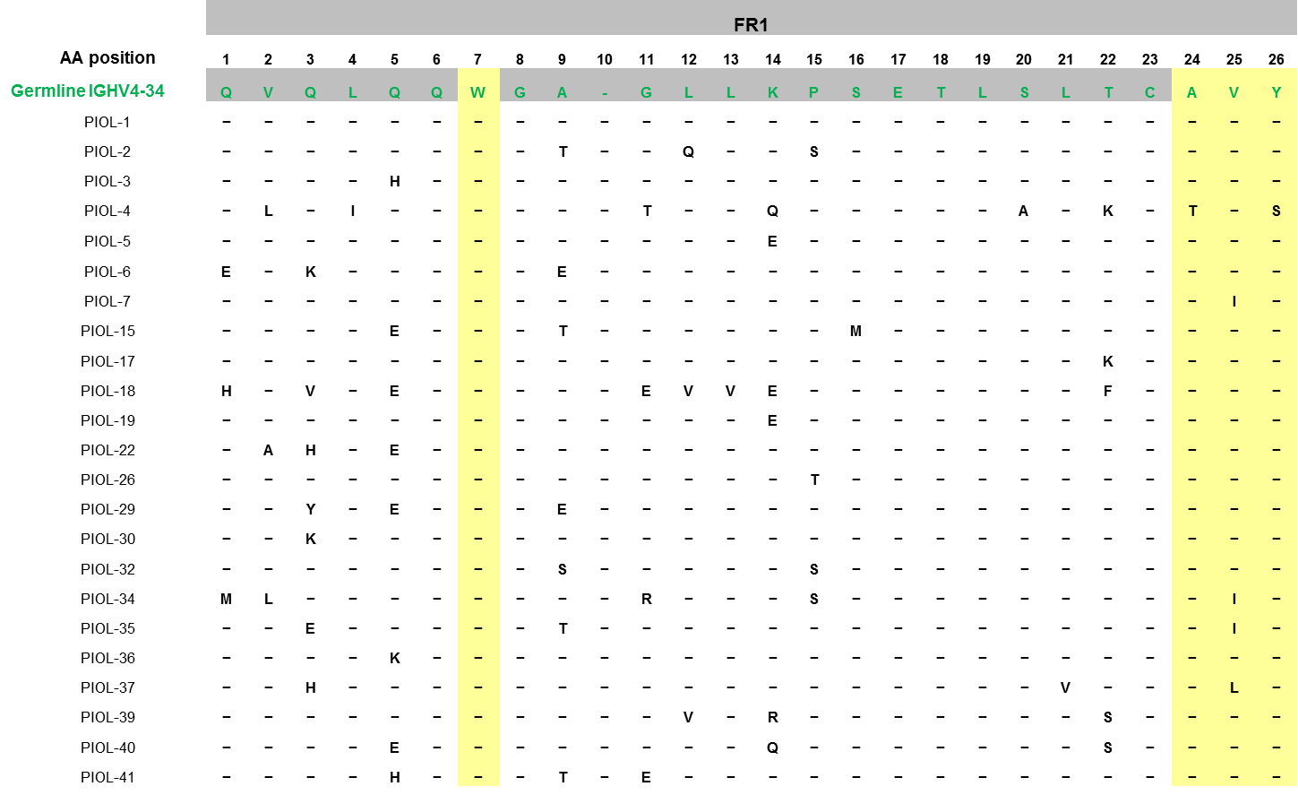
Motivation & Background Knowledge: Mutation Variations in Excel Format

Slide 9
A simple visualization
Germ line | A | C | T
Patient 1 | C | G | T
Patient 2 | A | T | T

Slide 10
Working Procedure and Flow Diagram
Input Sequence
Frequency/Entropy Computation
Logo Visualization

Slide 11
Result Analysis: Input Sequence
Germline: QVQLQQWGA-GLLKPSETLSLTCAVYGGSF--- GYYWSWIRQPPGKGLEWIGEINHS---GSTNYNPSLK-SRVTISVDTSKNQFSLKLSSVTAADTAVYYC
Patient 1:.......................AVYSEFF----TRYFWTWIRQTPGKGLEWIGEINHS---GSTTYTLSLQ- SRVTISVDTSKNQFSLRLIFVTDADTAVYYC
Patient 2:QVHIEQWGI-GILEPSETLSLTCAVYGGSF----SDYFWTWLRQPPGKGLEWIGEINQS---GSTNCDPSLK-SRLTISLDMSKNQFSLQMISVTAADTAMYFC
Patient 3:QVHPQQWGT-ELLHPSGTLSLTCAVYGGSF----KEFNWNWVRQFPGKGLEWLGEINHY---GRVNYNPSLE-SRITMSIDTSVNQFSLKIVSVTAADTASYFC
Patient 4:QVQLQQWGE-GLLKPSETLSLTCAVYGGSF----NFNYWTWIRQPPGMGLEWIGEFRHG---EATKYNPSLK-SRVTISGDTYKNQFFLNVKSLTAADTAVYYC
Patient 5:QVHLQQWGT-QLLKPSETLSLTCAVYGGSF----SGSYWSWIRQSPGRGLEWIGEINHS---GSTNYNPSLK-SRVTISMDTSKNQFSLILASVTAADTAVYFC
Patient 6:QVQLQQWGA-GLLKPSETLSLTCAVYGGSL----SSFYWTWIRQPPDKGLEWIGEINHS---GNANYNPSFM-SRVTISIDTSKNQFSLTLISLTAADTAIYFC
Patient 7:QVYLKQWGA-GLLKSSETLSRICALYGGSF----NNYHWSWLRQTPEKGLEWIGEIHHG---GSNKYNPSLK-SRATISIDTSKNQFSLRVRSVSAADTAVYYC
Patient 8:LTQWDTWGA-GILKPSETTSLTCAVYGGSL----SGFYWTWLRQSPEKGLEWIGEIDHG---GGTNSNPSLK-SRVTLSIDTSKQQFSLMLTSVIATDTAVYYC
Patient 9:QVQLDQWGA-GLLASSETLSLTCAVYGASL----SENFWSWVRQSPGKGLEWIGEITQS---GNTNYNSDFK-SRVTISEDTSKRQFSLKVTSMTAADTGVYYC

Slide 12
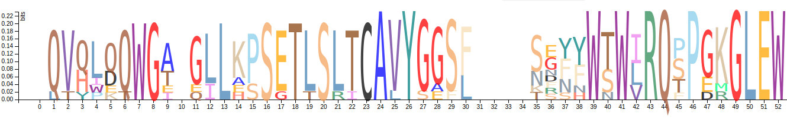

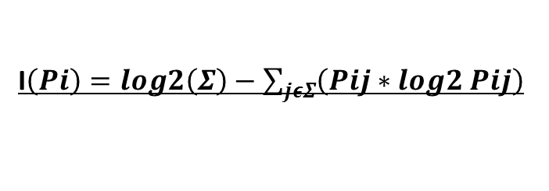
Result Analysis: Sequence Logo
I$\left(Pi\right)=log2\left(Σ\right)−\sum_{jεΣ}{\left(Pij∗log2 Pij\right)}$
lij$=Pij∗I(Pi)$

Slide 13
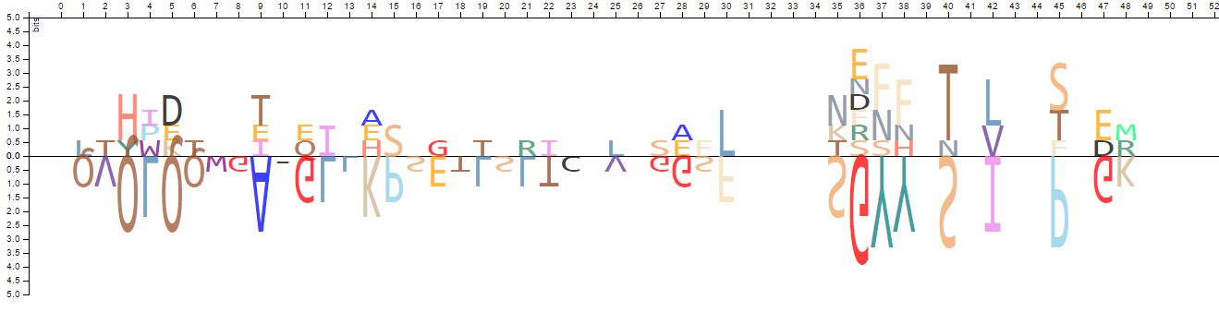
Result Analysis: Mutation Logo
For Upper Logo, ith position and recurrent mutation of residue j,
lij=𝑃𝑖𝑗/𝑁, N is total sequences in the alignment
For Lower Logo, ith position and Total Mutation Ti
lij=𝑇𝑖/𝑁, N being total sequences in the alignment

Slide 14
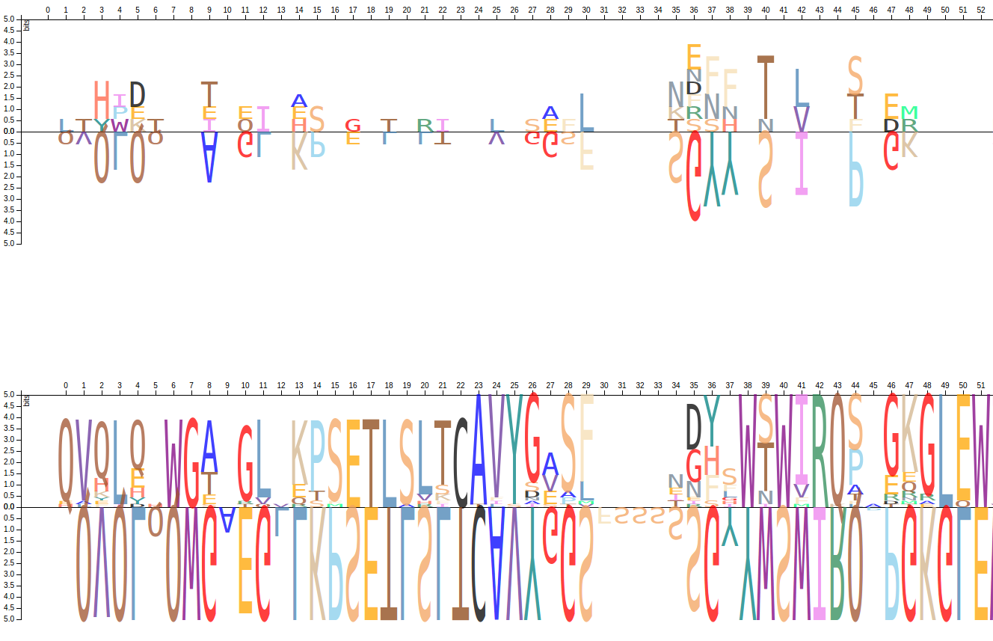
Result Analysis: Multiview Logo

Slide 15
Tools And Technologies
Java Script: A High Level Dynamic, Untyped, Interptreted Language
Faster.
Versatile
Reduces demand on the server.
D3.js: A JavaScript library for Browser based dynamic, interactive data visualization
Specially designed for interactive visualization of data
Control over how the chart is being drawn.
Add/remove data from the chart seamlessly.
Completely a client side language.

Slide 16
Learning outcome and Challenges
Learning Outcome
A hands on Experience on Javascript, D3.js and Client Side Visualization.
Hands on experience Biological sequence processing , variation analysis and visualization techniques.
Challenges
Difficult
Hard

Slide 17
Conclusion and Future Works
This project builds a tool for visualizing Mutational variations in Biological Sequences.
A faster and efficient implementation using Javascript and D3.js
Currently, Sequence Logo, Mutation logo and Multi-view logo is presented as working features.
Extension possibility to include other types of logos like Sub family logo, Mutagenesis logo etc..
Various input and output format will be included in future.
A number of parameters to be added to make the logos more interactive and dynamic.

Slide 18
Thank you

