Slide 1


DuPont Financial Analysis
Cheng Yu | Jing Wang | Marius Gnoth | Alexander Moshchev

Slide 2
Outline
Agenda
Importance of financial analysis for investors and stakeholders
What is Dupont financial analysis - Explanation of why it's a valuable tool for financial evaluation
Display the DuPont formula - Breakdown of Return on Equity (ROE) into components
Data Pipeline Overview / Technical Approach
Background & Business Model Coca-Cola vs. PepsiCo
Code and Dashboard Demonstration (5-6 Financial Metrics)
Comparative Financial & Accounting Analysis (Deep Dive)
Key Insights

Slide 3
Importance of financial analysis for investors and Analysts
Intro
Purpose:
Examine a public company‘s performance & financial health and changes in financial position in the context of its environment
Primary Data Sources:
Income statement, balance sheet, cash flow statement
A tool to answer specific economic questions such as:
Evaluating a merger or acquisition candidate
Evaluate past, current and potential performance
…
Financial ratios express relationships between financial statement items and make companies performances comparable.

Slide 4





What is dupont financial analysis?
Intro
DuPont analysis is a framework of performance measurement that was started by the DuPont Corporation in the 1920s
Highlights areas of strengths and weaknesses evident in the financial statements
1-Step
$$ROE= \frac{Net Income}{Total Equity}$$
$$ROE= \frac{Net Income}{Total Assets} × \frac{Total Assets}{Total Equity}$$
2-Step
ROA
$$×$$
Leverage
$$ROE= \frac{Net Income}{Total Revenue} × \frac{Total Revenue}{Total Assets} × \frac{Total Assets}{Total Equity}$$
3-Step
Net Profit Margin
$$×$$
Asset Turnover
$$×$$
Leverage

Slide 5
Intro

Slide 6
Implementation

Slide 7
Approach: Data Pipeline
Ticker Entry
Yahoo Finance
Formatting Transformations
Calculation of Financial Ratios
GPT 3.5
Additional info
Visualization
7

Slide 8
Code

Slide 9
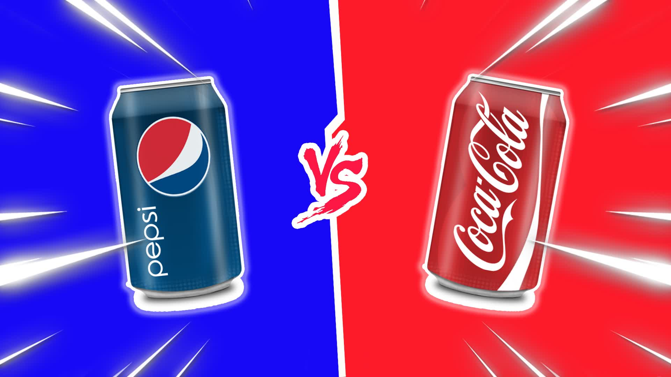

Slide 10


Background
Coca-Cola (KO) and PepsiCo (PEP) dominate the beverage (and convienient goods) market
Which company do you think is larger by revenue? And by how much?
86.39 Billion USD
43.00 Billion USD

Slide 11

Business Model Canvas
Key Partners
Key Activities
Value Proposition
Customer Relations
Customer Segments
Key Resources
Channels
Cost Structure
Revenue Streams
11

Slide 12

Business Model Canvas
Key Partners
Key Activities
Value Proposition
Customer Relations
Customer Segments
Bottlers and distribution partners
Developing, producing, marketing, selling of beverages, syrup & convienient goods
Worldwide diverse portfolio of beverages and convienient foods
Targeting consumer through omnipresent advertising Adaption to market trends
Contract manufacturers
Key Resources
Branding, trademarks and licence fees
Channels
Bottling plants
Branded finished goods
Direct Store Delivery, Warehousing, Retail (Walmart 14%), distributor networks, e-commerce
Third parties
Ware-houses
Cost Structure
Revenue Streams
Marketing & Advertising
Commodities: Agricultural producs, energy, metals
Shipping and handling activities
12

Slide 13
Dashboard DEMO

Slide 14
Comparative Financial & Accounting Analysis
14

Slide 16

THANKS FOR YOUR ATTENTION
16

Slide 17
Links & Literature
17

