Slide 1
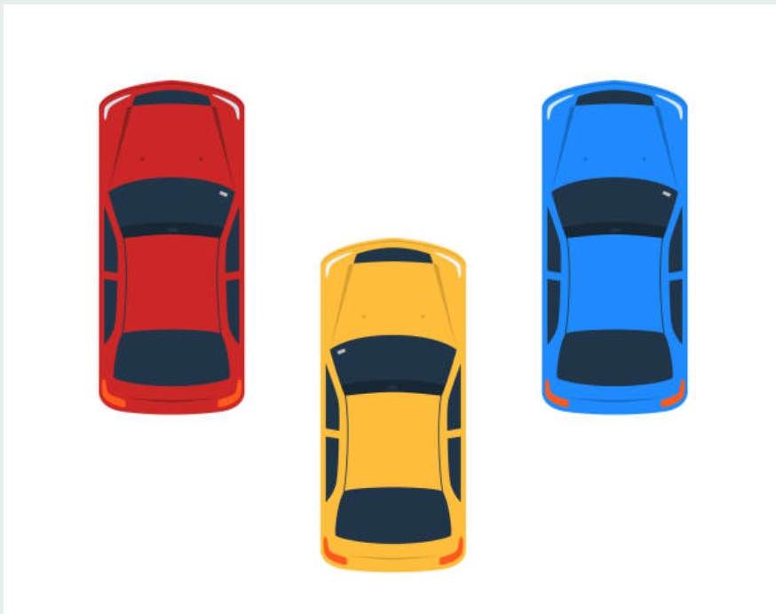

Slide 4
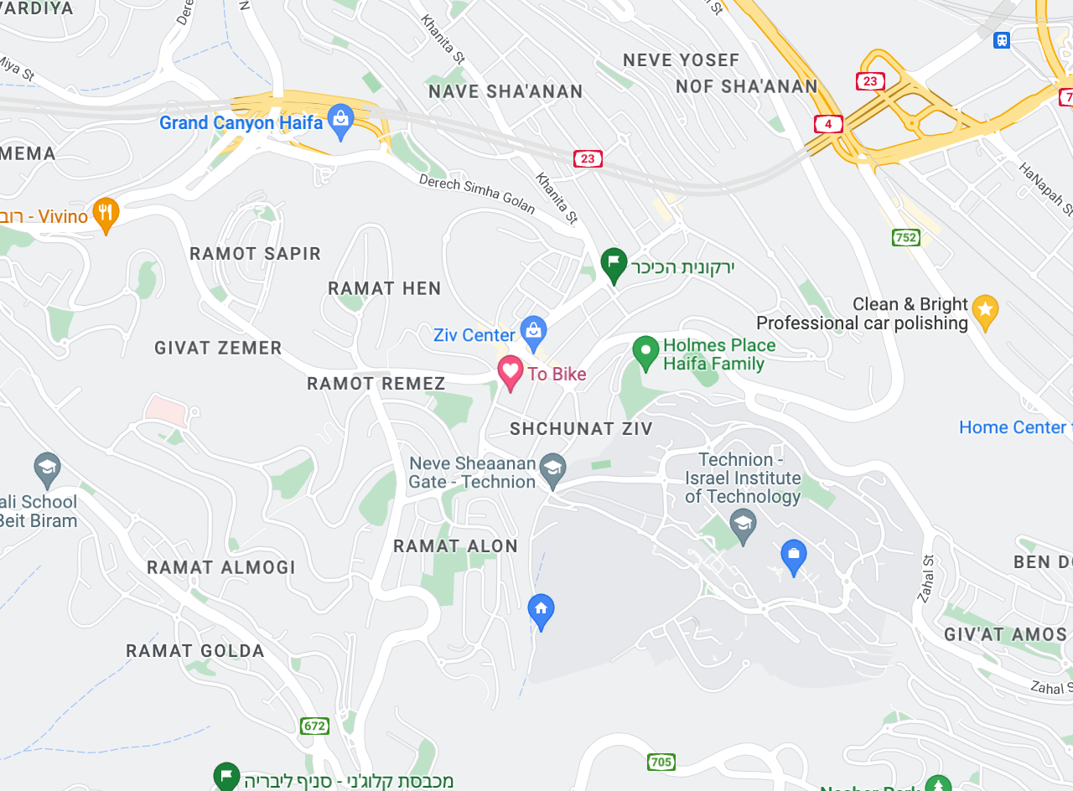


Slide 5



Slide 6
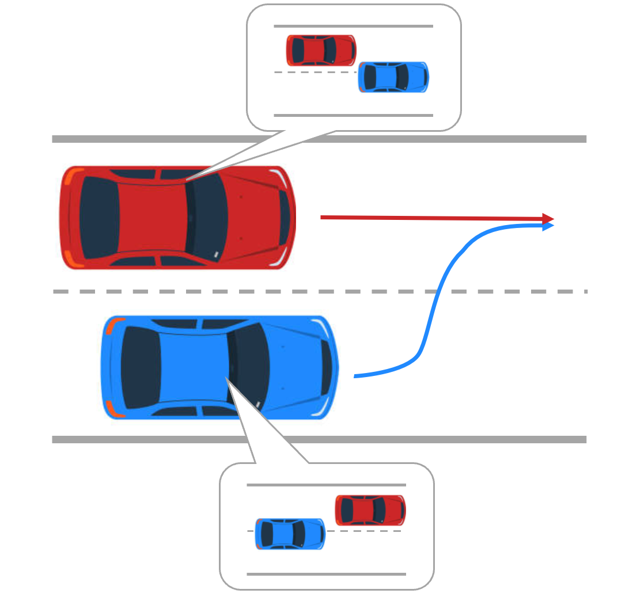
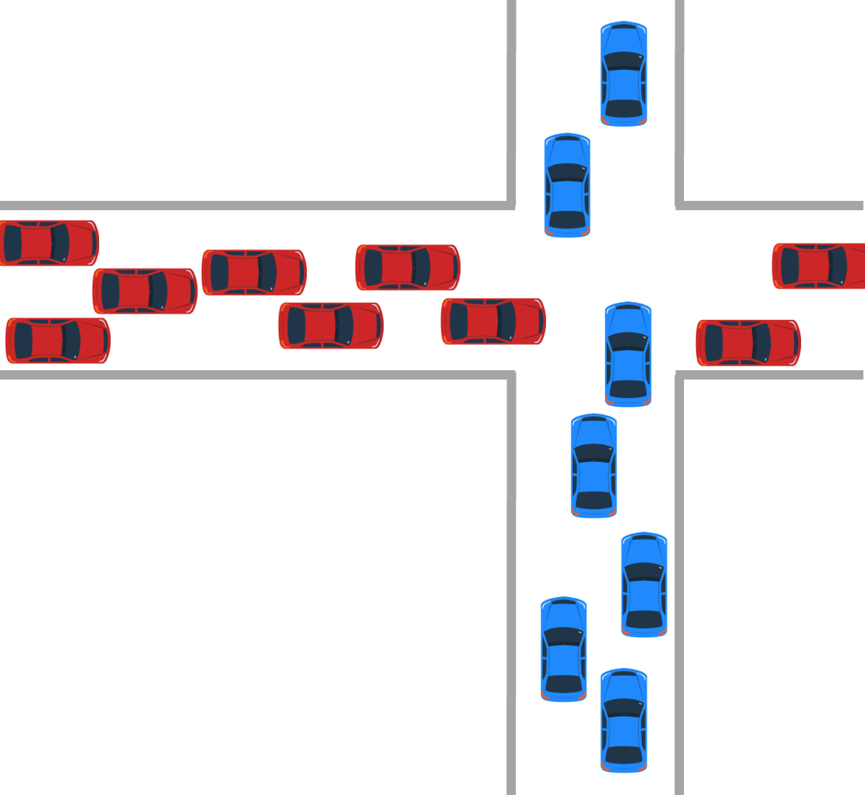
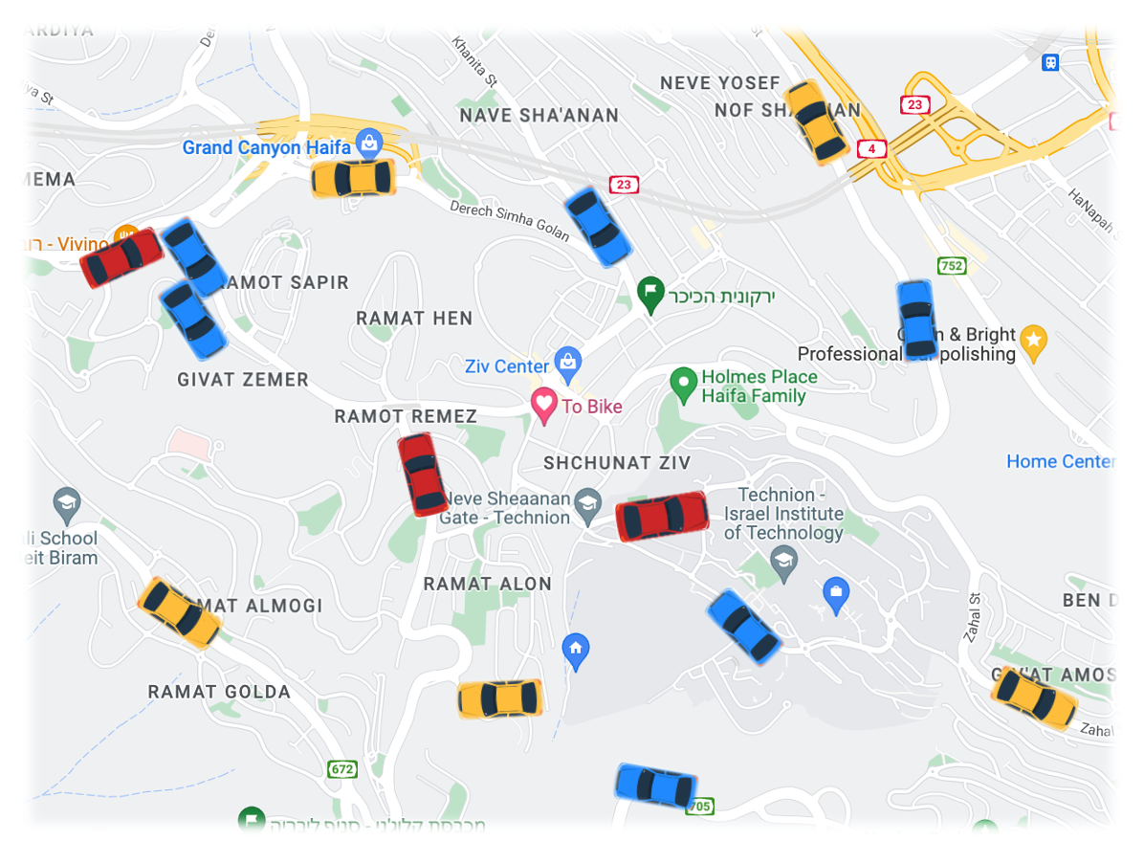

Slide 7
Objective 1: Game-theoretic motion planning via sampling-based approaches
Objective 2: AV coordination via kinodynamic multi-robot motion planning
Objective 3: Congestion-aware AMoD routing with the cell transmission model
Phase 1.1: RRT-based method for autonomous racing
Phase 2.1: Theory of kinodynamic tensor roadmaps
Phase 3.1: Efficient solution of dynamic traffic assignment
Phase 1.2: Extension to general Nash equilibria
Phase 2.2: Speedup methods for scalable implementation
Phase 3.2: Incorporation of rebalancing constraints

Slide 8
 | Timeline
 | 3 | 6 | 9 | 12 | 15 | 18 | 21 | 24 | 27 | 30 | 33 | 36
Objective 1: Communication-aware multi-vehicle autonomy | Filtering-based approaches
 |  |  |  |  | Factor-graph approaches
Objective 2: Coded communication over heterogeneous networks | Coded ARQ protocol design
 |  |  |  |  | Analysis and limits study
Objective 3: Co-design of multi-vehicle autonomy and coded communication |  |  |  |  | Freashness optimization
 |  |  |  |  |  |  |  |  | Further co-design solutions

Slide 9
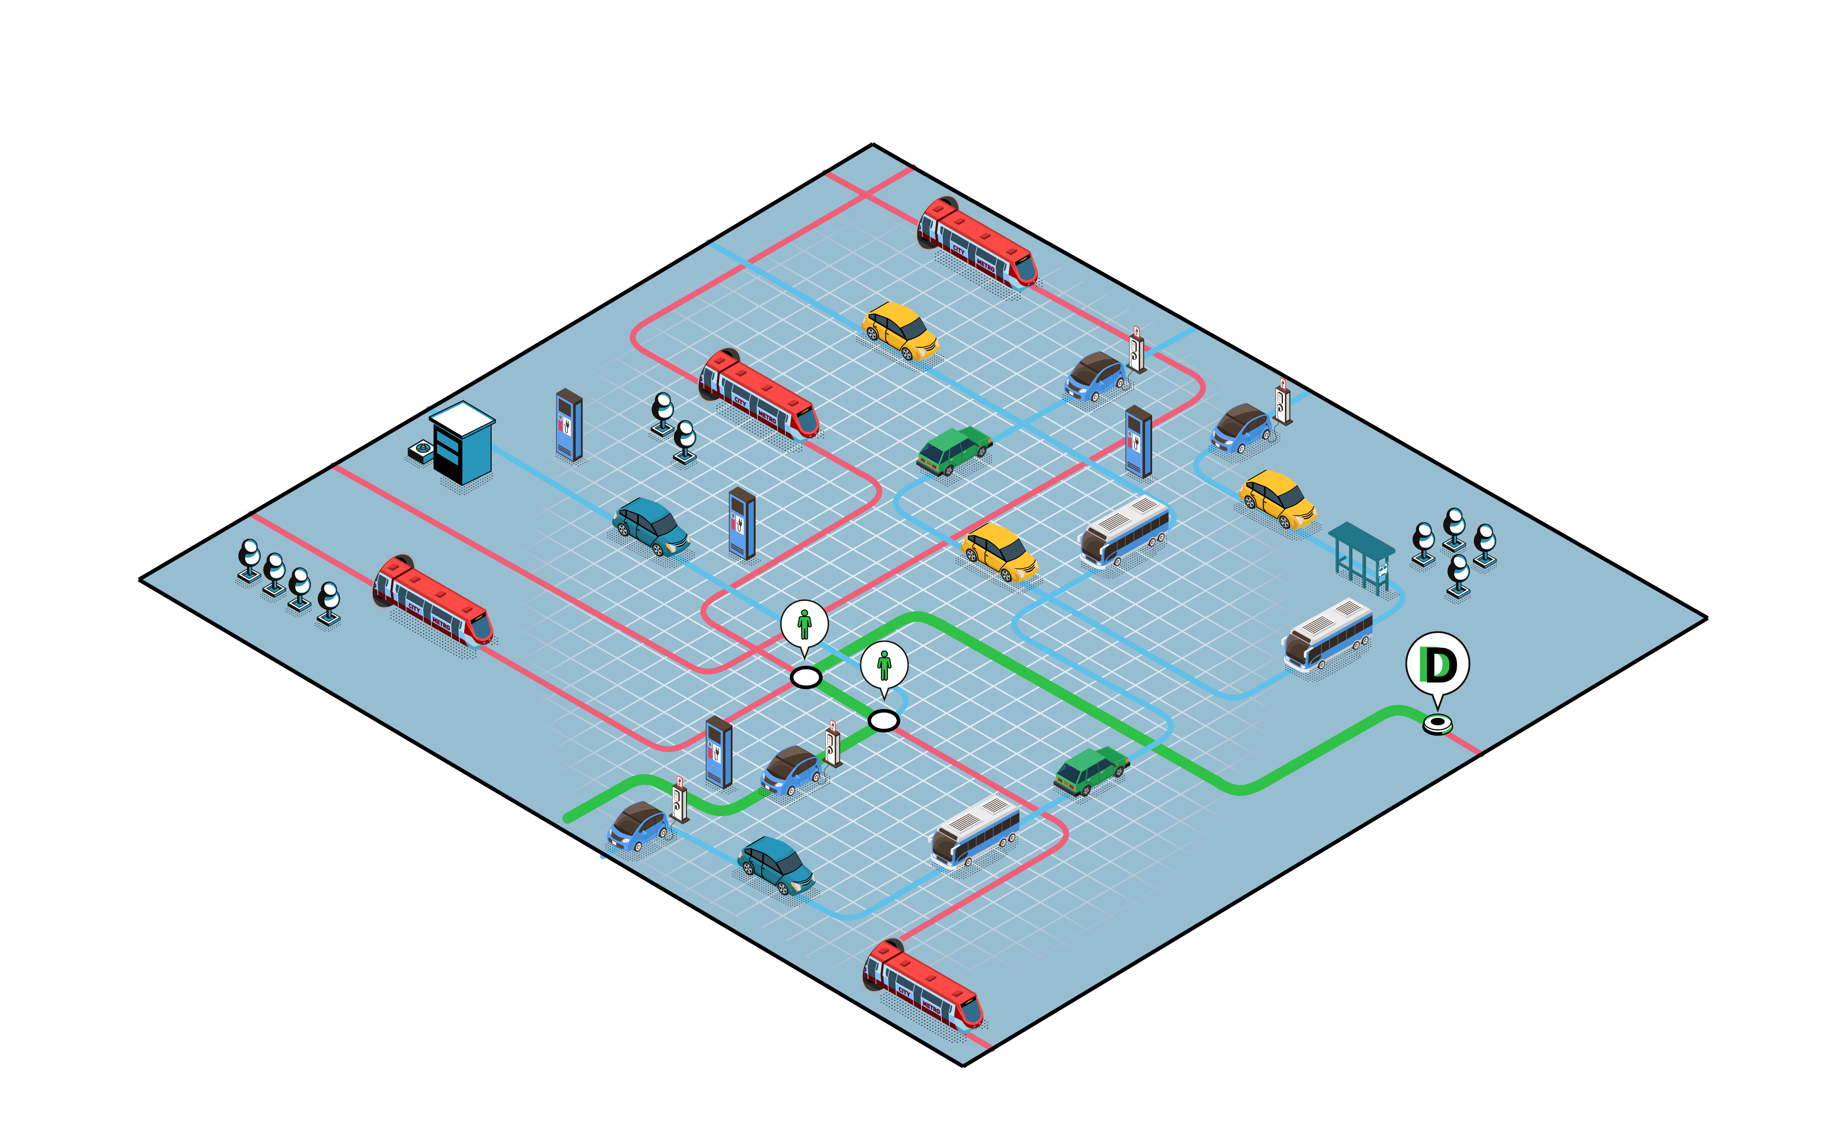

Slide 10
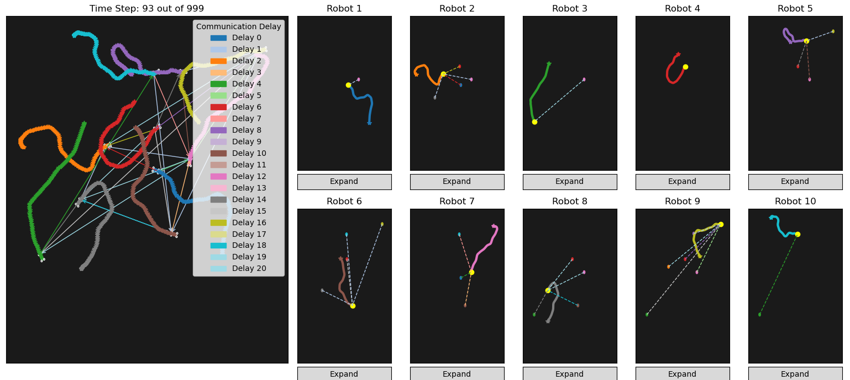
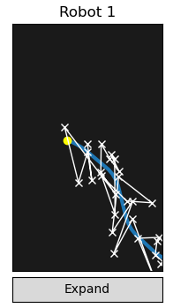

Slide 11



