Slide 1

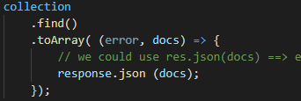
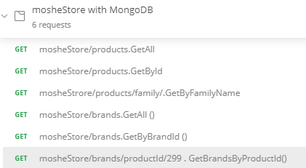
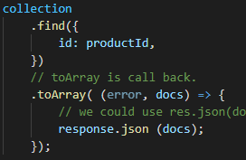
Database
mosheStore
collection
Brand
All routers use dbService.js To get the connection
The find / filter / projection is done locally in brands.js
Exampples for:
Find { filter }
Projection { list of fields }
Limit { number of rows to rerun }
Skip { start as of row N } → for Paging
collection
products
Supporting:
‘/’ = GetAll
‘/:id’ = GetById
‘/productId/:id’ = brands by a specific productId
Each API read handles its own connection
Supporting:
‘/’ = GetAll
‘/family’ = GetByFamilyName
‘/id’ = GetById

Slide 2
usersChats
Users – usersDB.js
usersDB/ReloadAllCollections
Posts – posts.DB.js
comments
Users
‘/’ –
‘/:id’
‘/:id/posts’
InsertOne - .post
InsertMany .post
DeleteOne .delete
DeleteMany .delete
Replace full record .put
Update Some fields .patch
posts
comments

Slide 3
